Slide 1


Two decades of Intelligent Access where we’ve been and where we’re going
Gavin Hill
Chris Koniditsiotis

Slide 2
Looking back, to look forward
You can't really know where you're going until you know where you have been.
Maya Angelou
Hill and Koniditsiotis, 2023

Slide 3
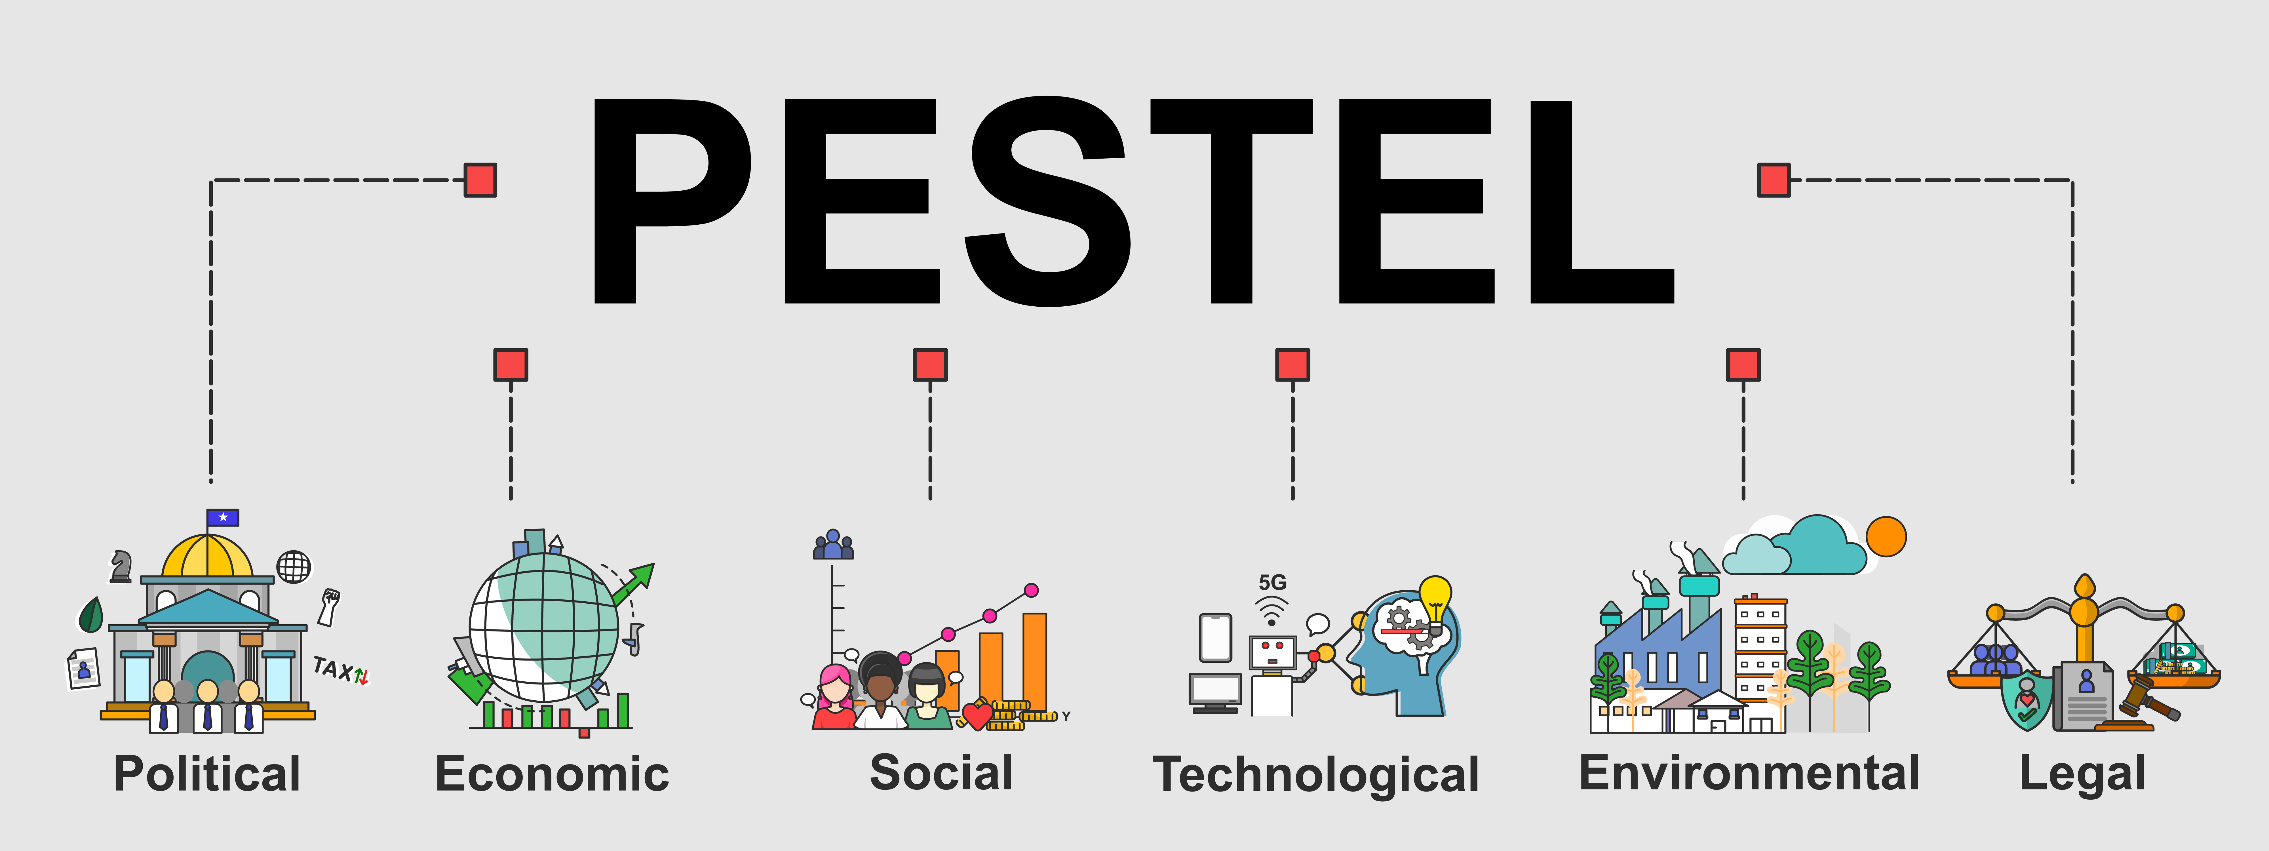
A convergence of influences over two decades
Hill and Koniditsiotis, 2023

Slide 4
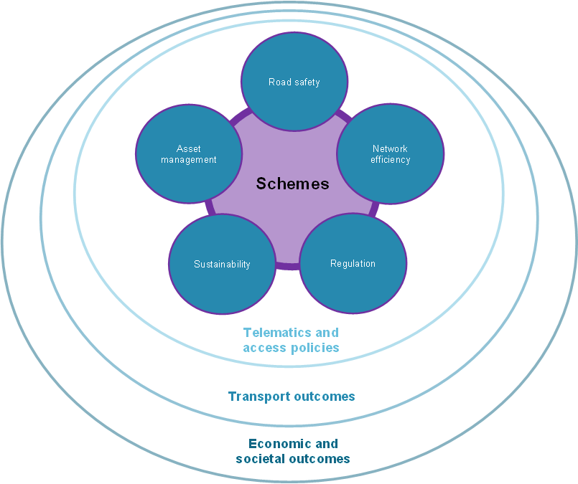
The digital expression of policy intent
Hill and Koniditsiotis, 2023

Slide 5
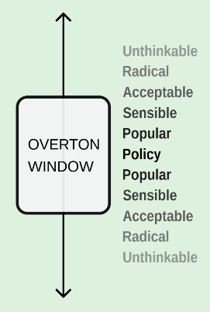
The art of the possible
“At any one time, some group of adjacent policies along the freedom spectrum fall into a window of political possibility.
Policies outside the window, either higher or lower, are politically unacceptable at the moment.
If you shift the position or size of the window, you change what is politically possible” (Lehman 2010).
Hill and Koniditsiotis, 2023

Slide 6
Shifting the Overton Window
Examples of how PESTEL influences have shifted the Overton Window:
Intelligent Access is all
about enforcement
Intelligent Access is used for a variety of purposes
Transport operator systems can’t be used
Transport operator systems can be used
TCA is a certifier and administrator
TCA is a certifier, administrator
and provider of data-driven services
Hill and Koniditsiotis, 2023

Slide 7
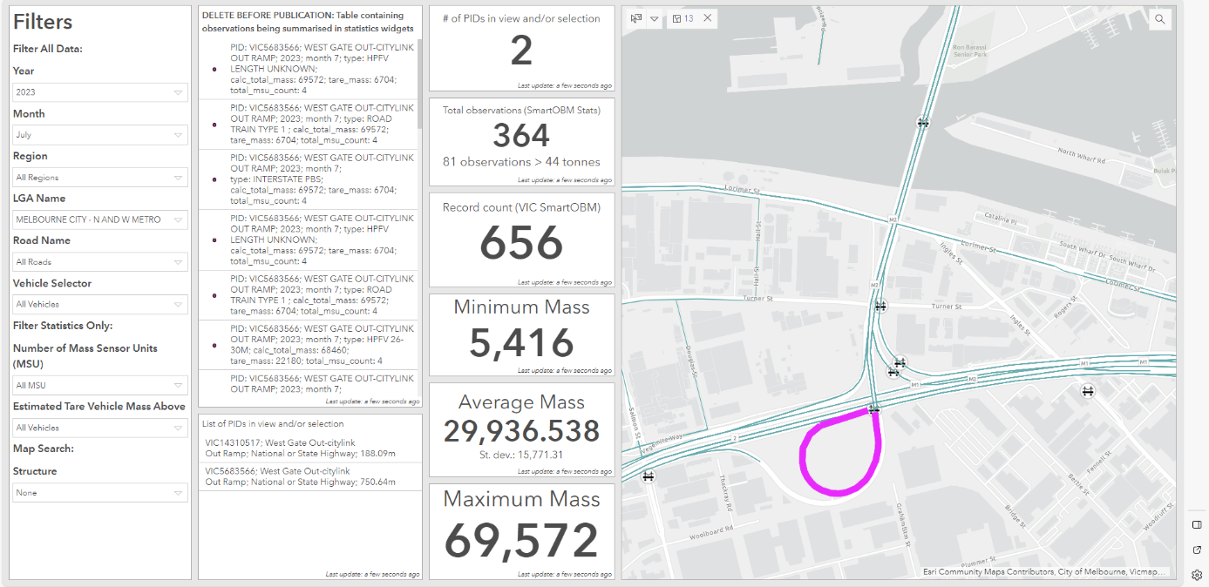
Smart OBM analytics
Hill and Koniditsiotis, 2023

Slide 8
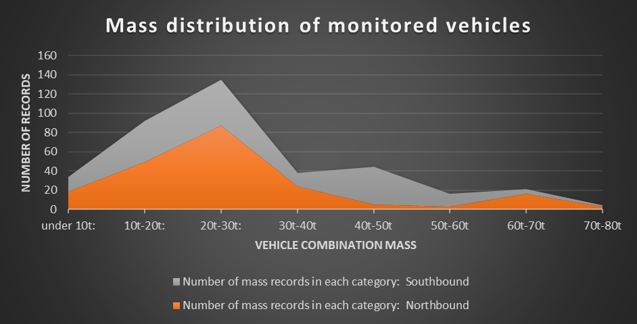
Smart OBM analytics
Hill and Koniditsiotis, 2023

Slide 9
Shifting the Overton Window
A combination of technological, policy, societal, environmental and legal influences are rapidly shaping what we mean by Intelligent Access. Key influences include:
Embedded vehicle technologies (technological, economic)
Regulatory developments involving the collection, use and retention of data (legal)
New types of vehicles with challenge current regulatory frameworks, such as Low and Zero Emission Heavy Vehicles (LZEHVs), Connected and Automated Vehicles (political, social, technological, environmental, legal)
Increased demands for better data, and a wider variety of data, to support evidence-based policy making and data-driven regulation (political, economic, social)
Hill and Koniditsiotis, 2023

Slide 10
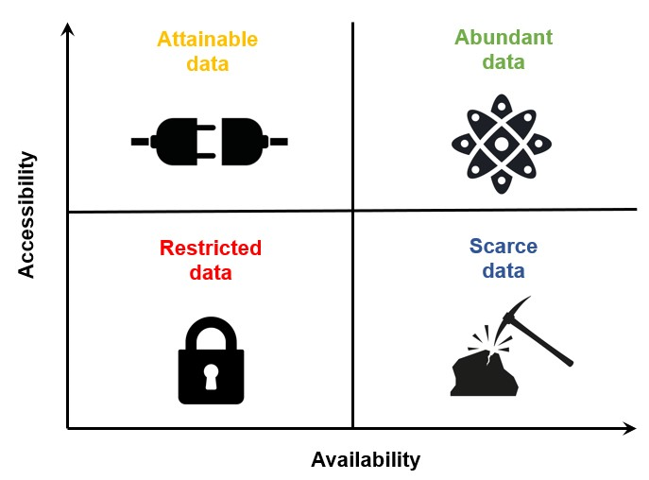
Data is the new gold
(albeit with different extraction techniques)
Hill and Koniditsiotis, 2023

Slide 11
Data is the new gold
(albeit with different extraction techniques)
Axle Mass
GNSS
Engine emissions
Digital imaging/video
Hill and Koniditsiotis, 2023

Slide 12
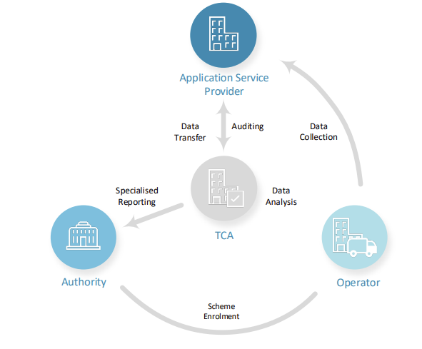
A convergence of actors
Hill and Koniditsiotis, 2023

Slide 13
A growing family of actors
Hill and Koniditsiotis, 2023

Slide 14
Final thoughts
The evolution of Intelligent Access will continue to be influenced by a range of political, economic, technical, environmental and legal influences.
Together, these influences will guide the future direction of Intelligent Access into new policy domains and operational deployments.
However, at its core, the structured interaction between different actors to give operational effect to Intelligent Access arrangement will remain a constant.
It’s about people, not technology.
Hill and Koniditsiotis, 2023

Slide 15
Thank you!
Hill and Koniditsiotis, 2023

