Slide 1
Addressing the Reliability Challenges of High-Speed WIM (HS-WIM) for Direct Enforcement
Tomasz KONIOR
APM PRO, Poland
Artur RYGUŁA
University of Bielsko-Biala, Poland
Jacek IZYDORCZYK
Silesian University of Technology, Poland
Leonardo GUERSON
Intercomp, USA

Slide 2
Research project background
Title: Intelligent Vehicle Weighing System
Implementation period: 2019-2021
Test period: 2021 – 2023
This research was part of the project titled ‘Intelligent weight-in-motion system’ no. RPSL.01.02.00-24-00A3/19, financed under the Regional Operational Programme for Śląskie Voivodeship for the years 2014-2020
Authors:
Tomasz KONIOR, Artur RYGUŁA, Jacek IZYDORCZYK, Leonardo GUERSON

Slide 3
Introduction
Objective:
Development of a HS-WIM system for direct enforcement
Challenges:
HS-WIM system to be used for direct enforcement should provide outputs at a known level of performance if it’s being used as proof for issuing overloading penalties.
HS-WIM system should provide predictable outputs over different external conditions.
Technical approach:
Development and deployment of a combination of hardware and software solutions that seeks to guarantee that no overloading penalties are applied to compliant vehicles.
Authors:
Tomasz KONIOR, Artur RYGUŁA, Jacek IZYDORCZYK, Leonardo GUERSON

Slide 4
HS-WIM system setup
Authors:
Tomasz KONIOR, Artur RYGUŁA, Jacek IZYDORCZYK, Leonardo GUERSON

Slide 5
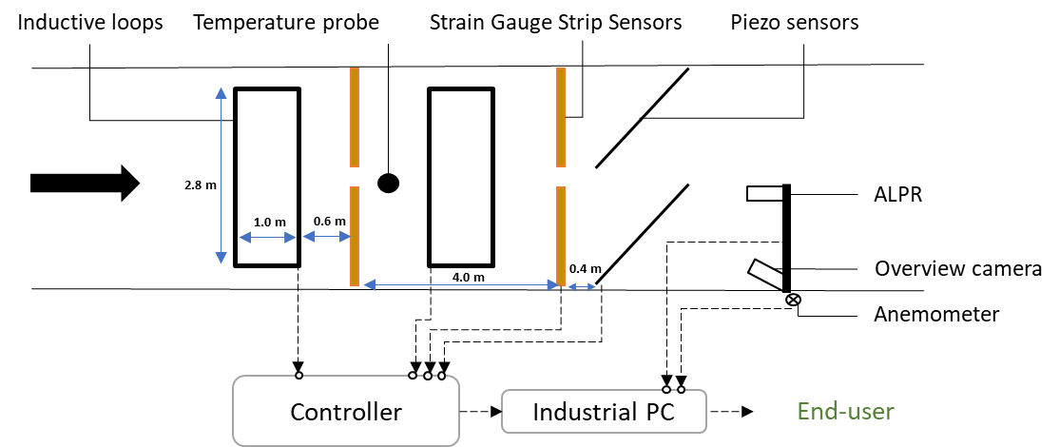
Road sensors and devices
Authors:
Tomasz KONIOR, Artur RYGUŁA, Jacek IZYDORCZYK, Leonardo GUERSON

Slide 6
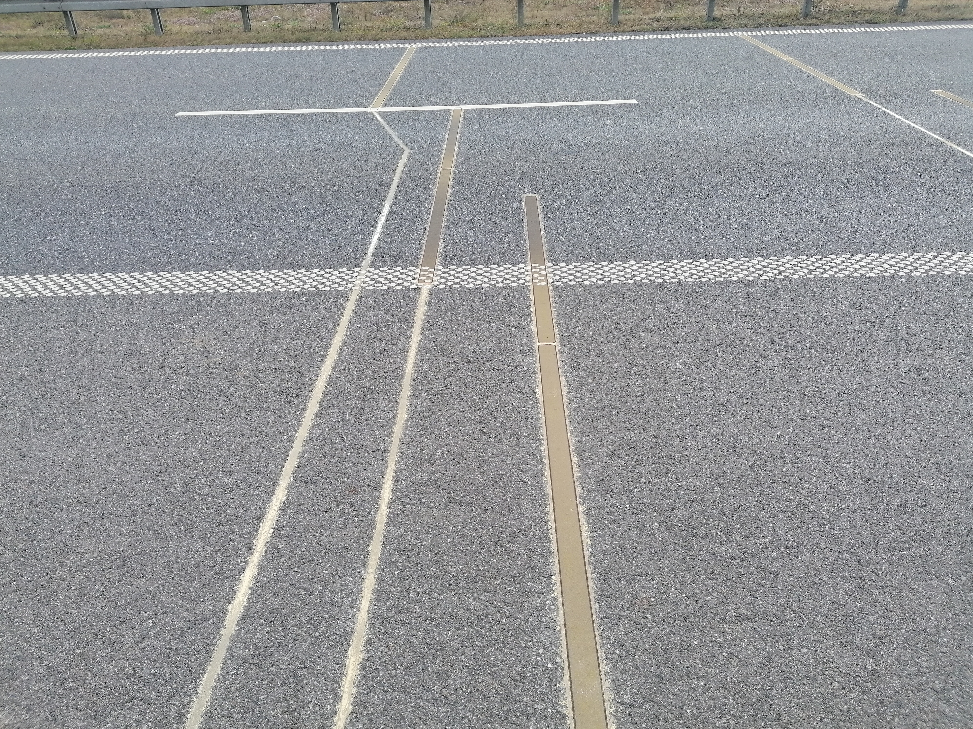
Strain Gauge Strip Sensor
Gross weight of tractors with semi-trailers in Strzelno
Authors:
Tomasz KONIOR, Artur RYGUŁA, Jacek IZYDORCZYK, Leonardo GUERSON

Slide 7
Data Reliability Algorithm
Key factors:
vehicle speed corrected for wind speed value and direction;
vehicle acceleration;
wheel-sensor contact point (offset);
road surface temperature.
Authors:
Tomasz KONIOR, Artur RYGUŁA, Jacek IZYDORCZYK, Leonardo GUERSON

Slide 8
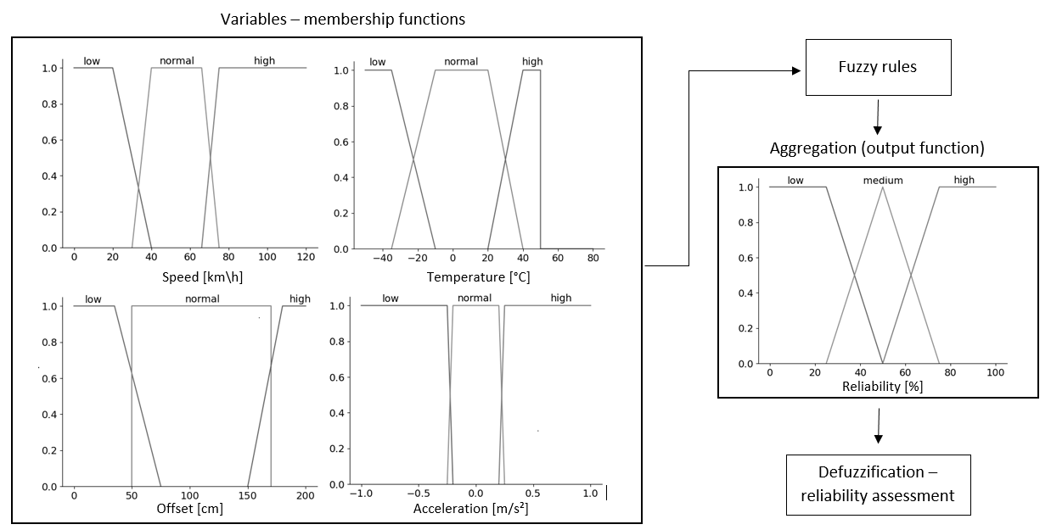
Data Reliability Algorithm
Authors:
Tomasz KONIOR, Artur RYGUŁA, Jacek IZYDORCZYK, Leonardo GUERSON

Slide 9
Reliability assessment
Authors:
Tomasz KONIOR, Artur RYGUŁA, Jacek IZYDORCZYK, Leonardo GUERSON

Slide 10
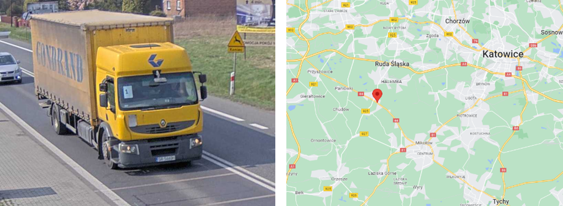
Pilot site implementation
Authors:
Tomasz KONIOR, Artur RYGUŁA, Jacek IZYDORCZYK, Leonardo GUERSON

Slide 11
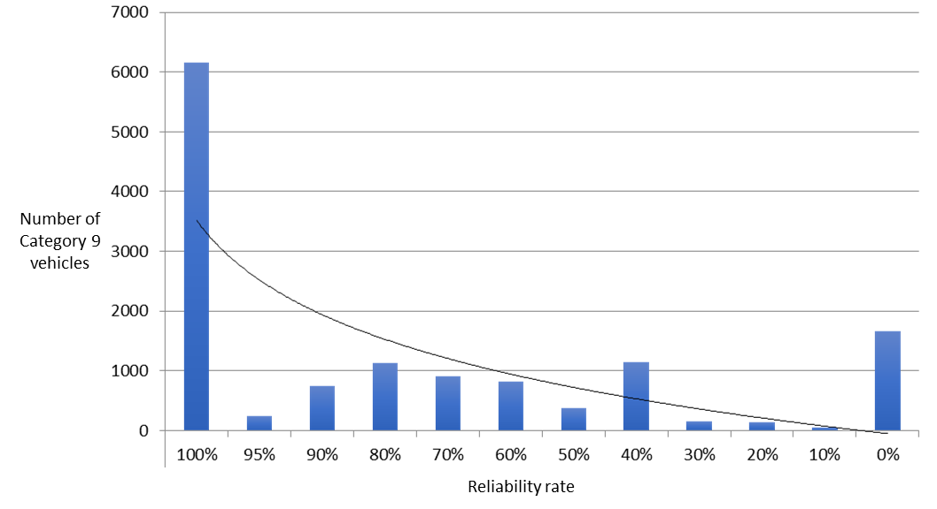
Pilot data analysis
Distribution of Category 9 vehicles per reliability rate interval
Authors:
Tomasz KONIOR, Artur RYGUŁA, Jacek IZYDORCZYK, Leonardo GUERSON

Slide 12
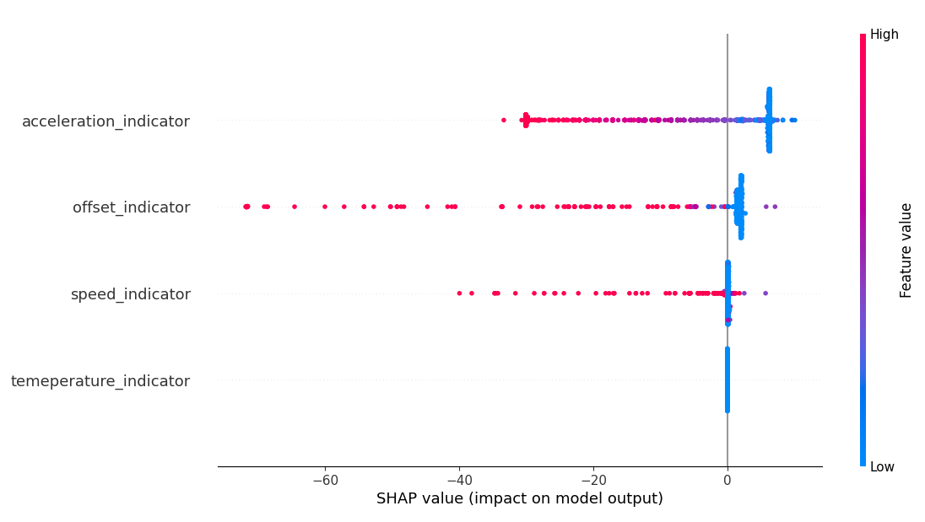
Pilot data analysis
SHAP analysis of influence of each parameter group on model output
Authors:
Tomasz KONIOR, Artur RYGUŁA, Jacek IZYDORCZYK, Leonardo GUERSON

Slide 13
Pilot site results
Vehicle position (offset) had an impact on approximately 40% of runs.
Over 20% of runs showed excessive corrected speed values, impacting measurements.
Temperature showed an insignificant impact over measurement reliability.
An inference system identified reliability rate under 50% as significant measurement error, affecting around 22% of site data.
Authors:
Tomasz KONIOR, Artur RYGUŁA, Jacek IZYDORCZYK, Leonardo GUERSON

Slide 14
Conclusions
It is possible to ensure HS-WIM system for direct enforcement minimizes false penalties.
Sensor choice is crucial for accurate weight measurements over time.
Data reliability varies due to external factors.
Proper calibration guarantees accuracy under standard conditions.
Vehicle dynamics significantly affect measurement reliability.
Authors:
Tomasz KONIOR, Artur RYGUŁA, Jacek IZYDORCZYK, Leonardo GUERSON

Slide 15
Conclusions
Fuzzy processing fine-tunes parameter impact assessment.
Field tests are required to establish critical values for uncertainty.
At least 20% of measurements may be unreliable due to factors beyond measurement capabilities.
Specific parameters can reduce reliability rate below 50%.
The proposed algorithm suits HS-WIM for direct enforcement, while site-specific analysis is required.
Authors:
Tomasz KONIOR, Artur RYGUŁA, Jacek IZYDORCZYK, Leonardo GUERSON

