Slide 1
Decarbonising the UK’s heavy goods vehicles: Lessons from the UK for Australia
Dr Daniel Ainalis^{1,2}
Dr Christopher de Saxe²
Prof. John Miles²
Prof. David Cebon²
¹ Sustainability and Materials Performance, National Transport Research Organisation ² Centre for Sustainable Road Freight, Department of Engineering, University of Cambridge
Daniel.Ainalis@ntro.org.au

Slide 2
Presentation outline
Context.
Developments in decarbonising UK Heavy Goods Vehicles (HGVs).
What can Australia learn from the UK?
Summary and next steps.
Authors:
Daniel Ainalis, Christopher de Saxe, John Miles, and David Cebon

Slide 3
Context
UK mandate for net zero emissions by 2050.
Transport is largest emitting UK sector.
HGVs: outsized emissions (5% UK total).
UK GHG emissions by transport mode (2017)
Authors:
Daniel Ainalis, Christopher de Saxe, John Miles, and David Cebon

Slide 4
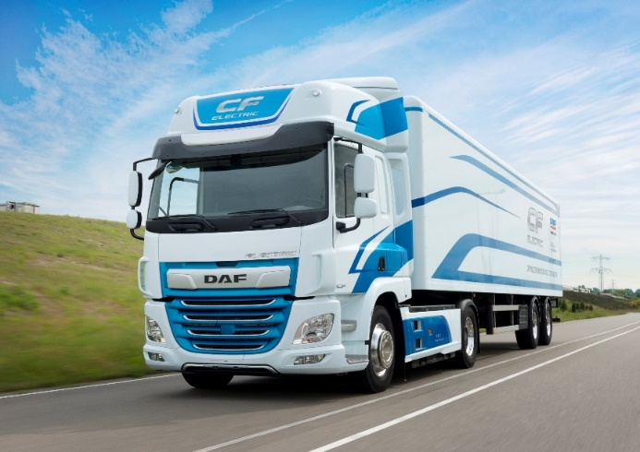
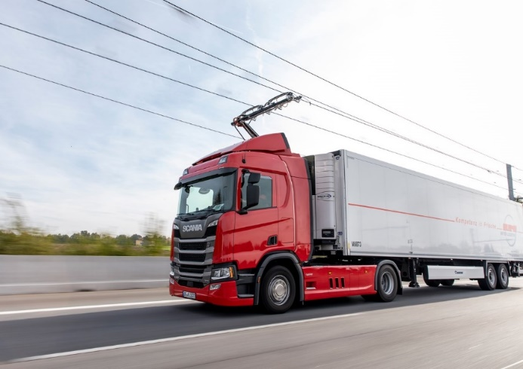
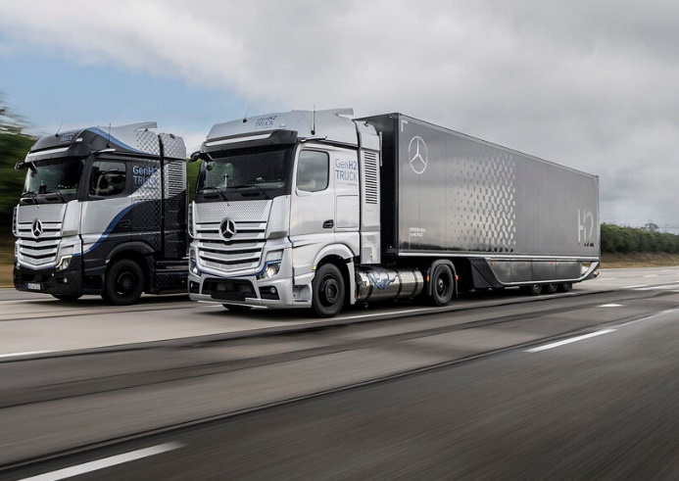
Pathways for zero emission HGVs in the UK
Biofuels
Battery Electric
Battery Electric with Electric Road System
Hydrogen Fuel Cell
Tailpipe emissions.
Fuel stations.
Source of fuels?
Zero tailpipe emissions.
Large on-board battery.
Slow/fast chargers.
Zero tailpipe emissions.
Small on-board battery.
Dynamic (on-the-go) charging.
Zero tailpipe emissions.
Hydrogen fuel stations.
Hydrogen production?
Authors:
Daniel Ainalis, Christopher de Saxe, John Miles, and David Cebon

Slide 5
Overview of UK progress and developments
CSRF Research
Roadmapping: decarbonisation of road freight only possible by electrification.
Several studies on electrification of road freight and HGVs, including white paper*.
Electric Road System (ERS) most promising.
ERS national feasibility study.
UK Government
Feasibility studies across 3 streams to support decarbonisations of HGVs (£20mn).
Real-world demonstration programme (£200mn).
Phase out dates for sale of new non-zero emission HGVs:
2035 for HGVs less than 26 t.
2040 for all HGVs.
*Decarbonising the UK’s Long-Haul Road Freight at Minimum Economic Cost: http://bit.ly/csrfwhitepaper
Authors:
Daniel Ainalis, Christopher de Saxe, John Miles, and David Cebon

Slide 6
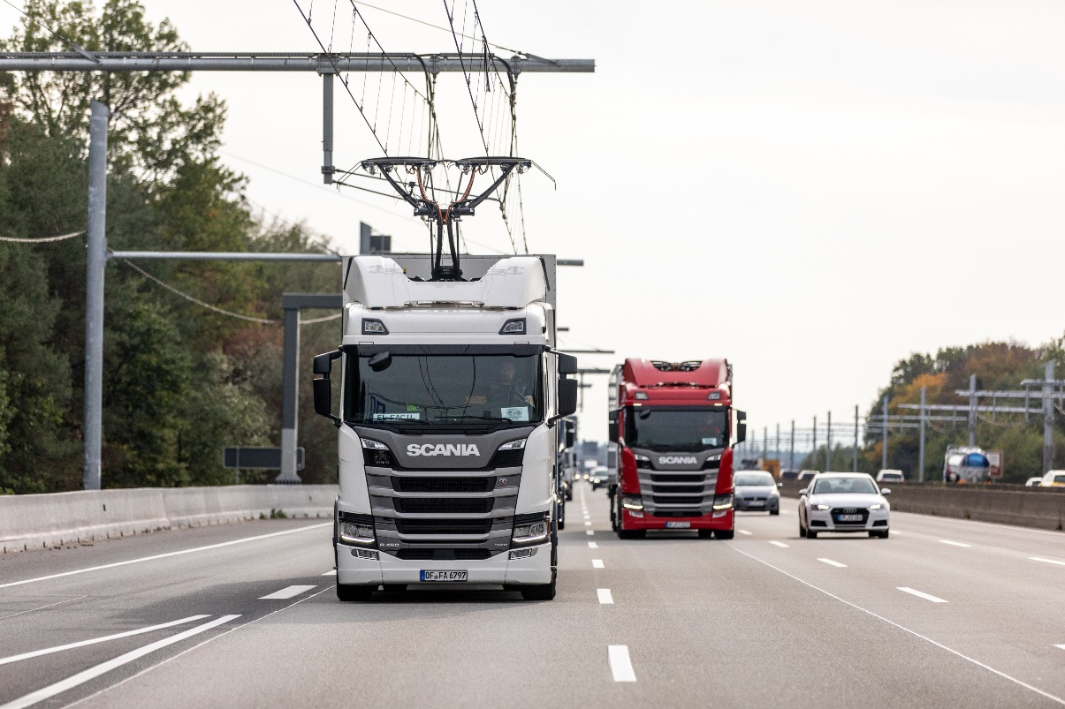
Electric road system for heavy goods vehicles
Catenary wires
Pantograph system
On-the-move charging: power vehicle & charge battery.
Smaller battery, highest efficiency.
Reduces stationary charging power and infrastructure.
Significant infrastructure building: high upfront costs to install.
Poles and arms to support catenary
Authors:
Daniel Ainalis, Christopher de Saxe, John Miles, and David Cebon

Slide 7
UK electric road system feasibility study: Overview of project
£2 million (£1.2 million funded).
July 2021 – March 2022.
Aims:
UK demonstrator plan and costings.
Understand the reality of UK logistics.
Optimal dynamic charging vs static charging vs battery size.
National transition models (economic and environmental).
Consortium
Authors:
Daniel Ainalis, Christopher de Saxe, John Miles, and David Cebon

Slide 8
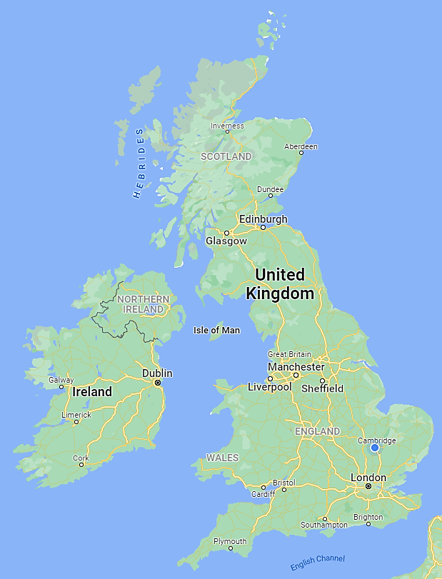
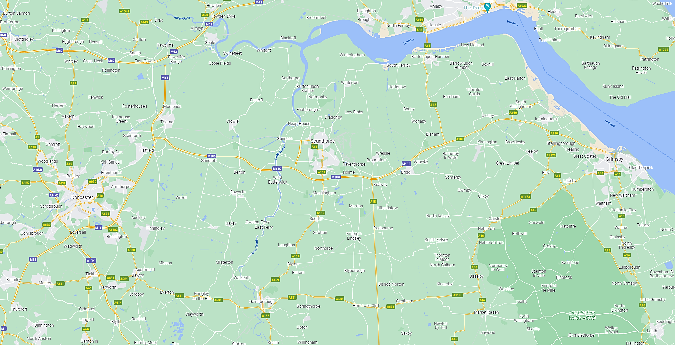
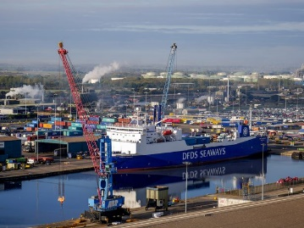
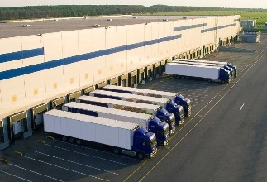
UK electric road system feasibility study: Proposed demonstrator programme
to Leeds, Manchester, North
Immingham
Grimsby
Doncaster
to Europe
M180
ERS
Minimum 30 lane-km
= 15 km in both directions
to Sheffield, Manchester, South
~80 km
Authors:
Daniel Ainalis, Christopher de Saxe, John Miles, and David Cebon

Slide 9
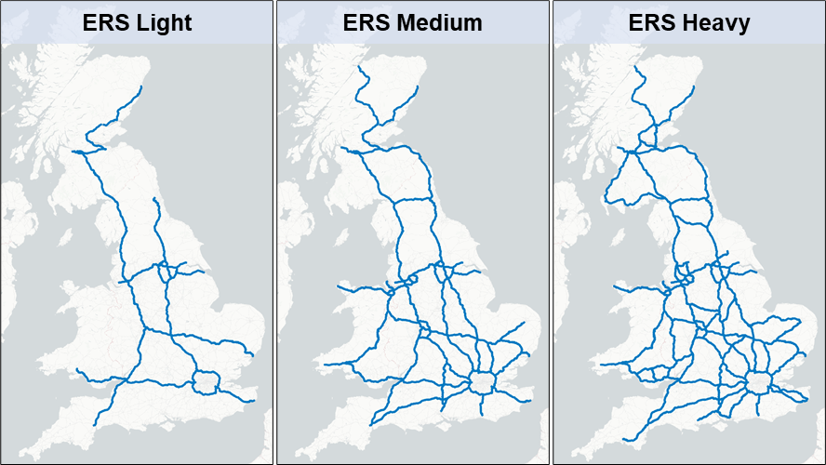
UK electric road system feasibility study: National network topologies
Length (2-way):
2,750 km
5,500 km
8,500 km
Authors:
Daniel Ainalis, Christopher de Saxe, John Miles, and David Cebon

Slide 10
UK electric road system feasibility study: Trade-offs in static and dynamic charging
No static charging
Drop-off charging
Rest stop charging
79%
74%
71%
64%
64%
58%
43%
42%
38%
Authors:
Daniel Ainalis, Christopher de Saxe, John Miles, and David Cebon

Slide 11
UK electric road system feasibility study: National economic modelling
ERS construction costs, ERS utilisation, average fleet battery size, and electricity price
Wholesale electricity price and technology for green H2 production and transport
Authors:
Daniel Ainalis, Christopher de Saxe, John Miles, and David Cebon

Slide 12
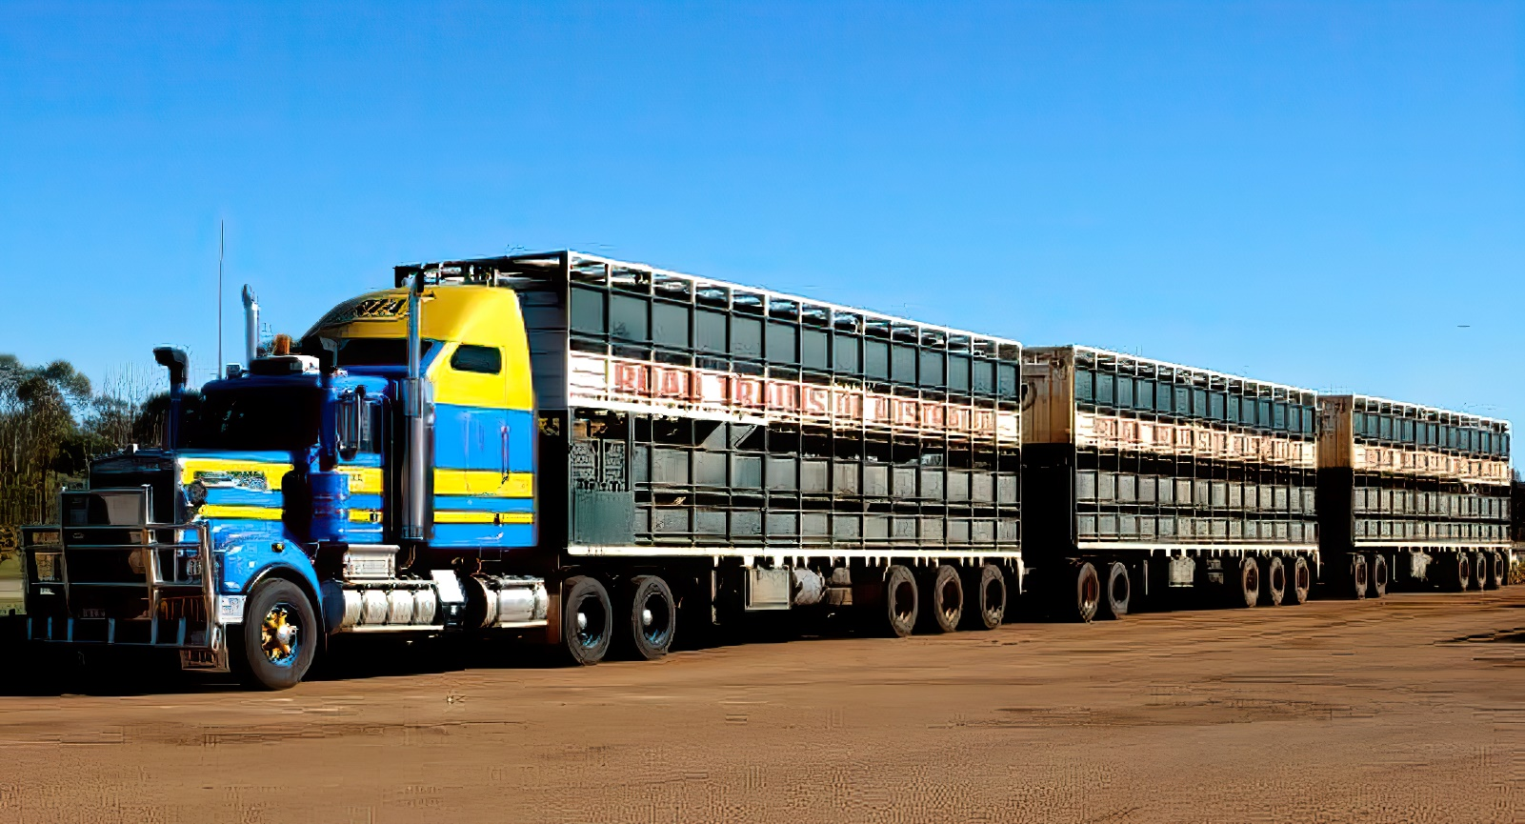
What can Australia learn from the UK?
Can we take the UK approach and apply it in Australia?
Differences to UK:
Geography (range and operational requirements).
Longer and heavier vehicle combinations.
Performance-based standards.
Emissions standards (lack of).
Credit: Norman Patrick Trickey Blake
Authors:
Daniel Ainalis, Christopher de Saxe, John Miles, and David Cebon

Slide 13
What can Australia learn from the UK?
Digital and data
Energy, grid operators, utilities
Freight buyers and shippers
Freight companies (operators)
Funders and financing
Zero emission road freight
Government and regulators
Infrastructure
Industry associations
Research and academic organisations
Site owners and developers
Performance-based standards
National telematics framework
Vehicles
Authors:
Daniel Ainalis, Christopher de Saxe, John Miles, and David Cebon

Slide 14
What can Australia learn from the UK?
Large body of knowledge exists
Identify gaps/ differences to Australian context
Identify potential alt. solutions
Define feasible future pathways
Nationally-consistent real-world assessment of solutions
Wide stakeholder groups
Independent evaluation for robust evidence base
Wide-dissemination
Kick-start initial infrastructure and signal demand to OEMs
Study
Coordinated long term planning and investment
National alignment
Emissions targets and phase out dates
Demo
Deploy
NOW
2050
Authors:
Daniel Ainalis, Christopher de Saxe, John Miles, and David Cebon

Slide 15
Decarbonising the UK’s heavy goods vehicles: Lessons from the UK for Australia
Dr Daniel Ainalis^{1,2}
Dr Christopher de Saxe²
Prof. John Miles²
Prof. David Cebon²
¹ Sustainability and Materials Performance, National Transport Research Organisation ² Centre for Sustainable Road Freight, Department of Engineering, University of Cambridge
Daniel.Ainalis@ntro.org.au

