Slide 1
Zero Emission, serving the long-haul Freight EcoSystem (ZEFES)
Omar Hegazy
Vrije Universiteit Brussel
Ben Kraaijenhagen
Vrije Universiteit Brussel

Slide 2
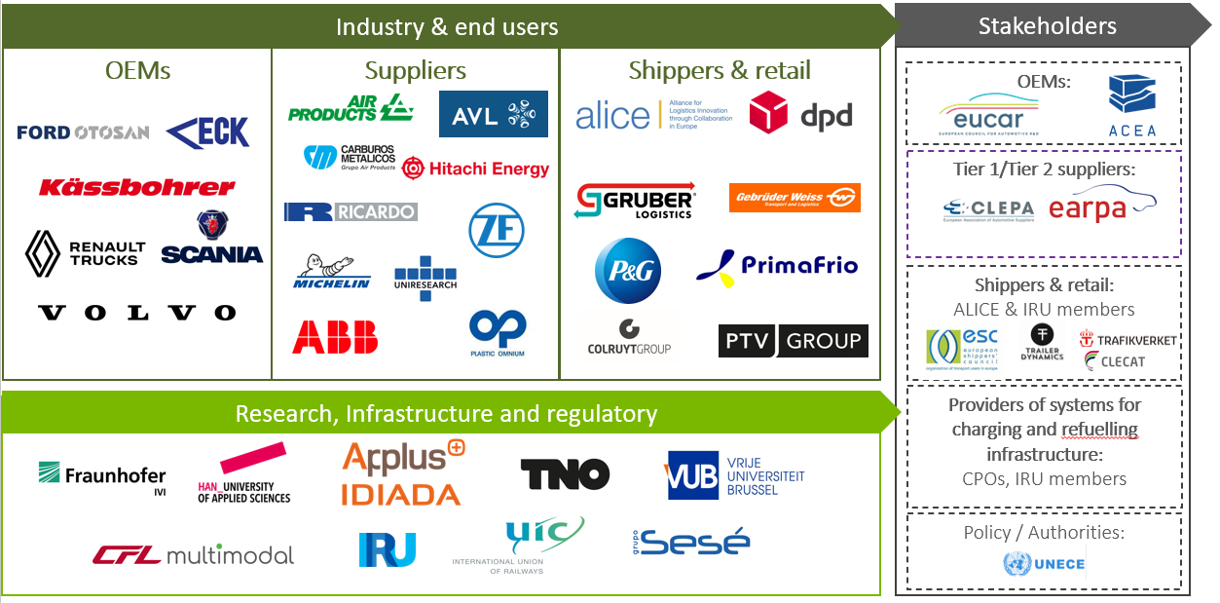
Zero Emission, serving the long-haul Freight EcoSystem (ZEFES)
Zero Emission, flexible vehicle platforms with modular powertrains serving the long-haul Freight EcoSystem (ZEFES)
Taking Zero-Emission Long-Haul Freight Transport in Europe to the next level
Jan 2023 – Jun 2026
Duration 42 Months
https://zefes.eu/
Author/s:
Omar Hegazy and Ben Kraaijenhagen, Vrije Universiteit Brussel, Belgium

Slide 3
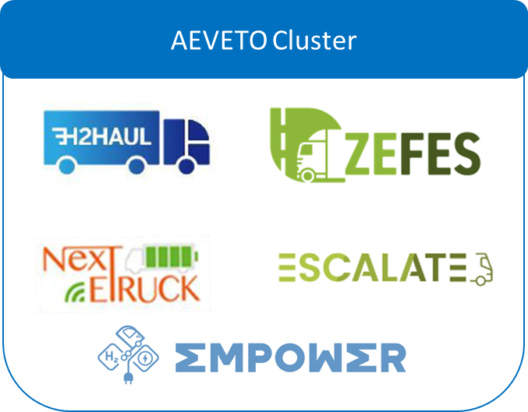
Vision and Story
Europe commits itself to be CO₂ neutral by 2050
Long haul freight transport needs to be transformed to reach this goal
Zero Emission Heavy Duty Vehicles are key to achieve the set-out targets
Battery Electric Vehicles (BEVs)
Fuel Cell Electric Vehicles (FCEVs)
ZEFES is part of AEVETO cluster, contributing to make Europe the leading example for a carbon-neutral transport system
Mapping Energy Infrastructure
Finding & exploiting synergies
Joined events and communication strategy to maximize impact
Author/s:
Omar Hegazy and Ben Kraaijenhagen, Vrije Universiteit Brussel, Belgium

Slide 4
Ambition
Real-world demonstrations of long-haul BEVs and FCEVs across Europe.
Pathway for long-haul BEVs and FCEVs to become more affordable, reliable and more energy efficient
Mapping of flexible and abundant charging/refuelling points. Demonstrate novel charging concepts.
Technologies which can deliver promised benefits to operate in complex transport supply chains.
Digital Twin for fleet management to support the long-haul BEVs and FCEVs vehicles in the logistics supply chains.
Author/s:
Omar Hegazy and Ben Kraaijenhagen, Vrije Universiteit Brussel, Belgium

Slide 5
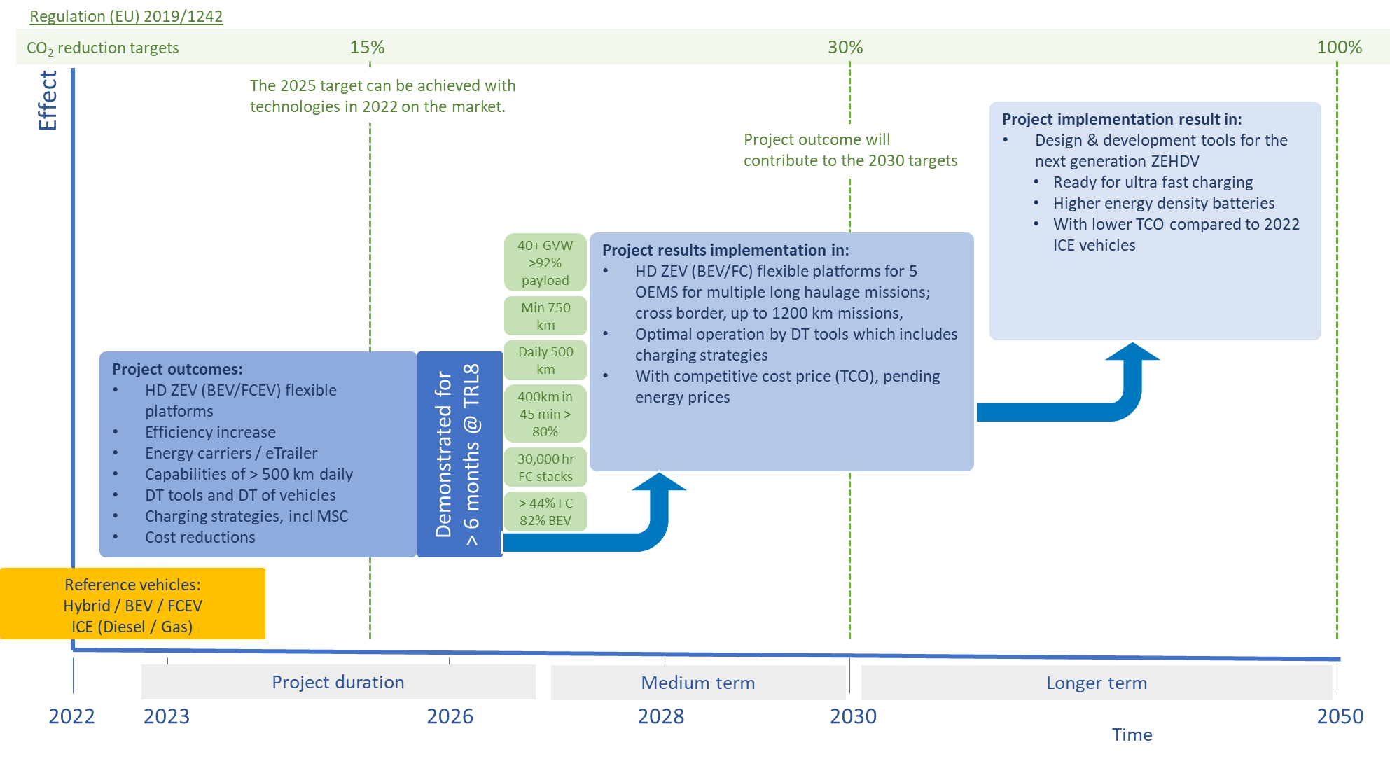
Concept
Q4/23
Q4/24
Project Developments
Project Demonstrations
Stakeholder´s engagement
Improved Zero Emission Heavy Duty Vehicles
Logistics missions
Challenge based
Energy supply
Needs & requirements to operate HD ZEVs in real time logistics missions
Digital Twin &
Fleet Management tools
Project Assessment
Market uptake increase > 2030
Impact
Charging & Refuelling Strategies
Pathways
Author/s:
Omar Hegazy and Ben Kraaijenhagen, Vrije Universiteit Brussel, Belgium

Slide 6
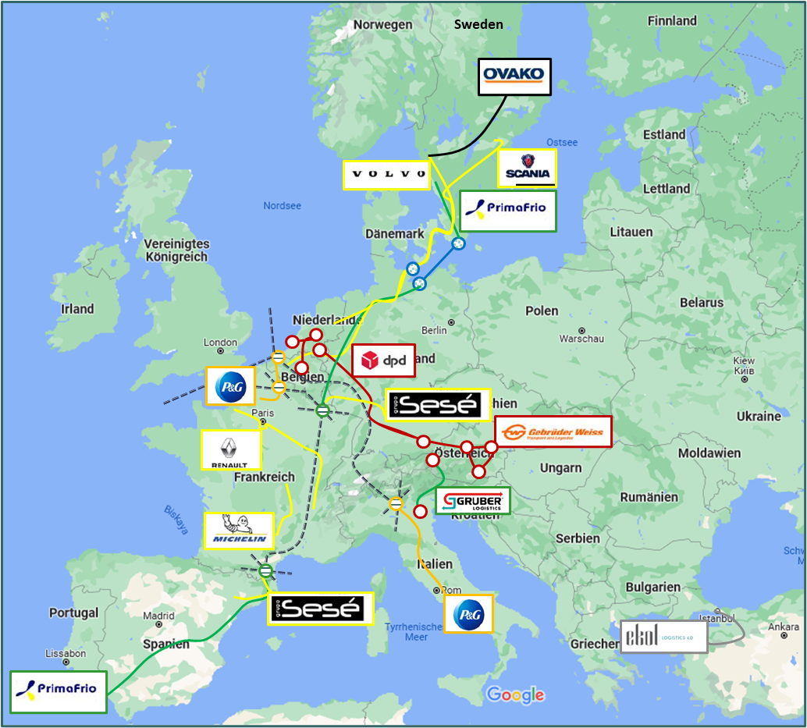
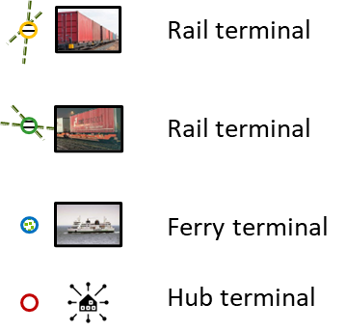
Expected outcome
Technologies
9 vehicle configurations, 6 BEV, 3FCEV, 2 e-trailers, Standard configuration 44t, EMS1 & EMS2 up to 64t GCW
Fast charging concepts, 400km after 40min charging
HRS up to 750km between refuelling
Digital Twin Platform for ZE-HDV in fleets, design, configuration and efficient operation
Demonstrations
15 demonstrations over 15 months
13 logistics service providers & shippers & carriers
TEN-T/E corridors under real-world conditions
Intermodal (rail & ferry) and cross border
Impact
>1Mio kilometres of data for validation and assessment
30.000hr expected lifetime of FC
Author/s:
Omar Hegazy and Ben Kraaijenhagen, Vrije Universiteit Brussel, Belgium

Slide 7
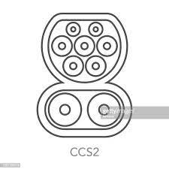
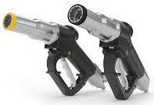
Needs & requirements, logistics
Challenges freight transport today
Time / probability
Quantity and quality cargo
Cost
Additional challenges ZE-HDV
Infrastructure
Charging CCS/MCS
Fueling 350 / 700bar
Intermodal, charging on rail and ferries
Drive & rest schedules
Charging time
40min – 11hr
Refueling
Energy consumption
Weight
Climate / weather
Route profile
€
Long-Haul
Regional - Urban
Author/s:
Omar Hegazy and Ben Kraaijenhagen, Vrije Universiteit Brussel, Belgium

Slide 8
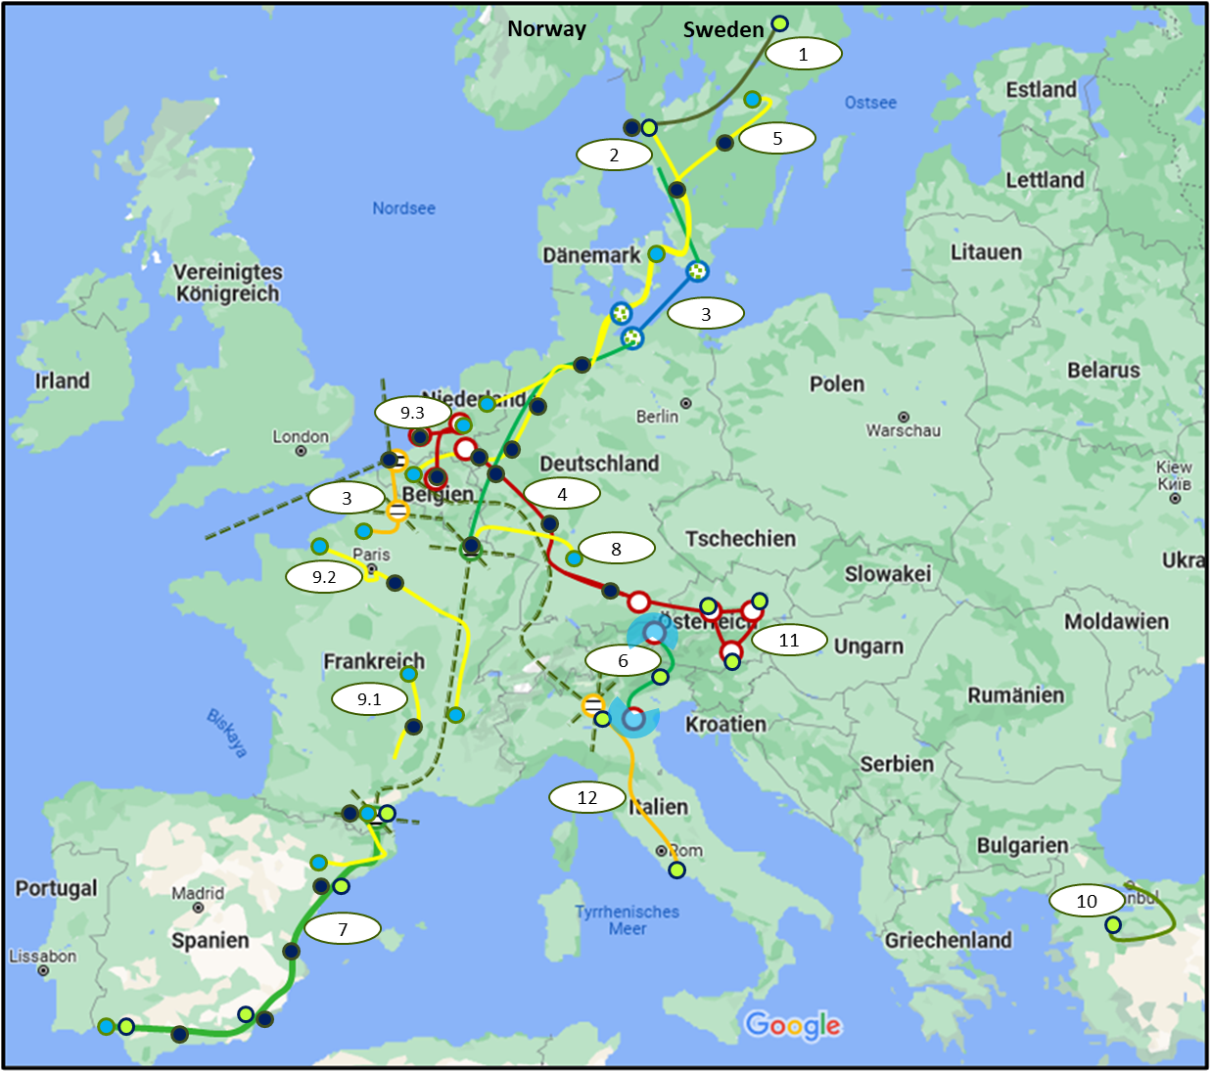
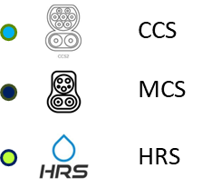
Needs & requirements, infrastructure
Enroute charging & fuelling locations needed
Minimum CCS 8, MCS 12, HRS 8
Ideal CCS 13, MCS 21, HRS 13
Reservation of charging and fuelling points
Aligning with real time energy prices
Call to action, invest in charging (CCS/MCS) and fuelling (HRS) is needed now
2025 - 2030 over 150.000 ZE-HDVs
2040 over 1.000.000 ZE-HDVs running on European corridors!
https://www.eca.europa.eu/Lists/ECADocuments/SR21_05/SR_Electrical_charging_infrastructure_EN.pdf.
Author/s:
Omar Hegazy and Ben Kraaijenhagen, Vrije Universiteit Brussel, Belgium

Slide 9
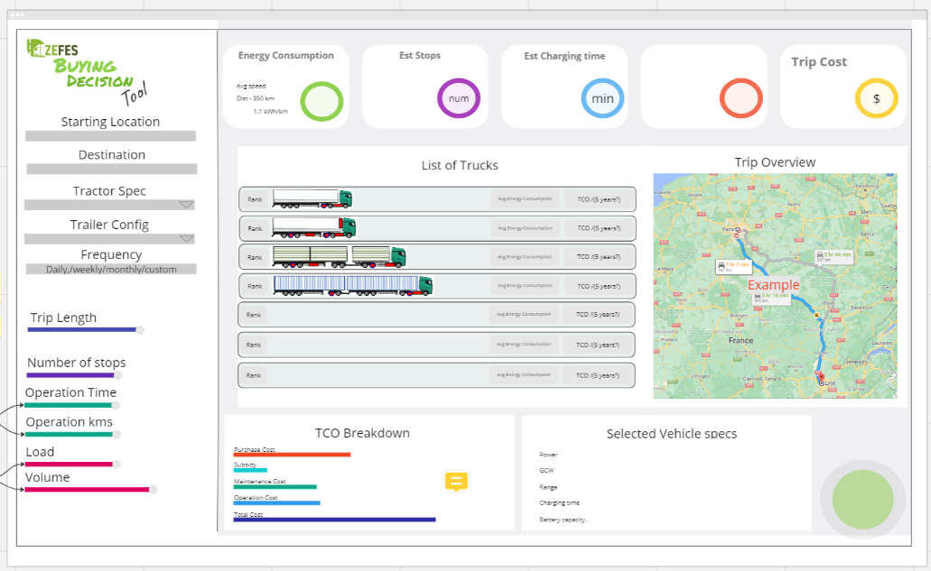
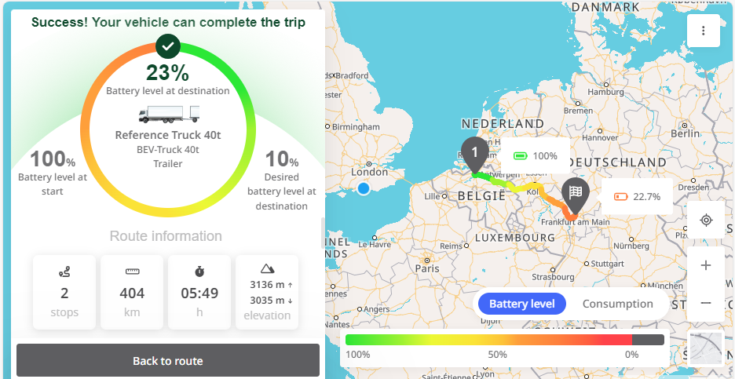
Needs & requirements, digital platform
The Digital Twin Platform should enable the deployment of following capabilities:
Buying decision. Finding suitable ZEV fleet for certain fleet operations. Default profiles of different vehicles and vehicle-trailer configurations. Dynamic fleet data to enhance the profiles towards resilient fleet choices.
Mission planning. Optimised routing for a certain mission and eco-routing algorithms for comparison.
Right vehicle in right duty. Select most suitable vehicles from the fleet for certain operations. Address the issue of weight and safety restrictions for European Modular Systems (EMS) deployment.
Dynamic correlation. Synchronise between real world and model data. Implement predictive control procedures to evaluate potential benefits.
Predictive Maintenance. Predict vehicle maintenance and/or software updates, for the ZEV specific components and systems, e.g., the battery, the fuel cell, the e-dolly and e-trailer, potentially the tyres.
Author/s:
Omar Hegazy and Ben Kraaijenhagen, Vrije Universiteit Brussel, Belgium

Slide 10
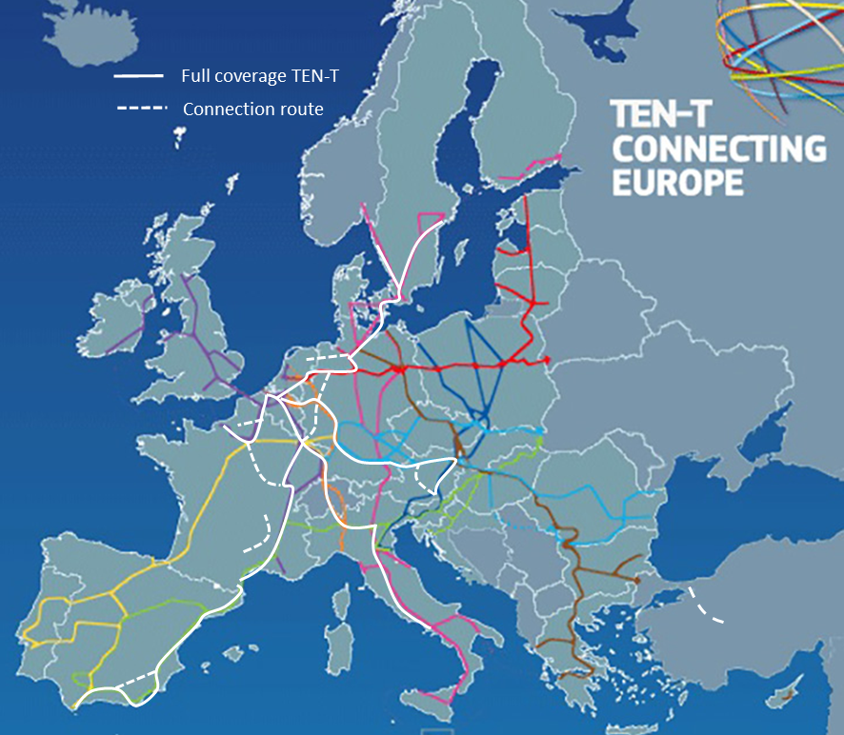
Needs & requirements, road permits
Corridor Working Groups, supported by CEDR
Following clustering of issues at stake:
Safety issues road,
Safety issues intermodal,
Energy infrastructure,
Type approval,
Weights and dimensions issues,
Road pricing issues,
Cross-border, especially weights and dimensions,
Position to be taken “how much risk are we willing to take”.
Not every ZEFES use case addresses all issues, but sooner or later they will become an issue for all countries
Author/s:
Omar Hegazy and Ben Kraaijenhagen, Vrije Universiteit Brussel, Belgium

Slide 11
Q&A
Author/s:
Omar Hegazy and Ben Kraaijenhagen, Vrije Universiteit Brussel, Belgium

Slide 12
Disclaimer
Funded by the European Union. Views and opinions expressed are however those of the author(s) only and do not necessarily reflect those of the European Union or the European Commission. Neither the European Union nor the granting authority can be held responsible for them.
This work has received funding from the Swiss State Secretariat for Education, Research and Innovation (SERI)
Author/s:
Omar Hegazy and Ben Kraaijenhagen, Vrije Universiteit Brussel, Belgium

