Slide 1
TOWARDS THE DEVELOPMENT OF A TRUCKING FLEET CONCEPT OF OPERATIONS (CONOPS) FOR MANAGING AUTOMATED DRIVING SYSTEM EQUIPPED TRUCKS IN MIXED FLEETS
Richard J. Hanowski
Andrew J. Krum
Erin Mabry

Slide 2
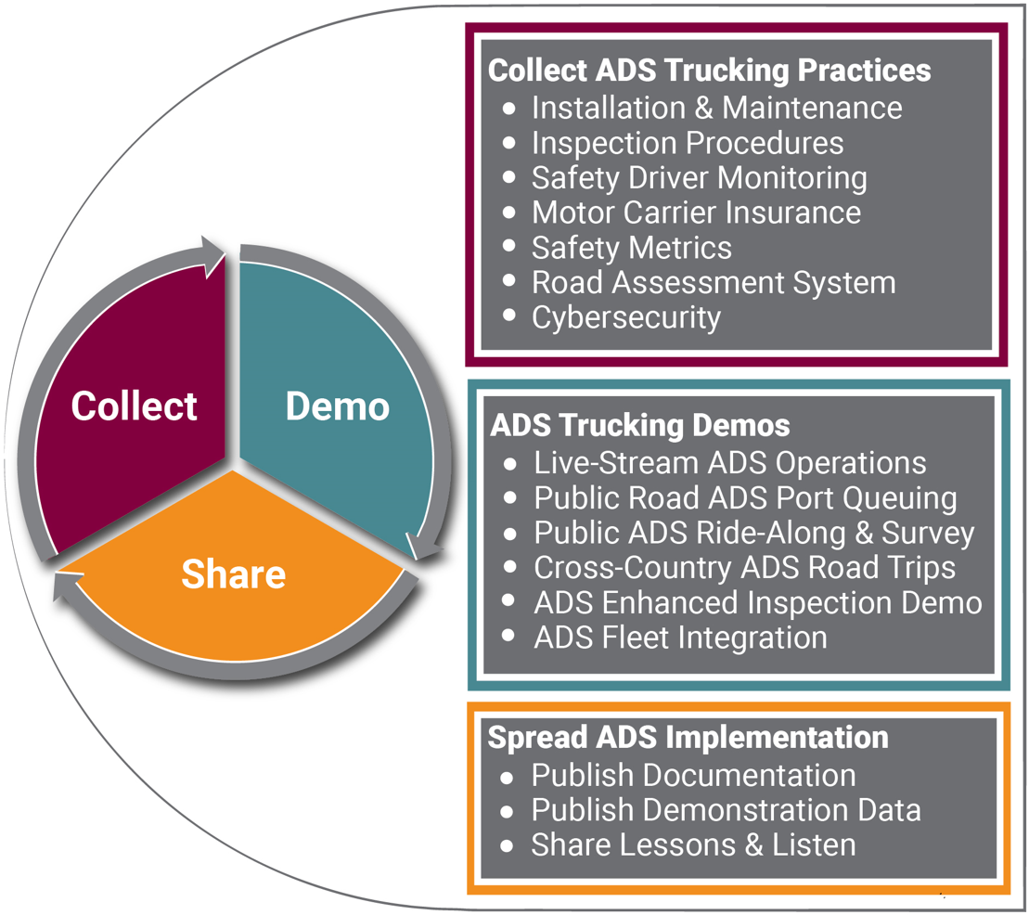
Background
Introducing automated driving systems (ADS) on heavy trucks will profoundly effect commerce
Technical progress currently outpaces fleet preparation for ADS deployment
A Fleet Concept of Operations (CONOPS) supports ADS integration
Provides the industry a “how to” guide for integrating ADS into existing operations
Hanowski, Krum, and Mabry
Notes:
Technical progress currently outpaces fleet preparation for ADS deployment
Delayed adoption by fleets/industry may impact the benefits of ADS-equipped trucks

Slide 3
CONOPS Pillars
7 critical pillars support the safe and efficient integration of ADS technology into existing, mixed-fleet operations
3 operational use cases and demonstrations highlight the application and implementation of ADS-equipped heavy vehicles
Hanowski, Krum, and Mabry

Slide 4
INSERT CONOPS PROJECT OVERVIEW VIDEO (TMC 2022)
https://youtu.be/eBnlxkS7i_4
Hanowski, Krum, and Mabry

Slide 5
ADS Inspection Procedures
ADS-equipped CMVs likely not subject to roadside inspections
A model is needed to ensure ADS equipment is well maintained and safe while operating
Enhanced CMV Inspection Program
CVSA training and certification program for operators of ADS-equipped CMVs to ensure defect-free operations at dispatch and in-transit fuel or service stops
INSERT CVSA full video
https://youtu.be/rcgJYd_gDnA
Hanowski, Krum, and Mabry
Notes:
ADS-equipped CMVs likely not subject to roadside inspections
Avoid risk of interactions with inspectors
A model is needed to ensure ADS equipment is well maintained and safe while operating
Industry Enhanced Inspection program
Training and certification program for operators of ADS-equipped CMVs to ensure defect-free operations at dispatch and in-transit fuel or service stops
Built upon existing industry practices (CVSA, FMCSA, ATA)
CONOPS research will explore this defect free self-certify inspection program to:
identify recommendations for training
monitor how stakeholders coordinate inspections of ADS equipment
document electronic messaging and roadside communication practices for ADS-equipped vehicles
consider the future of enforcement interactions between agents and ADS-equipped CMVs

Slide 6
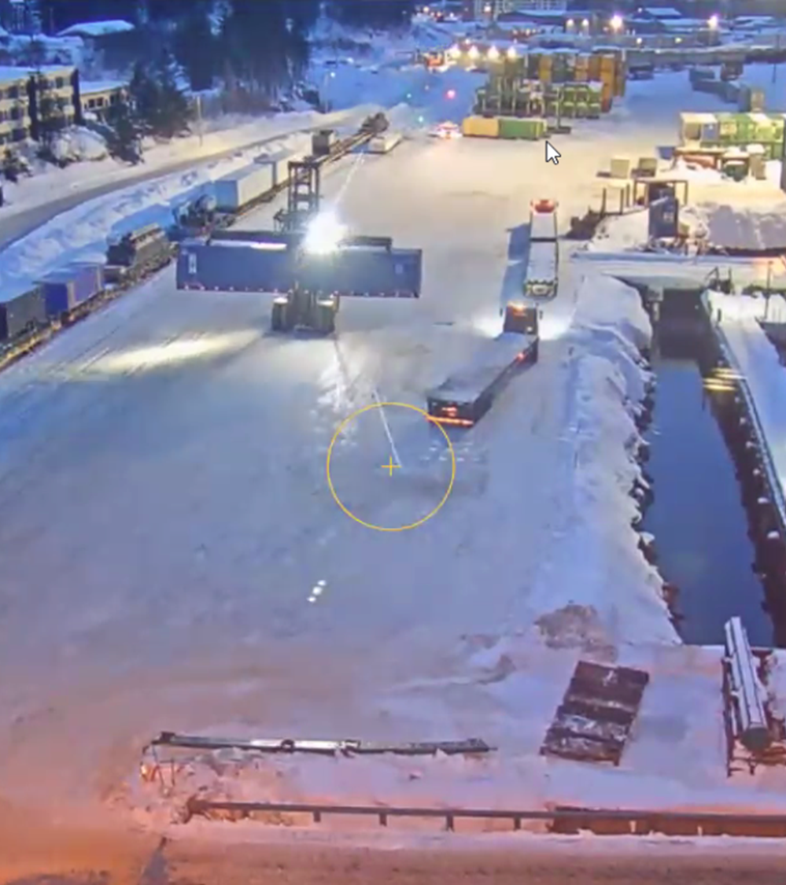
ADS Safety Metrics and Variables
Safety metrics for ADS vehicles have evolved into more granular and informative outputs
Proactively identify behavioral competencies of ADS vehicles
Leading indicators indicate a future event to prevent and control safety incidents
Data will be required to monitor how ADS-equipped CMVS perform while deployed in fleet operations
Deployment is underway at the Port of Whittier, Alaska.
Purpose: Learn about ADS deployment on private property to prepare for public on- or off-road deployments
Hanowski, Krum, and Mabry
Notes:
Safety metric rates consider exposure and the measured safety element
Exposure is traditionally measured in crash rates; however, crashes are lagging indicators and thus a poor measure of preventing safety incidents
Data will be required to monitor how ADS-equipped CMVS perform while deployed in fleet operations
Fleets should identify which metrics can be calculated and work toward a standardization process to store and record data to calculate safety metrics
Deployment is underway at the Port of Whittier, Alaska.
Operation: Commercial trucks with trailers that move cargo containers between railroad cars and a barge that docks at the port on a weekly basis. The ADS developer, Pronto.ai, has experience internationally deploying automation with on-road and off-road equipment.
Purpose: Seeking to learn about ADS deployment on private property to prepare for public on- or off-road deployments.
Considerations:
Impacts on the existing fleet
Weather
Interactions with other vehicles and personnel
Scalability

Slide 7
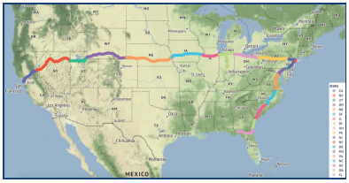
ADS Data and Road Assessment
ADS-equipped vehicles require infrastructure and roadway features-work is needed to integrate automated vehicles on public roads
The CONOPS will develop a system to assess road readiness with a specific ADS technology under a specific operational design domain (ODD)
Assess interactions between roadway features, ADS technology, and ODD requirements
Identify critical roadway attributes to effectively operate ADS-equipped vehicles
Develop a tool for highway agencies and fleet operators to see where ADS-vehicles can operate
Hanowski, Krum, and Mabry
Notes:
The CONOPS will develop a system to assess road readiness with a specific ADS technology under a specific operational design domain (ODD)
Assess interactions between roadway features, ADS technology, and ODD requirements
Identify critical roadway attributes to effectively operate ADS-equipped vehicles
Develop a tool for highway agencies and fleet operators to see where ADS-vehicles can operate
Cross-country deployments along major freight corridors to collect detailed inventory of ADS perception of sensory data on roadway features and quality of communication and location data
Develop a national public dataset (Dataverse) of infrastructure and ADS performance metrics required for ADS operations
Cellular LTE connectivity
Lane marking quality
Road bumpiness
GPS satellite coverage

Slide 8
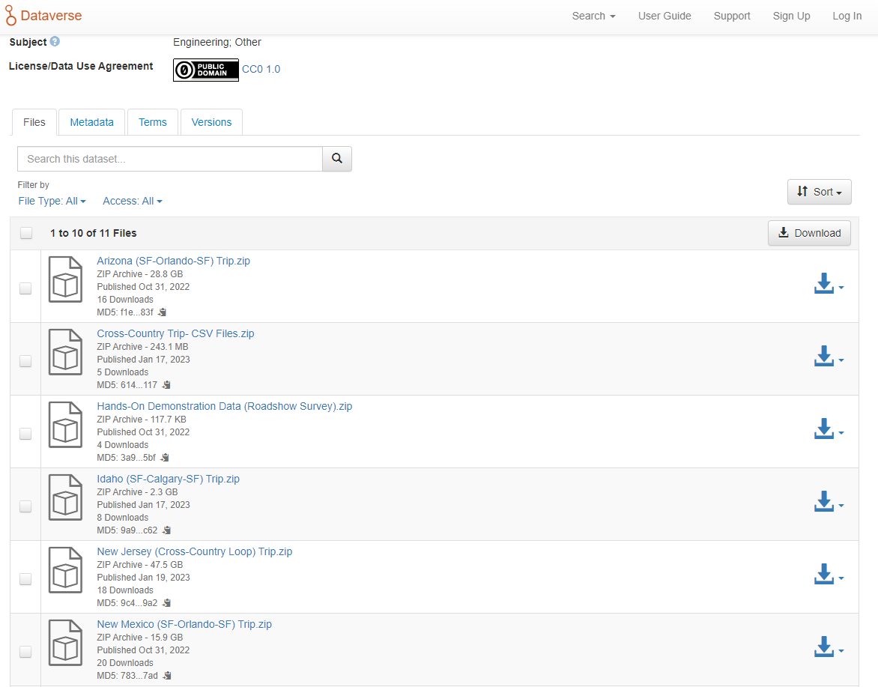
CONOPS Dataverse
Cross-country deployments along major freight corridors collect ADS perception of sensory data on roadway features and quality of communication and location data
A national public dataset (Dataverse), organized by state, of infrastructure and ADS performance metrics required for ADS operations is under development
Hanowski, Krum, and Mabry

Slide 9
Operational Use Cases and Demonstrations
Demonstrate applications and use cases for ADS-equipped CMVs in mixed fleet operations
Intelligent Transportation Society of America (ITS America) Annual Conference (Charlotte, NC; December 2021)
Port Queuing demonstration
ADS-equipped truck cross-country corridor operations
Technology Maintenance Council (TMC) Annual Meeting (Orlando, FL; March, 2022)
Ride and Drive for attendees to experience the capabilities of an ADS truck
Work zone navigation scenario
Commercial Vehicle Safety Alliance (CVSA) Annual Meeting and Exhibition (Grapevine, TX; September, 2023)
Enhanced CMV Inspection Program
Electronic verification and roadside communication
Hanowski, Krum, and Mabry

Slide 10
Autonomous Port Queuing Demonstration
INSERT PORT QUEUING VIDEO
https://youtu.be/DCs8uGJAuks
Hanowski, Krum, and Mabry

Slide 11
Thank you!
Erin Mabry
Senior Research Associate
CONOPS Co-PI
emabry@vtti.vt.edu
Hanowski, Krum, and Mabry

