Slide 1
Overweight Vehicles: Impact on Road Infrastructure and Safety
Tim Breemersch, researcher at Transport & Mobility Leuven (Belgium)
Iain Knight, Director at Apollo Vehicle Safety Ltd (United Kingdom)
Simona Fontul, Research Officer at LNEC (Portugal)

Slide 2
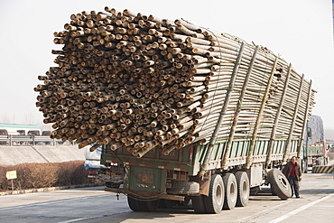
We’ve seen these before...
Authors:
Tim Breemersch, Iain Knight, Simona Fontul, Sandra Vieira Gomes, Bernard Jacob

Slide 3
Context of the research
Study for PIARC (World Road Association)
Objective was
To make an overview of existing weight limits around the world
To provide an overview of impacts of overloading (GVW/axle) on infrastructure and safety
To propose mitigation and enforcement tools and policy to improve compliance
To explicitly focus on differences between High Income Countries (HIC) and Low and Middle Income Countries (LMIC)
Using
Desk research
Global online surveys (on network composition, overloading statistics, measures in place)
Authors:
Tim Breemersch, Iain Knight, Simona Fontul, Sandra Vieira Gomes, Bernard Jacob

Slide 4
1. Current Weight Limits around the world
Europe (EU)
Non-driven axle: 10 tonnes – Driven axle: 11.5 tonnes
2 axles: 18t / 3 axles: 26t / 4 axles: 36t / 5 axle: 40t (44 for intermodal)
Many exceptions:
Driven axle up to 13t
EMS1 up to 60t, EMS2 70-100+t (Nordics)
NL up to 50t
Extra weight for alternativelly fueled/zero emission
Non EU generally same or lower limits
Authors:
Tim Breemersch, Iain Knight, Simona Fontul, Sandra Vieira Gomes, Bernard Jacob

Slide 5
1. Current Weight Limits around the world
Americas
Africa
Country | Weight per non-drive axle | Weight per drive axle | Lorry 2 axles | Lorry 3 axles | Road train 4 axles | Road train 5 axles and + | Articulated vehicles 5axles and +
USA (Federal) | 9.1 | 9.1 | 36.3 | 36.3 | 36.3 | 36.3 | 36.3
Canada (interprovincial) | 7.7 | 7.7 | 16.35 | 24.25 | 46.5 | 46.5 | 62.5
Canada (Quebec) | 9 | 10 | 17.25 | 25.25 | 35.5 | 51.5 | 53
Argentina |  | 10.5 |  |  |  |  | 49.5/52.5/60/75
Brazil | 6 | 8.2 | 17 | 25.5 | 24 |  | 45/57/74
Mexico | 6.5/11 | 12.5 | 19 | 27.5 | 38 | 54 | 66.5
MERCOSUR (Brazil, Argentina, Uruguay, Paraguay) | 6 | 10.5 | 18 | 25.5 | 18 |  | 45
Country | Weight per non-drive axle | Weight per drive axle | Lorry 2 axles | Lorry 3 axles | Road train 4 axles | Articulated vehicles 5axles and +
Malawi | 8 | 8 | 16 | 24 | 18 | 56
Mozambique | 8 | 8 | 16 | 24 | 18 | 56
Namibia | 8 | 8 | 16 | 24 | 18 | 56
South Africa | 8 | 8 | 16 | 24 | 18 | 56
Tanzania | 8 | 8 | 12 | 24 | 18 | 56
Zambia | 8 | 8 | 12 | 24 | 18 | 56
Zimbabwe | 8 | 8 | 16 | 24 | 18 | 56
Cameroon | 13 | 13 |  |  |  | 50
UEMOA | 6/11.5/12 | 6/11.5/12 | 18 | 26 | 38 | 51
Authors:
Tim Breemersch, Iain Knight, Simona Fontul, Sandra Vieira Gomes, Bernard Jacob
Notes:
UEMOA: Ivory Coast, Benin, Togo, Burkina Faso, Senegal, Mali, Niger, Guinee Bissau

Slide 6
1. Current Weight Limits around the world
Asia & Pacific
Country | Weight per non-drive axle | Weight per drive axle | Lorry 2 axles | Lorry 3 axles | Road train 4 axles | Articulated vehicles 5axles and +
Australia | 7 | 7 | 15 | 23 | 30 | 130
New Zealand | 7.6 | 7.6
China | 10 | 10 | 18 | 25 | 36 | 49
Japan | 10 | 10 |  | 20 | 36 | 36
Singapore | 12 | 12 | 19 | 28 | 39 | 46
South Korea |  |  |  |  |  | 40
Taiwan | 9.5 | 9.5 | 15 | 25 | 35 | 42
Thailand | 11 |  | 15 | 25 | 37 | 50.5
Vietnam | 10 | 10 | 18 | 24/30 | 34 | 48
Indonesia
Pakistan |  | 12 | 22.5 | 33 | 33
India | 11.5 |  | 19 | 28.5 | 40 | 55
Malaysia | 12 |  |  | 27 |  | 53
Cambodia | 11 |  |  | 30 |  | 40
Kyrgyzstan | 11.5 | 11.5 |  | 32 |  | 44
Tajikistan | 10 | 10 |  |  |  | 40
Uzbekistan | 11.5 | 11.5 |  | 32 |  | 44
Turkmenistan | 10 | 10 |  |  |  | 36
Azerbaijan | 10 | 10 |  | 32 |  | 44
Georgia | 11.5 | 11.5 |  | 24 |  | 44
Turkey | 11.5 | 11.5 |  | 32 |  | 44
Authors:
Tim Breemersch, Iain Knight, Simona Fontul, Sandra Vieira Gomes, Bernard Jacob
Notes:
Gross vehicle weights differ greatly between countries and continents, from as low as 36 tonnes to as high as 130 tonnes (or more with special permits). Higher weight limits are generally set in countries that aim to maximise the potential of their fleet, though motives for this may vary: in developed countries, the aim is to improve productivity and reduce costs, while in developing countries, it may be more about meeting demand with existing fleet, as new vehicles may not be purchased easily.
Maximum axle loads are directly related to infrastructure damage and therefore relate closely to the budget available for road infrastructure investment. They vary from as low as 6 tonnes up to 13 tonnes.

Slide 7
2. Overweight vehicles around the world
Country | Share of overloaded vehicles
Estonia | 11%, usually limited to 10t
Portugal | 37.5% (data from 1999)
Russia | 40%
Hungary | 1% overloaded, 0.4% by more than 5 tonnes
France | 1-8% overloaded, 5% by more than 10%
Ukraine | 21.5% of vehicles, but for tridem axles up to 60% are overloaded
Brasil | 77% of vehicles, 10% of axles, mostly single axles
USA | 0.5% overloaded (60% GVW, 20% axle, rest bridge formula)
Argentina | 30% of vehicles overloaded by at least 20%
Mexico | 14.3% overloaded, decreasing
South Korea | 0.07%
Taiwan | 14.2%, axle overloads mostly on tandem
Pakistan | 33-48%
Thailand | 33%
Malaysia | 24-29%, but only 8% on motorways
Indonesia | 30-98% based on axle load
South Africa | 15-20%, lower on primary roads
Cameroon | In 1996 85%, 1/3 by 20-40%, 1/3 by over 40% - In 2014 reduced to 5.9%
UEMOA | Senegal 18%, Togo 6%, Ivory Coast 17%, decreased by 20% since 2013
Austria | 40 000 non-compliance with loading limits per year
Authors:
Tim Breemersch, Iain Knight, Simona Fontul, Sandra Vieira Gomes, Bernard Jacob
Notes:
Most European and North American countries and regions report high compliance rates, with violations typically limited to 10% of the fleet, or even less. LMIC report much lower compliance levels, with the share of overweight vehicles ranging from 15 to 40% in Latin America, up to 80% and more in South-East Asian countries like Thailand and Indonesia.
The most cited reason for overloading is cost saving, facilitated by a lack of enforcement. Other causes (negligence, customer pressure, …) were generally not considered to be very relevant.

Slide 8
2. Overweight vehicles around the world
HIC (e.g. North America, EU, South Korea): relatively good compliance rate (no more than 10% overloaded vehicles, mostly limited to 10% over the limit)
Latin America: overload shares of 15-40%
SE Asia (Thailand, Indonesia) 80% and more, high overloads
Most cited reason: cost savings – facilitated by lack of enforcement
BUT: cost savings for transport operators are severely outweighed by additional maintenance cost for road managers
Authors:
Tim Breemersch, Iain Knight, Simona Fontul, Sandra Vieira Gomes, Bernard Jacob

Slide 9
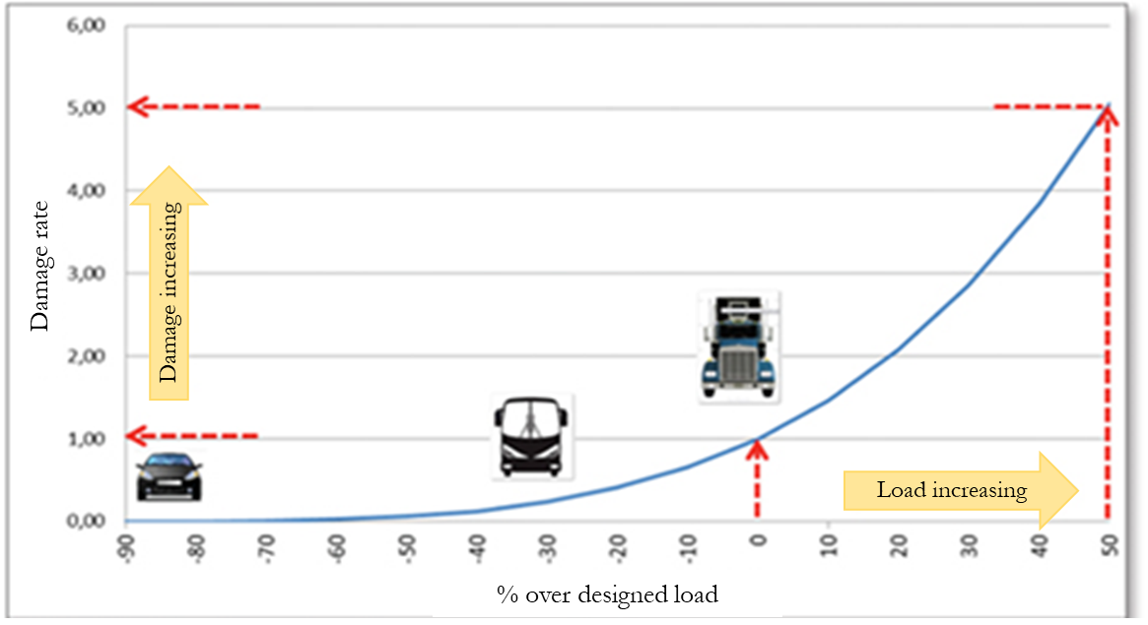
3. Impacts on infrastructure (pavement)
 | Influence on pavement service life (H= high, M= medium, L= low)
 | Type of pavement
 | Unpaved | Flexible | Semi-rigid | Rigid
Vehicles configuration
Axle load | H | H | H | H
Group of axles | M | M | L | L
Wheels and tyres | M | M | L | L
Load distribution | H | H | M | M
Suspension | M | M | L | L
Pavement characteristics
Type of pavement | H | H | Only above over design load | Only above over design load
Unevenness | M | M | L | L
Environmental factors
Temperature | L | H | L | L
Drainage and water presence | H | H | L | L
Authors:
Tim Breemersch, Iain Knight, Simona Fontul, Sandra Vieira Gomes, Bernard Jacob

Slide 10
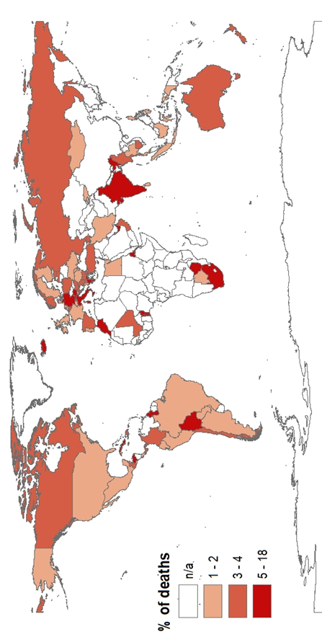
4. Impacts on safety
Impact on infrastructure: all road users
Reduced maneuverability + higher impact <-> lower vkm for same tkm
Better vehicle and road maintenance reduces impact (LMIC vs HIC)
% truck occupant deaths
Country | Proportion of all accidents with HGV involved where overloading was present (Portugal) or contributory to cause (GB/Scotland)
 | Collisions | Fatalities
Portugal | 0.3% | 1.2%
GB | 1.0% | 0.3%
Scotland | 1.3% | 0.0%
Authors:
Tim Breemersch, Iain Knight, Simona Fontul, Sandra Vieira Gomes, Bernard Jacob

Slide 11
5. Prevention and mitigation
Legislation
Prevention and education
Detection and enforcement
Penalties
Authors:
Tim Breemersch, Iain Knight, Simona Fontul, Sandra Vieira Gomes, Bernard Jacob

Slide 12
Conclusions
Damage from overloaded vehicles is disproportionate (axle weight – “4th power law”)
System perspective: cover all aspects
Economic need is driver
Strong enforcement: detection + penalties/incentives
High quality infrastructure can better withstand overloads
High quality vehicles reduce safety risks
LMIC:
higher frequency over overloading (10-100%)
Secondary roads
Unpaved/thin flexible pavement roads most sensitive
More data would be nice…
Authors:
Tim Breemersch, Iain Knight, Simona Fontul, Sandra Vieira Gomes, Bernard Jacob

Slide 13
Thank you!
Contact: Tim.Breemersch@tmleuven.be
+32 16 745 123
Authors:
Tim Breemersch, Iain Knight, Simona Fontul, Sandra Vieira Gomes, Bernard Jacob

