Slide 1



Introducing a Novel Method for Measuring Rolling Resistance and Dynamic Vertical Load on a Semi-Trailer Suspension
William Levesque, CPI, Ph.D. Candidate
André Bégin-Drolet, ing., Ph.D.
Julien Lépine, ing., Ph.D.

Slide 2

Research Project with the Quebec Ministry of Transport and Sustainable Mobility
Pavement types (i.e. Flexible vs Rigid) and fuel consumption comparison
Consideration for cold climate conditions
Many on-road physical phenomena to consider
William Levesque, André Bégin-Drolet, Julien Lépine

Slide 3
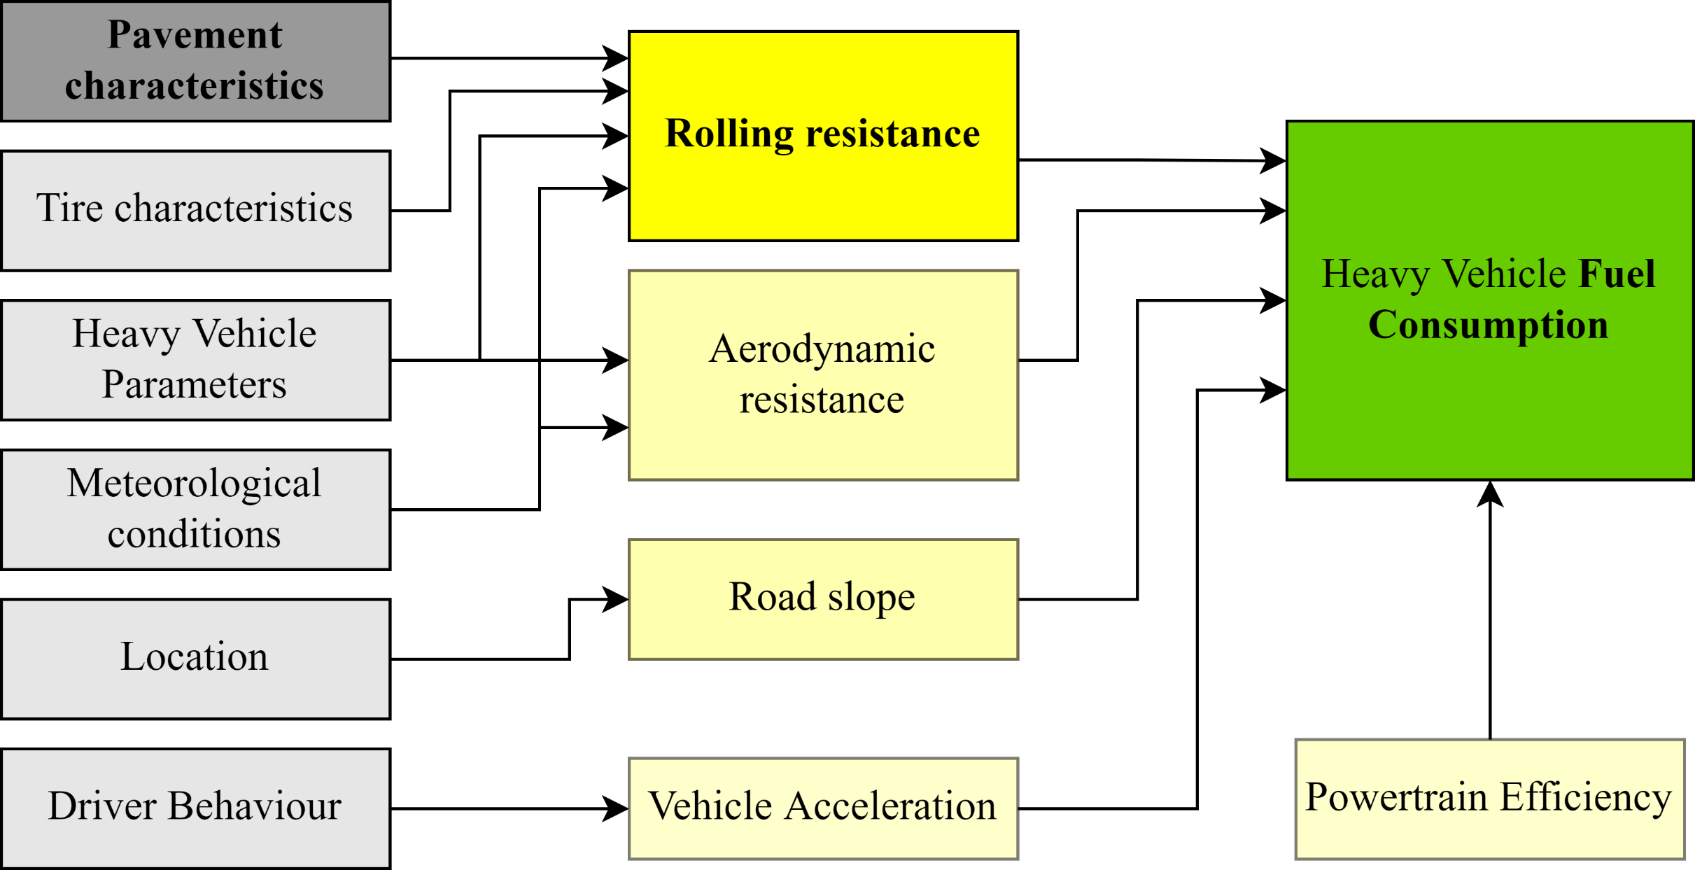
On-road experimental approaches
Many disturbing factors
No normalized conditions
Need for a more direct approach for rolling resistance measurements
William Levesque, André Bégin-Drolet, Julien Lépine

Slide 4
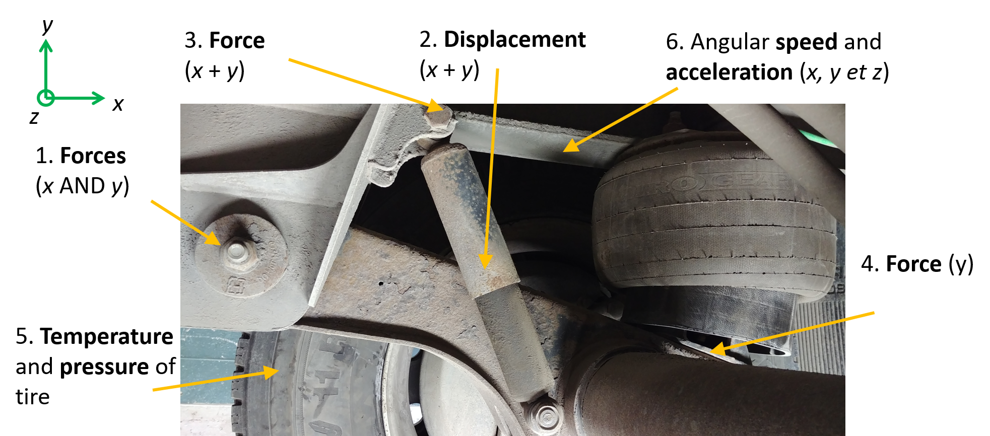
Novel Method of Measurement
Measuring all forces and movements between the suspension and the semi-trailer frame
No major modifications
Direct computation of dissipated energy in the damper
  Road Roughness
William Levesque, André Bégin-Drolet, Julien Lépine

Slide 5
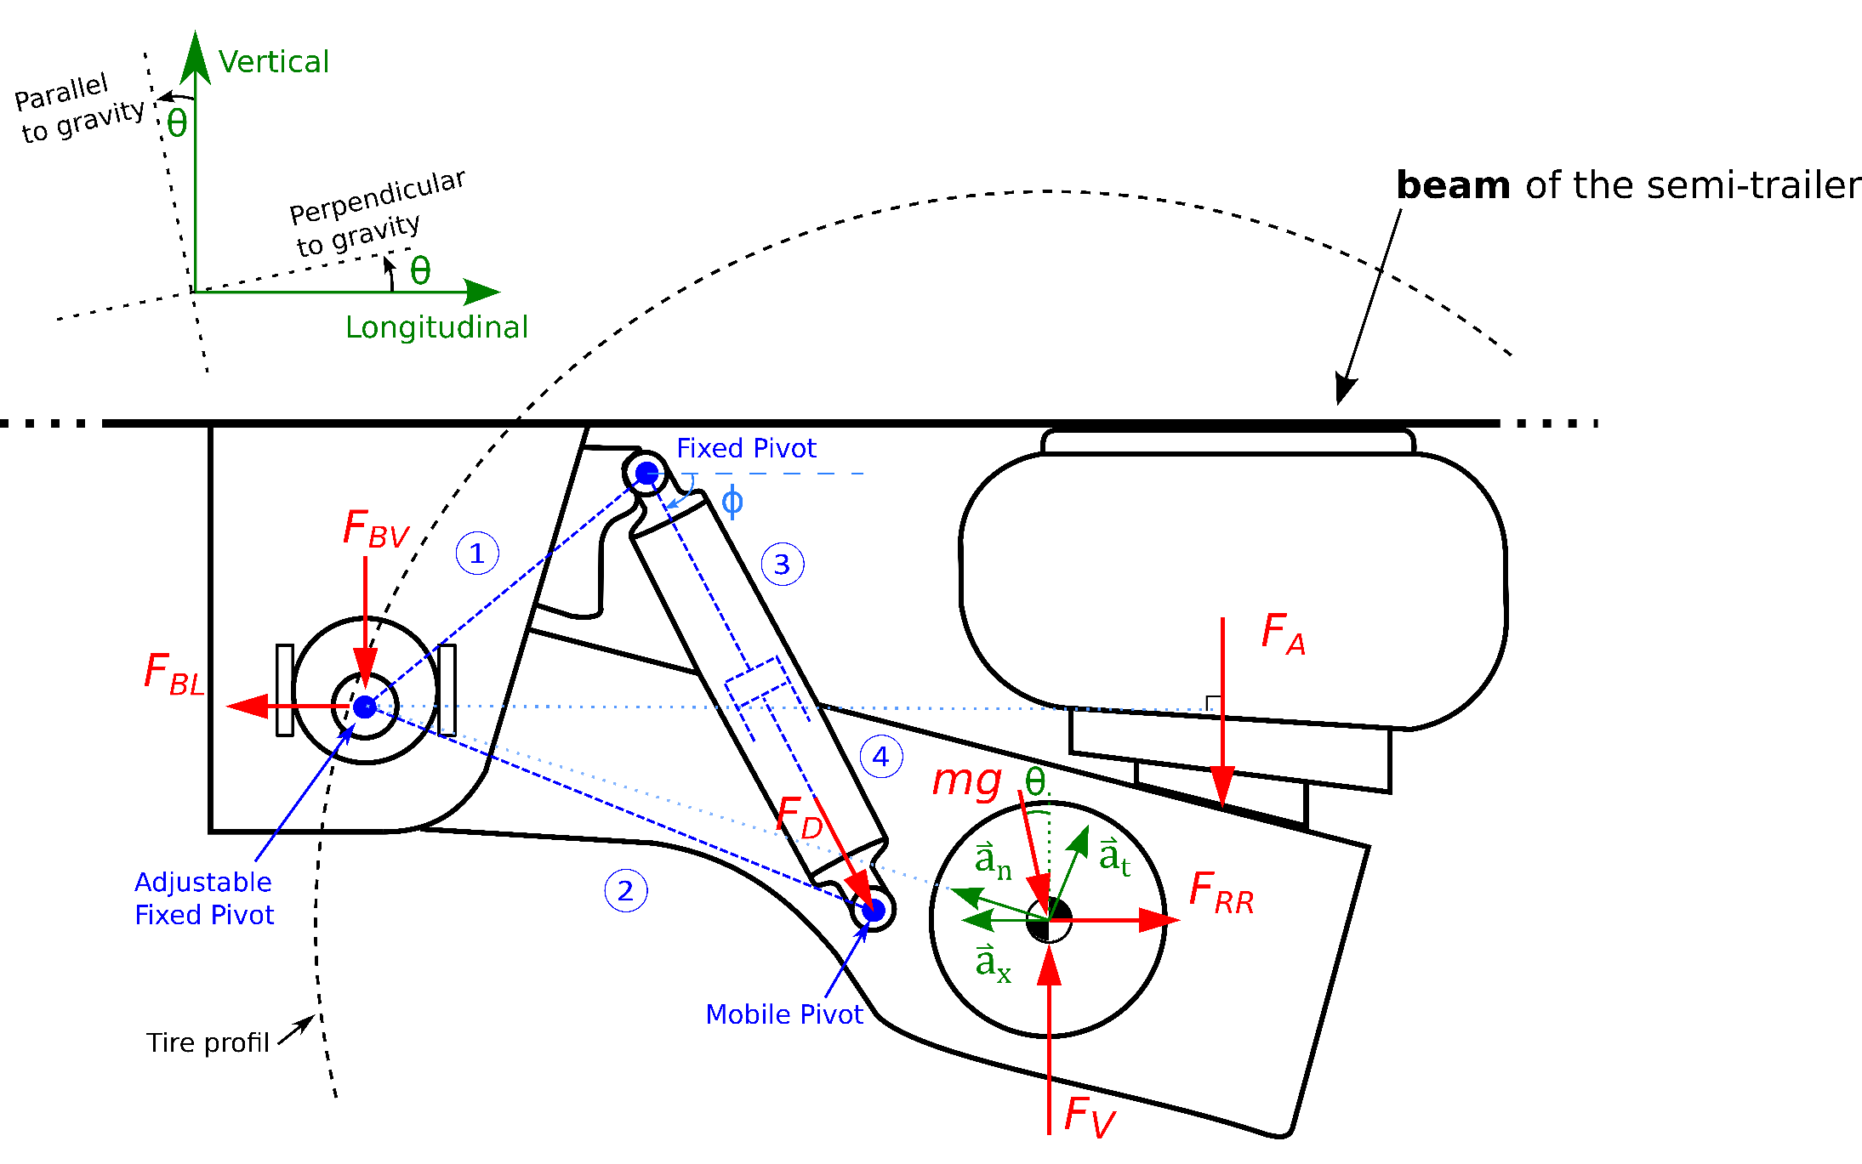
Conceptual Approach
Solving the equations of the free-body diagram
Consideration for :
  Damping force
  Dynamic vertical load
  Road slope
  Vehicle acceleration
Four-bar mechanism and kinematic model
William Levesque, André Bégin-Drolet, Julien Lépine

Slide 6
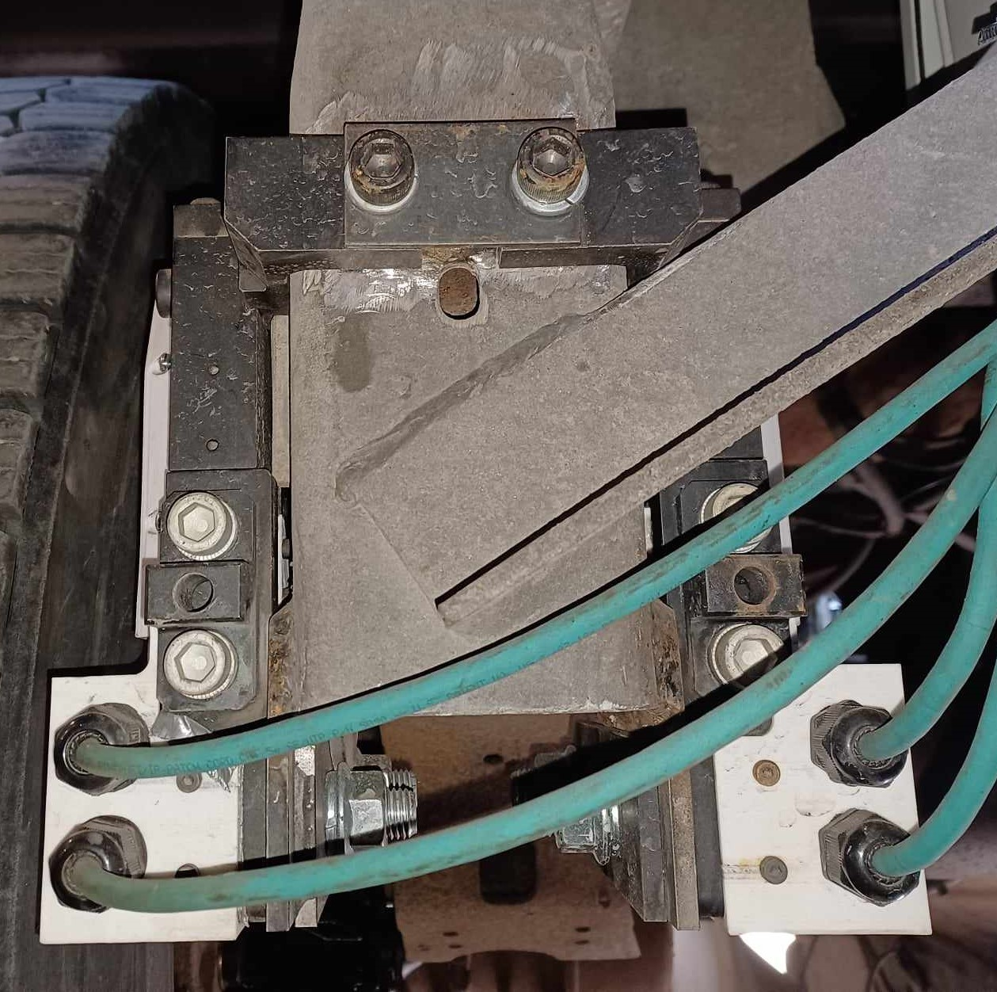
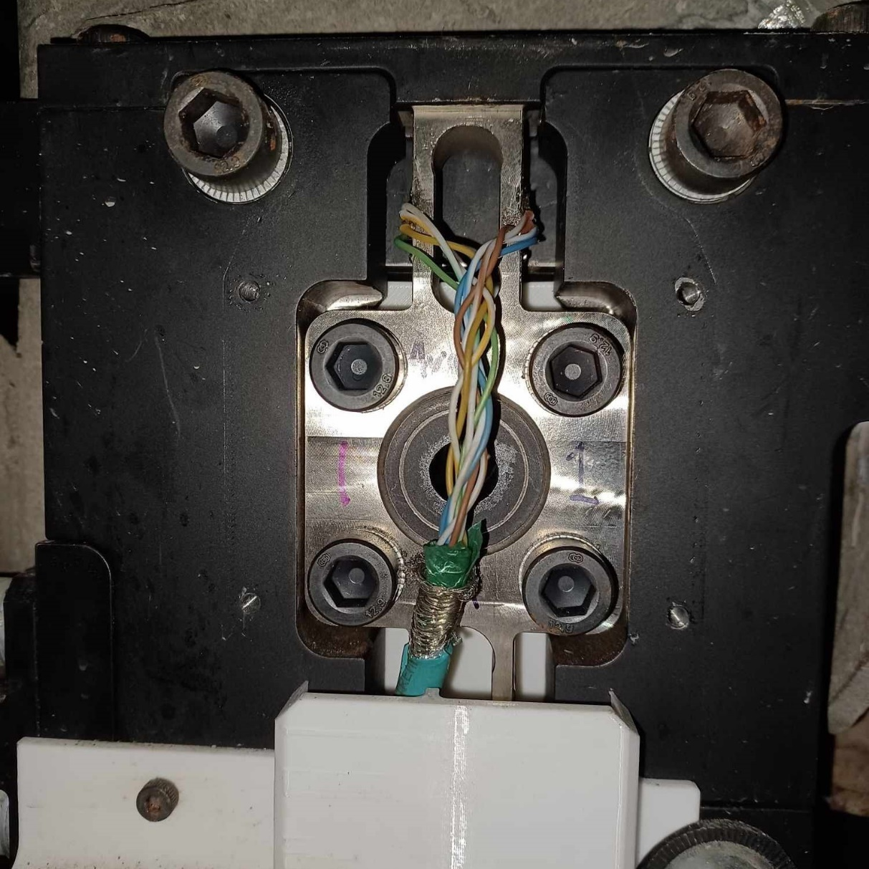
Installation of custom-made sensors
Bolted assembly welded on each frame bracket
  Four in total
Measure forces in two orthogonal directions
William Levesque, André Bégin-Drolet, Julien Lépine

Slide 7
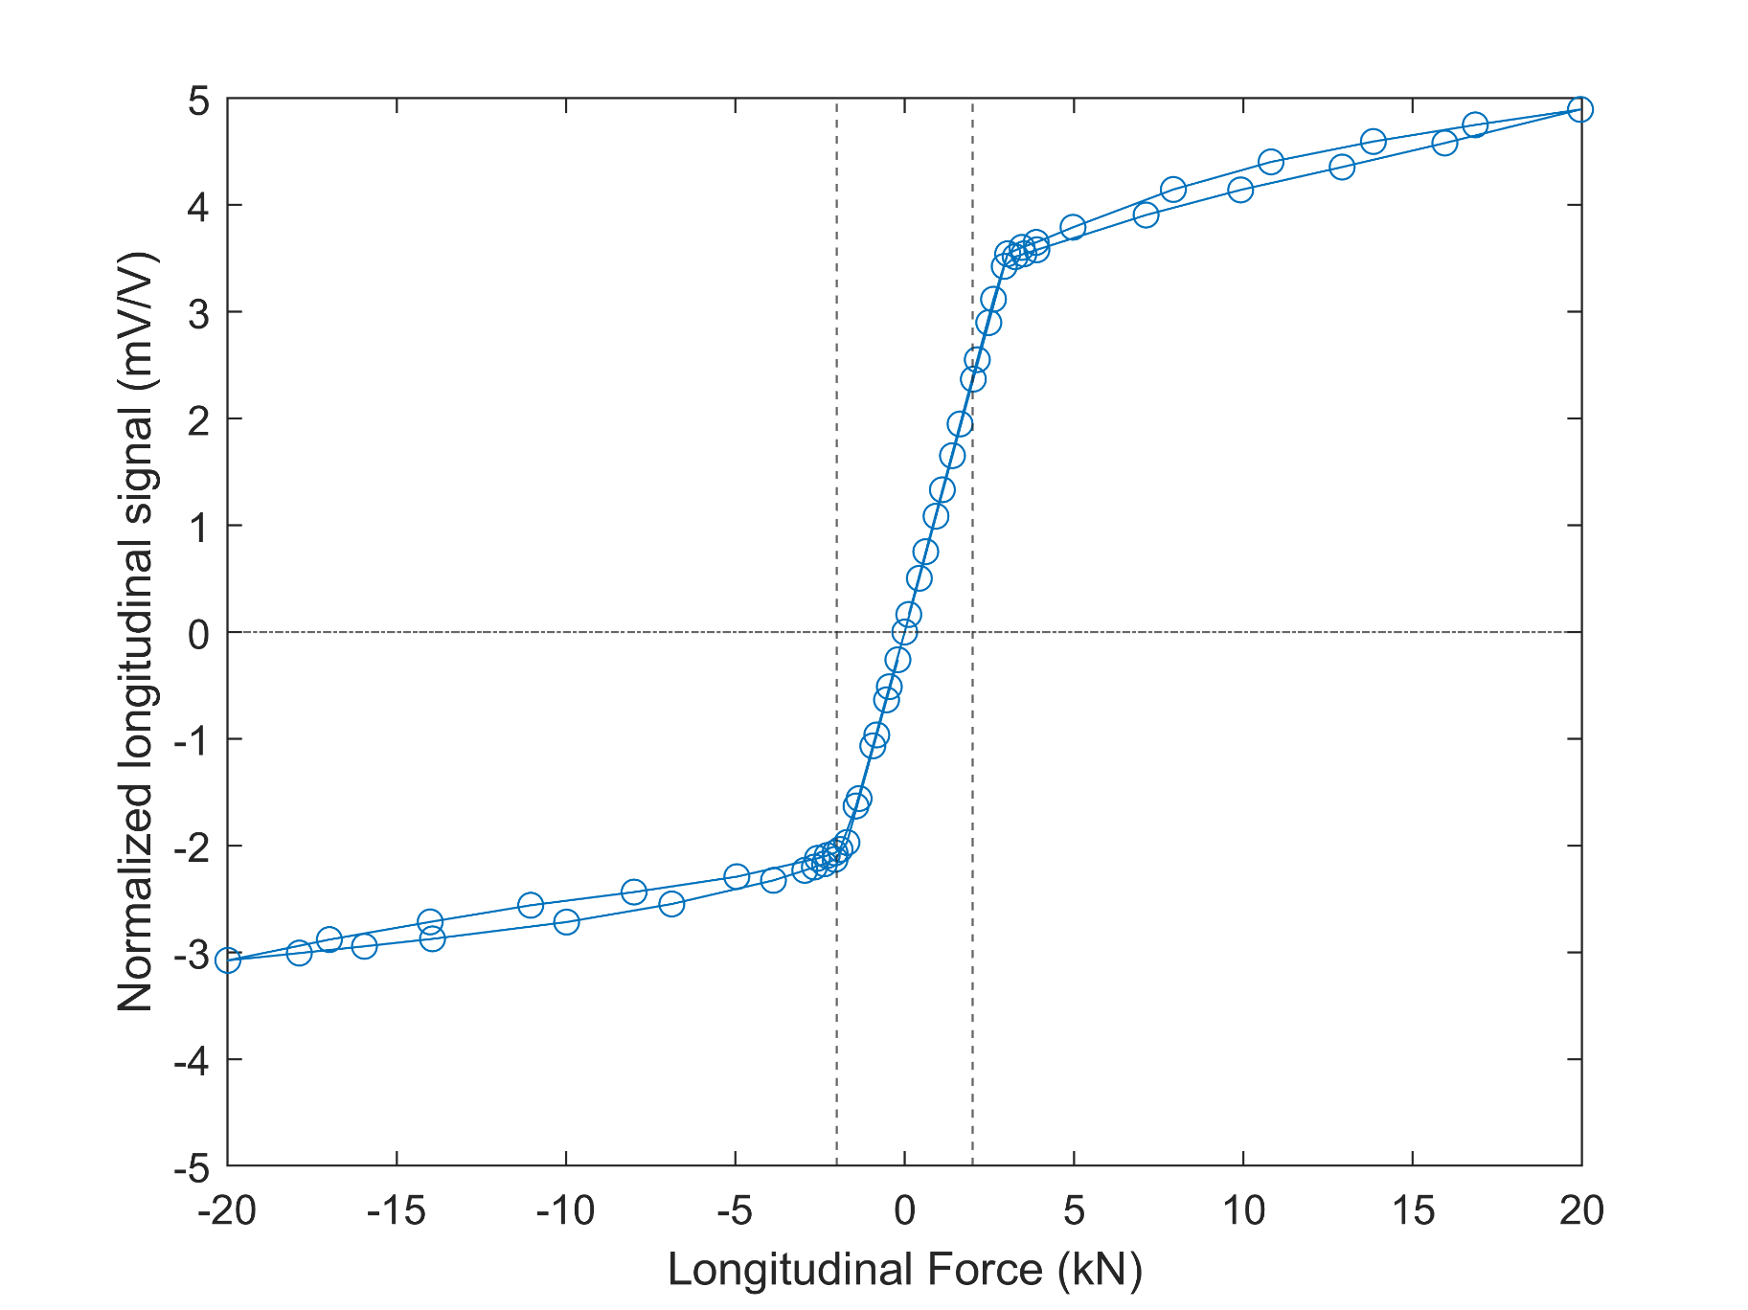
Load Cell Design and Laboratory Calibration
Dynamic forces to measure (i.e. 2kN)
  Expected maximum rolling resistance of ≈0.2kN (per load cell)
Brakes installed on the suspension
  Force up to 20kN (per load cell)
  Mechanical end-stop
William Levesque, André Bégin-Drolet, Julien Lépine

Slide 8
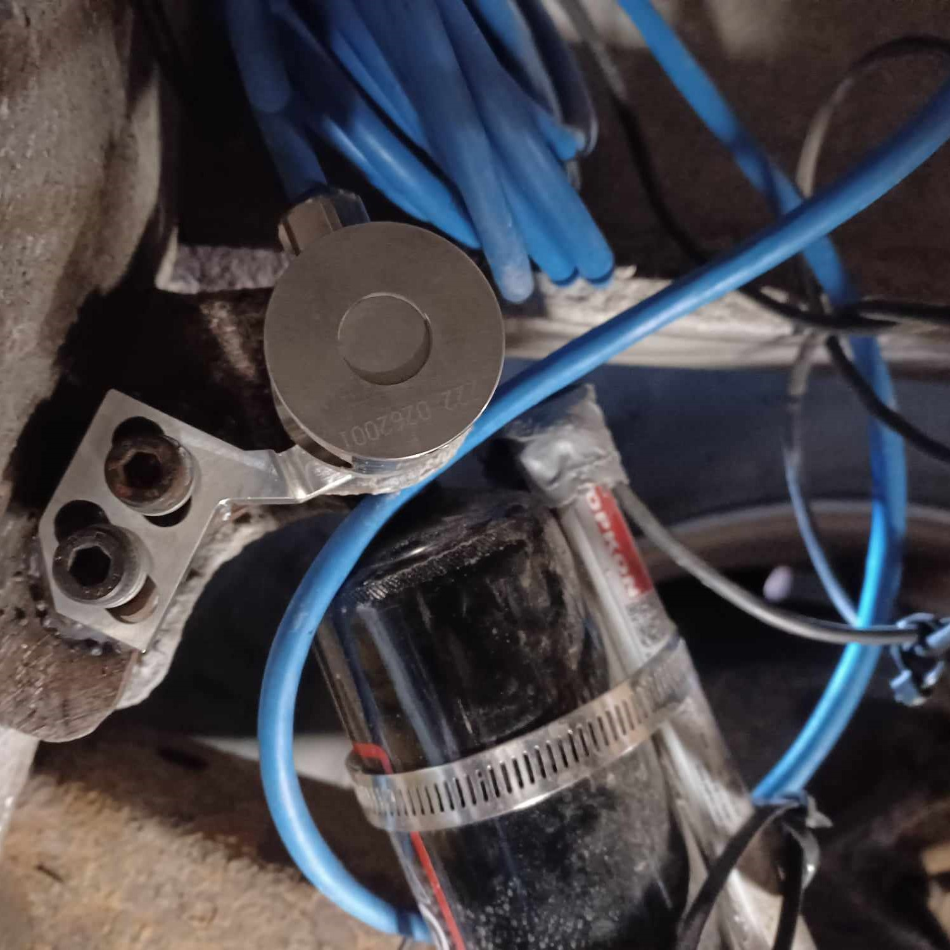
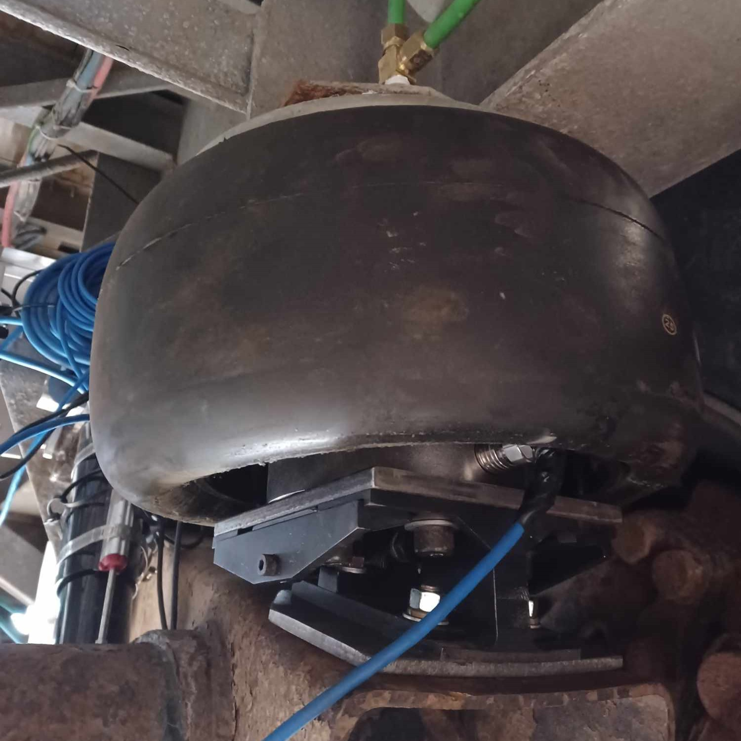
Other measurement systems [1]
Damping force
  Load pin
Damper displacement
  Linear potentiometer
Air bellow weight
  Low-profile load cell
William Levesque, André Bégin-Drolet, Julien Lépine

Slide 9
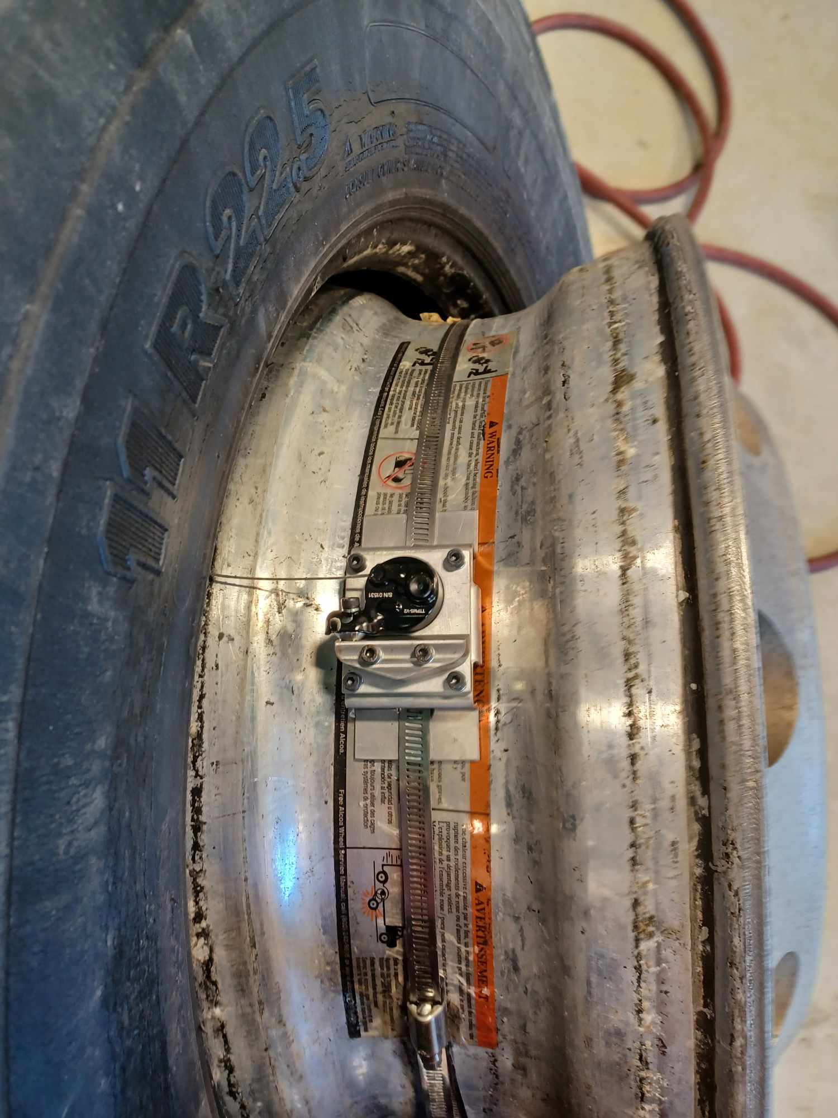
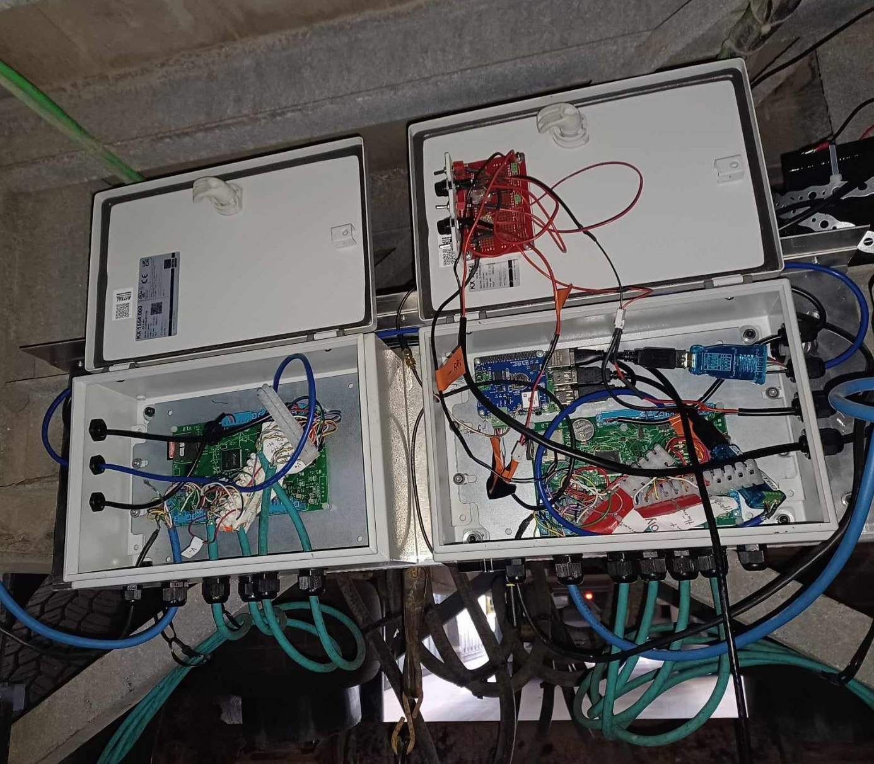
Other measurement systems [2]
TTPMS at the center of the rim
  Internal temperature at 16 points
  Inflation pressure
  Installed on each side of the axle
MEMS
  Pitch angle
  Vehicle acceleration
GPS
Custom-made data-acquisition system
William Levesque, André Bégin-Drolet, Julien Lépine

Slide 10
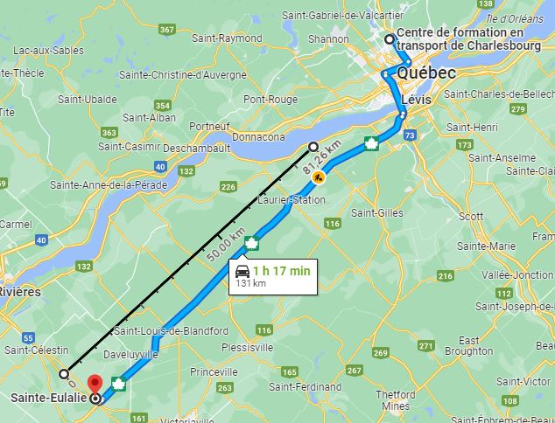
Experimental Campain
During September and October 2023
Focus on highway conditions at constant speed (i.e. 95 km/h)
Measurements on various pavements
  Rigid vs Flexible
Generally a straight and flat road
  Low average pitch angle (< 0.05 degree)
  Low maximum pitch angles (< 1.5 degree)
Tire temperature stabilization
William Levesque, André Bégin-Drolet, Julien Lépine

Slide 11
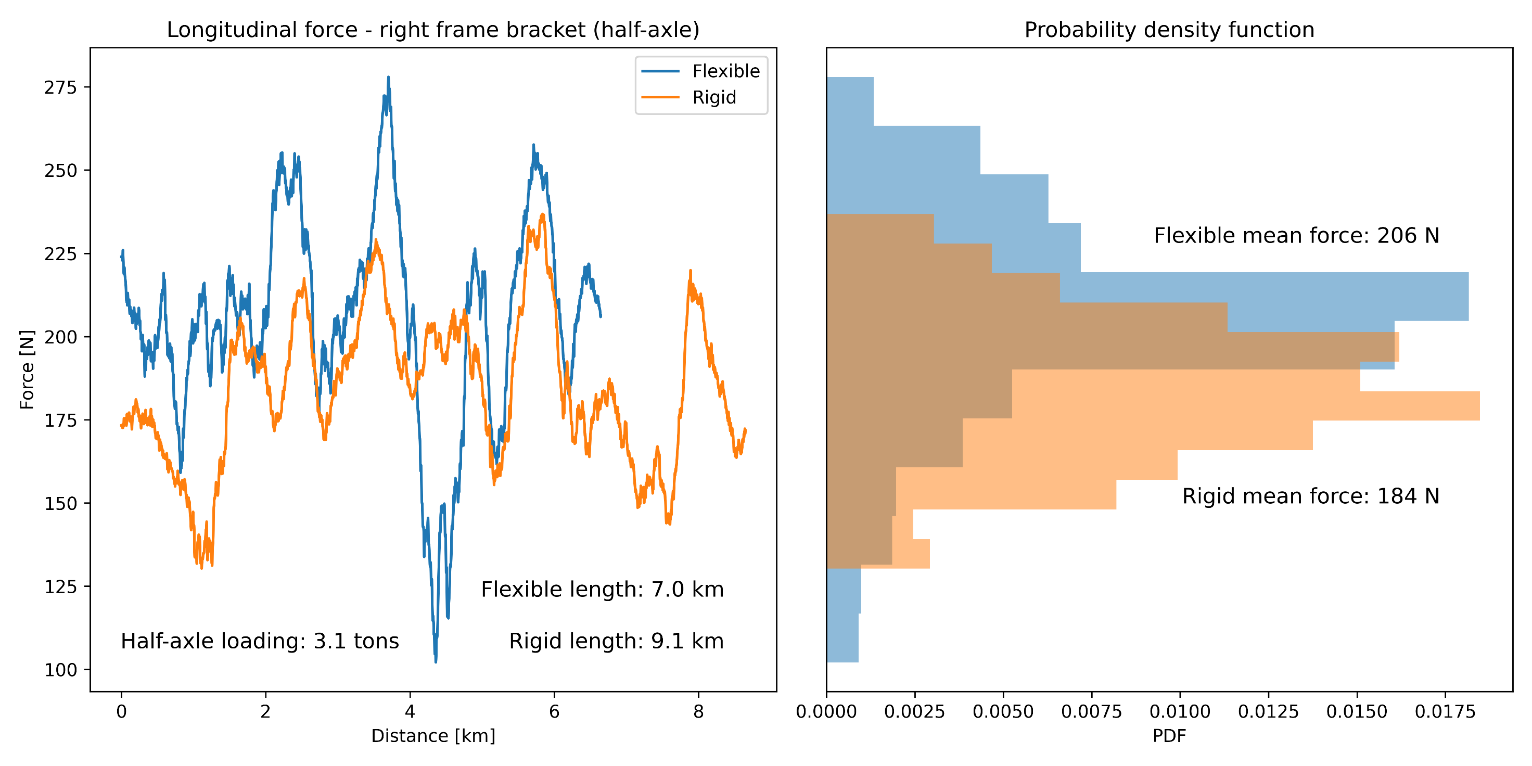
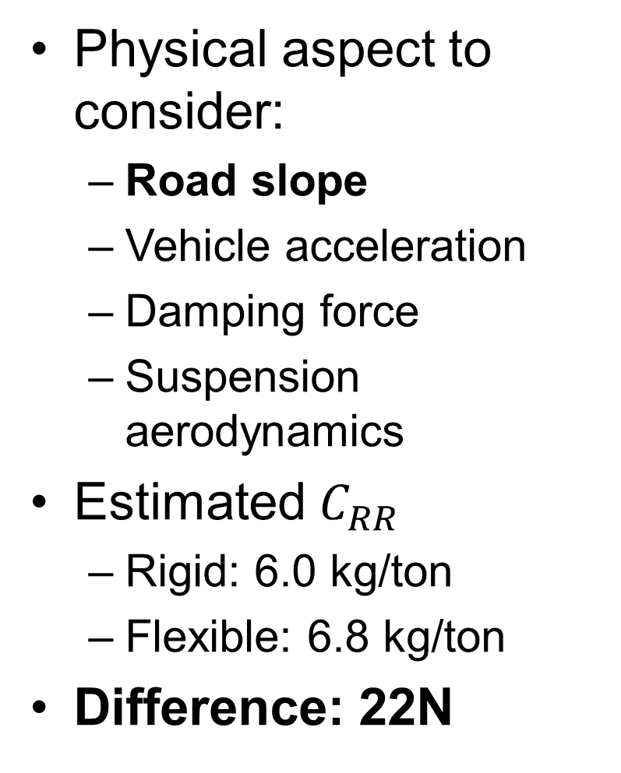
Preliminary Results: Right Frame Bracket Longitudinal Force
Physical aspect to consider:
  Road slope
  Vehicle acceleration
  Damping force
  Suspension aerodynamics
Estimated $C_{RR}$
  Rigid: 6.0 kg/ton
  Flexible: 6.8 kg/ton
Difference: 22N
William Levesque, André Bégin-Drolet, Julien Lépine

Slide 12
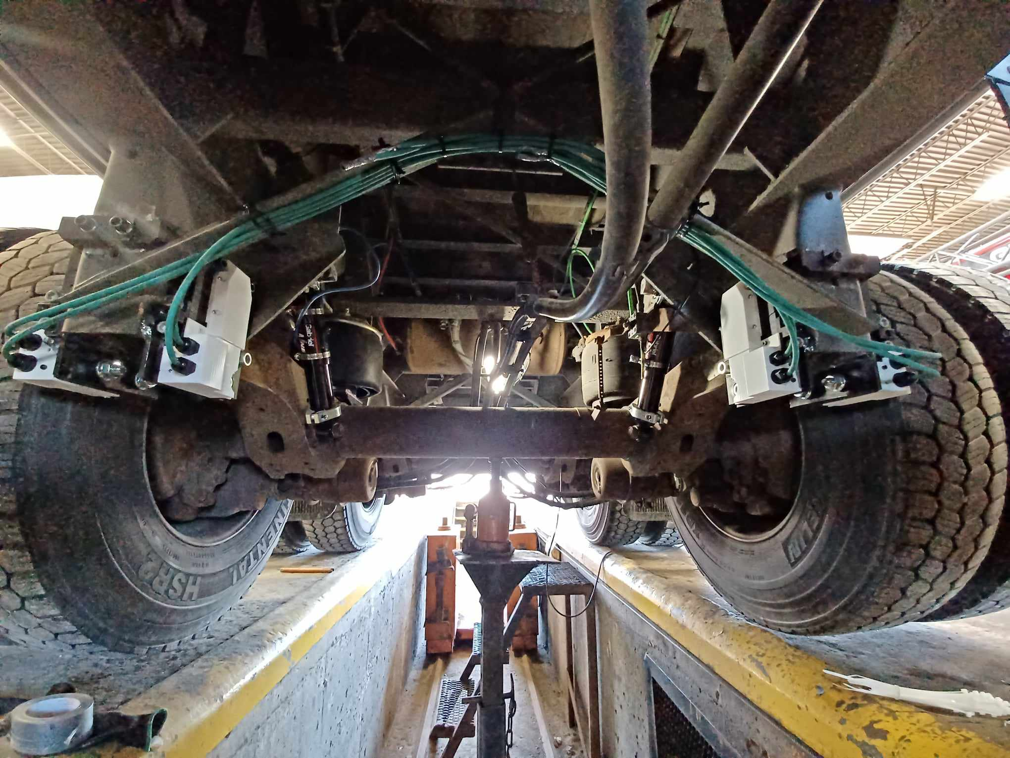
Conclusion
Successfully installed and used on real roads
More data analysis is required:
  Implementation of the whole model
  Tire vibration
  In-depth comparision Rigid vs Flexible
Validation of the instruments
Experimental is hard (but worth it)
William Levesque, André Bégin-Drolet, Julien Lépine

