Slide 1



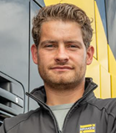


E-Trailer, emission reduction based on electrically propelled trailer
Joop Pauwelussen
Pavonodum, HAN
Jawdat Abo Aish
HAN
Michel van Klink
Van Klink Engineering
Kris van Meele
Kraker Trailers
Karel Kural
HAN
Rob Koppejan, RKI
Sustainable Solutions
1

Slide 2
Presentation layout
The environmental challenge
Hybrid tractor – semitrailer combinations
Dutch Kraker E-Trailer initiative
Controller design / power management system
Modelling and hybrid drivetrain validation
Hybrid drivetrain fuel (and GHG) reduction potential
Conclusions and next steps
Author/s:
Jawdat Abo Aish, Joop Pauwelussen, Karel Kural, Kris van Meele, Michel van Klink, Rob Koppejan
2

Slide 3
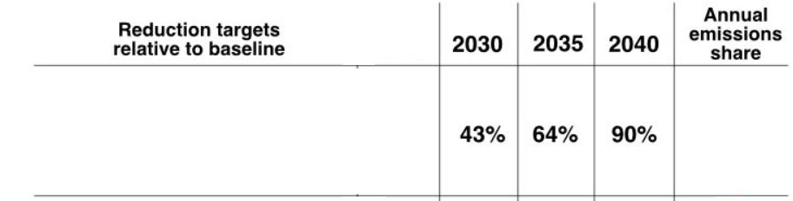
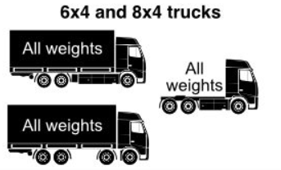
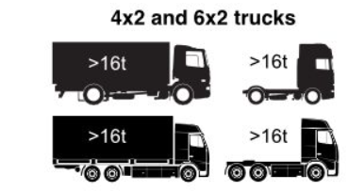



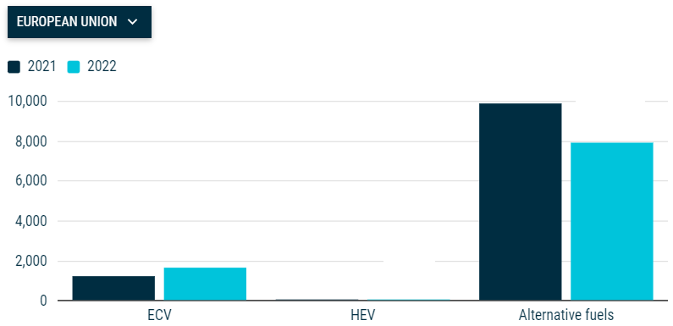





The environmental challenge (EU)
EU proposed
CO₂ targets EURO7,
ICCT, 2023
Europe’s new heavy-duty CO2 standards, explained - International Council on Clean Transportation (theicct.org)
Source: ACEA
ECV (0.6 %)
HEV
Alt. fuels (2.8 %)
Author/s:
Jawdat Abo Aish, Joop Pauwelussen, Karel Kural, Kris van Meele, Michel van Klink, Rob Koppejan
3

Slide 4
Hybrid tractor – semitrailer combinations
Surcel & Michelsen (2010): Hybrid tractor/derated diesel/motorized trailer
Regional haul fuel reduction: 13 %
Construction haul fuel reduction: 18 %
Diba (2014): Series hybrid tractor – trailer electric drivetrain
Reduced TCO in 10 year
Both studies:
Better tractive and gradeability (uphill, downhill) properties
Better braking capability. longitudinal performance and driver control
Downsized tractor ICE / auxiliaries (moving floor, cooling, …)
Author/s:
Jawdat Abo Aish, Joop Pauwelussen, Karel Kural, Kris van Meele, Michel van Klink, Rob Koppejan
4

Slide 5
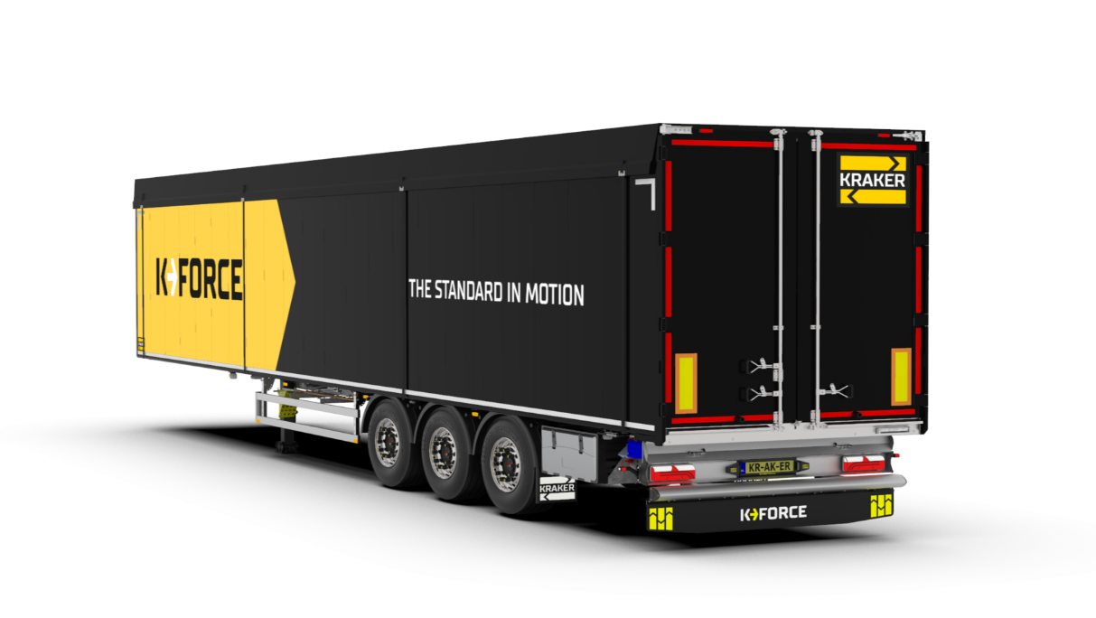
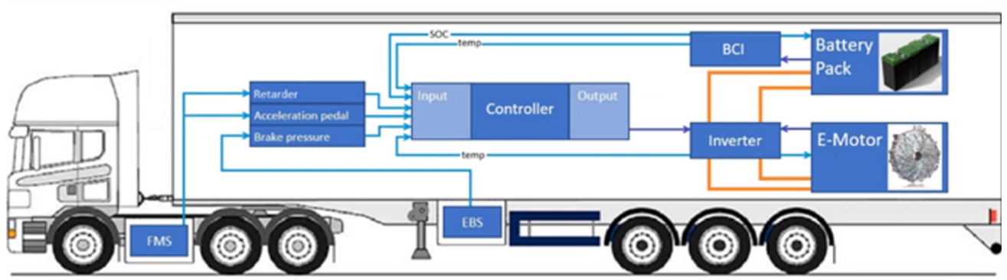
Dutch Kraker E-Trailer initiative
Objectives
Validate E-Trailer controller approach (fuel reduction) (hybrid driving mode)
Explore possible driving purely electrically (electric driving mode)
hybrid driving mode
SOC
temp
BCI
Battery Pack
Retarder
input
controller
output
Accelerator pedal
Brake pressure
temp
inverter
E-Motor
FMS
EBS
Communication with the existing Truck/Trailer network
Novel controller along with an optimum control strategy
  Fleet Management Standard (FMS) / Electronic Brake System (EBS)
400 Nm max. torque
70 kW max. cont. Power
38 kWh battery capacity
Author/s:
Jawdat Abo Aish, Joop Pauwelussen, Karel Kural, Kris van Meele, Michel van Klink, Rob Koppejan
5

Slide 6
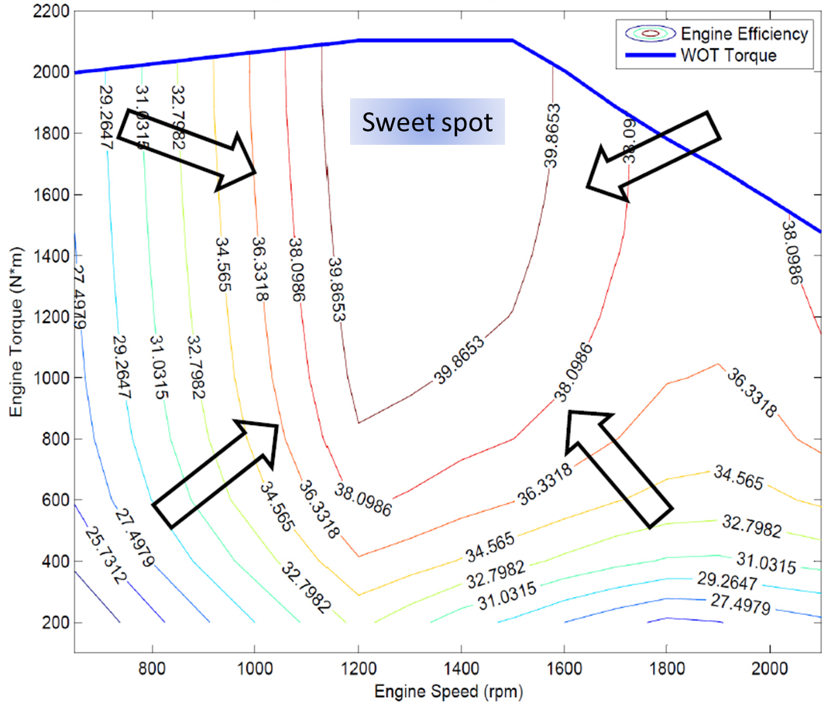
Power management system objectives
Meet power demand
Improve the efficiency of the diesel engine
Recuperate as much braking energy as possible
Maintain predefined SOC thresholds
The full throttle speed-torque curve and the efficiency map of a diesel engine (Diba, 2014).
Author/s:
Jawdat Abo Aish, Joop Pauwelussen, Karel Kural, Kris van Meele, Michel van Klink, Rob Koppejan
6

Slide 7
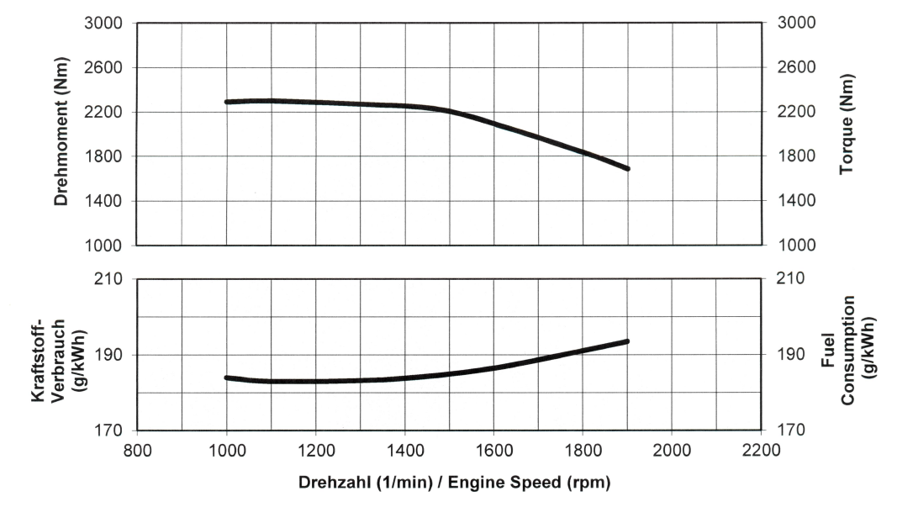
Power management system
Energy recovery
Support
The full throttle speed-torque curve and the fuel consumption of the OM471 diesel engine.
Author/s:
Jawdat Abo Aish, Joop Pauwelussen, Karel Kural, Kris van Meele, Michel van Klink, Rob Koppejan
7

Slide 8
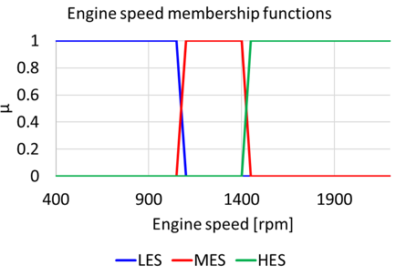
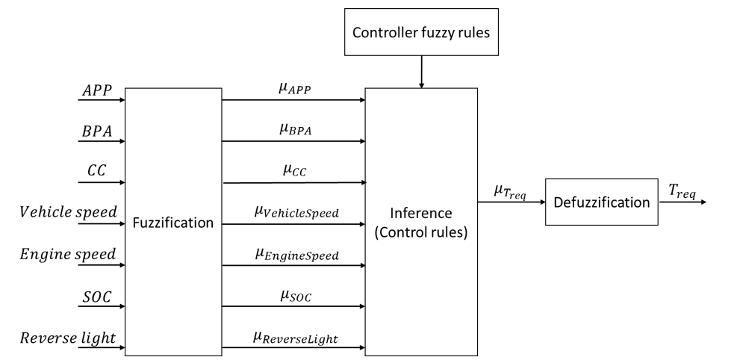
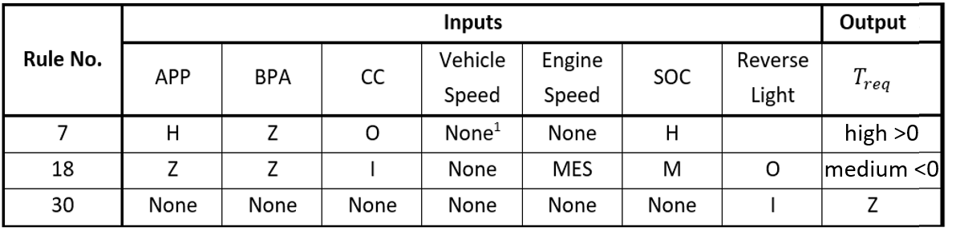
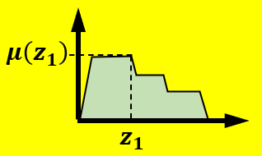
Controller design (FLC: Fuzzy Logic)
Rule-based Multiple input Single output controller
30 rules covering normal driving scenarios
APP: Accelerator Pedal Position
BPA: Brake Pressure Average
CC : Cruise Control
Torque
Request
neg/pos
LoM: Largest of Max
Author/s:
Jawdat Abo Aish, Joop Pauwelussen, Karel Kural, Kris van Meele, Michel van Klink, Rob Koppejan
8
Notes:
APP : indicates T_{req} > 0 (support)
BPA : Energy recovery T_{req}<0
SOC : Avoid overcharging
SOC : Avoid extreme discharging
ω : Exploit engine sweet spot
In total 30 rules have been designed
Some general concepts:
APP is used to indicated that the driver wants to accelerate
BPA indicated that brake energy recovery is in order
Avoid overcharging (for high SOC), avoid battery depletion (for low SOC)
No throttle but positive speed: decelerating and E-Trailer may be used as retarder
Engine speed may be used to indicate efficient/nonefficient driving conditions
Under efficient cruise control conditions, some energy may be recovered through slightly braking (with negligible effect on tyre wear)
Rule 7: high acceleration suggests large torque request (support), at least if the SOC is sufficiently high
Rule 18: Under efficient cruise control conditions (engine speed not too high), and not to high SOC, use energy recovery
Rule 30: if reverse driving, switch off torque request whatsoever.

Slide 9
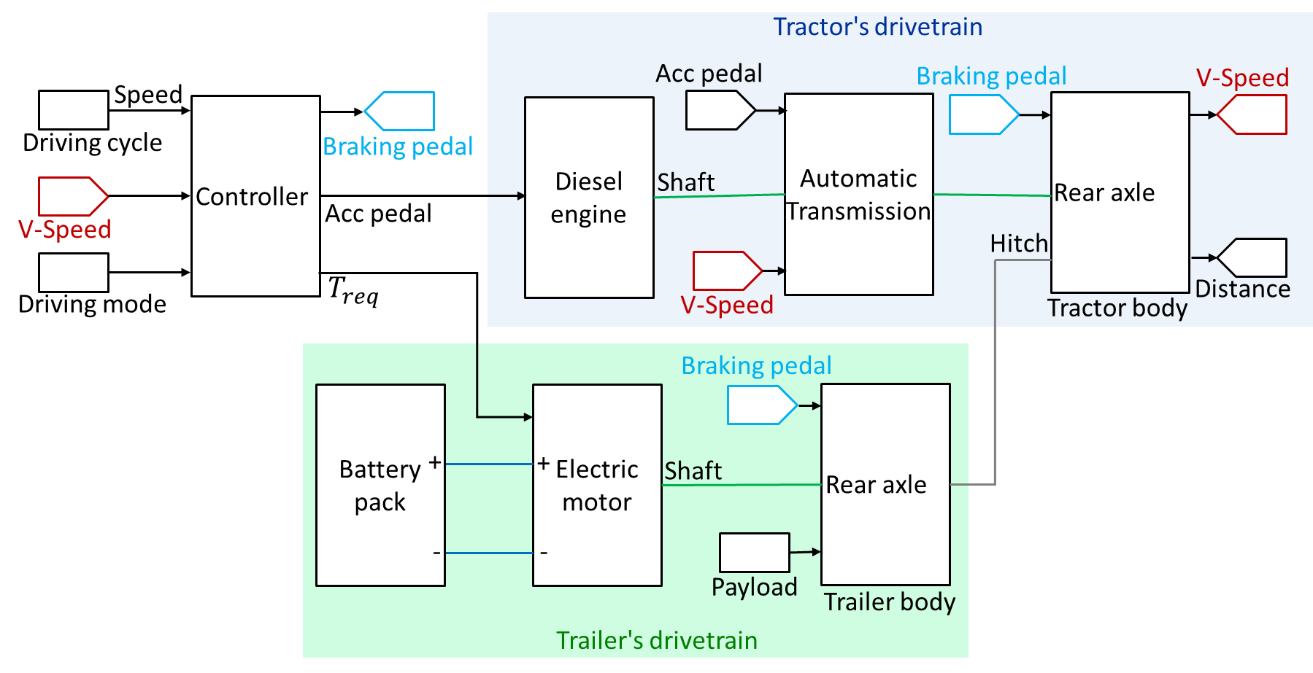
Modelling
power
feedback
power
shiftmap
Conventional
Hybrid
Purely electr.
Torque
SOC
Energy used
Current
Voltage
ω
The high-level block diagram of the hybrid electric drivetrain model
Author/s:
Jawdat Abo Aish, Joop Pauwelussen, Karel Kural, Kris van Meele, Michel van Klink, Rob Koppejan
9

Slide 10
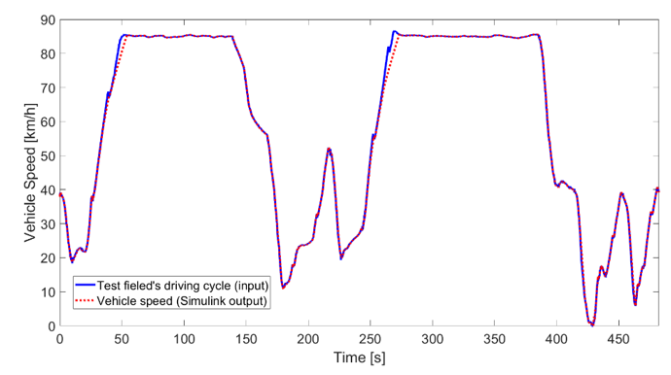
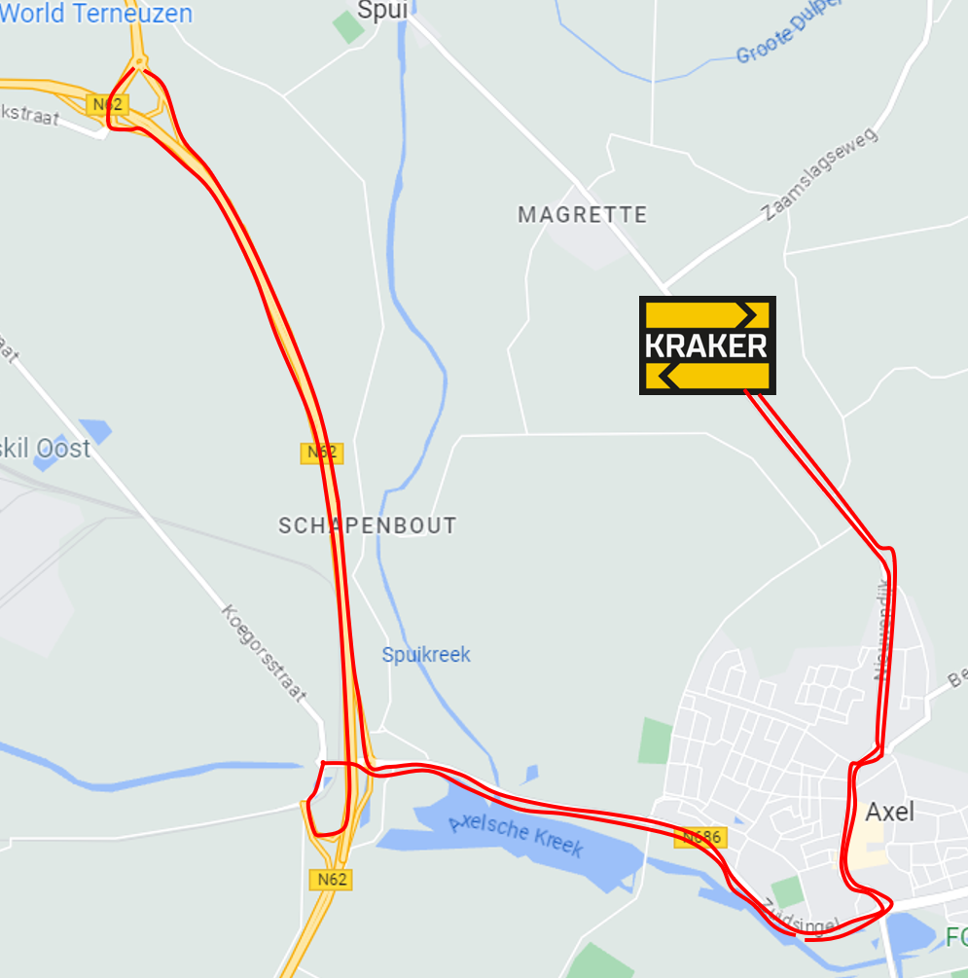
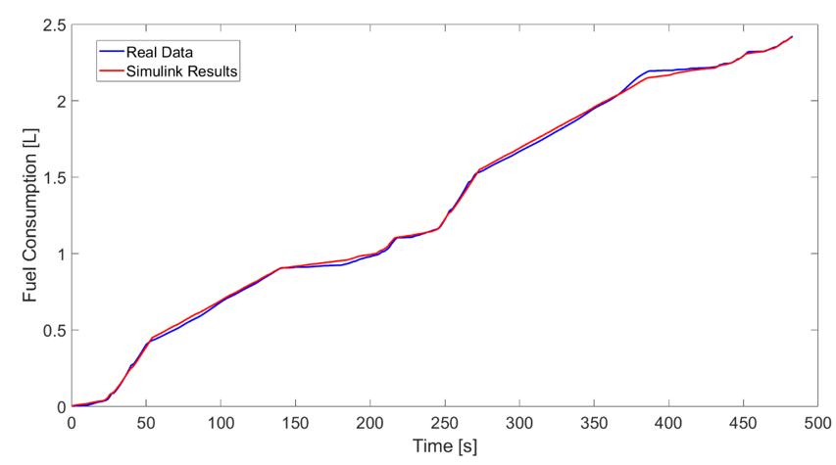
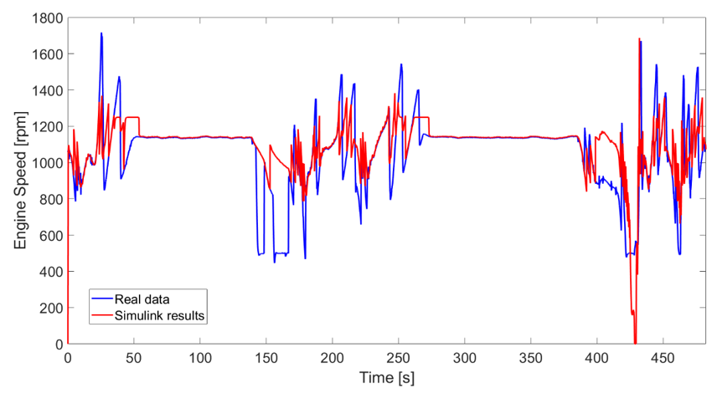
Hybrid drivetrain validation
Short field test(7.8 km) used as drive cycle
non-sequential
shifting logic
Author/s:
Jawdat Abo Aish, Joop Pauwelussen, Karel Kural, Kris van Meele, Michel van Klink, Rob Koppejan
10

Slide 11
Hybrid drivetrain fuel reduction potential
Some practical issues during first testing:
Inverter overheating ➔ actual electric motor’s torque didn’t reach requested torque
Charging problems for one sub-battery
Fluctuating torque request
Tuning diesel engine efficiency performance
Test 1:
With inverter overheating
reducing output torque
Test 2:
Zero torque request while cruise control to allow inverter to cool down
Author/s:
Jawdat Abo Aish, Joop Pauwelussen, Karel Kural, Kris van Meele, Michel van Klink, Rob Koppejan
11

Slide 12
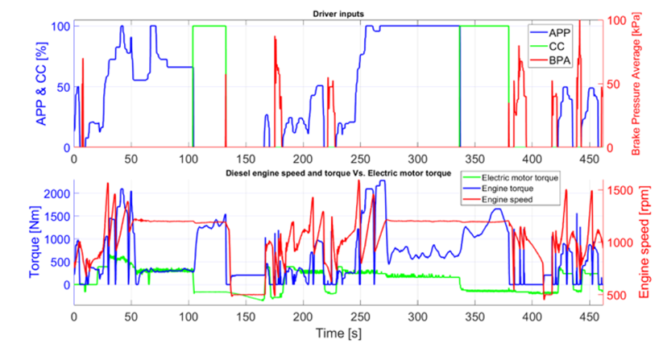
Hybrid drivetrain fuel reduction potential
Test 1:
BPA
CC
High APP
APP
T_{engine}
ω
T_{electr.}≈ 550 Nm
< T_{req}= 800 Nm
for high APP
T_{electr.}
energy
recovery/
retarder
Author/s:
Jawdat Abo Aish, Joop Pauwelussen, Karel Kural, Kris van Meele, Michel van Klink, Rob Koppejan
12

Slide 13
Hybrid drivetrain fuel reduction potential
Test 1 Test 2
Reduction fuel consumption
14.5 %
19.9 %
Time saved (acceleration performance)
4.3 %
6.6 %
However:
Overheating ➔ cooling will give better results
Driving cycle not representative ➔ more field test experience required
More load variations
Savings does not include battery SOC
Author/s:
Jawdat Abo Aish, Joop Pauwelussen, Karel Kural, Kris van Meele, Michel van Klink, Rob Koppejan
13

Slide 14
Conclusions
Prototype E-Trailer established
Reduction fuel (and GHG) potentially 15 – 20 %
Low emission (urban) driving possible with E-trailer based heavy duty vehicles
Next steps:
More field tests, representative transport environment
Improving/tuning the controller, adapting to ICE/driving/loading conditions
E-Trailer independent of the tractor, using trailer (added) sensors and data science technology (e.g. AI, sliding mode control,…)
Author/s:
Jawdat Abo Aish, Joop Pauwelussen, Karel Kural, Kris van Meele, Michel van Klink, Rob Koppejan
14

Slide 15

Thank you
https://weeklyvoice.com/minister-alghabra-announces-canadas-green-freight-program-and-zev-awareness-initiative/
Author/s:
Jawdat Abo Aish, Joop Pauwelussen, Karel Kural, Kris van Meele, Michel van Klink, Rob Koppejan
15

