Slide 1
The ARTSA- Institute
Brake Calculator
Developed and Presented by
Dr Peter Hart

Slide 2
Developed with financial support from Australian NHVR under the Heavy Vehicle Safety Initiative that is sponsored by the Australian Government.
Purpose: To provide a reliable brake calculator that can be applied to single or combination vehicles to check compliance with brake rules and to improve brake designs.
Achievement: A web-based, sophisticated yet simple-to-use brake calculator with leading features that allows users to create and store models.
ARTSA-i Brake Calculator

Slide 3
The need exists because:
Vehicles are modified and need to be verified.
Optimized brake designs are safer and lessen dependance on autonomous systems.
Type approval of Australian trailers requires detailed calculations. Wheel lock-up should be included but is not.
PBS brake designs should be calculable. Vehicle engineers can learn by exploring brake design options.
ARTSA-i Brake Calculator

Slide 4
ARTSA-i Brake Calculator
The inputs:
Vehicle configurations, dimensions, C of M weights, tyres....
Foundation and emergency brake torques.
Pneumatic control system transfer characteristics.
Road-tyre friction, starting speed, hill slope.

Slide 5
ARTSA-i Brake Calculator
The outputs:
Deceleration and stopping distance V brake control level.
Adhesion utilization at each axle V brake control level.
Mass on each axle V brake control level.
Parking brake hold level V slope.
Threshold (contact) air pressure V axle number.

Slide 6
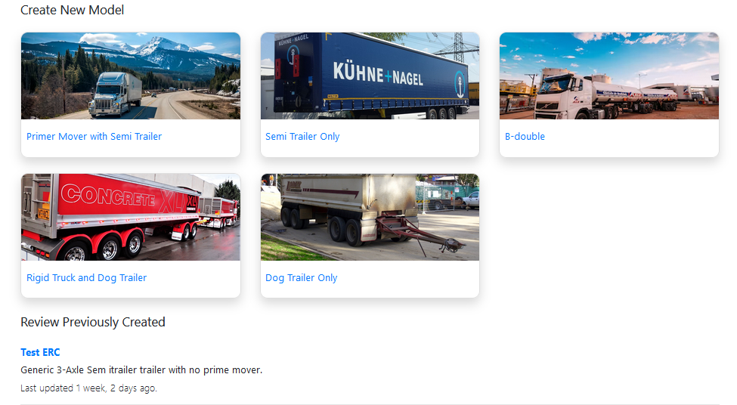
Vehicle Selection

Slide 7
Truck & Trailer Specification

Slide 8
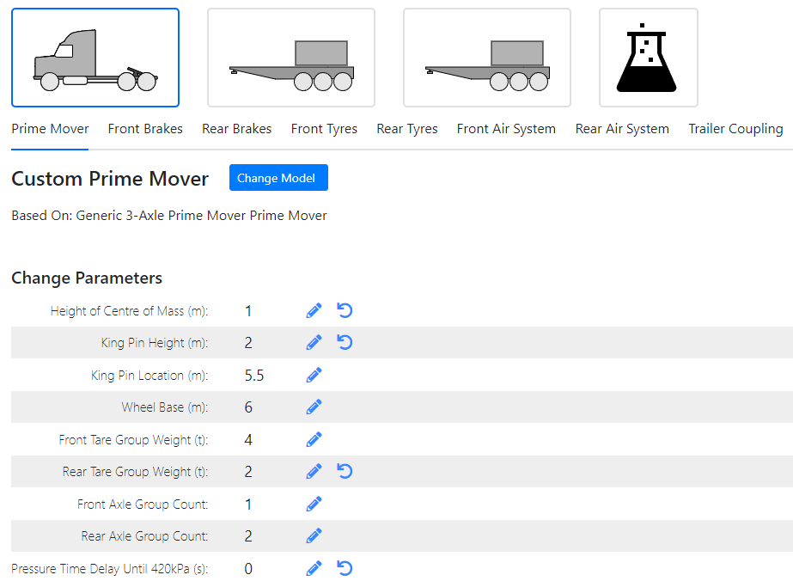
- Dimensions

Slide 9
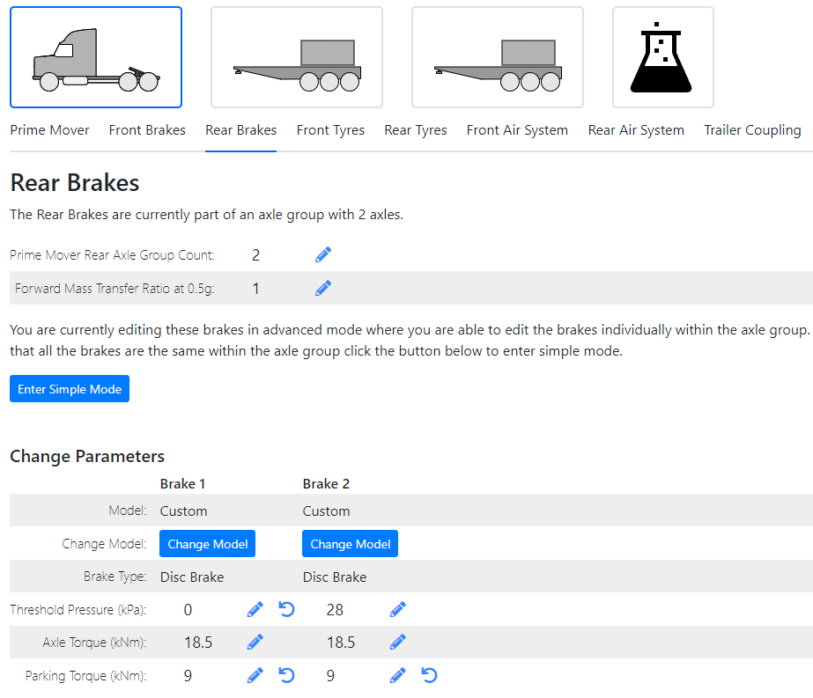
- Brakes

Slide 10
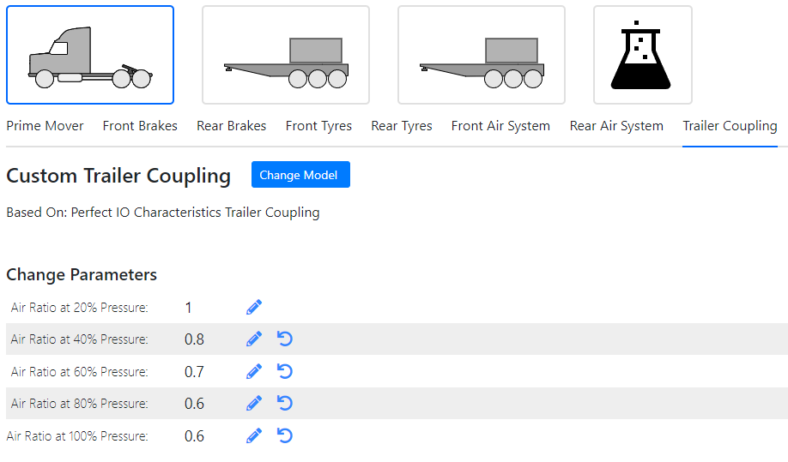
- Coupling air
characteristics

Slide 11
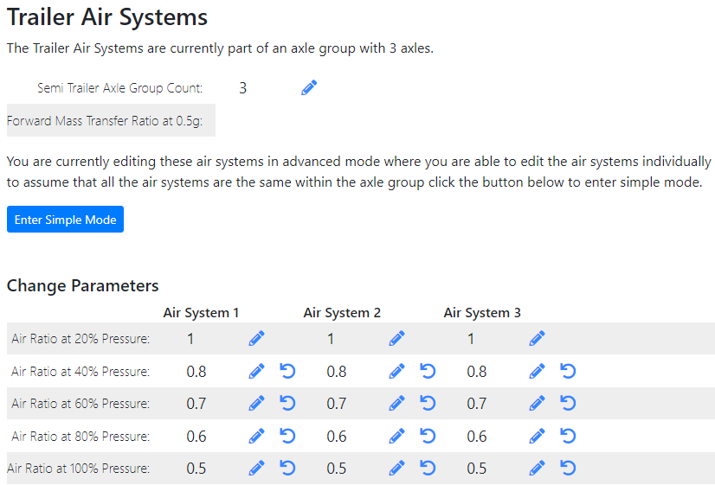
- Axle air
controls

Slide 12
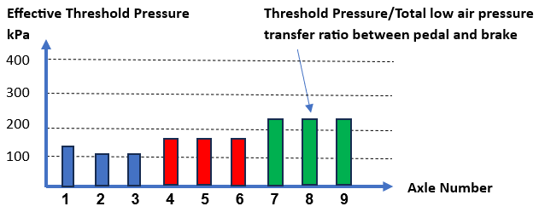
Threshold Pressure Graph

Slide 13
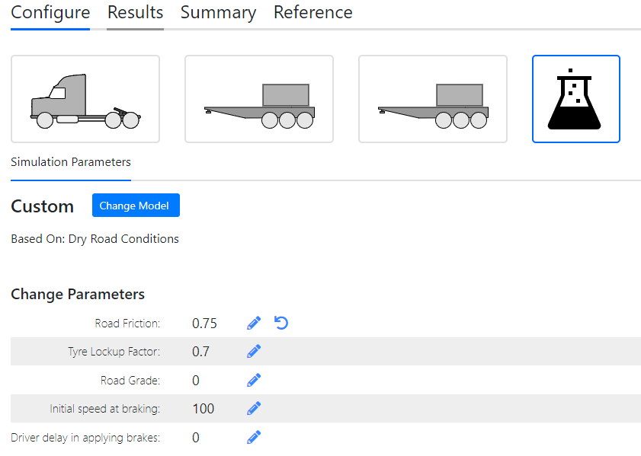
Road
Conditions
Specification

Slide 14
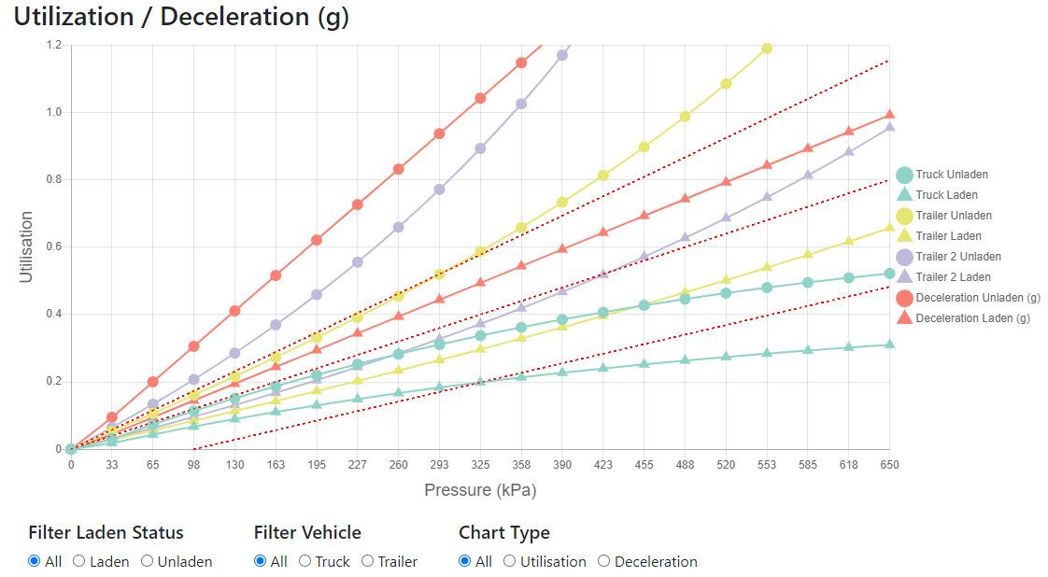
Results –
Vehicle
Decel’n &
Utilization
Laden &
Unladen

Slide 15
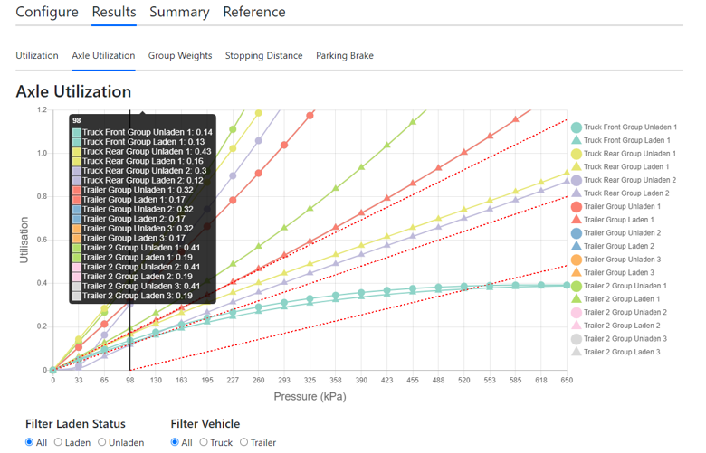
Results -
Axle
Utilization

Slide 16
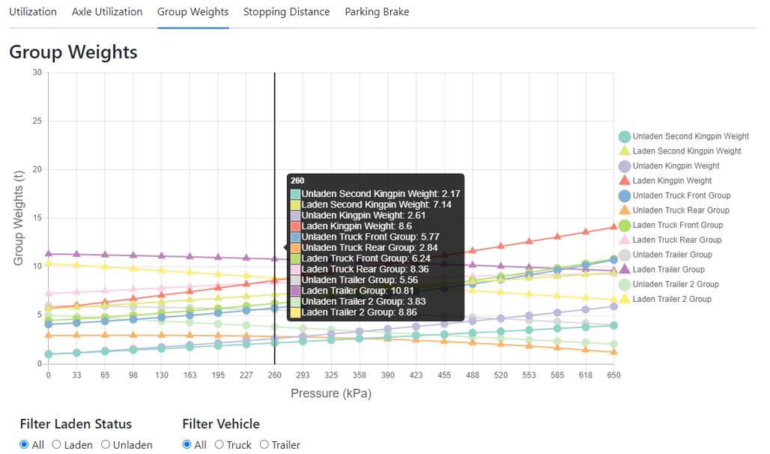
Results –
Dynamic
Mass

Slide 17
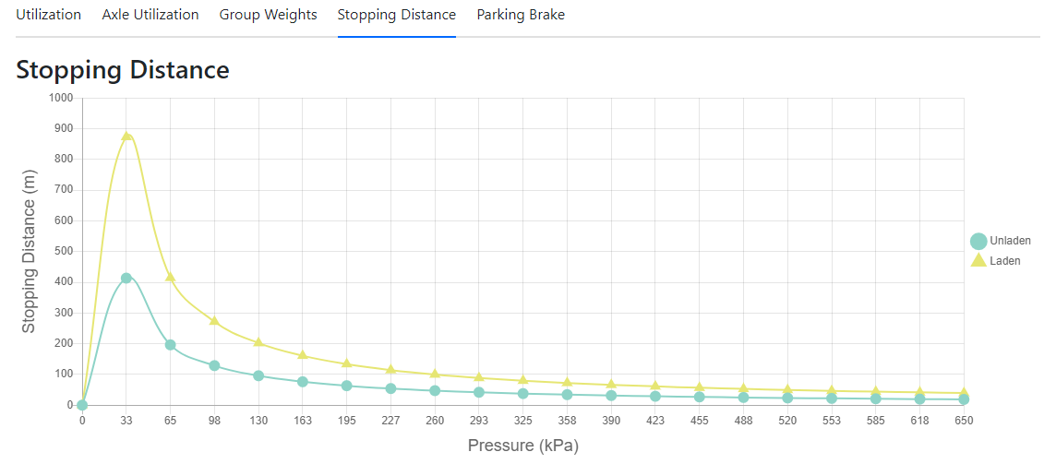
Results -
Stopping
Distance
Results

Slide 18
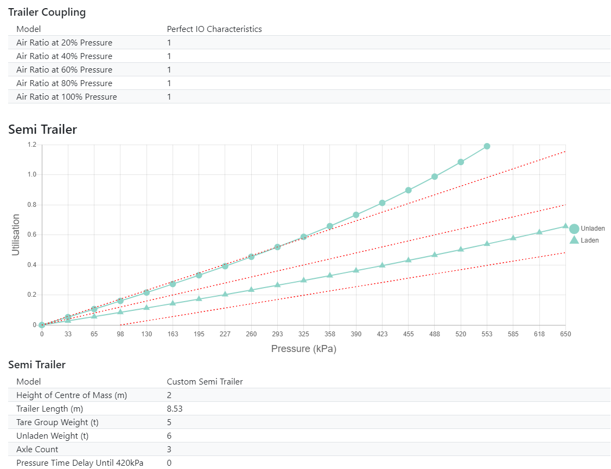
Detailed
Results
Report

Slide 19
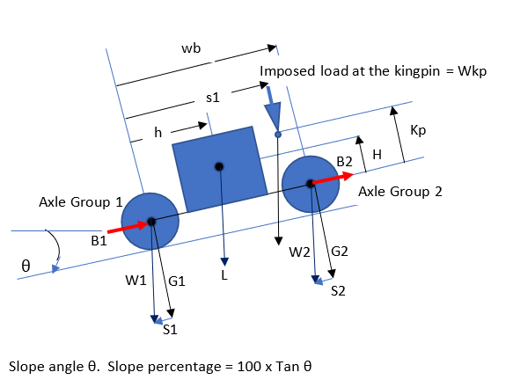
Novel Features: Vehicle Mass Distribution

Slide 20
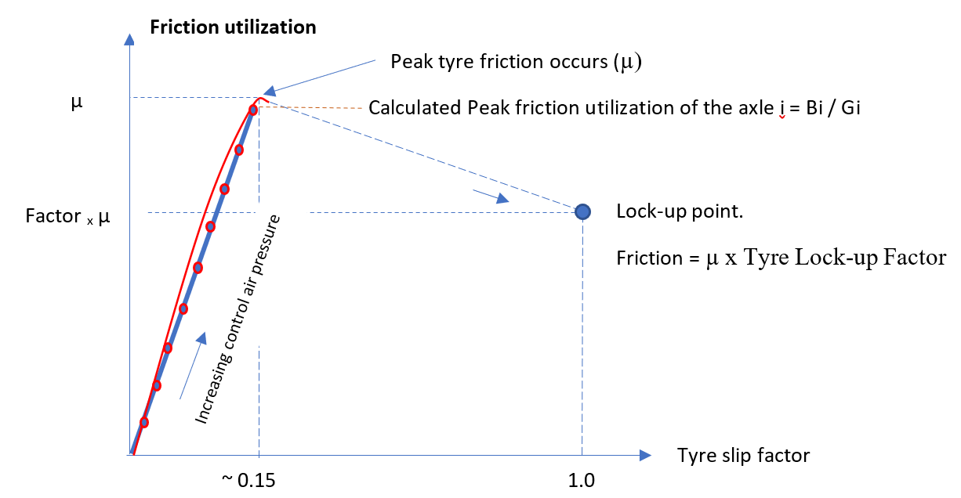
Novel Features: Wheel Lock-up Model

Slide 21
Novel Features: Axle Mass Distribution
Mass is distributed between axles in a group according to an assumed linear function based upon deceleration and the user’s specified:
“Forward Mass Transfer Ratio at 0.5g”………………..
Vehicles are modified and need to be verified.
Optimized brake designs are safer.
Type approval of Australian trailers requires detailed calculations.
Vehicle engineers can learn explore brake design options.

Slide 22
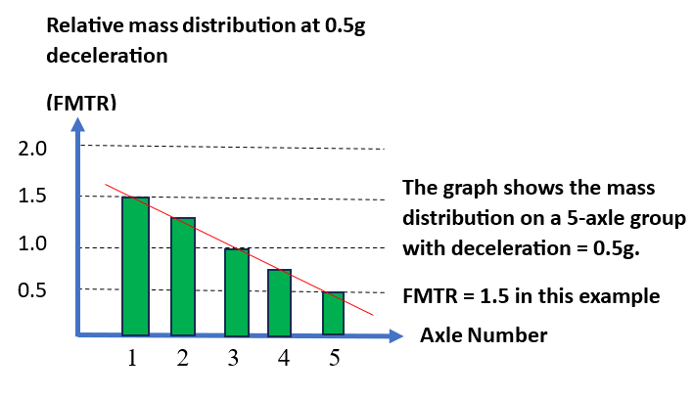
Novel Features: Axle Mass Distribution

Slide 23
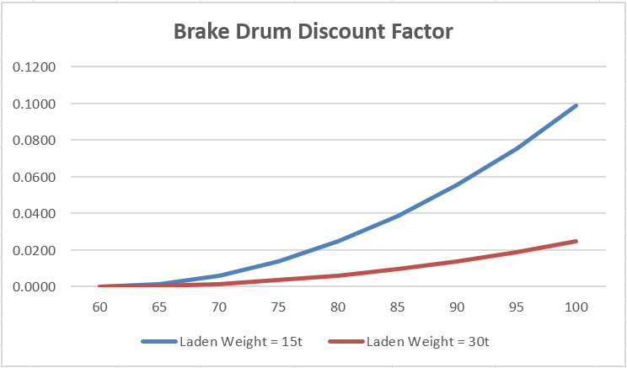
Novel Features: Drum Brake Discount
Brake drum discount depends upon initial speed and mass – i.e. initial energy.
No discount applies to a
disc brake.
Laden
Unladen
30t
15t

Slide 24
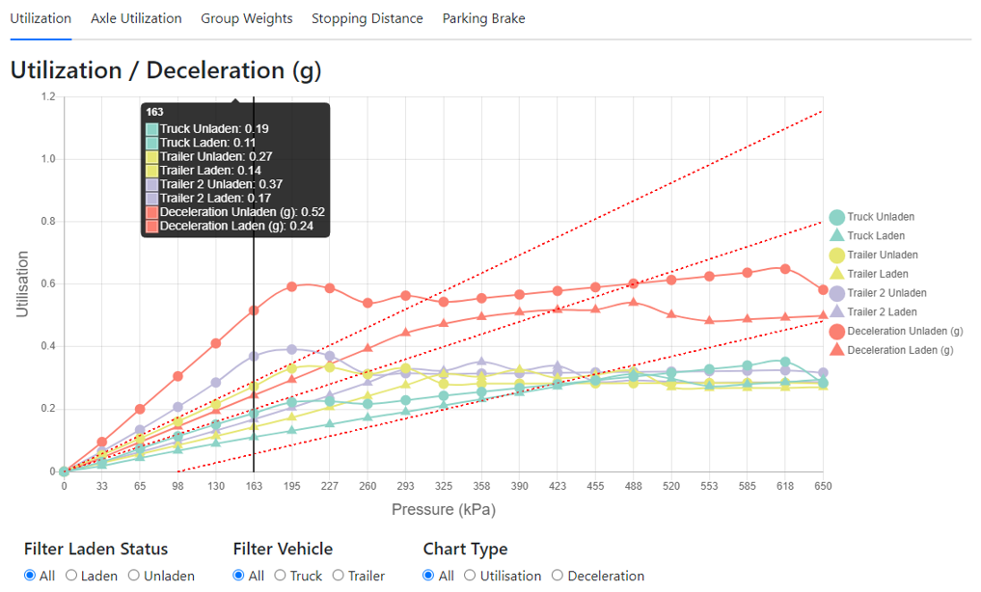
Wheel Lock-up Example - Vehicle
Peak μ = 0.75
Skid μ = 0.5

Slide 25
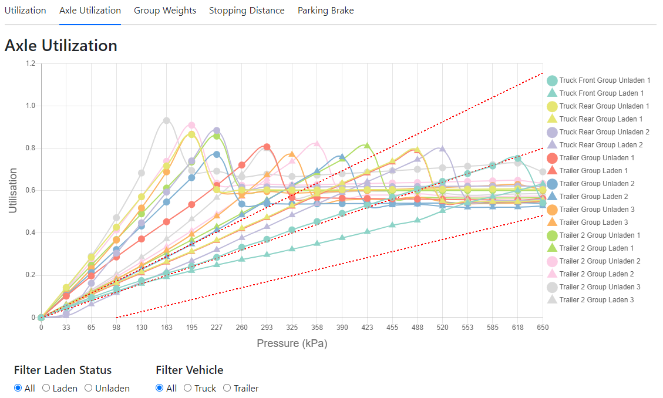
Wheel Lock-up Example - Axles
Onset of wheel lock-up, unladen

Slide 26
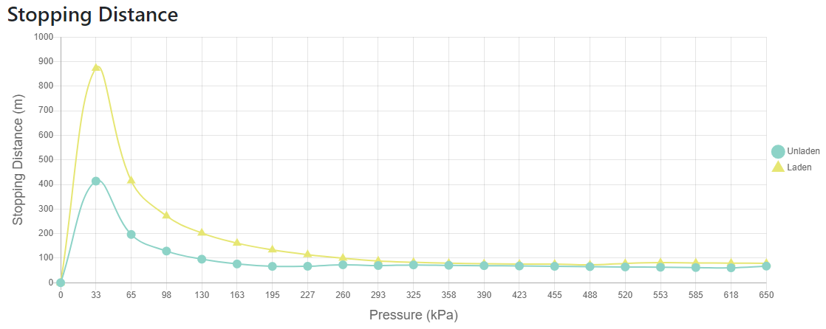
Wheel Lock-up – Stopping Distance
Onset of wheel lock-up, unladen

Slide 27
Future Plans
ARTSA-i makes the calculator available free of charge to people who have completed brake calculator (web-based) training.
The calculator is released at Beta version. A feedback button exists on the login page to make suggestions. Some further development is likely.
ARTSA-i intends to lobby regulators to have the standard of brake calculations required for acceptance of brake system designs to be improved.

Slide 28
Thank you for your attention

