Slide 1
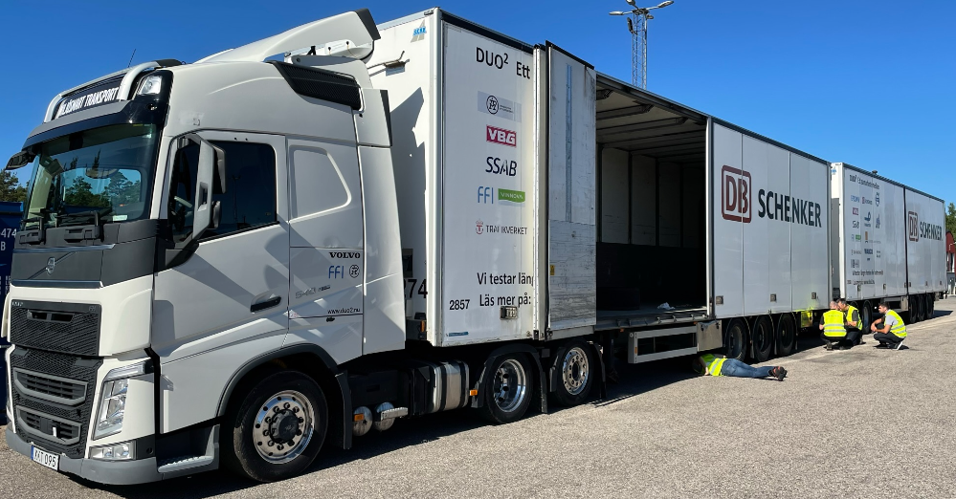
ANALYSIS OF AXLE CONFIGURATION, TIRE PRESSURE, AND TIRE TEMPERATURE ON FUEL CONSUMPTION OF HCT COMBINATIONS
Lennart Cider¹, Klara Pålsson¹, Emil Pettersson¹, Lena Larsson¹
Tobias Johansson², Stefan Johansson²,
Geert Iven³, Stefan Köppen³, Christian Repplinger³
¹ Volvo Technology, Sweden
² VBG Group Truck Equipment AB
³ Goodyear SA, Innovation Center Luxembourg
Notes:
Welcome to this presentation. My name is Lennart Cider, but off record I prefer BEER to CIDER
I will talk your through a subject that has fascinated me for more than 10 years.
I am from Sweden and have been working with Volvo for more than 25 years. I am a Chemical Engineer and started with catalytic exhaust gas aftertreatment of NOx and other harmful substances from combustion engines. However, I have worked with engines, vehicle, vehicle combinations, and currently working with the transport solution and the energy efficiency.
I am a member of a team at Volvo Technology, including Lena Larsson, Klara Pålsson and Emil Pettersson. Volvo is working together with about 30 partners in various High-Capacity Transport projects. The partnerships are co-funded by the Swedish government to improve the transport efficiency by joint efforts.
In this study we have worked together with Tobias Johansson and Stefan Johansson both at VGB. VBG is based in Sweden. They sell and develop coupling equipment for trucks with heavy trailers Worldwide.
Geert Iven, Stefan Köppen and Christian Repplinger from GoodYear based in Luxemburg are also heavily involved in this study. GoodYear sell and develop Tires Worldwide.
In this picture some of the authors and the test track can be seen. I am behind the camera.
I could summarize this presentation with these statements
1 Rolling resistance is a reality – Rolling resistance coefficient is based on standardized laboratory tests
2 Axle management will reduce your energy consumption and improve drivability
3 Tire temperature is the most important factor for rolling resistance

Slide 2
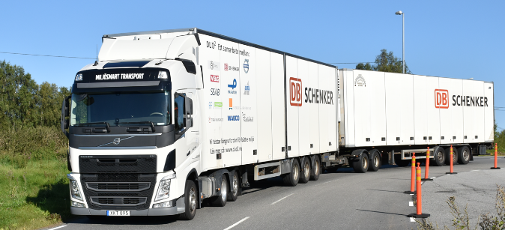
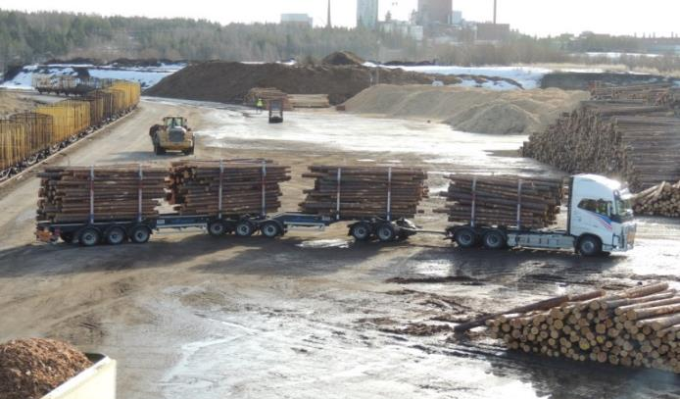
BACKGROUND
2016
HVTT14
New
Zealand
2021
China
2012
HVTT12
Sweden
2018
HVTT15
Netherlands
2
Notes:
We have been developing HCT combination in Sweden since 2007. The first demonstration started in 2009 and the work was presented at HVTT12 in Stockholm 2012. Further advancement has been presented at HVTT conferences in New Zealand, the Netherlands and China.
The driving forces behind the projects are decreased fuel consumption and CO2 emissions. We have measured reduction between 20 and 30% compared to standard combinations.
Several factors affect the fuel consumption such as aerodynamics, rolling resistance, driver behavior, road condition, and cargo size.
Rolling resistance has been shown to be larger than air resistance for many HCT applications
In this presentation we will focus on better understanding of rolling resistance.

Slide 3
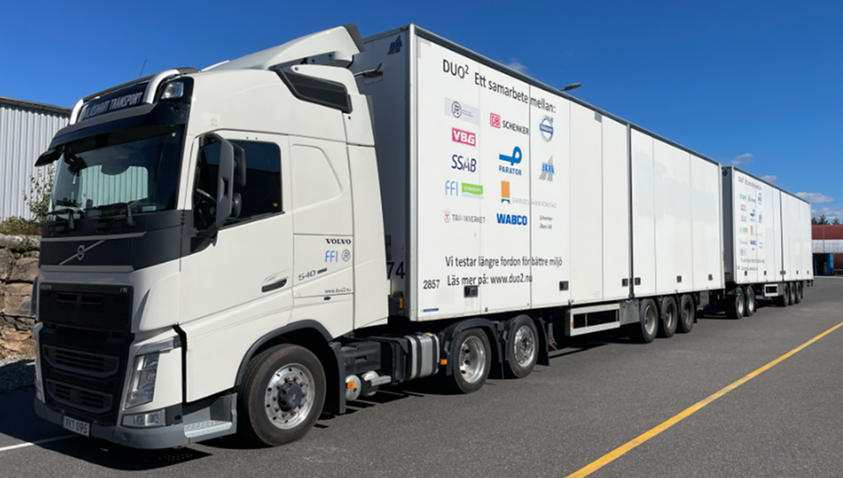
The test combination
Duo-trailer
32 meter
11 axles
5 liftable axles
43 tonnes GCW
Single-trailer
16.5 meter
6 axles (3 lifted)
23 tonnes GCW
3
Notes:
This is the test combination. It can be used both as a duo-trailer and a single trailer. The first semitrailer has a VBG coupling in the rear. A dolly is connected to the first trailer and the second semitrailer is coupled to the fifth wheel on the dolly.
All 24 tires are equipped with GOODYEAR tire sensors for both temperature and pressure.
The semitrailers are only partly loaded to allow lifting of two out of the 3 axles on each semi.
The tractor can lift the tag axle.
The Gross Combination Weight of the dolly and the second trailer is 20 tonnes.

Slide 4
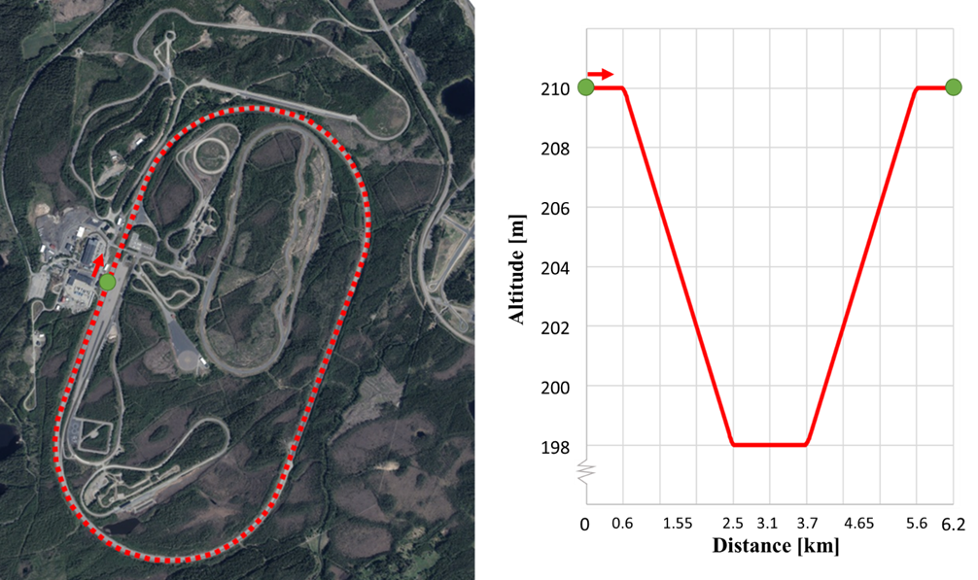
The test track
6200 m
2 * 1200 m straight
2 * 1900 m curves
80 km/h speed
4
Notes:
The test track has two completely straight sections. The two curves have slopes with a gradient of about 0.6 % or 12 m on almost 2 km distance. The first curve has a negative slope and the second has a positive slope. We will see how this influences the time resolved measurements of fuel consumption and force in the dolly drawbar.

Slide 5
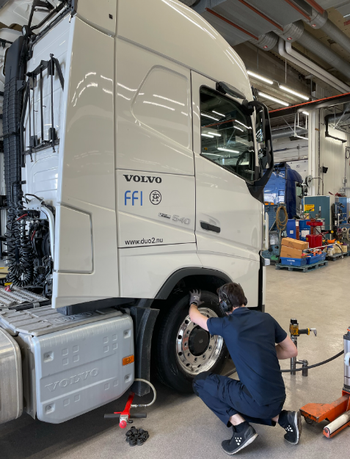
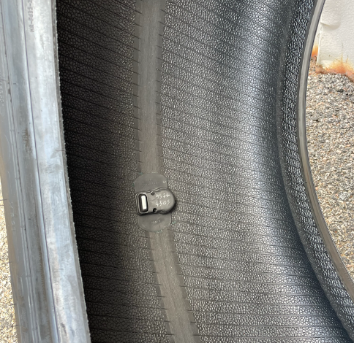
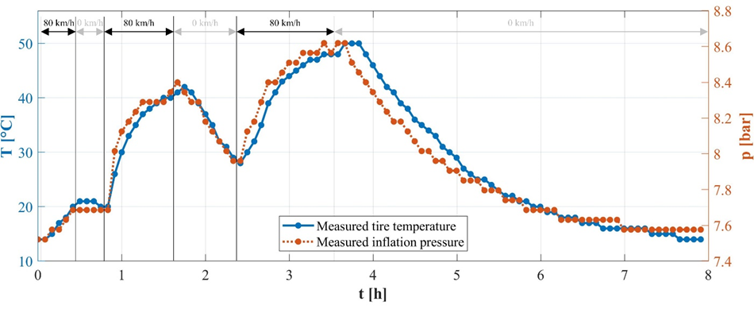
Tire sensor for Temperature & Pressure
5
Notes:
As already mentioned, all 24 tires have temperature and pressure sensors. The sensors are placed inside the tires. A readout from an 8-hour test is seen on this slide. As we can see, it takes more than one hour to reach a steady state while driving at 80 km/h. After driving, it takes more than 4 hours for the tire to cool down to ambient temperature.
Why is the tire temperature important?
Later in this presentation, I will show the effect of temperature on rolling resistance and fuel consumption.

Slide 6
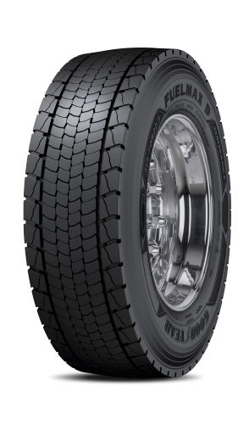
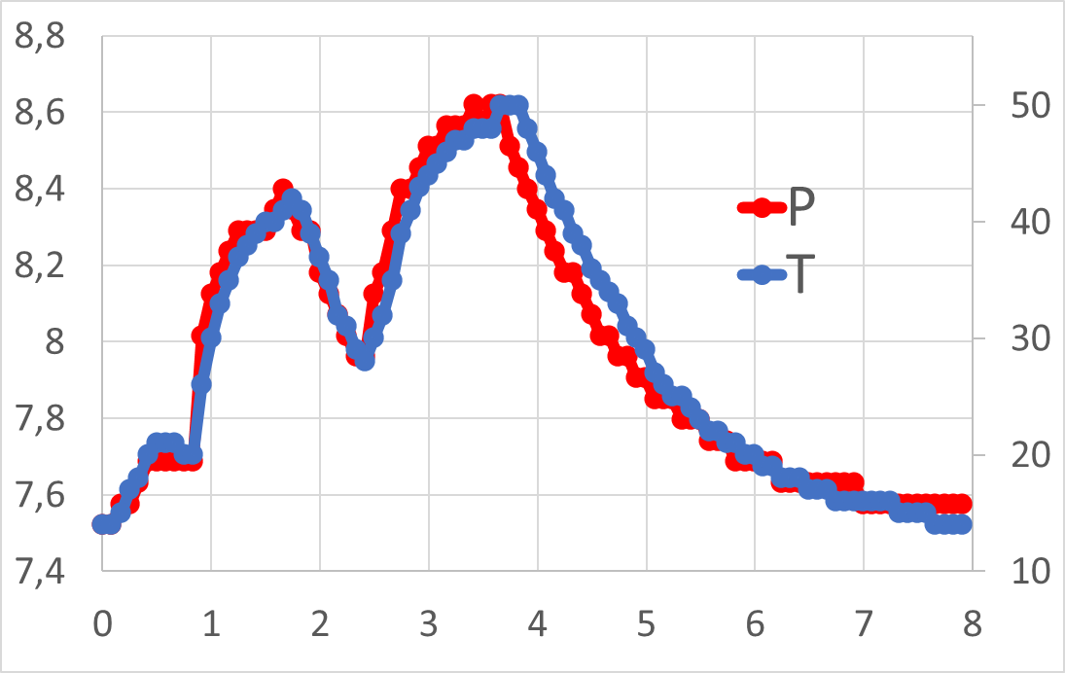
Ideal Gas Law
PV=nRT
P (bar)
T (°C)
P = tire pressure
V = enclosed tyre volume
n = number of gas molecules
R = ideal gas constant
T = tire temperature
Time (h)
6
Notes:
Since I am a Chemical engineer, I just had to check if the ideal gas law applies.
And, YES it does. Since volume, number of gas molecules and the gas constant are the same, pressure is proportional to temperature and vice versa.

Slide 7
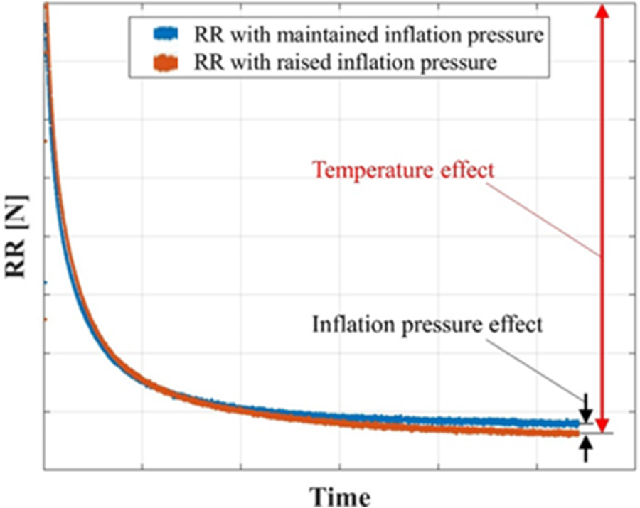
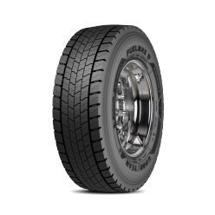
Rolling Resistance vs Temperature/Pressure
Temperature > 95%
Pressure < 5%
7
Notes:
I asked the experts at GOODYEAR if the change in rolling resistance is due to the increase in pressure or the increase in temperature.
Their answer surprised me. The effect is mainly a temperature effect rather than a pressure effect.
Their answer was based on laboratory results from rolling a truck tire on a steel drum.
The rolling resistance is reduced by 50% over a period of several hours. The pressure, temperature and load on the tire in GOODYEAR´s laboratory test is the same as for the truck and trailer test in our test track study.
With this test one could claim that the rolling resistance coefficient is not a coefficient since it is shifting over time.

Slide 8
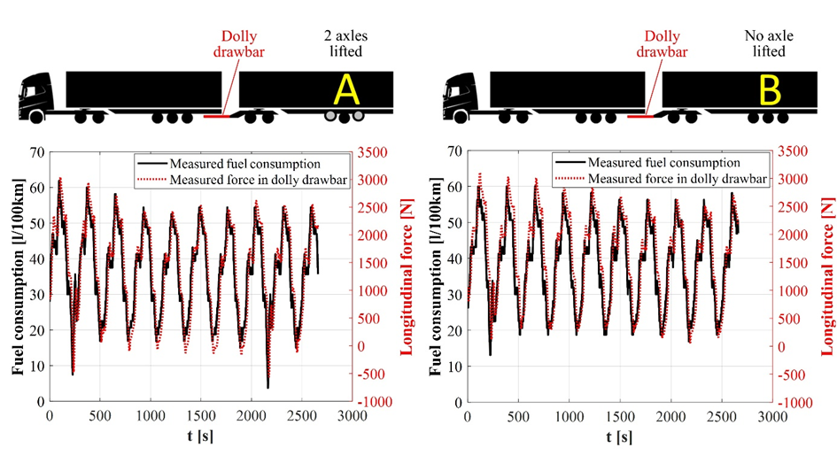
Force in the drawbar vs Fuel consumption
A | B
34.8 [l/100km] | 37.1 [l/100km]
1260 [N] | 1470 [N]
8
Notes:
The dolly is equipped with a force sensor in the drawbar eye. The registered force on the drawbar eye reflects the rolling resistance of the dolly and second trailer. Thus, a decrease in the force on the drawbar shows a decrease in rolling resistance. And a decrease in rolling resistance translates into lower total fuel consumption.
The VBG sensor registers the force in the eye of the dolly drawbar. The test is made on the 6.2 km long test track. First run is 10 laps with 2 lifted axles on the second semi than 10 laps with no lifted axles and finally 10 more laps with 2 lifted axles to confirm that the fuel consumption and force returns to the initial values.
We can see that there is a very good correlation between the fuel consumption, black line, and the force, dotted red. The fuel consumption is 6% lower for the A case with two lifted axles and the force is 14% lower than for the B case with no lifted axles. The only change in the two cases is the lifted axles.
The two tires on the second semi in case A increase from 7,5 bar to 8 bar and from 15°C to 40°C. In case B the 6 tires reach 7,7 bar and 27°C.

Slide 9
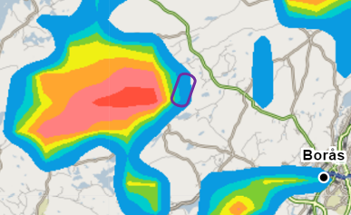
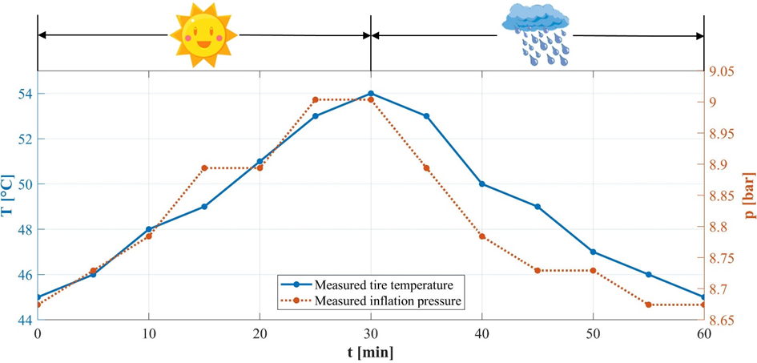
Impact of Rain – “a gift from above”
9
Notes:
One of the topics we wanted to cover was the impact of Rain on tires and fuel consumption. Borås is known to be the rainiest city in Sweden so sooner or later we expected to have heavy rain.
This day came and we were lucky to have our test combination on the test track. The picture on the left is a radar image with the test track in purple in the center.
The colors represent rain from blue moderate to red very heavy >10 mm/h. The change in tire pressure and temperature are significant.

Slide 10
Impact of Rain + 25% on Fuel Consumption
10
Notes:
The impact on the fuel consumption is very big for the two tested combinations. In this test case rainwater was standing about 3 cm high on the road. So, the large effect can be assigned to both pushing water aside and decreased temperature and pressure in the tires.

Slide 11
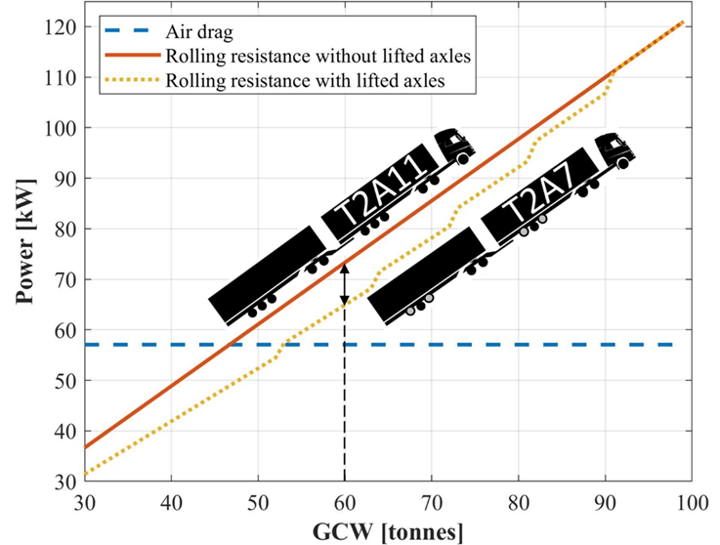
Power usage vs GCW & lifted axles
Higher impact for Duo-trailer
Partly loaded in weight
Lifting 4 axles at GCW 60 tonnes
Decrease in Power usage 9 kW
11
Notes:
The last part of this presentation is a Power usage comparison for single and duo-trailers. The unloaded combination has a weight of 30 tonnes. An average load is 15 tonnes per trailer which corresponds to 60 tonnes GCW. At a GCW of 60 tonnes it is possible to lift 4 axles without exceeding present Swedish legislation.
The decrease in rolling resistance is around 9 kW. Dependent on the GCW the number of axles that can be lifted differs and so does potential for decrease in power demand.

Slide 12
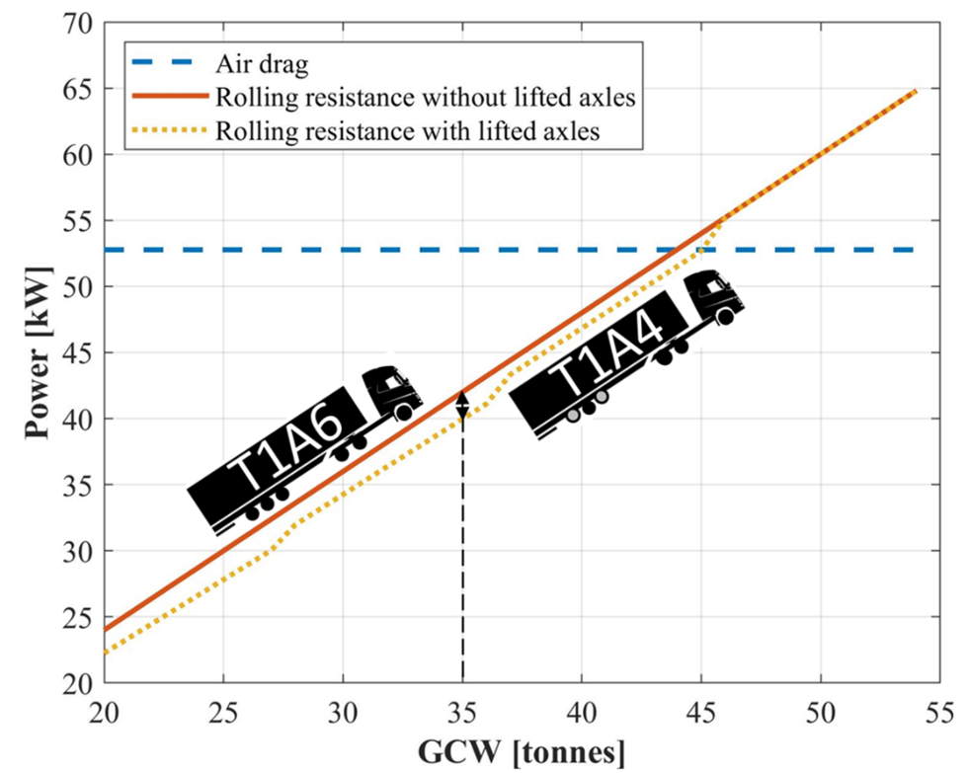
Power usage vs GCW & lifted axles
Lower impact for Single-trailer
Partly loaded in weight
Lifting 2 axles at GCW 60 tonnes
12
Notes:
For the single trailer case the air drag is higher than the rolling resistance, Hence, the potential for axle lifting is less than for a duo-trailer.

Slide 13
Conclusions
Rain can increase fuel consumption by 25%
Force measurement in the coupling positions is positive for complete vehicle control
T
>> p
Temperature is important for Rolling Resistance
Lifting of axles is beneficial for handling and power need
13
Notes:
Axle management is beneficial – Fuel Consumption & Handling
Lifting of axles will decrease the rolling resistance
Increased tire temperature is the main source for reduced rolling resistance in our study
Take handling of the vehicle combination into consideration when deciding which axles to lift. The five colored tires represents 5 different possible lifting positions.
The impact on power need using lifted axles is larger for longer combination than for shorter combinations.
Rain can increase fuel consumption by 25%
Force measurement in the coupling positions is beneficial for complete vehicle control.

