Slide 1
Testing of Next Generation Wide Base Tyres – Pavement impacts
→
Anthony Germanchev
Les Bruzsa
Chris Loose

Slide 2
Project team
Funding and technical guidance: NHVR – HVSI Grant
Project lead by: Truck Industry Council
Supported by suppliers: Michelin and Goodyear.
Pavement testing: Australian Road Research Board
Author/s:
A.Germanchev, L.Bruzsa, C.Loose.

Slide 3
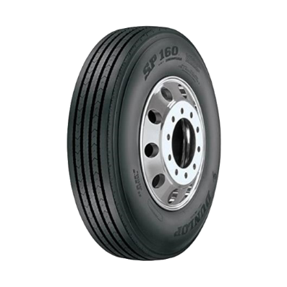
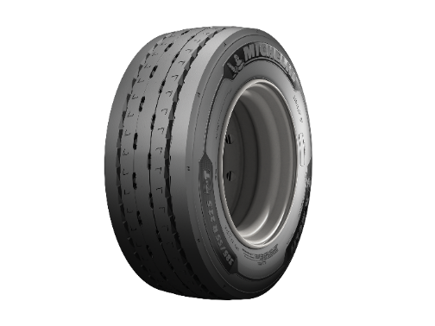
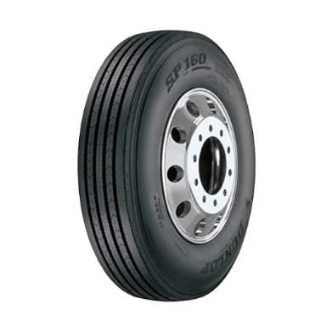
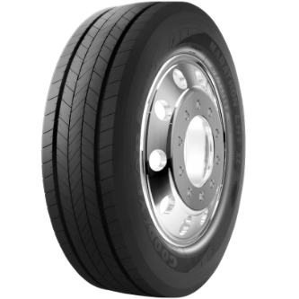
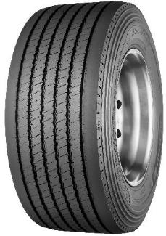
Motivation
Improving safety with increased uptake of
next generation ultra base wide single tyres
Michelin 445/50R22.5
Michelin 385/55R22.5
Goodyear 11R22.5
Dunlop 255/70R22.5
Author/s:
A.Germanchev, L.Bruzsa, C.Loose.

Slide 4
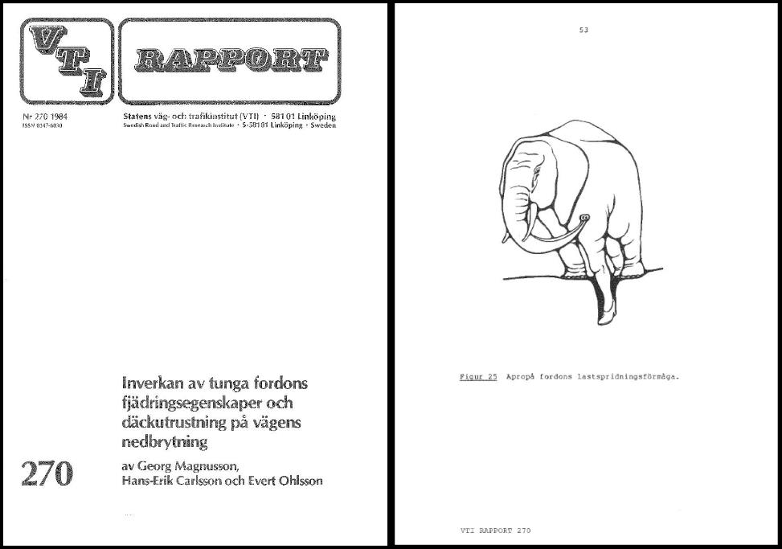
Like an elephant in high heels
Figure 25 Vehicle spreading the load
Author/s:
A.Germanchev, L.Bruzsa, C.Loose.

Slide 5
Program of work
Contact area and pressure distribution
Pavement construction
Trafficking of pavement
Analysis & results
Author/s:
A.Germanchev, L.Bruzsa, C.Loose.

Slide 6
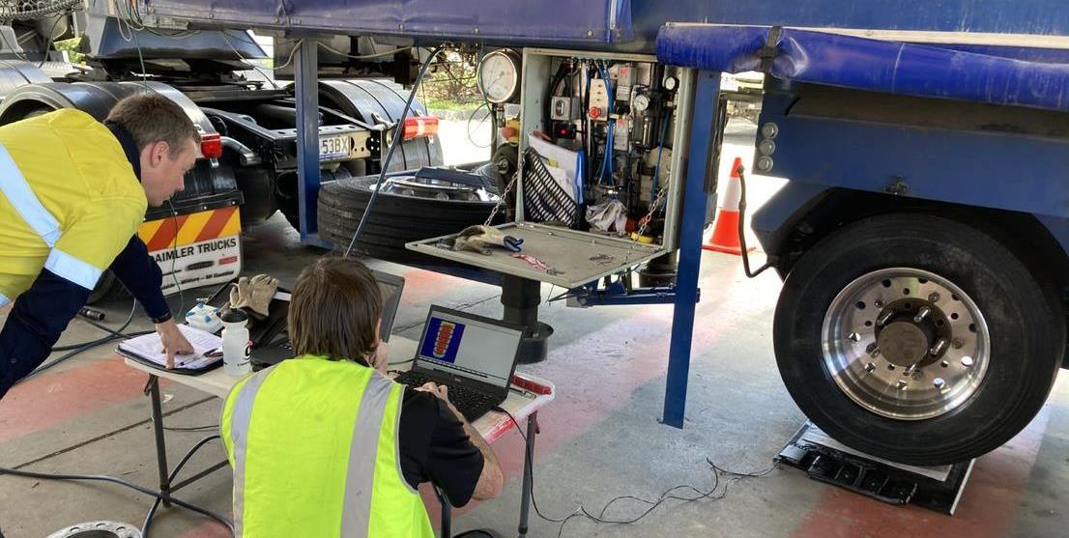
Contact area and pressure distribution
Author/s:
A.Germanchev, L.Bruzsa, C.Loose.

Slide 7
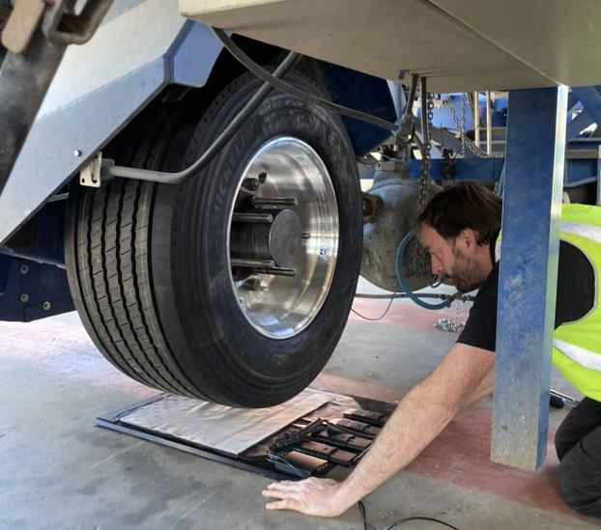
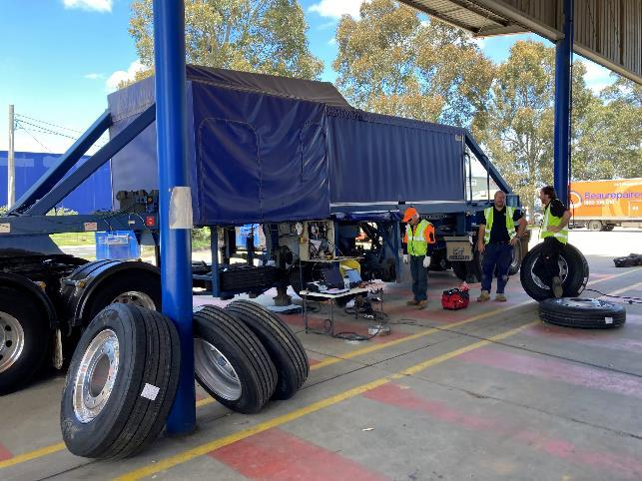
Contact area and pressure distribution
Author/s:
A.Germanchev, L.Bruzsa, C.Loose.

Slide 8
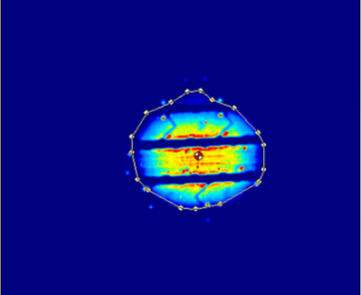
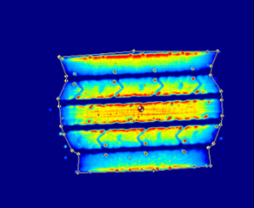
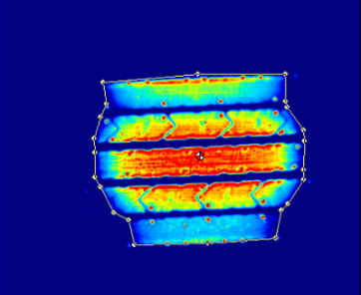
11R22.5 – Comparison of inflation pressure and loads
 | Unladen 500kPa @ 1000 kgs | Laden 500kPa @ 1,875 kgs | Laden and Over Inflated 690kPa @ 1,875 kgs
Total Area | 252 cm² | 871 cm² | 762 cm²
Average Pressure | 98 psi | 101 psi | 112 psi
Percentage Area | 34.7% | 100% | 83.5%
Author/s:
A.Germanchev, L.Bruzsa, C.Loose.

Slide 9
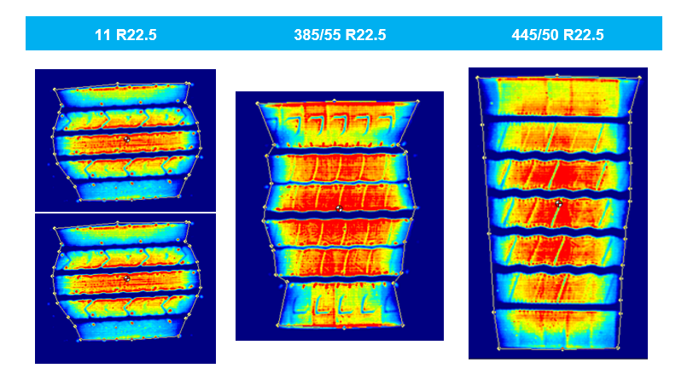
Pressure distribution comparison
Centrally concentrated hotspot
hotspot – wider centre and edges
wider hotspot over a wider area
Author/s:
A.Germanchev, L.Bruzsa, C.Loose.

Slide 10
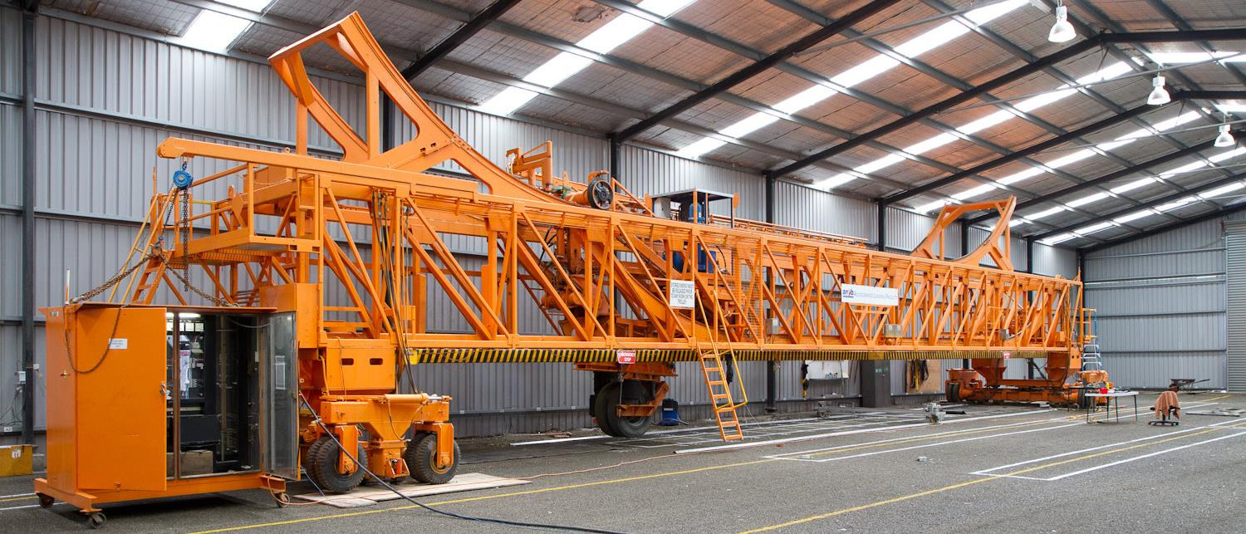
Accelerated Load Facility (ALF)
Author/s:
A.Germanchev, L.Bruzsa, C.Loose.

Slide 11
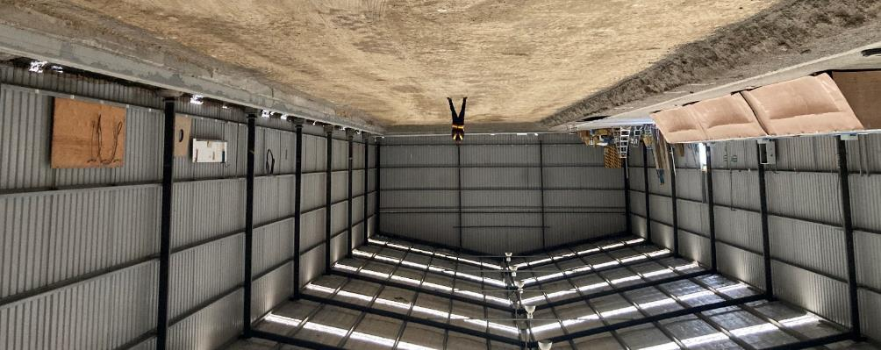
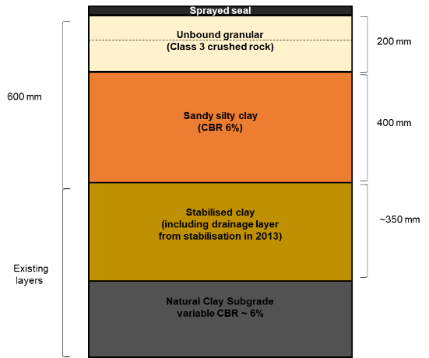
Pavement construction
Author/s:
A.Germanchev, L.Bruzsa, C.Loose.

Slide 12
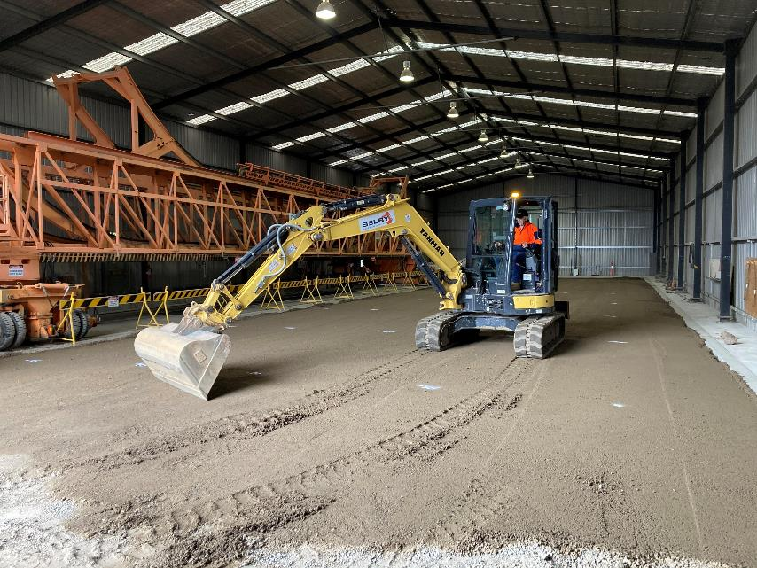
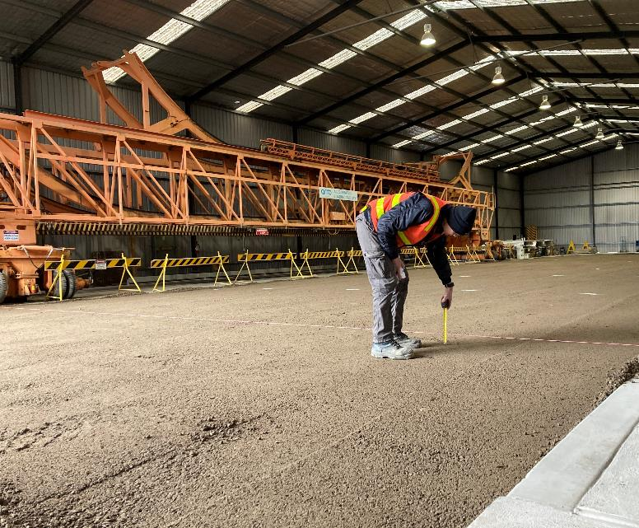
Pavement construction
Author/s:
A.Germanchev, L.Bruzsa, C.Loose.

Slide 13
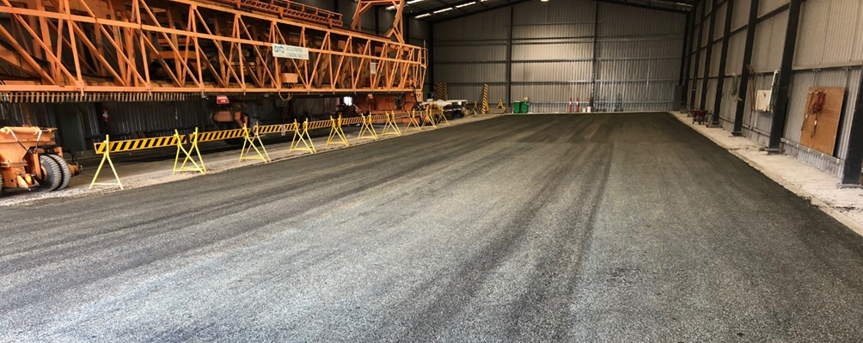
Pavement construction
Author/s:
A.Germanchev, L.Bruzsa, C.Loose.

Slide 14
Test program
Test no. | Name | Load | Tyre size | Tyre type | Inner pressure | Outer pressure | Cycles | Start | End
1 | Most damaging | 40 kN | 255/70R22.5 | DUAL | 675 kPa (98 psi) | 675 kPa (98 psi) | 75,000 | 10/11/2021 | 30/11/2021
2 | Most common | 40 kN | 11R22.5 | DUAL | 525 kPa (76 psi) | 525 kPa (76 psi) | 52,500 | 2/12/2021 | 14/12/2021
3 | Most common - uneven | 40 kN | 11R22.5 | DUAL | 525 kPa (76 psi) | 682.5 kPa (99 psi) | 52,500 | 12/01/2022 | 25/01/2022
4 | Most common - over inflated | 40 kN | 11R22.5 | DUAL | 682.5 kPa (99 psi) | 682.5 kPa (99 psi) | 67,500 | 31/01/2022 | 18/02/2022
5 | Ultra-wide | 40 kN | 445/50R22.5 | SINGLE | 700 kPa (102 psi) | NA | 60,000 | 28/02/2022 | 03/15/2022
6 | Ultra-wide - under inflated | 40 kN | 445/50R22.5 | SINGLE | 560 kPa (81 psi) | NA | 60,000 | 22/03/2022 | 04/04/2022
7 | Ultra-wide - over inflated | 40 kN | 445/50R22.5 | SINGLE | 840 kPa (122 psi) | NA | 60,000 | 08/04/2022 | 22/04/2022
8 | Super single - max pressure | 40 kN | 385/55R22.5 | SINGLE | 900 kPa (131 psi) | NA | 60,000 | 03/05/2022 | 13/05/2022
9 | Super single -recommended | 40 kN | 385/55R22.5 | SINGLE | 790 kPa (115 psi) | NA | 67,500 | 19/05/2022 | 02/06/2022
10* | Ultra-wide | 40 kN | 445/50R22.5 | SINGLE | 700 kPa (102 psi) | NA | 60,000 | 13/05/2023 | 20/5/2023
Author/s:
A.Germanchev, L.Bruzsa, C.Loose.

Slide 15
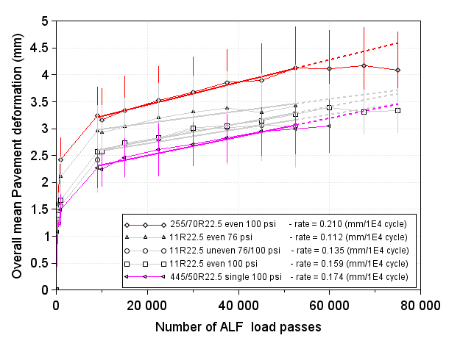
Results – deformation rate
Preliminary data analysis
Author/s:
A.Germanchev, L.Bruzsa, C.Loose.

Slide 16
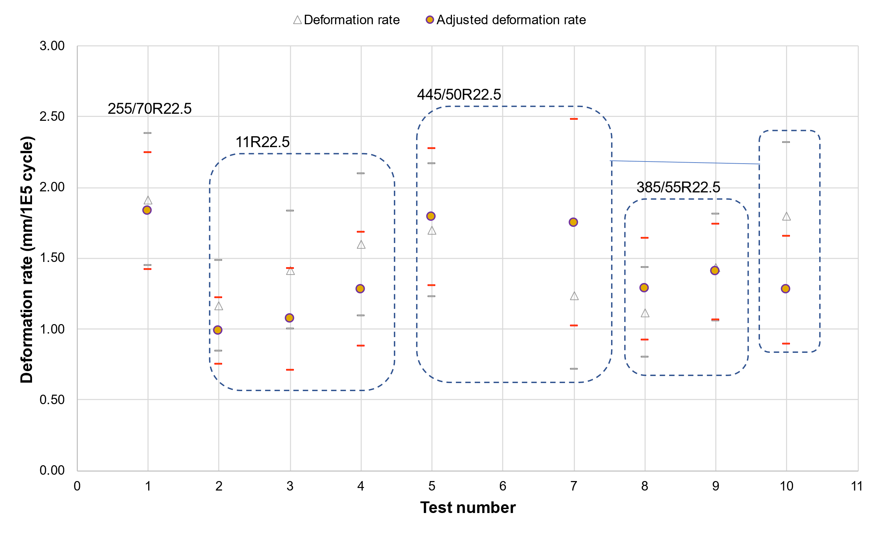
Adjusted deformation rate

Slide 17
Adjusted deformation rate calculation
Deformation rate between 9000 and 52,500 cycles
Adjusted deformation rate
Adjusted Structural Number (SNP) – normalised to 700 kPa surface stress at 9000 cycles
$$SNP = SN + {SN}_{sg}$$
$$SN=12.992−4.167×\log_{10}\left(D_{0}\right)+0.936×\log_{10}\left(D_{900}\right)$$
$${SN}_{sg}=3.51×\log_{10}\left(CBR\right)−0.85×{\left(\log_{10}\left(CBR\right)\right) }^{2}−1.43$$
$$CBR= {10}^{3.264−1.018 ×\log_{10}\left(D_{900}\right)}$$
Adjusted deformation rate
Use relationship between 20mm Montrose crushed rock (AP-T73-06)
approx. SNP₀ = 4.7
$a$ = -3.5
$$ΔRut\left(SNP_{0}\right)= {\left(\frac{SNP_{0}}{SNP_{i}}\right)}^{a}×ΔRut(SNP_{i})$$
Author/s:
A.Germanchev, L.Bruzsa, C.Loose.

Slide 18
Results - deformation
Test no. | Name | Tyre size | Tyre type | Total Deformation (mm) | Deformation rate (mm/cycle) x 10⁻⁵ | Adjusted Deformation rate (mm/cycle) x 10⁻⁵
1 | Most damaging | 255/70R22.5 | DUAL | 4.13 | 1.91 | 1.83
2 | Most common | 11R22.5 | DUAL | 3.43 | 1.17 | 0.99
3 | Most common - uneven | 11R22.5 | DUAL | 3.04 | 1.42 | 1.07
4 | Most common - over inflated | 11R22.5 | DUAL | 3.27 | 1.60 | 1.28
5 | Ultra-wide | 445/50R22.5 | SINGLE | 2.95 | 1.70 | 1.79
6 | Ultra-wide - under inflated | 445/50R22.5 | SINGLE | 3.20* | 2.17* | 3.22*
7 | Ultra-wide - over inflated | 445/50R22.5 | SINGLE | 2.37 | 1.24 | 1.75
8 | Super single - max pressure | 385/55R22.5 | SINGLE | 1.86 | 1.12 | 1.28
9 | Super single -recommended | 385/55R22.5 | SINGLE | 2.82 | 1.44 | 1.40
10 | Test 5 - repeated | 445/50R22.5 | SINGLE | 3.34 | 1.80 | 1.27
*test pavement moisture content exceeded acceptable range
Author/s:
A.Germanchev, L.Bruzsa, C.Loose.

Slide 19
Results - deformation
Test no. | Name | Tyre size | Tyre type | Total Deformation (mm) | Deformation rate (mm/cycle) x 10⁻⁵ | Adjusted Deformation rate (mm/cycle) x 10⁻⁵
1 | Most damaging | 255/70R22.5 | DUAL | 4.13 | 1.91 | 1.83
2 | Most common | 11R22.5 | DUAL | 3.43 | 1.17 | 0.99
3
4
5 | Ultra-wide | 445/50R22.5 | SINGLE | 2.95 | 1.70 | 1.79
6
7
8
9 | Super single -recommended | 385/55R22.5 | SINGLE | 2.82 | 1.44 | 1.40
10 | Test 5 - repeated | 445/50R22.5 | SINGLE | 3.34 | 1.80 | 1.27
*test pavement moisture content exceeded acceptable range
Author/s:
A.Germanchev, L.Bruzsa, C.Loose.

Slide 20
Conclusions - deformation
Deformation rates for both the dual tyres and single tyres were within a similar range (within the variability of the experiment).
The deformation rate of the 255/70R22.5 dual tyres was the highest.
Based on these results, tyre size (section width) alone did not correlate with deformation rate, with other contributing factors including contact patch area, shape and pressure distribution.
Author/s:
A.Germanchev, L.Bruzsa, C.Loose.

Slide 21
Conclusions - deformation
Based on the deformation rates, inflation pressure was found to have a significant effect on wear for the dual 11R22.5 tyres, but not for wide single tyres.
The differences were marginal When comparing the results representative of common practice:
11R22.5 dual tyres at 100 psi (689 kPa) → 0.0000128 mm/cycle
445/50R22.5 tyres at 102 psi (703 kPa) → 0.0000127 mm/cycle
385/55R22.5 tyres at 115 psi (792 kPa) → 0.0000140 mm/cycle
Author/s:
A.Germanchev, L.Bruzsa, C.Loose.

Slide 22
Conclusions – inflation pressure
The tests designed to quantify the effects of tyre inflation pressure for wide single tyres produced some counter-intuitive results.
The results were not statistically significant and could not be attributed to the characteristics of the tyre.
This implies that wide single tyres can operate at a wider range of inflation pressures, with no discernible difference in pavement wear.
This finding was consistent with the pressure distribution tests which showed less variation in contact patch area (maintained a regular rectangular contact area) and less high-pressure locations (hot spots) when compared with dual tyres.
Author/s:
A.Germanchev, L.Bruzsa, C.Loose.

Slide 23
Conclusions – pavement wear
Pavement construction and measurement tolerance had a greater impact on pavement wear (approximately 0.000012 mm/cycle) than the tyres themselves.
The adjustments (in deformation rate, due to environmental factors) were of a similar magnitude to the differences between the tyres and in practice, these would have a greater influence on field performance.
The results suggest that the wider adoption of wide single tyres with a section width between 385 and 445 mm – at the same loads as currently allowed on dual 11R22.5 tyre sets – would not necessarily cause a discernible increase in road pavement wear.
Author/s:
A.Germanchev, L.Bruzsa, C.Loose.

Slide 24
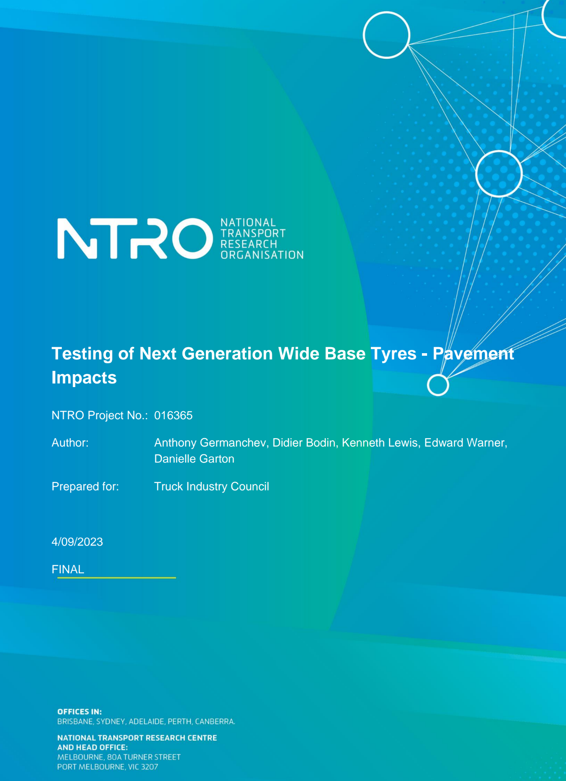
Next steps
Published report available from TIC
Project summary will soon be available via the NHVR’s HVSI website
TIC/NHVR press release
Thank you for your attention
Author/s:
A.Germanchev, L.Bruzsa, C.Loose.

