Slide 1
Brazilian Guide For Performance Monitoring of HS-WIM System
Keyla. J. C. Shinohara
Gustavo. G. Otto
Emmanuelle. S. H. Garcia
Adosindro J. Almeida
Valter Z. Tani
Wellington L. Repette

Slide 2
Brazilian Guide For Performance Monitoring of HS-WIM System
Motivation for a specific pavement for the HS-WIM system with structures with greater resistance and durability and eccentricities of the Brazilian situation → development of THE BRAZILIAN GUIDE FOR PERFORMANCE MONITORING OF HS-WIM SYSTEMS.
Author/s:
Keyla J.C.Shinohara, Gustavo G.Otto, Emmanuelle S.H.Garcia, Adosindro J.Almeida, Valter Z.Tani,, Wellington L.Repette

Slide 3
Brazilian Guide For Performance Monitoring of HS-WIM System
1 - Introduction
2 - HS-WIM
3 - Development of the Brazilian Guide
4 - Final Considerations
Author/s:
Keyla J.C.Shinohara, Gustavo G.Otto, Emmanuelle S.H.Garcia, Adosindro J.Almeida, Valter Z.Tani,, Wellington L.Repette

Slide 4
Brazilian Guide For Performance Monitoring of HS-WIM System
Introduction
WIM → preservation of infrastructure, reduction of maintenance costs, fair competition between transporters and reducing the risk of accidents.
WIM technology → monitoring and inspection tool.
Brazil → empirical method of pavement design (since 1970).
HS-WIM systems implementation in sections of conventional highways in Brazil → the structure is incompatible with the extreme demands of traffic.
Author/s:
Keyla J.C.Shinohara, Gustavo G.Otto, Emmanuelle S.H.Garcia, Adosindro J.Almeida, Valter Z.Tani,, Wellington L.Repette
Notes:
The importance of weighing vehicles on highways is due to the preservation of infrastructure (because Overloading of the road system and early damage the pavement), the reduction of maintenance costs, fair competition between transporters, in addition to reducing the risk of accidents on the highway.
The WIM technology has evolved as an important monitoring and inspection tool, in addition to automatically identifying and classifying, at the guideline speed of the road.
..used for many years in the country, since 1970.
Thus, the fragility of the structures is evidenced by the implementation of HS-WIM systems in sections of conventional highways.

Slide 5
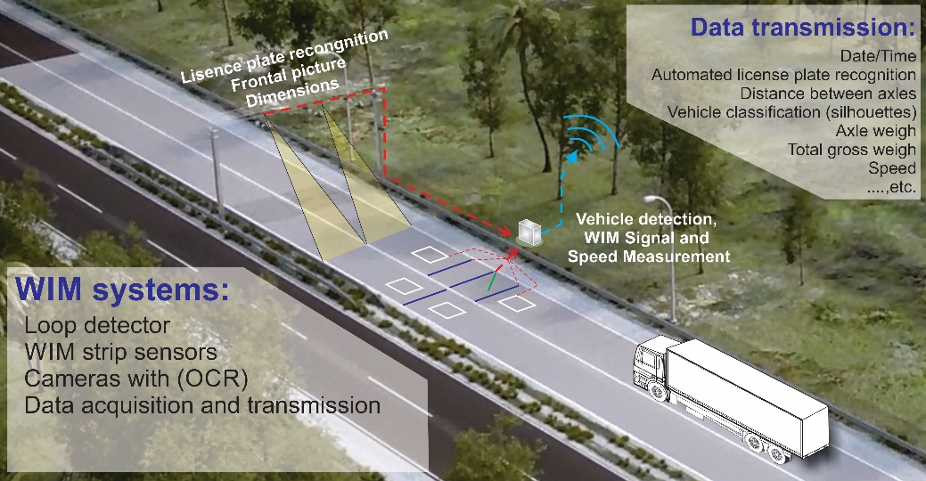
Brazilian Guide For Performance Monitoring of HS-WIM System
2. HS-WIM
Monitors all traffic passing through the instrumented area.
Without the need for stoppages.
Pre-selection.
Enabling the automation of the process
of collecting weights.
Legal limits verification.
Guidance for drivers
(to go to the inspection area).
Author/s:
Keyla J.C.Shinohara, Gustavo G.Otto, Emmanuelle S.H.Garcia, Adosindro J.Almeida, Valter Z.Tani,, Wellington L.Repette
Notes:
- HS-WIM monitors all traffic passing through the instrumented area, without the need for stoppages in the flow of vehicles on the lanes.
- This system allows for the pre-selection of potential offending vehicles, enabling the automation of the process of collecting weights, for the verification of legal limits, and guidance for drivers to go to the inspection area.
.... together with cameras, scanners, inductive loops, among others, which allow the collection of various information from each vehicle that passes over the weighing area

Slide 6
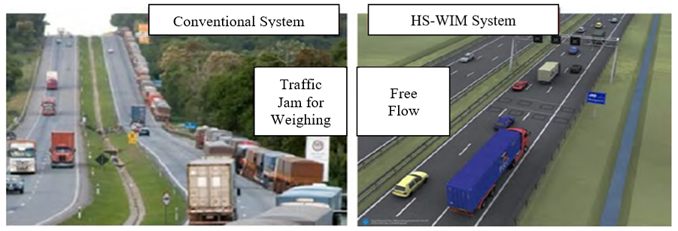
Brazilian Guide For Performance Monitoring of HS-WIM System
conventional weighing and the WIM system comparison
Author/s:
Keyla J.C.Shinohara, Gustavo G.Otto, Emmanuelle S.H.Garcia, Adosindro J.Almeida, Valter Z.Tani,, Wellington L.Repette
Notes:
Eliminating the obligation to stop vehicles reflects positively on the level of service on the highway and on the efficiency of overload control, as shown by the comparison between the conventional weighing method and the WIM system. If the vehicle is not overloaded, it will pass the pre-selection at the road's guideline speed without having to face a traffic jam at the entrances to the inspection station and will be able to continue their journey.

Slide 7
Brazilian Guide For Performance Monitoring of HS-WIM System
Evolution of HS-WIM
Systems in Brazil
Author/s:
Keyla J.C.Shinohara, Gustavo G.Otto, Emmanuelle S.H.Garcia, Adosindro J.Almeida, Valter Z.Tani,, Wellington L.Repette
Notes:
- In the 90s, the first WIM standard (ASTM-1318) was published, and the COST323 action provided European specifications of WIM.
- In 1995 1st ICWIM in Zurich.. and countries began to implement the technologies presented there, as a way to spread WIM worldwide and modernize the process.
- In Brazil, the first cooperation term was signed in 2007 between the Transport and Logistics Laboratory (LabTrans) of the Federal University of Santa Catarina (UFSC) and the National Department of Transport Infrastructure (DNIT).
- In the same year, Brazil took another important step towards the automation of the weighing system, with the creation of the National Weighing Plan, which included in its studies the implementation of 148 fixed weighing stations and 72 stations operating mobile equipment.
- ..in 2011 the 2nd International Seminar on WIM (RSWIM2) was held in the Florianopolis city.
- in 2015, specific pavements were designed and built in this same area for the use and installation of the WIM system, concrete and asphalt pavement.
- Brazil hosted the 7th International Conference on WIM, in Foz do Iguaçu, in 2016.
- In 2021, the project for the implementation of mixed weighing stations with operation and inspection of operational mobile units equipped with the WIM system began.
- The next steps of technological innovation in Brazil with respect to the WIM system are due to the application of direct inspection of the weight of vehicles, that is, without a human agent.

Slide 8
Brazilian Guide For Performance Monitoring of HS-WIM System
HS-WIM
Evolution of HS-WIM Systems in Brazil
The National Institute of Metrology, Quality and Technology (INMETRO) → Ordinance nº19 → GVW, loads per axle and per set of axles.
Test (quartz sensors) → general classification of 2B:
- 3.50% for GVW
- 6.00% for axles and groups of axles
→ Class A(5) of COST 323 (2002).
Author/s:
Keyla J.C.Shinohara, Gustavo G.Otto, Emmanuelle S.H.Garcia, Adosindro J.Almeida, Valter Z.Tani,, Wellington L.Repette
Notes:
- Based on these advances, Brazil began to technically regulate the accuracy class of automatic instruments for road vehicles in motion. The INMETRO published the Ordinance nº 19 of applies to the instruments that are used to determine the GVW, loads per axle and per set of axles of road vehicles in motion when used in vehicle inspection.
- An example of the application of INMETRO Ordinance nº 19 on a WIM road, using quartz sensors, was carried out by the company Fiscaltech, which resulted in a general classification of 2B, that is, 3.50% for GVW and 6.00% for axles and groups of axles.
- Considering the accuracy levels of class 2B, the equipment can be related to class A(5) of COST 323 (2002), indicated for weight inspection. Thus, Brazil takes a big step related to WIM to improve techniques and technological advances.

Slide 9
Brazilian Guide For Performance Monitoring of HS-WIM System
Development of the Brazilian Guide
Purpose → focus on Brazilian eccentricities.
World guides and references in the HS-WIM system → regulations, recommendations, standards and indicatives.
Based on “The Guide for Users of WIM – ISWIM” → specification, purchase, installation, testing, operation and maintenance and data generated.
Author/s:
Keyla J.C.Shinohara, Gustavo G.Otto, Emmanuelle S.H.Garcia, Adosindro J.Almeida, Valter Z.Tani,, Wellington L.Repette
Notes:
- Great world guides and references in the HS-WIM system were used, however, the purpose of the guide is to present and focus on Brazilian eccentricities so that technologies are implemented in the country.
- For the development of the Brazilian Guide for HS-WIM systems, an advanced research was initially carried out in the technologies already present worldwide. Regulations, recommendations, standards and indicatives were consulted.
- The Guide for Users of WIM - ISWIM, was one of the materials consulted as it presents information on the different aspects related to the use of WIM systems, specification, purchase, installation, testing, operation and maintenance and data generated. The guide uses simplified language on all aspects, and also provides references for further insight into the subject.

Slide 10
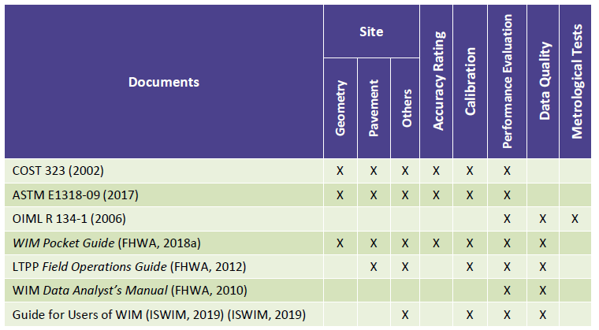
Brazilian Guide For Performance Monitoring of HS-WIM System
Recommendations
used as
a reference
Author/s:
Keyla J.C.Shinohara, Gustavo G.Otto, Emmanuelle S.H.Garcia, Adosindro J.Almeida, Valter Z.Tani,, Wellington L.Repette
Notes:
Brazilian Guide for Performance Monitoring of HS-WIM Systems comes from the installations at weighing sites in Brazil and the results of international research (COST 323 (2002), ASTM E1318-09 (2017), OIML R 134-1 (2006), FHWA (2018), LTPP (FHWA, 2012), WIM Data Analyst's Manual (FHWA, 2010) and, mainly, the Guide for Users of WIM (ISWIM, 2019)).

Slide 11
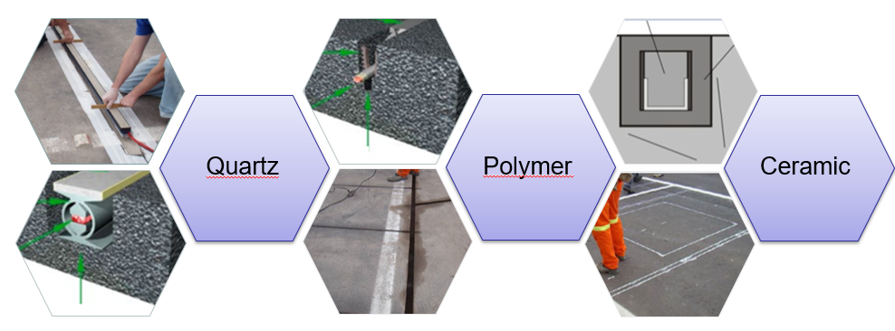
Brazilian Guide For Performance Monitoring of HS-WIM System
Author/s:
Keyla J.C.Shinohara, Gustavo G.Otto, Emmanuelle S.H.Garcia, Adosindro J.Almeida, Valter Z.Tani,, Wellington L.Repette
Notes:
during the development of the Brazilian Guide, several types of sensors were evaluated, as a way to compose the HS-WIM system. However, the focus was on those that are usually traded and have a lower financial impact. The idea at this time was that the guide represented the instrumentations already carried out in Brazil and that these could be associated with the HS-WIM systems. Thus, sensor technology consists of piezoelectric sensors (quartz, polymers, ceramics).

Slide 12
Brazilian Guide For Performance Monitoring of HS-WIM System
Development of the Brazilian Guide
HS-WIM Pavement
WIM system be installed on road segments with characteristics that do not impair data collection during weighing activities and that guarantee the accuracy of results.
Brazil → asphalt pavements correspond to 95%.
Brazilian Guide for HS-WIM implementation → important tool as this technology has gained great prominence in the country.
Author/s:
Keyla J.C.Shinohara, Gustavo G.Otto, Emmanuelle S.H.Garcia, Adosindro J.Almeida, Valter Z.Tani,, Wellington L.Repette
Notes:
- It is recommended that the WIM system be installed on road segments with characteristics that do not impair data collection during weighing activities and that guarantee, together with the equipment, the accuracy of results.
- considering that, in Brazil, asphalt pavements correspond to 95% of the types of pavement, this was be the focus of the Guide.
- The implementation of the Brazilian Guide for HS-WIM inspection becomes an important tool as this technology has gained great prominence in the country.

Slide 13
Brazilian Guide For Performance Monitoring of HS-WIM System
Development of the Brazilian Guide
HS-WIM Systems Installation in Brazil roads
Structural design method of conventional pavement in Brazil → empirical → different from European structures.
New pavement for WIM → specific characteristics of mechanical structure → implementation of HS-WIM systems (empirical-mechanistic dimensioning method (MeDiNa) and French methodologies as a form of improvement).
Brazilian Guide → aims to help adapt pavements to the demands of HS-WIM systems at the lowest cost of the necessary intervention.
Author/s:
Keyla J.C.Shinohara, Gustavo G.Otto, Emmanuelle S.H.Garcia, Adosindro J.Almeida, Valter Z.Tani,, Wellington L.Repette
Notes:
- the pavement, which must present specific characteristics of mechanical structure so that the implementation of HS-WIM systems is possible.
- Due to the dimensioning method used in Brazil, for many years, being exclusively empirical, the presented structure no longer matches the requirements of the HS-WIM system. Unlike the structures executed in Europe, which are mechanistically dimensioned and result in robust structures with greater resistance in all layers.
This is an eccentricity faced by Brazil, which, based on the Brazilian Guide, aims to help adapt pavements to the demands of HS-WIM systems at the lowest cost of the necessary intervention.
- the initial objective was to implement the WIM sensors on existing highways in Brazil. The road was kept in operation and over the five years, several fissures, cracks and other defects were observed..

Slide 14
Brazilian Guide For Performance Monitoring of HS-WIM System
Development of the Brazilian Guide
HS-WIM Systems Installation in Brazil roads
For test: 2 types of pavements were dimensioned (asphalt and concrete).
Brazil adaptations: different kind of materials, thickness of the pavement layers and types of sensors.
Change the dimensioning method for WIM → like in developed countries.
Data and information collected in Brazil road → database for Brazilian Guide.
Author/s:
Keyla J.C.Shinohara, Gustavo G.Otto, Emmanuelle S.H.Garcia, Adosindro J.Almeida, Valter Z.Tani,, Wellington L.Repette
Notes:
- in 2017, two types of pavements, asphalt and concrete, were dimensioned
some adaptations were made so that the structures were compatible with the Brazilian reality and with the demands of the country. The main adaptations were due to the materials used, thickness of the layers and types of sensors.
- This change in the dimensioning method, over the years, will provide changes in the construction and management of pavements in Brazil, corresponding to that used in developed countries.
- In this way, data and information began to be stored to integrate the database of Brazilian studies, which originated the Technical Guide.

Slide 15
Brazilian Guide For Performance Monitoring of HS-WIM System
HS-WIM Systems
Installation
in Brazil
Author/s:
Keyla J.C.Shinohara, Gustavo G.Otto, Emmanuelle S.H.Garcia, Adosindro J.Almeida, Valter Z.Tani,, Wellington L.Repette
Notes:
- Test in Brazil the initial objective was to implement the WIM sensors on existing highways in Brazil. The road was kept in operation and over the five years, several fissures, cracks and other defects were observed..
- In this way, it is concluded that conventional highways do not perform well when targeted for the installation of weighing systems, making the restructuring of the pavement inevitable.
- after experience with conventional roads, there was a need to restructure a section of the road to install the HS-WIM system and its components. The new pavement met the demands regarding the necessary strength and performance of the HS-WIM systems. On the test road, quartz, polymer and ceramic sensors were installed.

Slide 16
Brazilian Guide For Performance Monitoring of HS-WIM System
Final Considerations
Brazilian digital Guide for HS-WIM systems was created with the specifications of the sensors and pavements constructed; the installation steps; the tests carried out; the operation and necessary maintenance.
New pavement design methods to compose the weighing systems.
Contribute to understanding of the inspection of heavy vehicles through the use HS-WIM.
Reduction of accidents and extending the service life of the pavement.
Author/s:
Keyla J.C.Shinohara, Gustavo G.Otto, Emmanuelle S.H.Garcia, Adosindro J.Almeida, Valter Z.Tani,, Wellington L.Repette
Notes:
A Brazilian digital guide was created with the specifications of the sensors and constructed pavements, the installation steps, the tests carried out, the operation and necessary maintenance.
- After almost 6 years, the pavement and sensors are in good condition and serving as pre-selection of excess load.
- In this way, it is concluded that the elaboration and implementation of a technical Guide considering the Brazilian conditions can contribute to a better understanding of the inspection of heavy vehicles through the use HS-WIM, contributing to the reduction of accidents and extending the service life of the pavement.

Slide 17
Brazilian Guide For Performance Monitoring of HS-WIM System
Acknowledgment
Author/s:
Keyla J.C.Shinohara, Gustavo G.Otto, Emmanuelle S.H.Garcia, Adosindro J.Almeida, Valter Z.Tani,, Wellington L.Repette
Notes:
The authors thank the National Department of Transport Infrastructure for the funding and support to this research work.

