Slide 1
High-fidelity in-service performance evaluation of heavy goods vehicles in South Africa
M. Atkins¹, C. de Saxe^{1,2,3}, A. Kamdar⁴, X. Na³, L. Khumalo⁵, D. Ainalis^{3,6}, D. Cebon³
¹ Univerity of the Witwatersrand, School of Mechanical, Industrial & Aeronautical Engineering, Johannesburg, South Africa
² Zeus Labs, London, United Kingdom
³ University of Cambridge, Department of Engineering, Cambridge, United Kingdom
⁴ KDG Logistics, Isipingo, South Africa
⁵ CSIR Smart Mobility, Pretoria, South Africa
⁶ NTRO, Melbourne, Australia

Slide 2
Outline
Background
High-resolution in-service data logging
  Overview
  Results
Low-rolling resistance tyres evaluation
  Preliminary work
Conclusions & recommendations
M. Atkins, C. de Saxe, A. Kamdar, X. Na, L. Khumalo, D. Ainalis, D. Cebon

Slide 3
Background
M. Atkins, C. de Saxe, A. Kamdar, X. Na, L. Khumalo, D. Ainalis, D. Cebon

Slide 4
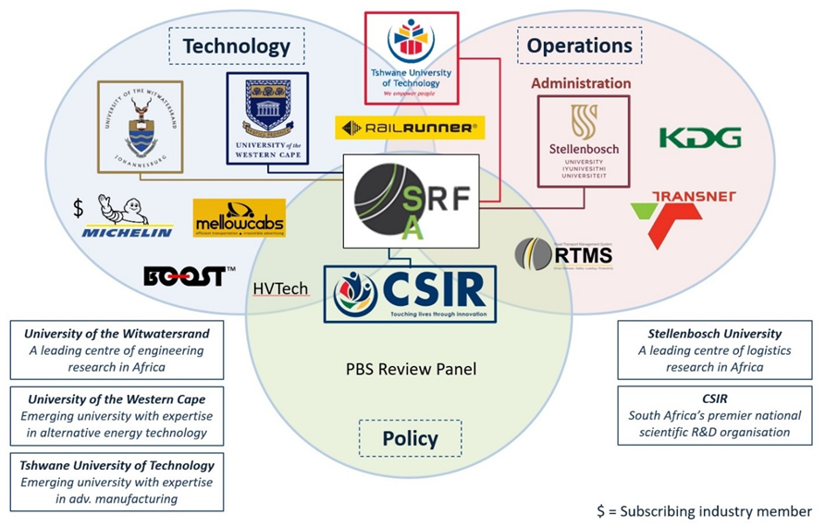




SRF-SA: South African Centre for Sustainable Road Freight
M. Atkins, C. de Saxe, A. Kamdar, X. Na, L. Khumalo, D. Ainalis, D. Cebon

Slide 5
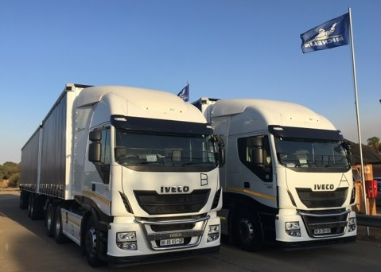
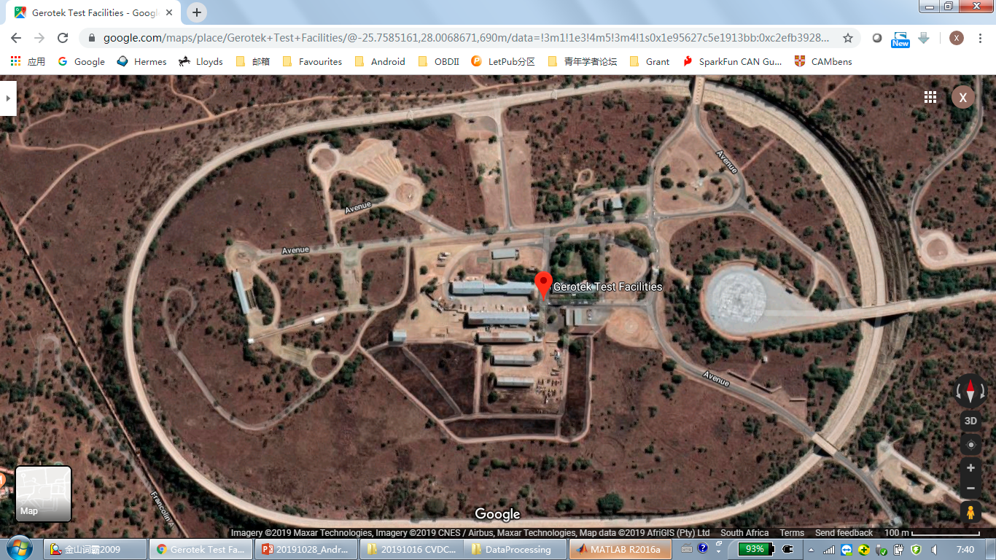
Controlled field tests of low-rolling resistance tyres (2019, RAEng IAPP)
Objective
  Compare the fuel consumption performance of Michelin X® LINE ENERGY (LRR) and Michelin X® MULTI tyres
Methodology
  Two fully-loaded 56-tonne B-doubles (7 axles, 26 tyres)
  80 km/h on circular test track at Gerotek (South Africa)
  2 days x 4 sessions x 2 hours driving with driver and tyre swaps
  SRF Loggers used for the first time in SA (local data storage)
Findings
  8-10% fuel savings with X-Line Energy
  Higher savings due to larger vehicle combination mass, high temperatures, and increased altitude
M. Atkins, C. de Saxe, A. Kamdar, X. Na, L. Khumalo, D. Ainalis, D. Cebon
Notes:
Industry Academia Partnership Programme

Slide 6


In-service tests (2021-23, RAEng TSP)
Second RAEng grant in 2021 via the Transforming Systems through Partnership programme
Project title: “Cost-Effective Freight Transport Emissions Reduction”
  Logistics modelling data collection
  High-capacity vehicles
  Eco-driver training
  Electric truck refrigeration
  Implementation of low-rolling resistance tyres
Objectives:
  Implement the SRF Loggers in an in-service environment with off-site data streaming
  Compare in-service fuel consumption, emissions and tyre life of Michelin “green” and “black” tyres
M. Atkins, C. de Saxe, A. Kamdar, X. Na, L. Khumalo, D. Ainalis, D. Cebon

Slide 7
In-service data logging:
Overview
M. Atkins, C. de Saxe, A. Kamdar, X. Na, L. Khumalo, D. Ainalis, D. Cebon

Slide 8
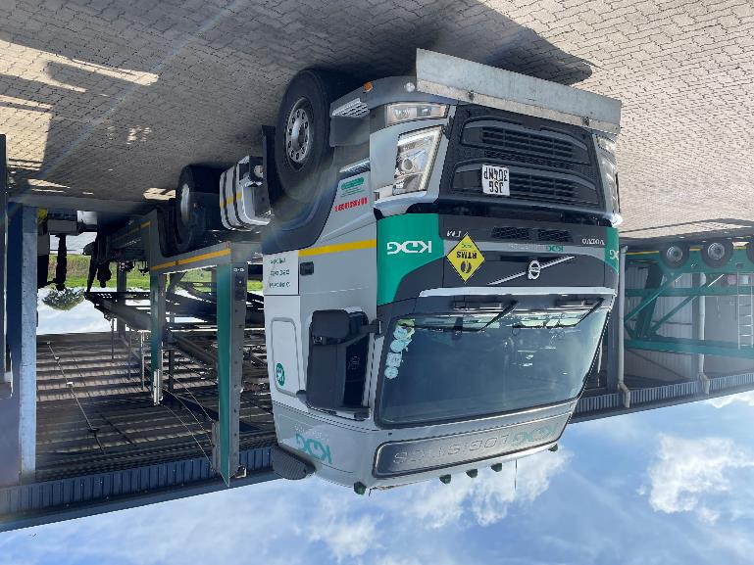
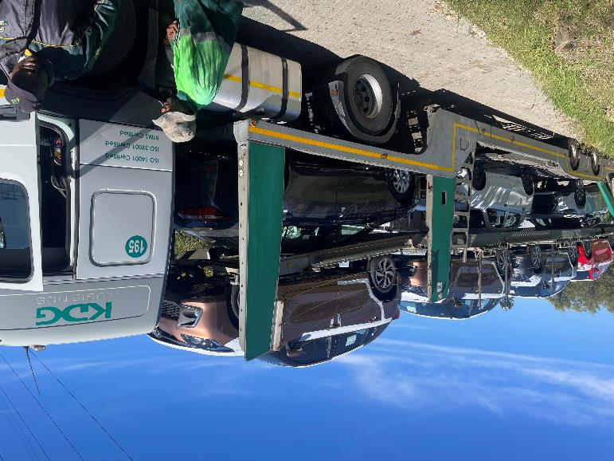

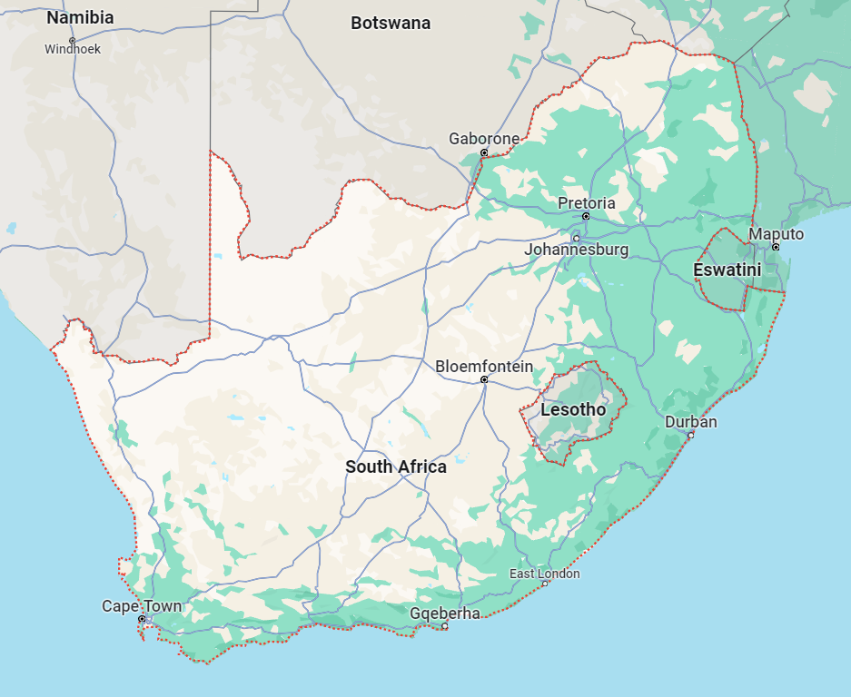
Vehicles
Botswana
Gauteng
Namibia
Two identical car transporters
  Tractor semi-trailer combinations
  Volvo FM42 T1HA + Lohr SHR EVO 2
  Up to 8 passenger vehicles capacity
  Dedicated driver per vehicle (5+ years with KDG)
  Fitted with stock commercial telematics unit
Durban port
Import vehicles
OEM
Export vehicles
M. Atkins, C. de Saxe, A. Kamdar, X. Na, L. Khumalo, D. Ainalis, D. Cebon
Notes:
Typical vehicle duty cycles include:
Import vehicles from Durban port to inland dealerships, Namibia (~1890 km trip) and Botswana (~ 960 km trip)
Locally-made vehicles from plant in KZN to Durban port for export

Slide 9




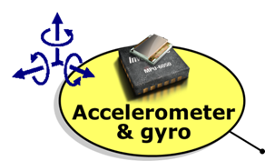








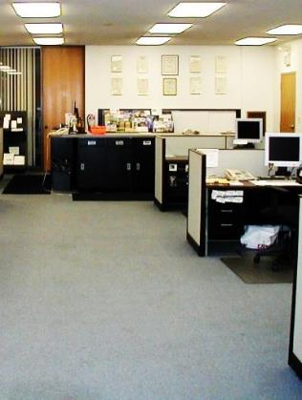



SRF Logger
Android application + Bluetooth-enabled CAN interface
GPS data
  Location, speed & bearing (1 s)
Motion sensor data
  Acceleration & rotation (0.1 s)
CAN data
  Engine: fuel use & rate, rpm, torque (< 0.1 s)
  Driver: accelerator pedal pos., gear, cruise switch… (0.1s)
  Vehicle: distance, speed…
Weather data
  Wind speed & direction, temperature… (2 min)
Multiple Bluetooth connections
  I.e., to additional sensors (gas meter, trailer accelerometer)
Real-time data transmission over 4G
all measured data
M. Atkins, C. de Saxe, A. Kamdar, X. Na, L. Khumalo, D. Ainalis, D. Cebon

Slide 10
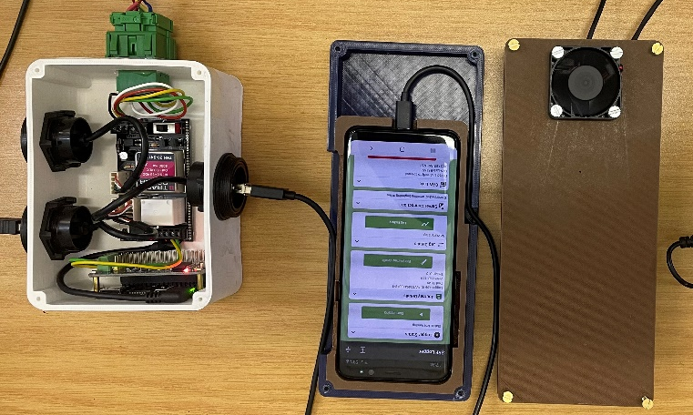
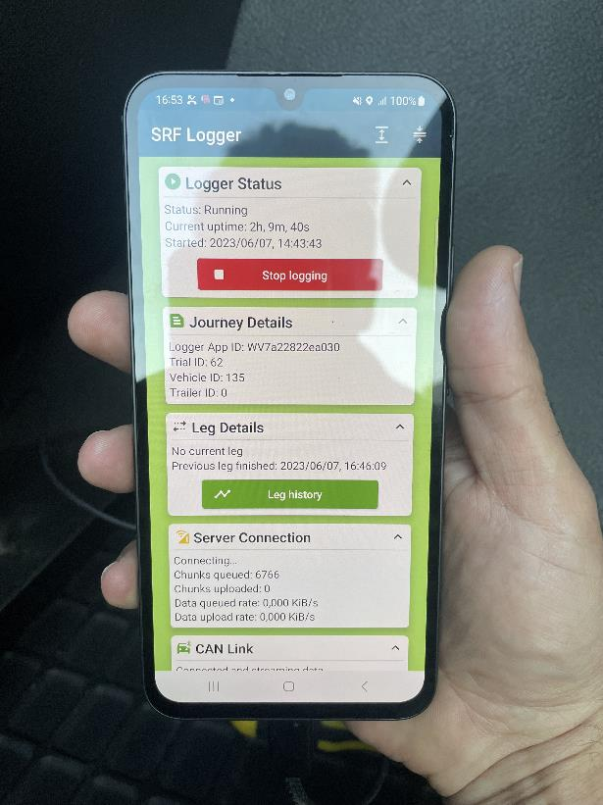
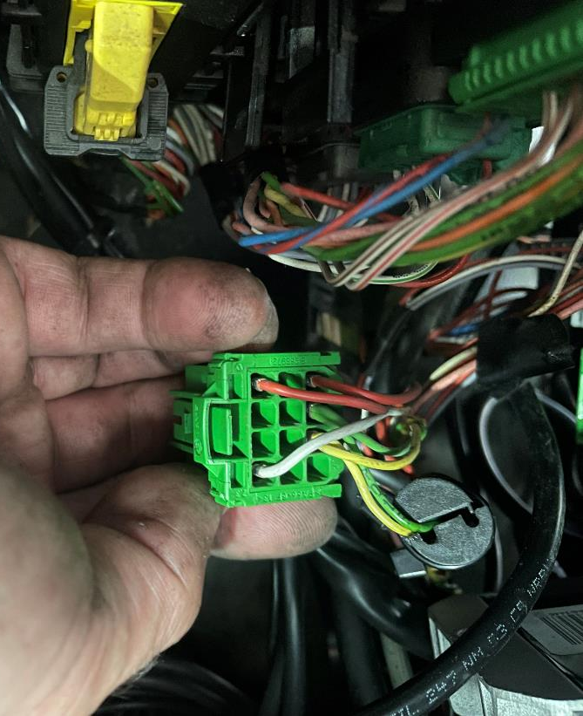
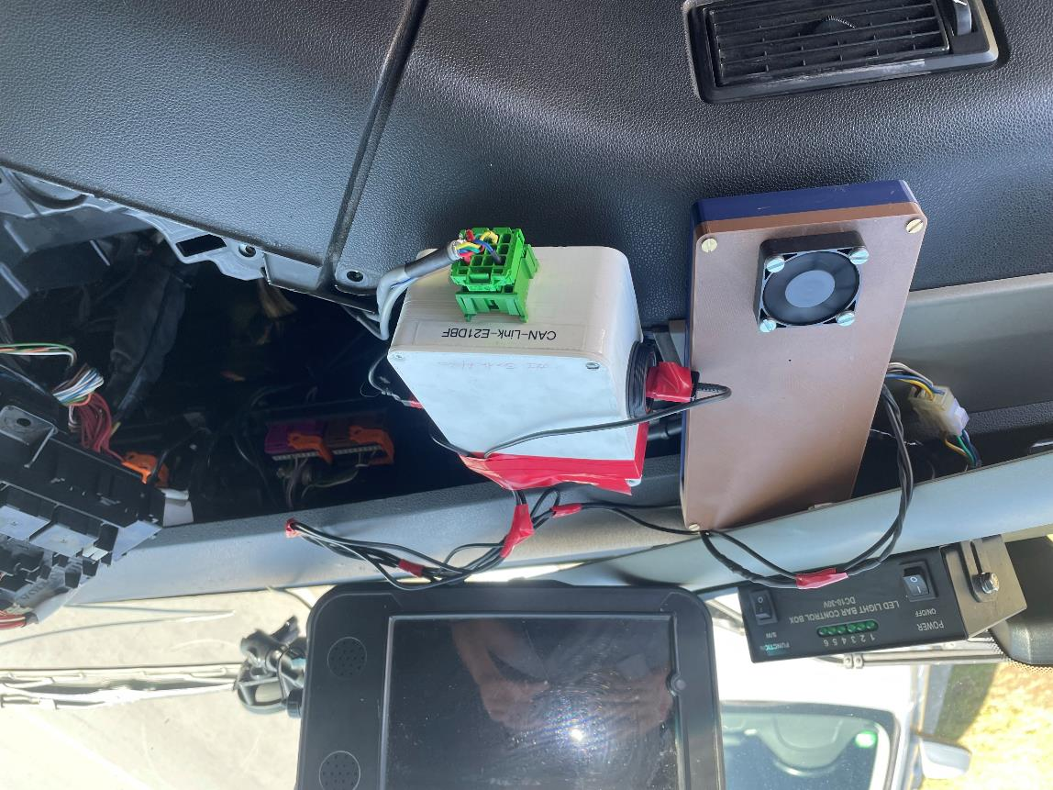
Installation
Android device & CAN interface box
SRF Logger app
FMS connector behind dash
Android device & CAN interface box in cab
M. Atkins, C. de Saxe, A. Kamdar, X. Na, L. Khumalo, D. Ainalis, D. Cebon

Slide 11
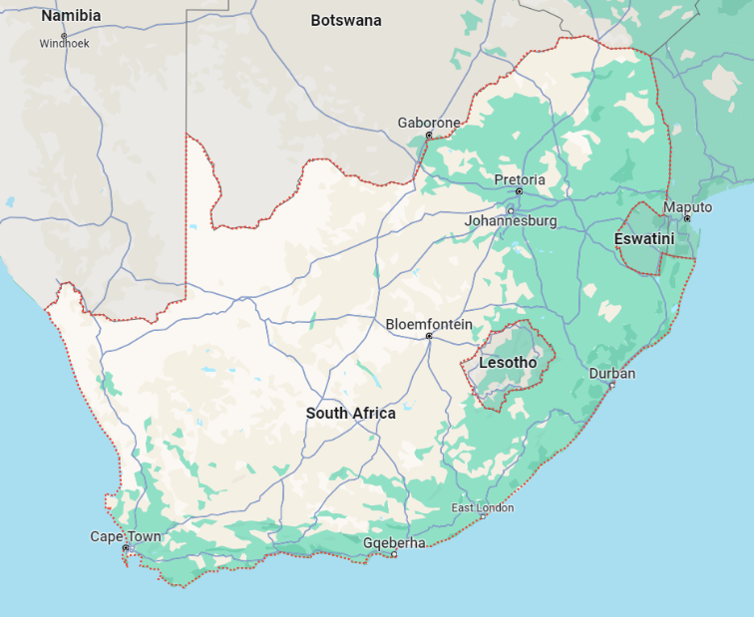
Data collection
Data collected over four weeks in April 2023
N3 section used for comparison (same day, same fuel level, GVM = 31 t, ~200 km)
M. Atkins, C. de Saxe, A. Kamdar, X. Na, L. Khumalo, D. Ainalis, D. Cebon

Slide 12
In-service data logging:
Results
M. Atkins, C. de Saxe, A. Kamdar, X. Na, L. Khumalo, D. Ainalis, D. Cebon

Slide 13
TSP vs SRF Logger: Cumulative data
 |  | Vehicle #194 |  |  | Vehicle #195
 |  | TSP | SRF | Error (%) | TSP | SRF | Error (%)
Leg 1 | Distance (km) | 199.7 | 199.85 | -0.1 | 198.8 | 200.9 | -1.1
 | Fuel used (l) | 98.5 | 98.5 | 0.0 | 94.5 | 96 | -1.6
 | Fuel economy (km/l) | 2.0 | 2.0 | 0.0 | 2.1 | 2.1 | 0.0
 | Comparison with fleet ave. (%) | -35.4 | - | - | -32.8 | - | -
Leg 2 | Distance (km) | 205.0 | 2.4.9 | 0.0 | 131.4 | 131.3 | 0.1
 | Fuel used (l) | 86.5 | 86.5 | 0.0 | 53 | 53 | 0.0
 | Fuel economy (km/l) | 2.4 | 2.4 | 0.0 | 2.5 | 2.5 | 0.0
 | Comparison with fleet ave. (%) | -22.5 | - | - | -20.0 | - | -
Observations:
Good agreement between TSP and SRF Logger (cumulative data)
Leg 1 exhibited 17% lower fuel economy than Leg 2
Vehicle #195 achieved 4-5% greater fuel economy than vehicle #194
Fuel economy is well below the fleet average for both legs (20-30% lower)
SRF Logger = 10 Hz
TSP = 0.017 Hz
M. Atkins, C. de Saxe, A. Kamdar, X. Na, L. Khumalo, D. Ainalis, D. Cebon
Notes:
→ While the TSP unit gives a good indication of cumulative fuel use, the lack of high resolution data and missing data channels makes it difficult to investigate further

Slide 14
High-resolution SRF Logger data:
Elevation
Leg 1
ΔH = 1106 m
Leg 2
ΔH = 569 m
M. Atkins, C. de Saxe, A. Kamdar, X. Na, L. Khumalo, D. Ainalis, D. Cebon
Notes:
Look into SRF Logger elevation data - TSP does not provide elevation data
Higher fuel use now clear
Source of elevation data? HERE Maps or Google? Includes snap to road and filtering

Slide 15
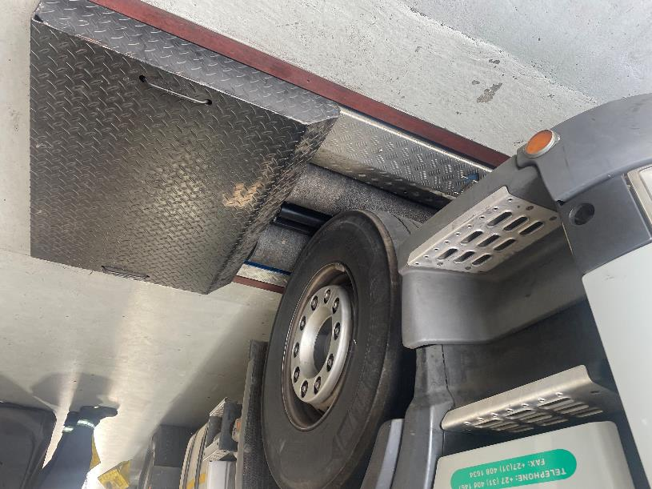
High-resolution SRF Logger data:
Combination mass
Combination mass estimate is reported via the FMS
The SRF Logger captures this while the TSP unit does not
These data were validated against weigh bridge results to within 2%
Mass is almost identical for both vehicles → not influencing fuel economy difference
M. Atkins, C. de Saxe, A. Kamdar, X. Na, L. Khumalo, D. Ainalis, D. Cebon
Notes:
Still a difference between drivers – investigate further

Slide 16
High-resolution SRF Logger data:
Driver factors
V_{ave} (#194) = 67.8 km/h
V_{ave} (#195) = 63.2 km/h
#194 uses cruise control
#195 does not
M. Atkins, C. de Saxe, A. Kamdar, X. Na, L. Khumalo, D. Ainalis, D. Cebon
Notes:
Note deceleration / stop events
Difference possibly congestion etc
When comparing tyres later we want sections with CC on

Slide 17
High-resolution SRF Logger data:
Van Reenen’s Pass (Leg 2)
Note lower speeds and higher engine load during climb.
#194 stops half-way up the pass. Waits for engine temp to drop?
M. Atkins, C. de Saxe, A. Kamdar, X. Na, L. Khumalo, D. Ainalis, D. Cebon

Slide 18
Low-rolling resistance tyres evaluation
(Grain Carriers)
M. Atkins, C. de Saxe, A. Kamdar, X. Na, L. Khumalo, D. Ainalis, D. Cebon

Slide 19
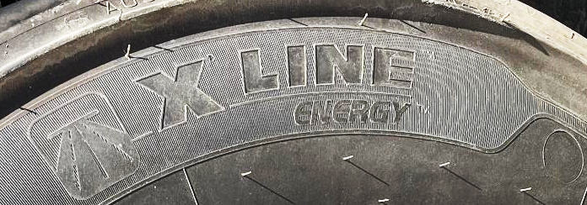

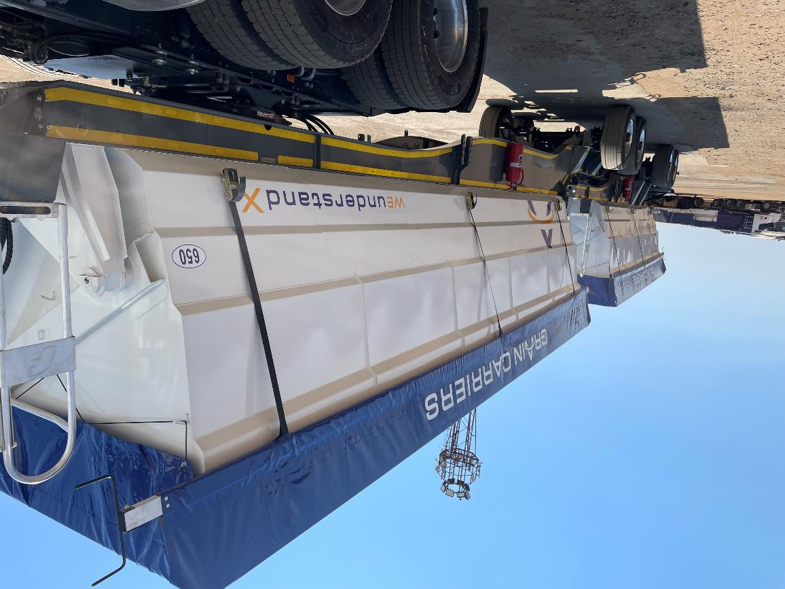
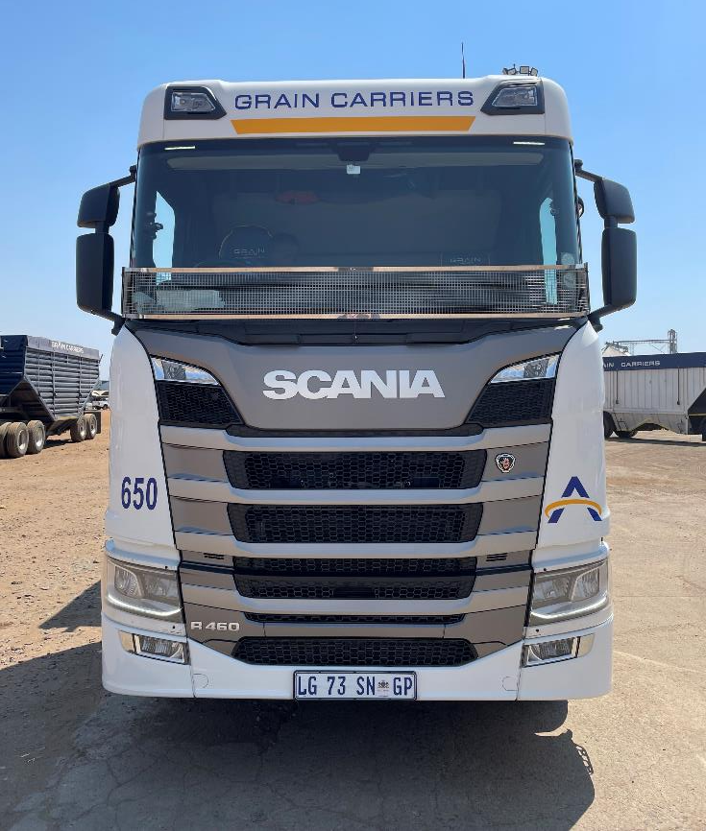
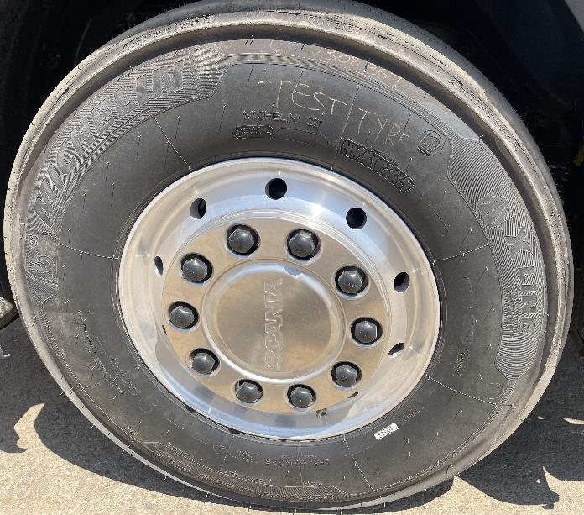
Overview
56-tonne B-double side-tippers
Michelin X® LINE ENERGY vs X® MULTI tyres comparison
Android devices no longer hidden in cases
M. Atkins, C. de Saxe, A. Kamdar, X. Na, L. Khumalo, D. Ainalis, D. Cebon

Slide 20
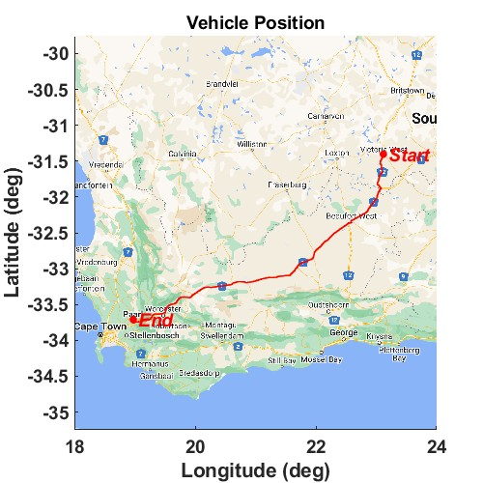
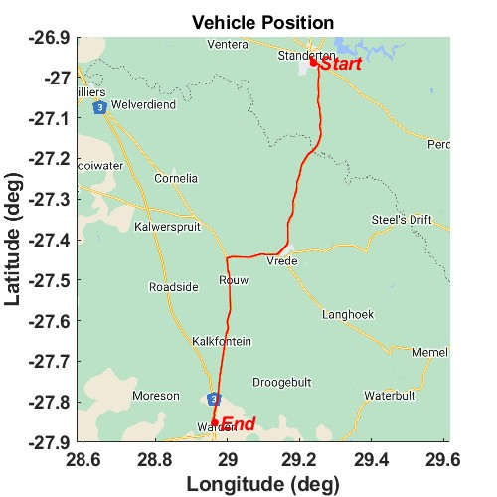
Preliminary data collection
M. Atkins, C. de Saxe, A. Kamdar, X. Na, L. Khumalo, D. Ainalis, D. Cebon

Slide 21
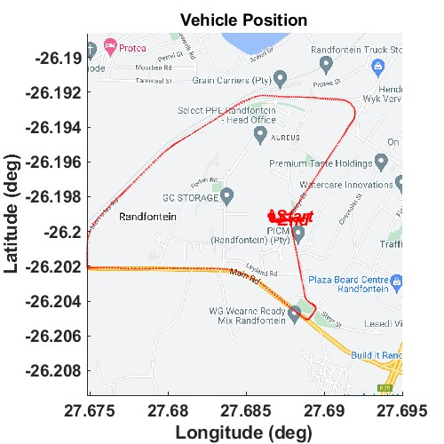
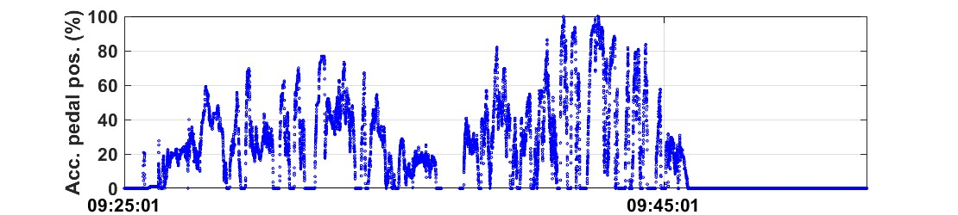
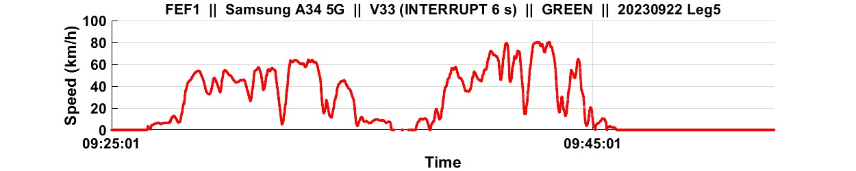
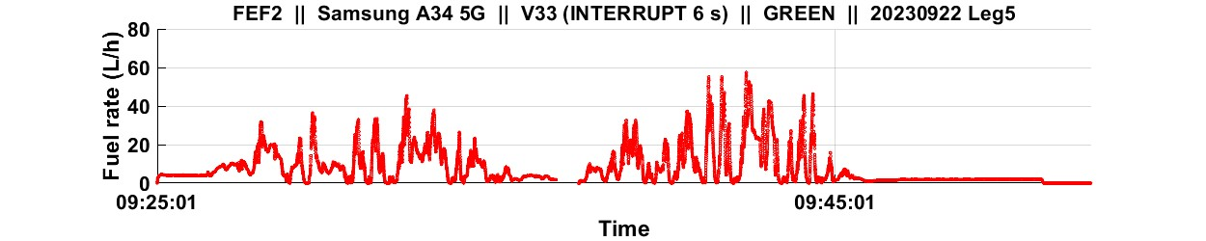
Preliminary data collection
1st lap – driver and me
2nd lap – driver alone
M. Atkins, C. de Saxe, A. Kamdar, X. Na, L. Khumalo, D. Ainalis, D. Cebon

Slide 22
Conclusion & next steps
M. Atkins, C. de Saxe, A. Kamdar, X. Na, L. Khumalo, D. Ainalis, D. Cebon

Slide 23
Conclusions & next steps
SRF Loggers operating with off-site data streaming for in-service data collection
Preliminary in-service data collection completed with KDG Logistics, demonstrating the value of the high-resolution data and additional channels available with the SRF Logger
In-service tyre comparison data collection now underway with Grain Carriers
Initial challenges around mobile device overheating and theft concerns have been overcome
Next steps:
  Collect continuous in-service data for 3+ months
  Collect adjacent data on tyre wear and alignment
  Isolate sections of data with comparable conditions for tyre performance comparison
M. Atkins, C. de Saxe, A. Kamdar, X. Na, L. Khumalo, D. Ainalis, D. Cebon

Slide 24






Acknowledgements
South African Centre for Sustainable Road Freight
  Project consortium
Royal Academy of Engineering (RAEng)
  Funding via the Transforming Systems through Partnership programme (TSP2021\100310)
Michelin Tyre Company SA
  In-kind support and travel expenses
(UK) Centre for Sustainable Road Freight / Cambridge
  SRF Logger equipment, data server, technical support
KDG Logistics & Grain carriers
  Test vehicles
Zeus Labs
M. Atkins, C. de Saxe, A. Kamdar, X. Na, L. Khumalo, D. Ainalis, D. Cebon

Slide 25
Thank you!
Contact:
michael.atkins@wits.ac.za
chris@zeuslabs.com

