Slide 1


Characterisation of Vibration Response Spectra of Road Transport Vehicles
M.J. Lamb
V. Rouillard

Slide 2
Characterisation of Vibration Response Spectra of Road Transport Vehicles
Research impetus:
Are there typical vibration response spectra that can be used to represent the ride quality of heavy goods vehicles?
Primary purpose:
Laboratory simulation for packaging optimisation.
Why:
Current (generic) vibration spectra (PDS) do not match reality – leads to over-packaging or product damage.
Constraints:
Only vertical vibrations (heave) are considered.
Analysis based on largest possible set of measured (vibration response) data from HGVs around the world.
M.J. Lamb & V. Rouillard

Slide 3
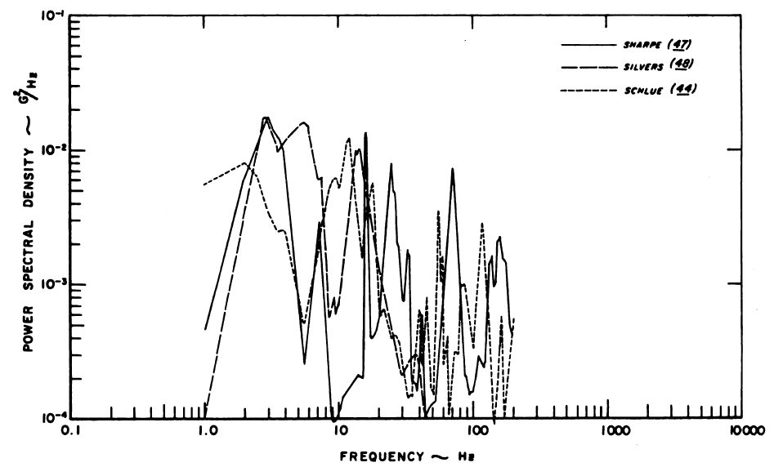
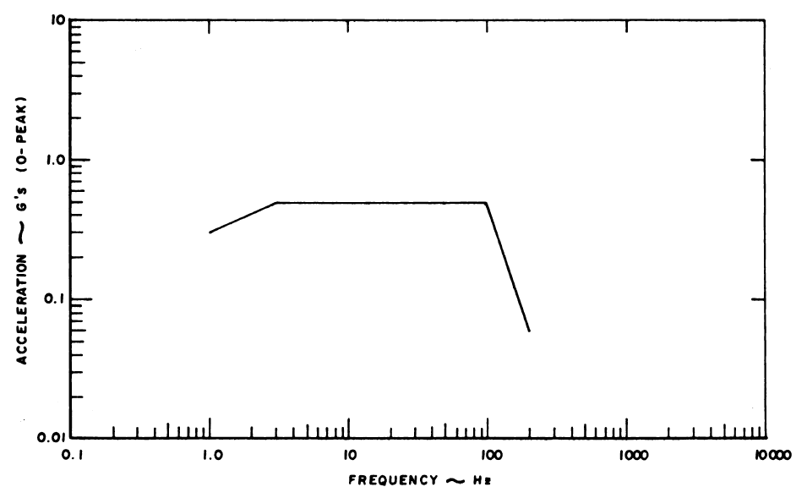
Characterisation of Vibration Response Spectra of Road Transport Vehicles
Background:
Unsurprisingly, early attempts (1970s) at measuring and characterising vibration spectra were gallant but largely wrong (mostly due to technological limitations):
M.J. Lamb & V. Rouillard

Slide 4
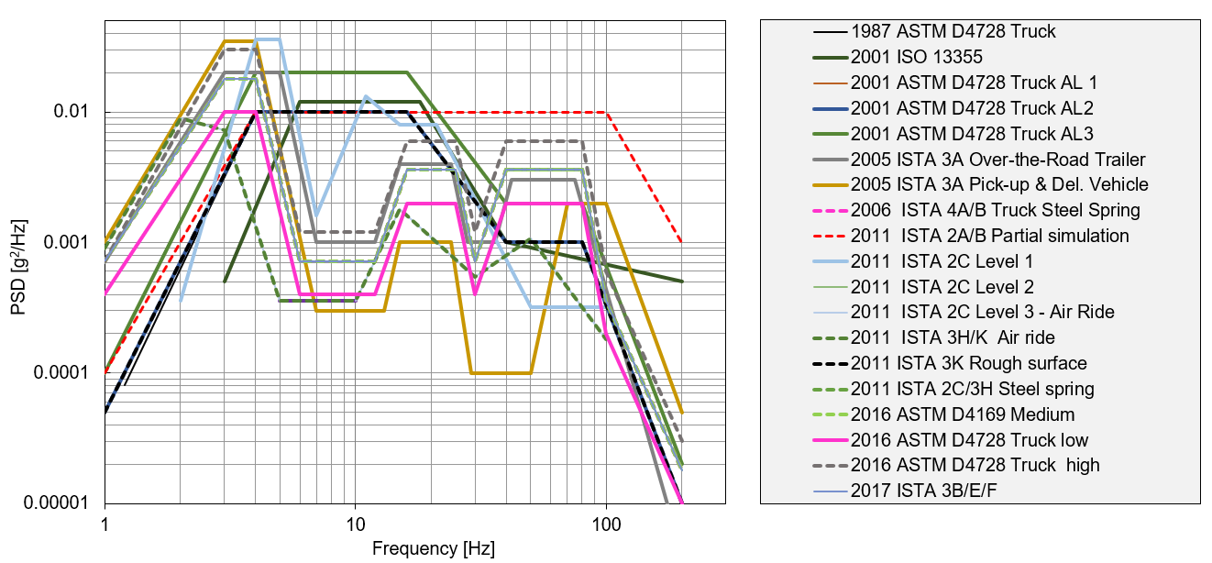
Characterisation of Vibration Response Spectra of Road Transport Vehicles
Background:
With the advent of more modern data recorders some improvement have been achieved but ‘test spectra’ specified by standard protocols remain problematic:
M.J. Lamb & V. Rouillard

Slide 5
Characterisation of Vibration Response Spectra of Road Transport Vehicles
What we found:
From 129 vibration response spectra (PDS) from a variety of vehicle types and road types, there appears to be groupings of vibration spectra based on suspension type and payload (sprung mass).
These representative response spectra were used to extract the parameters of quarter-car (2DoF) models:
M.J. Lamb & V. Rouillard

Slide 6
Characterisation of Vibration Response Spectra of Road Transport Vehicles
How we got there:
All available HGV vibration response spectra (PDS) was collected from the literature where clear information on the vehicle type, suspension type and (approximate) payloads was available.
We ended-up with 129 typical vibration response PDS:
  56 were computed using vibration data measured by the authors over the past 25 years
  73 extracted from published data (earliest reliable information published in 1992)
The frequency of the first natural mode (sprung mass resonance) was evaluated from the PDS and their distribution calculated for the two suspension types.
M.J. Lamb & V. Rouillard

Slide 7
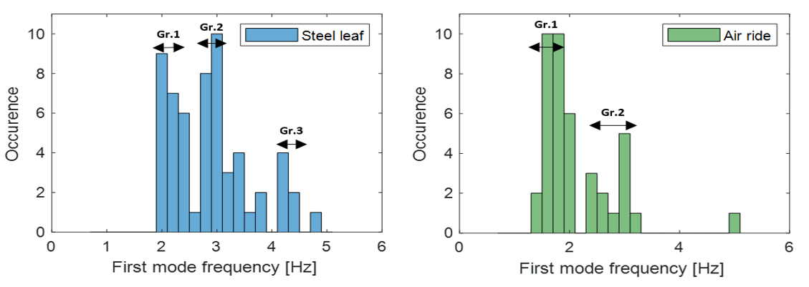
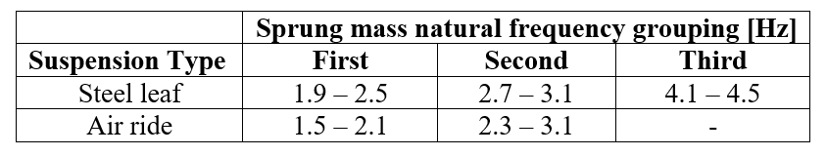
Characterisation of Vibration Response Spectra of Road Transport Vehicles
How we got there:
M.J. Lamb & V. Rouillard

Slide 8
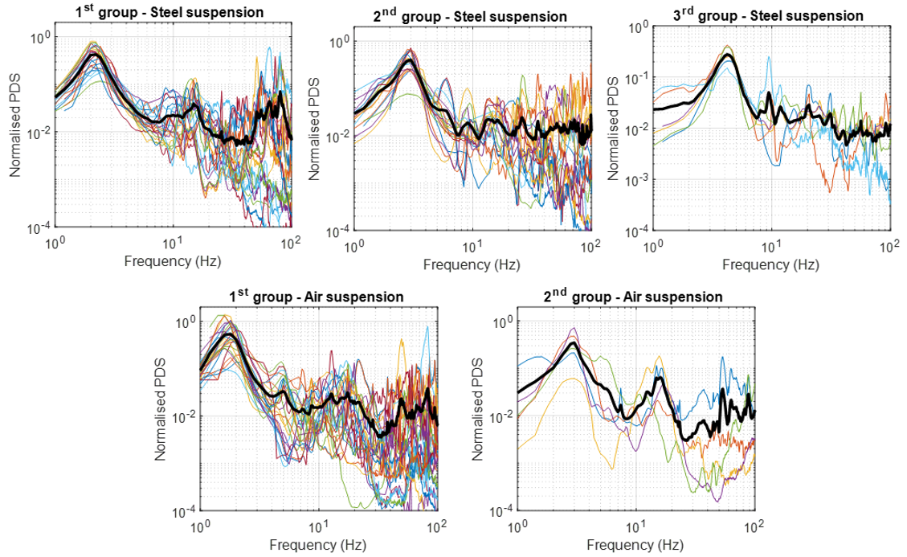
Characterisation of Vibration Response Spectra of Road Transport Vehicles
How we got there:
Mean PDS not acceptable.
Need to find representative PDS for each grouping; i.e. progressively eliminate ‘outliers’.
M.J. Lamb & V. Rouillard

Slide 9
Characterisation of Vibration Response Spectra of Road Transport Vehicles
How we got there:
Selective elimination to produce representative PDS
Focused on the important features of the vibration response PDSs (the prominent peaks corresponding to the sprung mass and unsprung mass (axle hop) resonance
Clearly abnormal PDS (with excessively large peaks outside the typical first and second mode frequency bands) were discarded.
The mean of the remaining PDS was then computed and individual PDS with large deviations from the mean across the low (rigid body) frequency bands were progressively eliminated with the mean re-computed after each elimination resulting in the representative PDS for the group.
M.J. Lamb & V. Rouillard

Slide 10
Characterisation of Vibration Response Spectra of Road Transport Vehicles
How we got there:
Selective elimination.
Selected mean.
M.J. Lamb & V. Rouillard

Slide 11
Characterisation of Vibration Response Spectra of Road Transport Vehicles
How we got there:
Each response spectrum was modeled as a 2DoF system (1/ 4 Car) and the Frequency Response Function T(f) was estimated by combining it with a standard road elevation spectrum G_{x}(n) :
This produced the vehicle’s (1/4 car) dynamical parameters (mass ratio, stiffness ratio and damping) according to:
M.J. Lamb & V. Rouillard

Slide 12
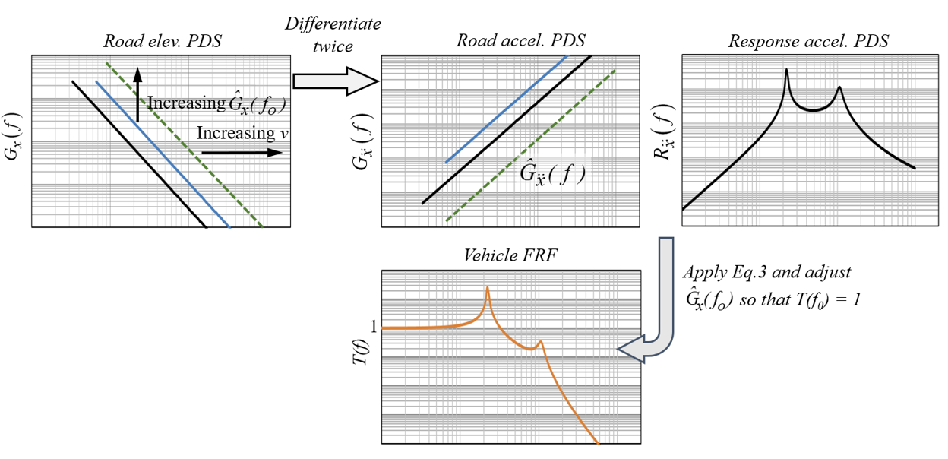
Characterisation of Vibration Response Spectra of Road Transport Vehicles
M.J. Lamb & V. Rouillard

Slide 13
Characterisation of Vibration Response Spectra of Road Transport Vehicles
What we found:
This work has yielded three interesting outcomes:
1. Testing of packaging/products for road transport can be undertaken using one of these ‘representative’ quarter-car models by selecting the vehicle type and the expected payload range.
2. (?) This method – based on vibration response measurements only - can be used to estimate the payload of a vehicle.
M.J. Lamb & V. Rouillard

Slide 14
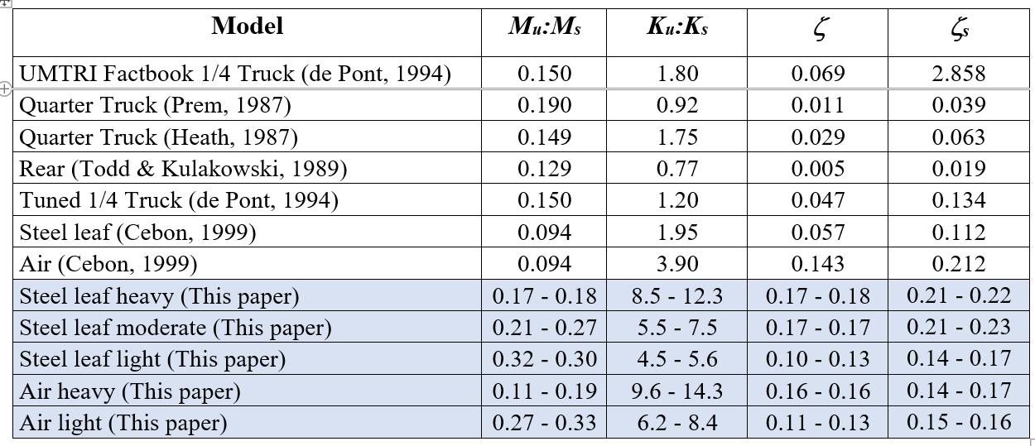
Characterisation of Vibration Response Spectra of Road Transport Vehicles
What we found:
This work has yielded three interesting outcomes:
3. Estimated suspension : tyre stiffness ratios diverge from (historical) published values (confirmation needed):
Table 2. Quarter-car parameters (for w = 2.0 to 2.4.) along with published values.
M.J. Lamb & V. Rouillard

Slide 15
Characterisation of Vibration Response Spectra of Road Transport Vehicles
Conclusions:
129 measured vibration spectra were classified in accordance with the sprung mass resonance frequency and produce representative (typical) response PDS (three for steel leaf suspension and two for air ride suspension).
It is recommended that these five representative spectra be used to evaluate and optimise the vibration resistance of products during road transport to yield more realistic vibrations than those promoted by standards organisations.
This should have a positive impact on the optimisation of packaging designs and a corresponding reduction in packaging waste.
Additional findings from the research are:
  i) potential for a technique to estimate the sprung mass (or payload) of road vehicles from vibration response measurements only
  ii) a clear difference in the tyre : suspension stiffness ratios for the representative vehicles studied when compared to existing published data.
Both these findings need to be investigated further. In addition, further work on developing and validating techniques for selecting and combining sample spectra to obtain representative PDS for selected groupings needs to be undertaken.
M.J. Lamb & V. Rouillard

Slide 16
Characterisation of Vibration Response Spectra of Road Transport Vehicles
Background:
Engineers have been trying the simulate (mostly vertical) vibration response of HGV for some decades with the aim of optimizing packaging systems.
Measuring, analysing and simulating the vibration response of road vehicles is complex and difficult:
  Vibrations are random and non-stationary (variations in road roughness and vehicle speed)
  The dynamic characteristics of HGVs are, to varying degrees, non-linear
  Vertical vibration response is influenced by pitch and roll motion
  Rigid-body vibrations are contaminated by:
    structural vibrations
    occasional transient responses
    drive/power train harmonics (multiple sinusoids of varying frequencies)
M.J. Lamb & V. Rouillard

