Slide 1
High-capacity transport in cities and the impact on the roads
Shafiqur Rahman
Sogol Kharrazi
Sigurdur Erlingsson

Slide 2
Background
Construction industry is responsible for one third of the greenhouse emissions world-wide.
About 10% of construction emissions stem from the transport of mass in connection with constructions.
In urban areas in Sweden as much as 50% of weight-restricted transport is connected to constructions.
Shafiqur Rahman, Sogol Kharrazi, Sigurdur Erlingsson

Slide 3
Background
The roads in Sweden are divided into four classes of bearing capacities (BK classes).
The allowed vehicle weight on each road class depends on the distance between the first and last axle of the vehicle.
Roads in inner cities usually have a BK2 bearing capacity and a maximum allowed length of 12 m, resulting in 25t limit for a truck with 7m axle distance.
Shafiqur Rahman, Sogol Kharrazi, Sigurdur Erlingsson

Slide 4
Background
The HCT city project started in 2021 to address the need for more efficient construction transport in cities.
A specially designed 5-axle truck with gross weight of 38-42 t and a length under 12 m is used for transport in a construction site in Stockholm.
Shafiqur Rahman, Sogol Kharrazi, Sigurdur Erlingsson

Slide 5
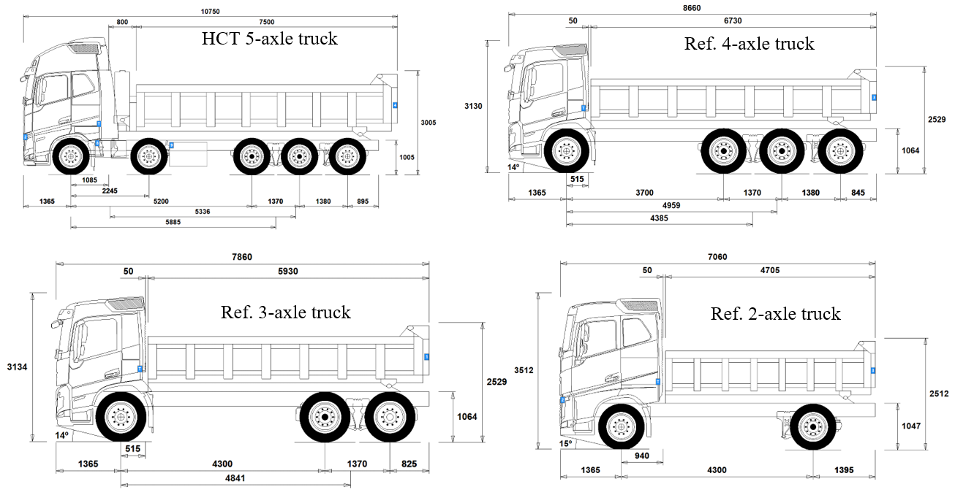
Objective of the study
Comparing pavement damage induced by the HCT truck with three reference trucks
 | Gross weight | Empty weight | Carried load
HCT truck (BK4) | 42 t | 18 t | 24 t
4-axle truck (BK4) | 33 t | 15 t | 18 t
3-axle truck (BK2) | 23.5 t | 12 t | 11.5 t
2-axle truck (BK2) | 18 t | 11 t | 7 t
Shafiqur Rahman, Sogol Kharrazi, Sigurdur Erlingsson

Slide 6
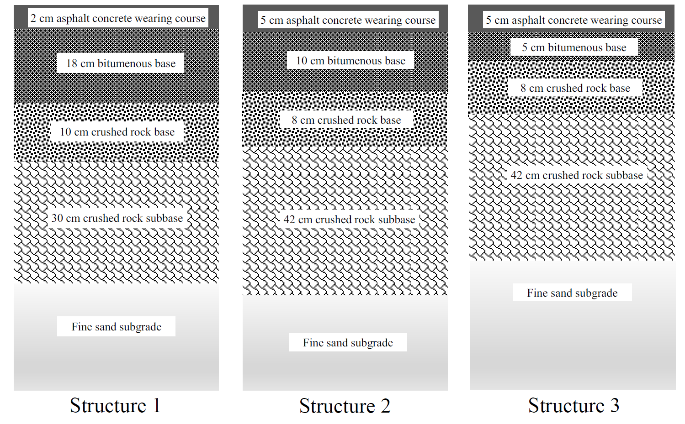
Methodology
Simulations were done in a pavement analysis tool called ERAPave*, developed at VTI.
Three pavement structures were analyzed, representative of Stockholm urban area.
* Elastic Response Analysis of Pavements
Shafiqur Rahman, Sogol Kharrazi, Sigurdur Erlingsson

Slide 7
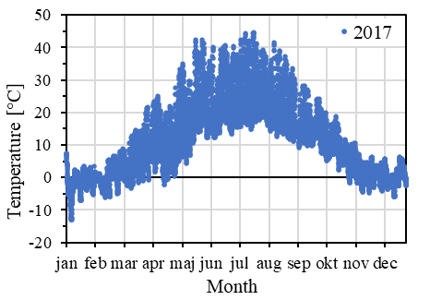
Methodology
The analyses were carried out for 5 seasons
Layer and material properties of the pavement structures were decided based on data from laboratory tests
Considered Seasons
Temperature (°C) | 0 | 10 | 20 | 30 | 40
Duration (month) | 3 | 3 | 3 | 2 | 1
Temperature variation at 2 cm depth of a pavement close to Stockholm
Shafiqur Rahman, Sogol Kharrazi, Sigurdur Erlingsson

Slide 8
Methodology
At vehicle speed of 45 km/h, transverse tensile strains at the bottom of the AC layer and vertical strains at the top of the subgrade were calculated.
Transverse tensile strains at the bottom of the AC layer during spring-thaw period
Shafiqur Rahman, Sogol Kharrazi, Sigurdur Erlingsson

Slide 9
Methodology
Vertical strains at the top of the subgrade during spring-thaw period
Relative damage factor:
$$D_{r}=\frac{{\left.{\left(ε\right.}_{1}^{4}+ε_{2}^{4}+…+ε_{j}^{4}\right)}_{j−axle truck}}{{\left(ε_{1}^{4}+ε_{2}^{4}\right)}_{2−axle truck}} \left(\frac{w_{2}}{w_{j}}\right)$$
Shafiqur Rahman, Sogol Kharrazi, Sigurdur Erlingsson

Slide 10
Results – Seasonal variation
Loaded vehicles one way trip
Temperature (°C) | 0 | 10 | 20 | 30 | 40
Duration (month) | 3 | 3 | 3 | 2 | 1
Summation of fourth powered peak strains (x10⁻¹⁸) per ton carried load (AC fatigue cracking)
HCT truck | 0.34 | 126.45 | 228.13 | 545.58 | 2460.83
4 axle truck | 0.27 | 96.52 | 183.32 | 458.14 | 2114.32
3 axle truck | 0.34 | 112.35 | 235.93 | 591.64 | 2848.07
2 axle truck | 0.32 | 96.13 | 229.82 | 606.10 | 2949.83
Summation of fourth powered peak strains (x10⁻¹⁸) per ton carried load (Subgrade rutting)
HCT truck | 0.18 | 5979.77 | 810.24 | 1418.83 | 4442.90
4 axle truck | 0.16 | 6184.62 | 737.93 | 1277.56 | 3979.27
3 axle truck | 0.19 | 5423.94 | 849.07 | 1496.72 | 4832.54
2 axle truck | 0.25 | 5989.47 | 1104.23 | 1956.04 | 6205.70
D_{r} (AC fatigue cracking)
HCT truck | 1.07 | 1.32 | 0.99 | 0.90 | 0.83
4 axle truck | 0.84 | 1.00 | 0.80 | 0.76 | 0.72
3 axle truck | 1.08 | 1.17 | 1.03 | 0.98 | 0.97
2 axle truck | 1.00 | 1.00 | 1.00 | 1.00 | 1.00
D_{r} (Subgrade rutting)
HCT truck | 0.70 | 1.00 | 0.73 | 0.73 | 0.72
4 axle truck | 0.63 | 1.03 | 0.67 | 0.65 | 0.64
3 axle truck | 0.75 | 0.91 | 0.77 | 0.77 | 0.78
2 axle truck | 1.00 | 1.00 | 1.00 | 1.00 | 1.00
Seasonal variation in strains and relative damage factor per trip (D_{r}) for Structure 1
Shafiqur Rahman, Sogol Kharrazi, Sigurdur Erlingsson

Slide 11
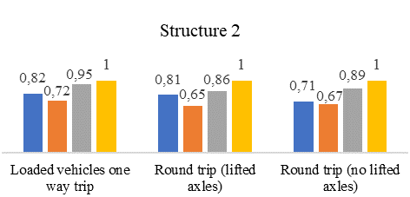
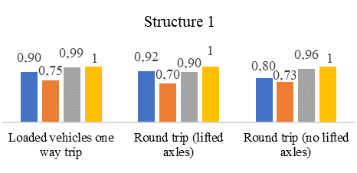
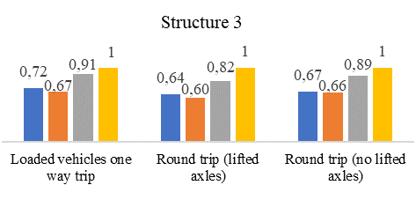
Results – AC fatigue cracking
Shafiqur Rahman, Sogol Kharrazi, Sigurdur Erlingsson

Slide 12
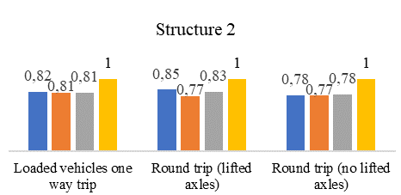
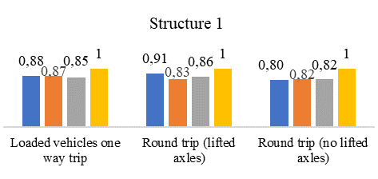
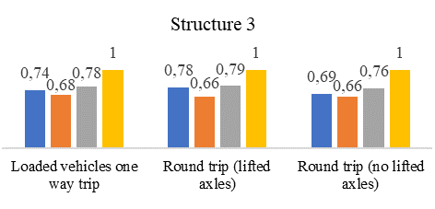
Results – Subgrade rutting
Shafiqur Rahman, Sogol Kharrazi, Sigurdur Erlingsson

Slide 13
Conclusions
The results indicate that the HCT truck is slightly more damaging than the 4-axle truck but less damaging than the 3-axle and 2-axle trucks.
The damage calculations include some simplifications and assumptions. For instance, the effect of tire width on the contact area is not included, which is disadvantageous for wide single tires.
Including tire width effects will decrease the relative difference between the HCT truck and the 4-axle truck.
Shafiqur Rahman, Sogol Kharrazi, Sigurdur Erlingsson

Slide 14
Conclusions
To assess the potential benefit of the HCT truck, fuel efficiency and other factors should also be weighed in, not only the pavement damage risks.
If HCT-trucks are used instead of 3-axle trucks for carrying a fixed amount of load, number of required trips will be reduced by half. The corresponding reduction in fuel consumption is estimated to be about 40%.
Weighing in other benefits, the HCT truck may be a better option than all the reference vehicles.
Shafiqur Rahman, Sogol Kharrazi, Sigurdur Erlingsson

Slide 15
Thank you!
shafiqur.rahman@vti.se
sogol.kharrazi@vti.se
sigurdur.erlingsson@vti.se
Shafiqur Rahman, Sogol Kharrazi, Sigurdur Erlingsson

