Slide 1
Enhanced Synergic Identification of Prestress Force and Moving Force in Prestressed Concrete Bridges
Kunaratnam
Jeyamohan
Tommy. H.T. Chan
Khac-Duy
Nguyen
David P.
Thambiratnam
6 - 10 November 2023
Brisbane, Australia

Slide 2
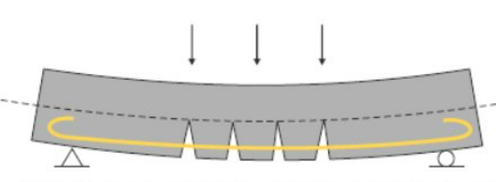
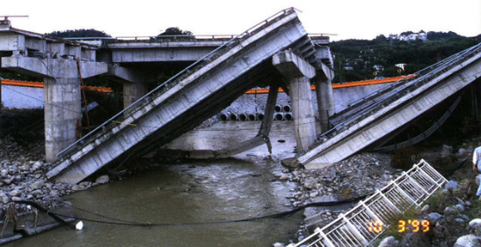
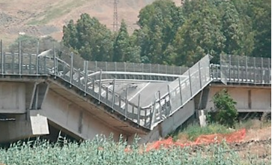
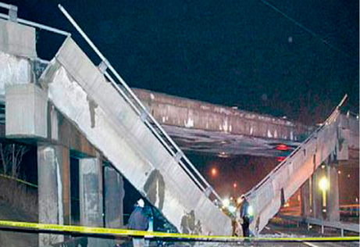
Introduction
Prestressing- compensate the weakness of the concrete in tensile resistance.
Reinforced concrete bridge under loading
Post tensioned concrete before loading
Failures of the prestressed concrete bridges around the world.
Loss of life and injuries
Property damages
Economic losses
Shi-Wei bridge (1999)
Petrulla viaduct (2014)
Lake-view drive bridge (2005)
Jeyamohan et al.

Slide 3
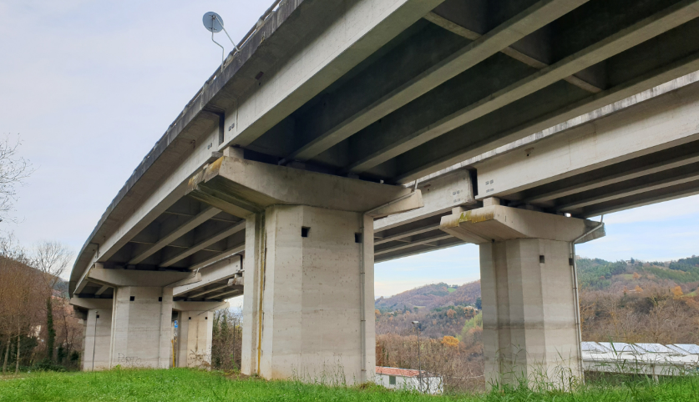
Monitoring of Prestressed Concrete Bridges
Effect of different boundary conditions on the bridge structure: stiffness of the structure is changed.
Simply supported prestressed concrete bridge
Continuously supported prestressed concrete bridge
Why monitoring of prestressed concrete bridge is important?
Prestress Losses
Prestress loss due to aging
Estimate the load carrying capacity
Ensure the bridge’s safety
To carryout maintenance
Immediate Losses
Friction
Elastic Shortening
Anchorage Slip
Long-term Losses
Creep
Shrinkage
Steel relaxation
Jeyamohan et al.

Slide 4
Moving Force Identification
Importance of moving force (MF) identification
Crucial for bridge design and maintenance
To study the interfacial response behaviour (shear force and bending moment)
Performance evaluation
This study aims to propose the innovative methodology for the synergic identification of existing PF and MF in prestressed concrete bridges with “nearby” accuracy.
Jeyamohan et al.

Slide 5
Literature Review
Existing research studies on PF identification
Limitations
References | Year | Methods
Chen and Wissawapaisal (2001) | 2001 | Stress wave technique
Law and Lu (2005) | 2005 | Modal superposition approach
Lu and Law (2006) | 2006 | State-space approach
Gao et al. (2006) | 2006 | Fibre optic sensor method
Lundqvist and Riihimäki (2010) | 2010 | Crack reopening method
Jang et al. (2013) | 2013 | Impact signal-based techniques
Gencturk et al. (2014) | 2014 | Digital image correlation technique
Biswal and Ramaswamy (2016) | 2016 | Vibrating beam strain gauge method
Hussain et al. (2020) | 2020 | Ultrasonic Technology
Bonopera and Chang (2021) | 2021 | Three-point bending method
Using modal analysis
- Less sensitive to the prestress loss
Optic fibre sensor method
Mechanical damage
Misalignment
Mishandling
Inverse method
- Heavily ill-conditioned
Jeyamohan et al.

Slide 6
Literature Review
Existing research studies on MF identification
Limitations
References | Year | Methods
Law et al. (1997) (Project led by Prof. Tommy Chan) | 1997 | Time domain-based modal superposition method
Chan et al. (1999) (Project led by Prof. Tommy Chan) | 1999 | Interpretive method
Law et al. (1999) (Project led by Prof. Tommy Chan) | 1999 | Time domain and frequency domain-based approach
Chan et al. (2000) (Project led by Prof. Tommy Chan) | 2000 | Using bending moment measurements
Law and Fang (2001) | 2001 | Optimal state estimation approach
Zu and Law (2001) | 2001 | Orthogonal function approach
Chan and Ashebo (2006) | 2006 | Acceleration and bending moment approach
Wang et al. (2012) | 2012 | Load shape function-based approach
Pourzeynali et al. (2021) | 2021 | Explicit form of Newmark-β method
Yang et al. (2021) | 2021 | Strain influence line method
Zhou et al. (2023) | 2023 | Probabilistic method
Prestress force is ignored
Inverse ill-posed problem
High computational effort
Required more data points
Known vehicle speed
Known vehicle-bridge interaction
Jeyamohan et al.

Slide 7
Enhanced Techniques for identifying PF and MF
PF and MF identification theory
Virtual distortion method
Load shape function (LSF) approach
Duhamel integral
Simplify the identification process
Reduce the complexity in the identification process
Techniques for overcoming challenges
Ill-posed Indicator (IPI)
Condition number
Determination of the ill-posed nature
LSF and Truncated LSF
Regularization techniques
Reduce the ill-posedness and computational efficiency
Jeyamohan et al.

Slide 8
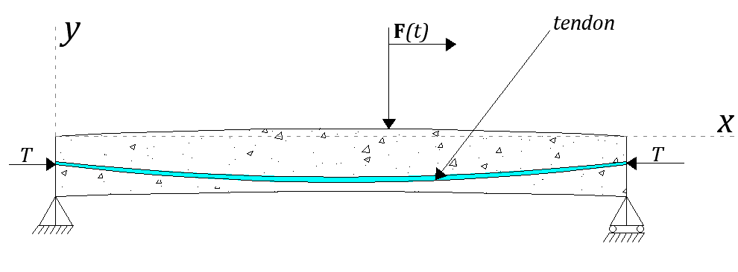
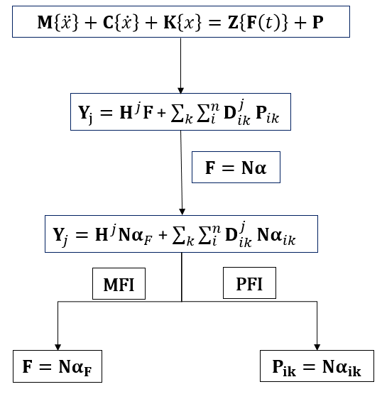
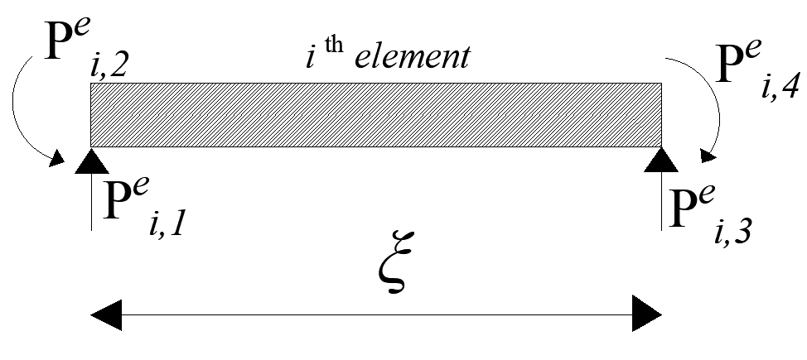
PF and MF Identification Theory
PF and MF identification via LSF approach
Z : Mapping matrix
M : Mass matrix
C : Damping matrix
K : Stiffness matrix
N : Shape function matrix
H : Impulse response matrix
D : Dynamic response matrix
T : Prestress force
α : Appropriate coefficient
F : Moving force
Prestressed concrete bridge model
Simplified model with PF induced pseudo loads
Xiang et al., (2016), (2017)
Jeyamohan et al.

Slide 9
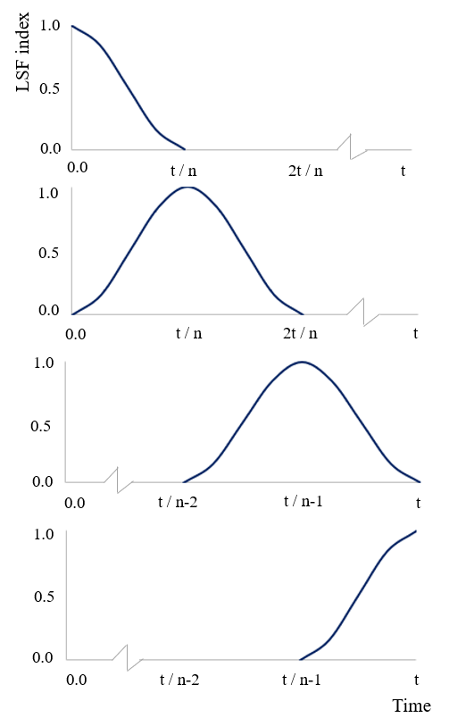
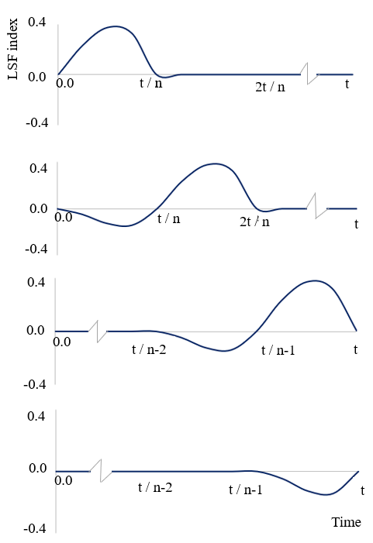
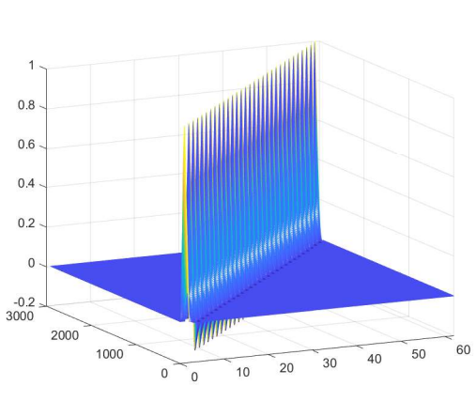
Load Shape Function (LSF)
Construction of prestressed bridge-vehicle system matrix
Time-beam
Virtual nodes
LSF matrix (displacement and rotation)
Bridge-vehicle system matrix
$f_{s} :$Sampling frequency
$F_{l} :$LSF frequency
Block-diagonal matrix
Load shape function (displacement)
Load shape function (rotation)
Number of time steps within the element $\left(ε\right)=\frac{f_{s}}{{2F}_{l}}$
Jeyamohan et al.

Slide 10
Truncated Load Shape Function (TLSF)
Proposed approach for the estimation of truncating coefficient
Improve the force identification accuracy
Introduce the truncating coefficient $(ψ)$
TLSF
By eliminating ineffective elements from the shape function matrix
$$ψ=\frac{\sum_{i=1}^{p}{n_{N_{1,i}}}+\sum_{ε−p}^{p}{n_{N_{2,i}}}+\sum_{ε−p}^{ε}{n_{N_{3,i}}}+\sum_{ε−p}^{p}{n_{N_{4,i}}}}{\sum_{i=1}^{ε}{\left.{\left(n\right.}_{N_{1,i}}+n_{N_{2,i}}+n_{N_{3,i}}+n_{N_{4,i}}\right)}}$$
$$F=ψNα$$
$$In general, value of ψ within the range of 0.9 and 0.95$$
$n_{N_{1,i}}, n_{N_{2,i}}, n_{N_{3,i}} and n_{N_{4,i}}$ are the number of elements in the matrix with respect to the shape function.
$p (<ε)$ is the truncating point and number of steps within the element ($ε)=\frac{f_{s}}{2F}$ (1, 2, 3…. $ε/2$,…., $p,$… $ε−2$, $ε−1$, $ε$) .
$f_{s}$ is the sampling frequency and F is the main frequency
Zhong et al. (2022)
Jeyamohan et al.

Slide 11
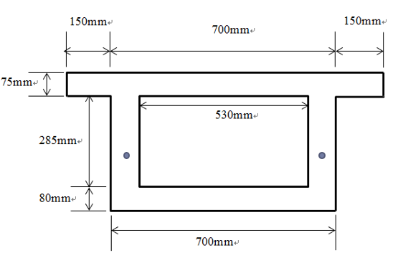
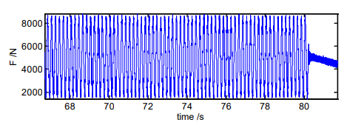
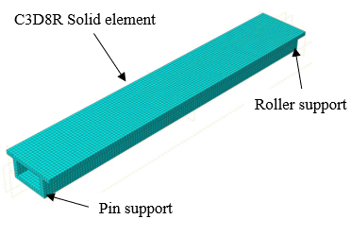
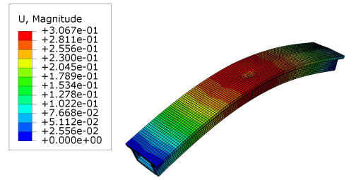
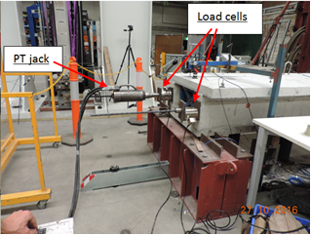
Verification of the proposed approach
Proposed approach is validated using laboratory model and numerical study.
Vehicle excitation and PF for the numerical and laboratory model
Cases | PF (kN) | Excitation force (N)
1 | 170.0 | $$20000(1+0.73Sin\left(10π\left(t−0.02\right)\right))$$
2 | 380.0 | $$20000(1+0.73Sin\left(10π\left(t−0.02\right)\right))$$
Laboratory model | 171.3 | $$4985(1+0.73Sin\left(10π\left(t−0.02\right)\right))$$
Excitation force on the bridge model
Geometry of the prestressed box girder bridge model.
Load cell
Hydraulic jack
ABAQUS model arrangement
Deformed shape of the box girder bridge
Laboratory model of the box girder bridge
Jeyamohan et al.

Slide 12
Ill-Posedness in the LSF
Fast Fourier Transform
$$Measured responses$$
$$Power spectral density curve$$
2%, 5% and 10%
$$Sensitivity analysis$$
$$F_{l}$$
Influence of LSF’s frequency on the singular values
$F_{l}$is sensitive to the level of noise
Condition number ($\frac{σ_{1}}{σ_{n}})$is reduced
$${Increase F}_{l}$$
$$Improve the accuracy$$
Eliminate the ineffective elements
Influence of noise level in the LSF frequency
$$Number of time step is reduced$$
Jeyamohan et al.

Slide 13
PF and MF identification via LSF and TLSF
RPE with TLSF for different cases
Cases | RPE (%) | RPE (%)
 | MF | PF
1 | 3.73 | 3.62
2 | 3.45 | 3.33
Laboratory model | 4.25 | 3.84
Identification of MF using LSF and TLSF
Identification of PF using LSF and TLSF
TLSF has reduced RPE by 40.50% in MF identification and 33.33% in PF identification when compared to LSF.
TLSF approach effectively addresses the issue of ill-posedness resulting from the LSF.
Jeyamohan et al.

Slide 14
Conclusion
Less computational effort due to LSF approach.
Improve the PF and MF identification accuracy with less computational time.
Monitoring of prestressed concrete bridges can be performed with minimal data without traffic disturbance.
MF can be identified without knowledge of the vehicle characteristics and road surface condition.
Proposed approach enables the early bridge assessment and maintenance.
Jeyamohan et al.

Slide 15
References
H.-L. (Roger) Chen and K. Wissawapaisal, ‘Measurement of Tensile Forces in a Seven-Wire Prestressing Strand Using Stress Waves’, J Eng Mech, vol. 127, no. 6, pp. 599–606, Jun. 2001, doi: 10.1061/(ASCE)0733-9399(2001)127:6(599).
S. S. Law and Z. R. Lu, ‘Time domain responses of a prestressed beam and prestress identification’, J Sound Vib, vol. 288, no. 4–5, pp. 1011–1025, Dec. 2005, doi: 10.1016/j.jsv.2005.01.045.
Z. R. Lu and S. S. Law, ‘Identification of prestress force from measured structural responses’, Mech Syst Signal Process, vol. 20, no. 8, pp. 2186–2199, Nov. 2006, doi: 10.1016/j.ymssp.2005.09.001.
J. Gao, B. Shi, W. Zhang, and H. Zhu, ‘Monitoring the stress of the post-tensioning cable using fibre optic distributed strain sensor’, Measurement, vol. 39, no. 5, pp. 420–428, Jun. 2006, doi: 10.1016/j.measurement.2005.12.002.
P. Lundqvist and J. Riihimäki, ‘Testing of five 30-year-old prestressed concrete beams’, PCI Journal, vol. 55, no. 4, pp. 50–58, Sep. 2010, doi: 10.15554/pcij.09012010.50.58.
J. B. Jang, K. M. Hwang, H. P. Lee, and B. H. Kim, ‘An assessment of the prestress force on the bonded tendon by SI and impact signal analysis techniques’, Nuclear Engineering and Design, vol. 255, pp. 9–15, Feb. 2013, doi: 10.1016/j.nucengdes.2012.10.004.
B. Gencturk, K. Hossain, A. Kapadia, E. Labib, and Y.-L. Mo, ‘Use of digital image correlation technique in full-scale testing of prestressed concrete structures’, Measurement, vol. 47, pp. 505–515, Jan. 2014, doi: 10.1016/j.measurement.2013.09.018.
Jeyamohan et al.

Slide 16
References
S. Biswal and A. Ramaswamy, ‘Measurement of existing prestressing force in concrete structures through an embedded vibrating beam strain gauge’, Measurement, vol. 83, pp. 10–19, Apr. 2016, doi: 10.1016/j.measurement.2016.01.031.
M. Hussin, T. H. T. Chan, S. Fawzia, and N. Ghasemi, ‘Identifying the Prestress Force in Prestressed Concrete Bridges Using Ultrasonic Technology’, International Journal of Structural Stability and Dynamics, vol. 20, no. 10, p. 2042014, Sep. 2020, doi: 10.1142/S0219455420420146.
M. Bonopera, K.-C. Chang, C.-C. Chen, Y.-C. Sung, and N. Tullini, ‘Feasibility Study of Prestress Force Prediction for Concrete Beams Using Second-Order Deflections’, International Journal of Structural Stability and Dynamics, vol. 18, no. 10, p. 1850124, Oct. 2018, doi: 10.1142/S0219455418501249.
S. S. Law, T. H. T. Chan, and Q. H. Zeng, ‘Moving force identification: A time domain method’, J Sound Vib, vol. 201, no. 1, pp. 1–22, Mar. 1997, doi: 10.1006/jsvi.1996.0774.
T. H. T. Chan, S. S. Law, T. H. Yung, and X. R. Yuan, ‘An interpretive method for moving force identification’, J Sound Vib, vol. 219, no. 3, pp. 503–524, Jan. 1999, doi: 10.1006/jsvi.1998.1904.
S. S. Law, T. H. T. Chan, and Q. H. Zeng, ‘Moving Force Identification—A Frequency and Time Domains Analysis’, J Dyn Syst Meas Control, vol. 121, no. 3, pp. 394–401, Sep. 1999, doi: 10.1115/1.2802487.
T. H. T. Chan, S. S. Law, and T. H. Yung, ‘Moving force identification using an existing prestressed concrete bridge’, Eng Struct, vol. 22, no. 10, pp. 1261–1270, Oct. 2000, doi: 10.1016/S0141-0296(99)00084-X.
Jeyamohan et al.

Slide 17
References
S. S. Law and Y. L. Fang, ‘Moving force identification: Optimal state estimation approach’, J Sound Vib, vol. 239, no. 2, pp. 233–254, Jan. 2001, doi: 10.1006/jsvi.2000.3118.
X. Q. Zhu and S. S. Law, ‘Orthogonal function in moving loads identification on a multi-span bridge’, J Sound Vib, vol. 245, no. 2, pp. 329–345, Aug. 2001, doi: 10.1006/jsvi.2001.3577.
T. H. T. Chan and D. B. Ashebo, ‘Theoretical study of moving force identification on continuous bridges’, J Sound Vib, vol. 295, no. 3–5, pp. 870–883, Aug. 2006, doi: 10.1016/j.jsv.2006.01.059.
L. Wang, J.-L.Hou and J.-P.Ou, ‘Moving force identification based on load shape function for a long-span bridge structure’, Chinese Journal of Computational Mechanics, vol. 29, no. 2, pp. 153–158, Apr. 2012.
S. Pourzeynali, X. Zhu, A. Ghari Zadeh, M. Rashidi, and B. Samali, ‘Comprehensive Study of Moving Load Identification on Bridge Structures Using the Explicit Form of Newmark-β Method: Numerical and Experimental Studies’, Remote Sens (Basel), vol. 13, no. 12, p. 2291, Jun. 2021, doi: 10.3390/rs13122291.
J. Yang, P. Hou, C. Yang, and Y. Zhang, ‘Study on the Method of Moving Load Identification Based on Strain Influence Line’, Applied Sciences, vol. 11, no. 2, p. 853, Jan. 2021, doi: 10.3390/app11020853.
X. Zhou, Y. Zeng, and Y. Zhang, ‘A probabilistic method for dynamic force identification of uncertain structures’, J Sound Vib, vol. 554, p. 117688, Jun. 2023, doi: 10.1016/j.jsv.2023.117688.
Jeyamohan et al.

Slide 18
References
J. Zhong, Z. Xiang, and C. Li, ‘Synchronized Assessment of Bridge Structural Damage and Moving Force via Truncated Load Shape Function’, Applied Sciences, vol. 12, no. 2, p. 691, Jan. 2022, doi: 10.3390/app12020691.
Z. Xiang, T. H. T. Chan, D. P. Thambiratnam, and A. Nguyen, ‘Prestress and excitation force identification in a prestressed concrete box-girder bridge’, Computers and Concrete, vol. 20, no. 5, pp. 617–625, 2017.
Z. Xiang, T. H. T. Chan, D. P. Thambiratnam, and T. Nguyen, ‘Synergic identification of prestress force and moving load on prestressed concrete beam based on virtual distortion method’, Smart Struct Syst, vol. 17, no. 6, pp. 917–933, Jun. 2016, doi: 10.12989/sss.2016.17.6.917.
Jeyamohan et al.

Slide 19
Thank You
Jeyamohan et al.

