Slide 1
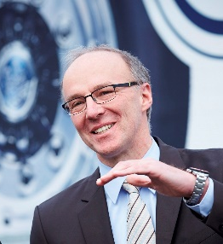
Axle design as a key factor for greening road freight transport
Hans Werner Kopplow
Director electromobility and innercity solutions at
BPW Bergische Achsen KG, Wiehl, Germany.

Slide 2



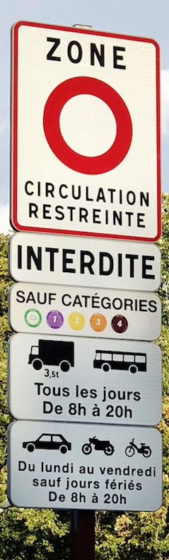



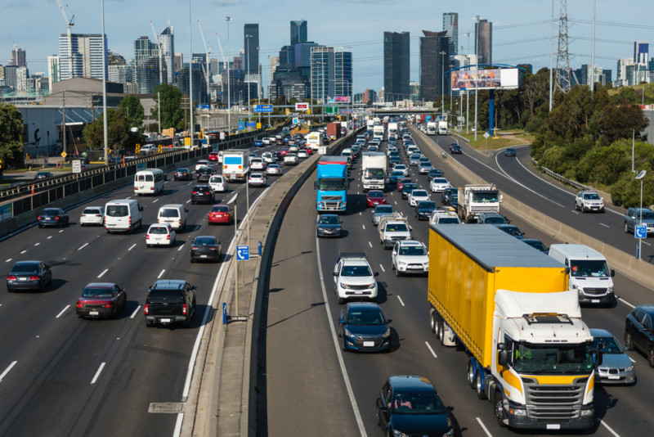
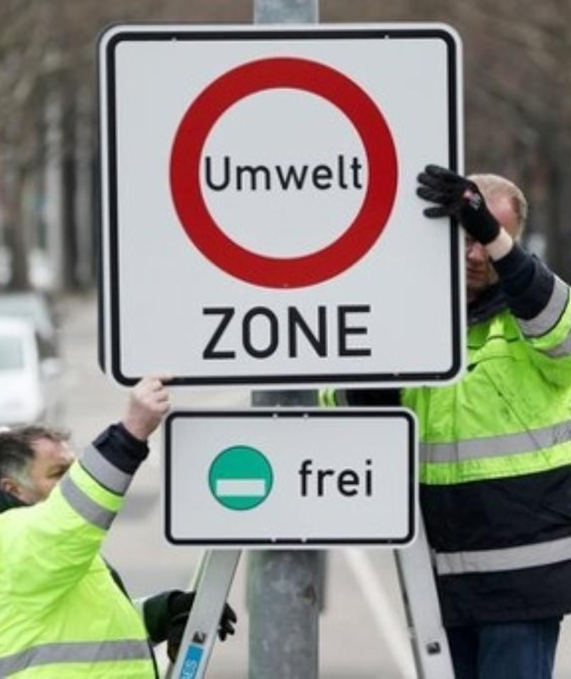
Electrification of road freight transport
Text in “Arial” size 36
Smaller text can be used
Larger text can also be used
Author:
Hans Werner Kopplow
Notes:
Be it Paris, Brussels, Berlin, Sidney or Melbourne: Large metropolises suffer from high traffic congestion with many traffic jams and high noise and pollution levels.

Slide 3
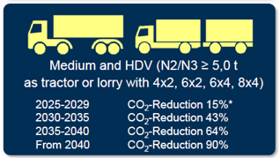
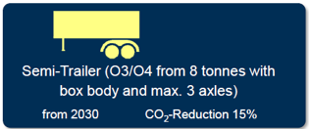
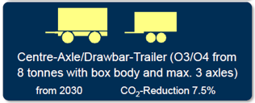

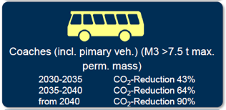
Electrification of road freight transport
In Europe, a significant tightening of the legal regulations to reduce CO2 emissions in trans-port is being discussed.
According to the current proposal for the revision of EU 2019/1242, trucks will have to demon-strate significant reductions in CO2 emissions from 2030.
>2030: -43%
> 2040: -90%
Otherwise, there is a threat of significant fines.
The new limits can only be achieved with alternative drives.
-> Electric drives are gaining ground.
Author:
Hans Werner Kopplow

Slide 4
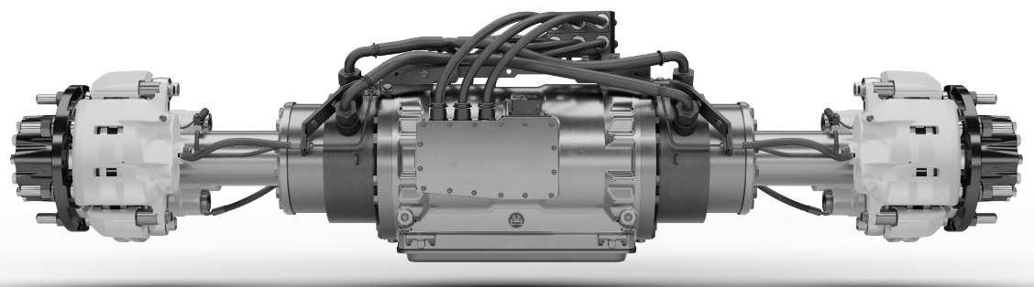
Axle-integrated electric drives
Electric drives offer the possibility of integration into the drive axle itself.
Advantages:
- Space-saving design with maximum installation space for batteries and other components.
- Low system weight due to compact arrangement on the axle
- High efficiency due to low number of parts
- Good traction control
- Potential for torque vectoring
BPW eTransport axle
Motor- gearbox- unit
2 electric motors and gearboxes integrated
BPW started to present axle integrated electric drives in 2016.
Due to its advantages axle-mounted electric drives will prevail in trucks.
Author:
Hans Werner Kopplow

Slide 5
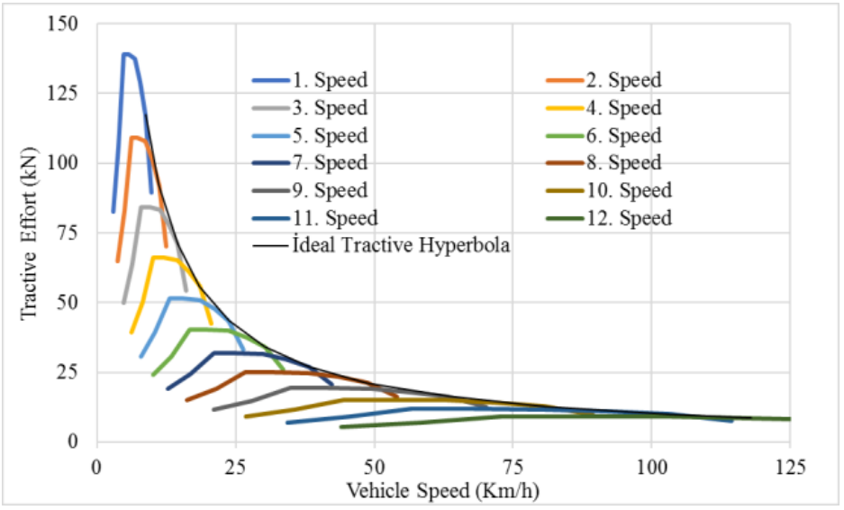
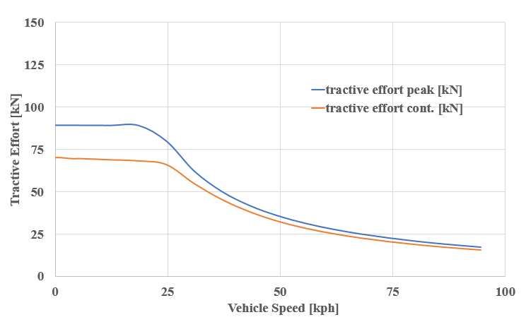
Axle-integrated electric drives drive train characteristics
Diesel engine:
narrow usable speed range
gearboxes with many ratios required
to meet the ideal tractive hyperbola
Electric motor:
Wide usable speed range
E- motor characteristic curve comes close to the ideal curve
single- gear transmissions are already well suited in many cases, especially in inner-city delivery applications
Author:
Hans Werner Kopplow

Slide 6
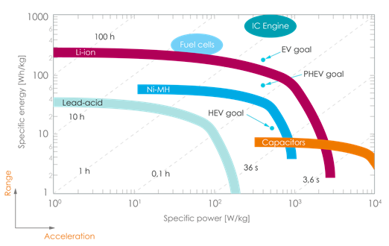
Axle-integrated electric drives efficiency and range
The biggest limitation of a battery- electric vehicle is the range,
due to the limited energy storage capacity.
Energy density of fuel is 70 times higher than that of a battery. Battery: 140 Wh/kg vs. Fuel: 11.000 Wh/kg
Efficiency of electric drive trains are becoming more important.
The overall efficiency of an electric drive is approx. 80-90%, while that of a combustion engine is max. 40%.
Energy consumption electric vehicle vs. ICE is 1 : 2 - 1 : 3
Author:
Hans Werner Kopplow

Slide 7
Axle-integrated electric drives drive train characteristics
A truck e-drive usually has the range of optimum efficiency at medium speeds.
At high and low speeds the efficiency drops.
In innercity distribution the main operating points are at
medium speeds, and thus in a range of excellent efficiencies.
In Long- haul operation the main operating points are at
high speeds, and thus in a range of non-optimal efficiencies.
To optimize efficiency it may make sense to provide a 2- or
even 3-speed gearbox. By using a 2- speed transmission,
the engine speed can be reduced, bringing the engines into
a more favourable efficiency range.
Efficiency improves by up to 10% at highway speeds.
Electric drives with 1- speed vs. 2- speed transmission
-> delivery trucks are well equipped with a 1- speed transmission
-> long- haul trucks should be equipped with a 2-speed transmission
Innercity distribution
Long- haul
Author:
Hans Werner Kopplow

Slide 8
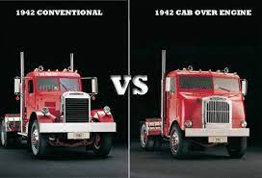
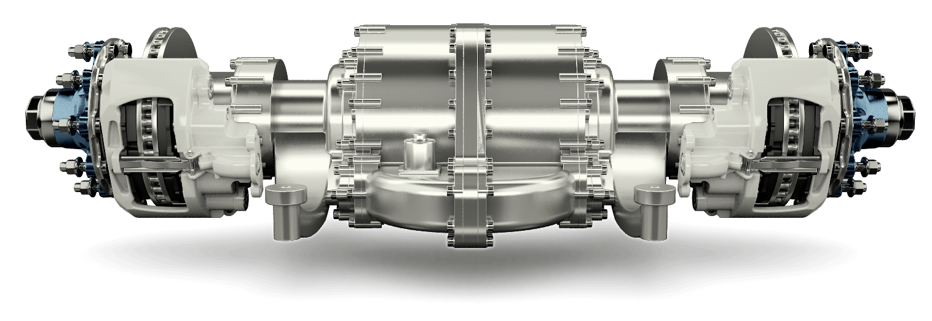
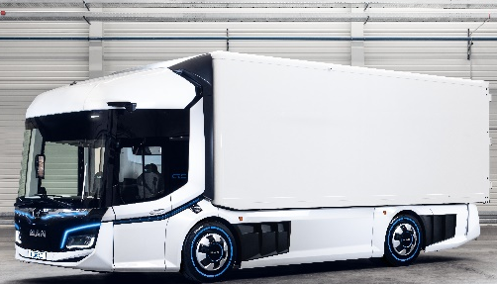
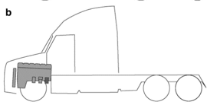
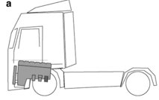
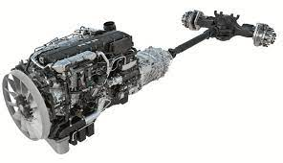
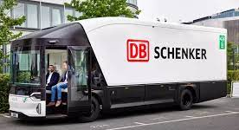
Electric vs. diesel- powertrains and their impact on vehicle architecture.
In the last century, truck design was dominated by the internal combustion engine.
Depending on the legal constraints, either the conventional- or the cab over engine- truck design emerged.
Electric drives are no longer bound by these constraints but can be integrated directly into the drive axle.
This allows us to envisage new truck configu-rations in the future, especially in inner-city transport applications.
It is to be expected that trucks for inner-city transport will look different in the future than they have in the past.
Author:
Hans Werner Kopplow

Slide 9
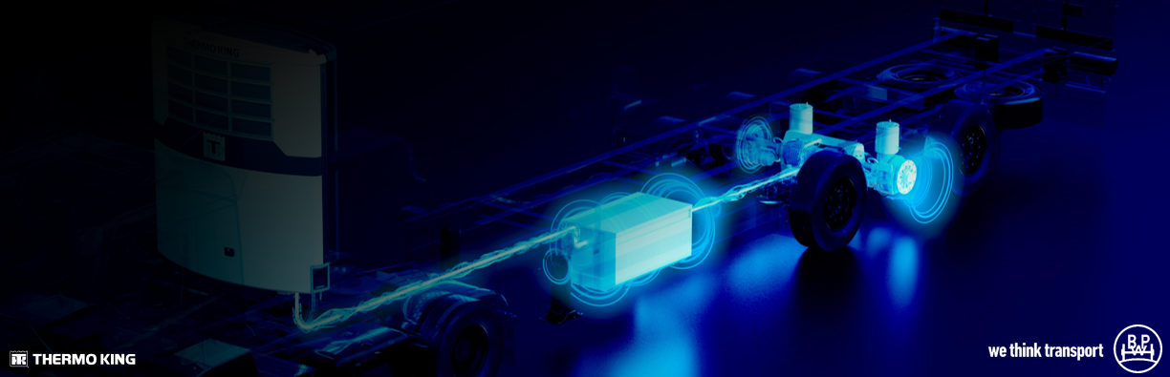
Trailer electrification – innovative solutions for the transport industry
Axle integrated e- drives can offer many advantages in trailer applications.
In the majority of countries, it is currently not yet possible to register trailers with an additional e-drive.
But...It is possible to recuperate electrical energy in the trailer and use it to supply auxiliary consumers such as the refrigeration unit.
Advantages for reefers:
Silent operation
Elimination of fuel consumption
Reduction of CO2- emissions
reefer unit is locally emission free
Author:
Hans Werner Kopplow

Slide 10
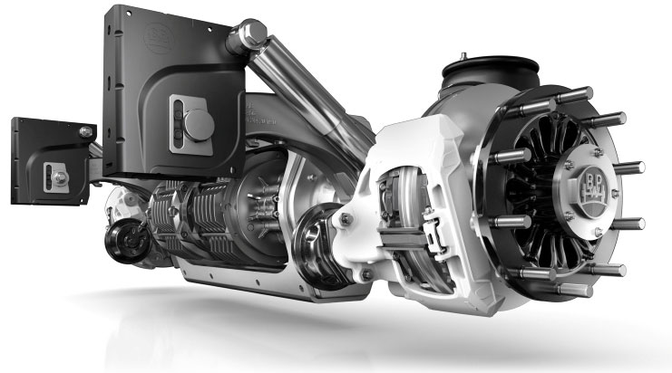
Trailer electrification – innovative solutions for the transport industry
ePower- trailer axle
2x generator transmission units:
5.5 kW, 8 kW max. each,
asynchronous motors, air cooled
Recuperates electric energy
Temporarily stores it in a battery
for the energy supply of a refrigeration unit
Current design:
  ECO Air 9 to
  22,5“, 19,5“ single, offset 120
  Disc brake TS2 4309/ 3709
Can easily be integrated in nearly every refrigeration trailer
Author:
Hans Werner Kopplow

Slide 11
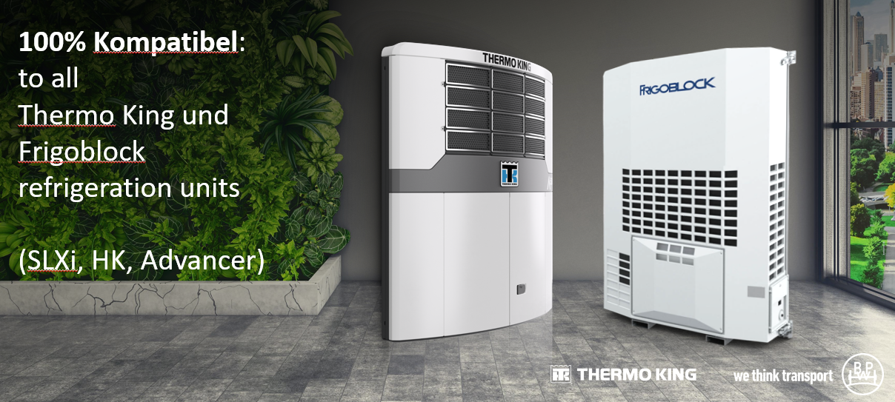
Trailer electrification – innovative solutions for the transport industry
Author:
Hans Werner Kopplow

Slide 12
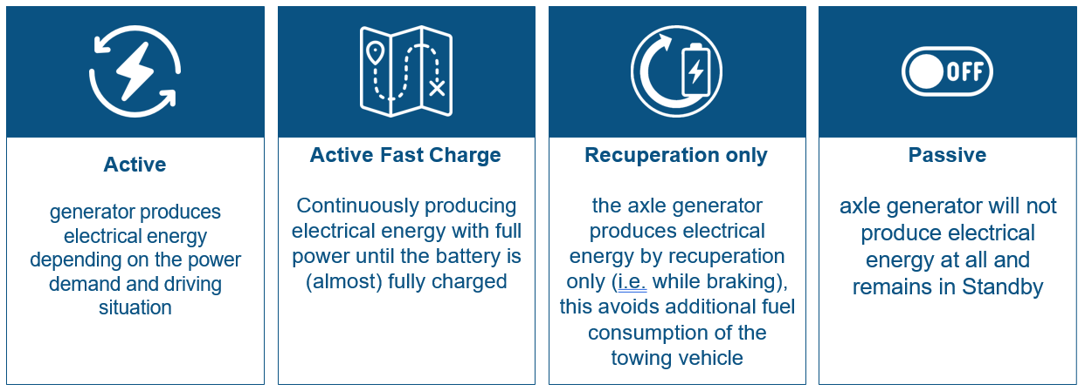
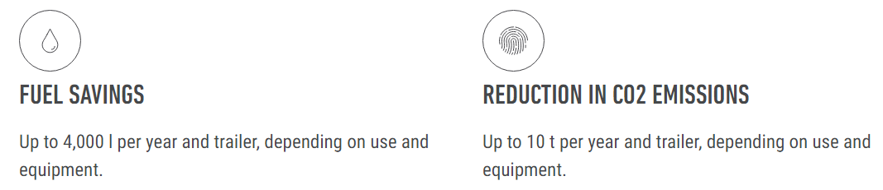
Trailer electrification – innovative solutions for the transport industry
Operation modes:
Benefits:
Author:
Hans Werner Kopplow

Slide 13
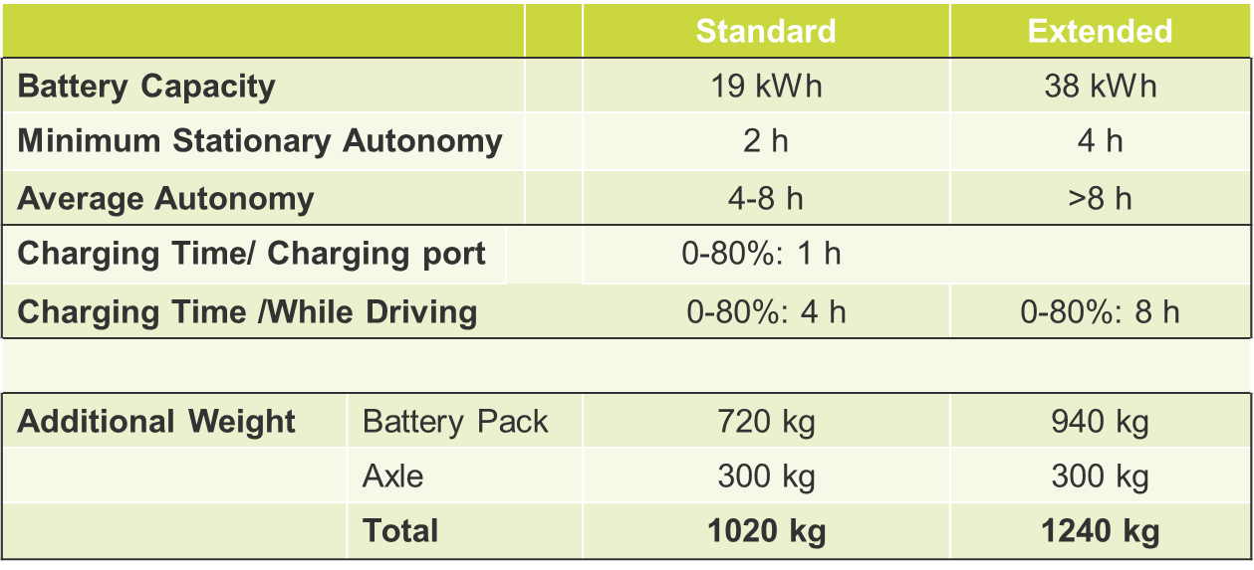
Trailer electrification – innovative solutions for the transport industry
Text in “Arial” size 36
Smaller text can be used
Larger text can also be used
The period of autonomy depends on the battery capacity and is therefore limited.
Pure electric system
Author:
Hans Werner Kopplow

Slide 14
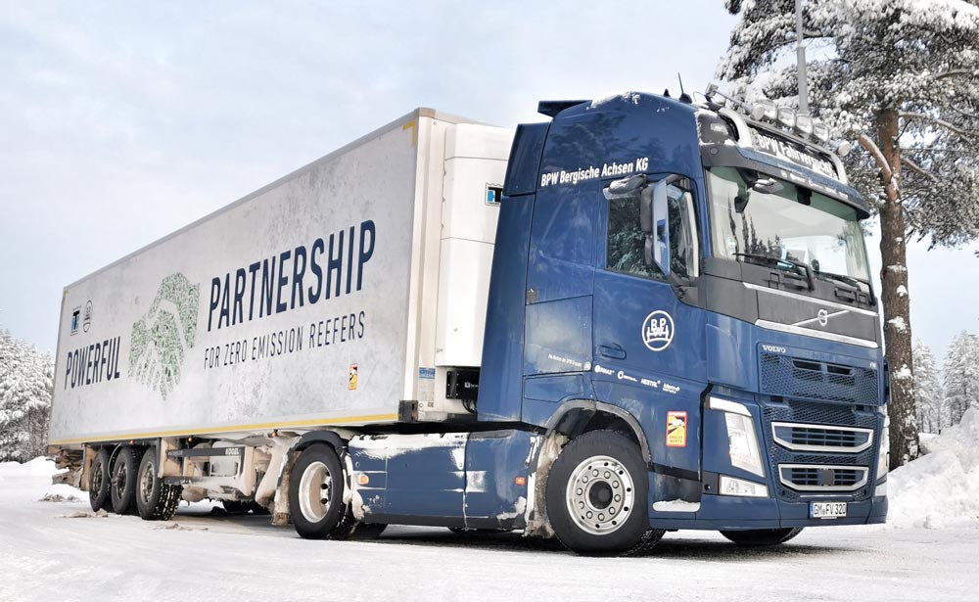
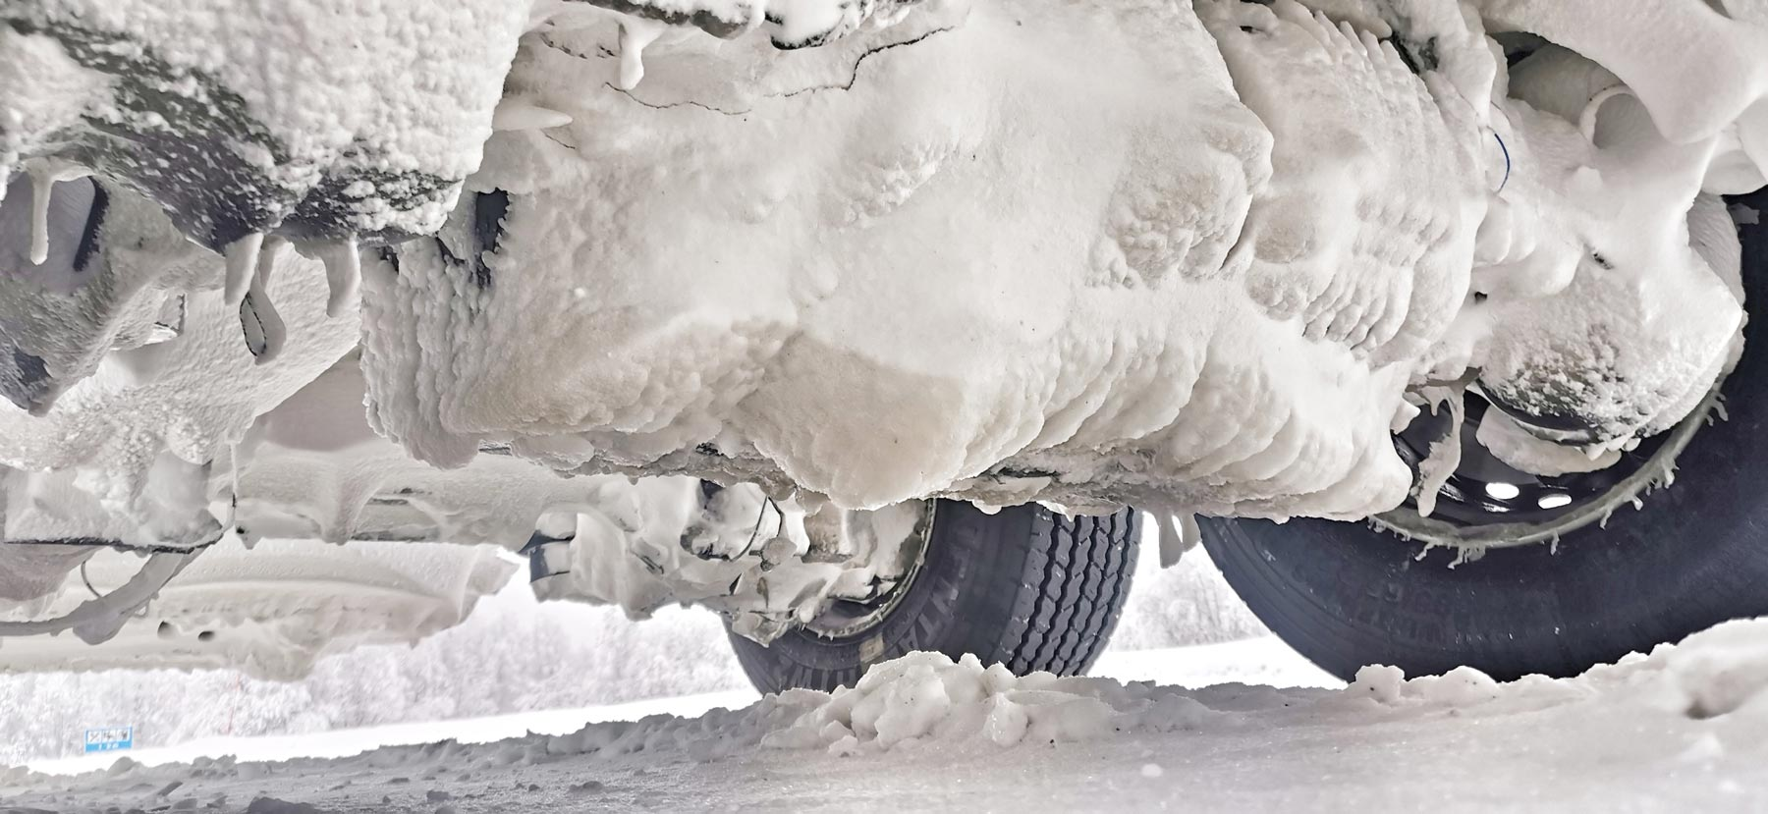
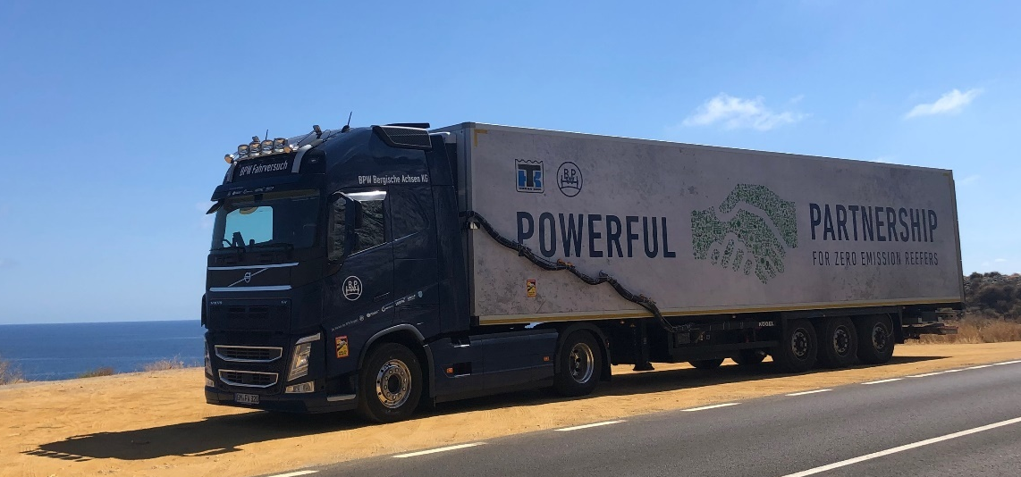
Trailer electrification – innovative solutions for the transport industry
Tested under toughest conditions
Ambient temperatures -25 to + 40°C
Wintertest in Scandinavia
Summertest in south of spain
Regardless of the external conditions, the system works reliably within the intended temperature range.
Author:
Hans Werner Kopplow

Slide 15
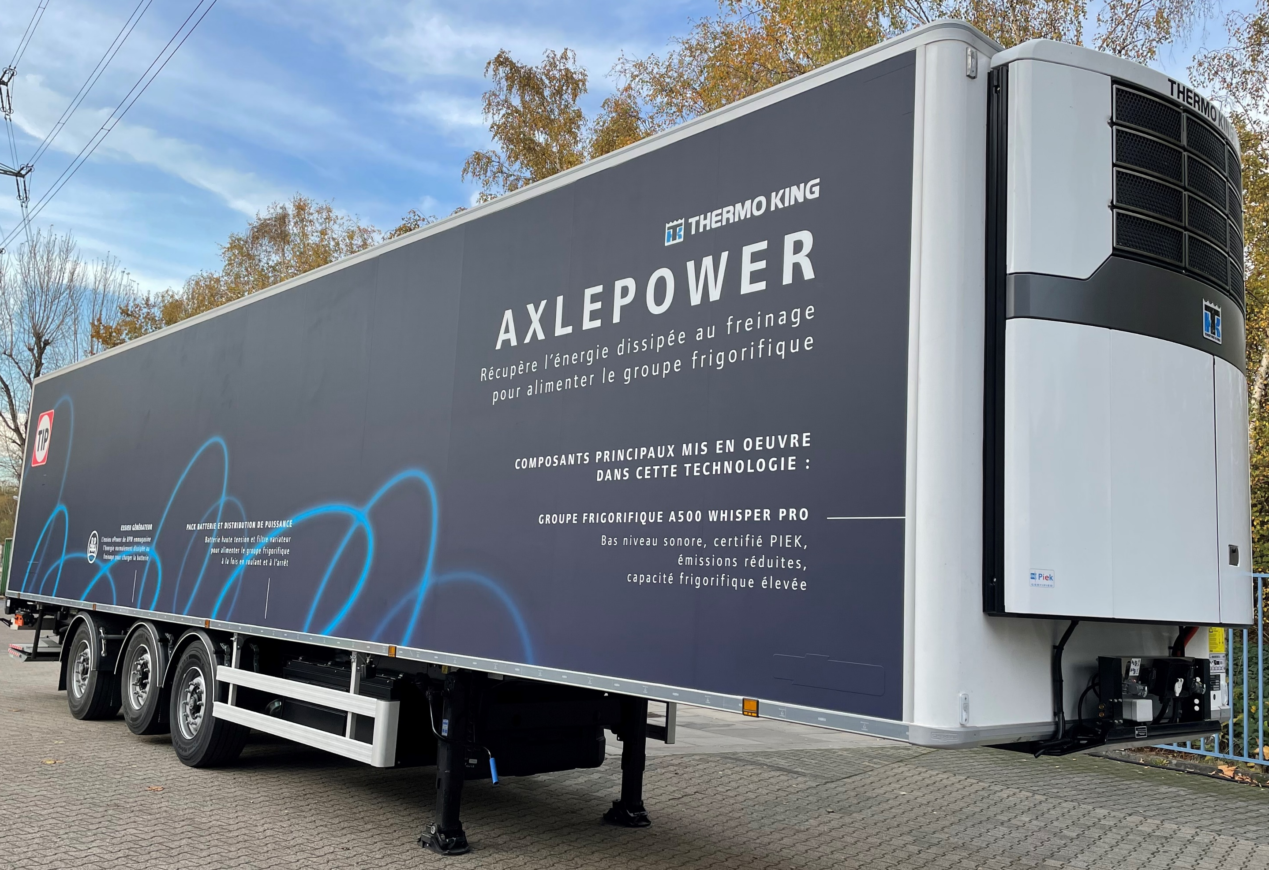
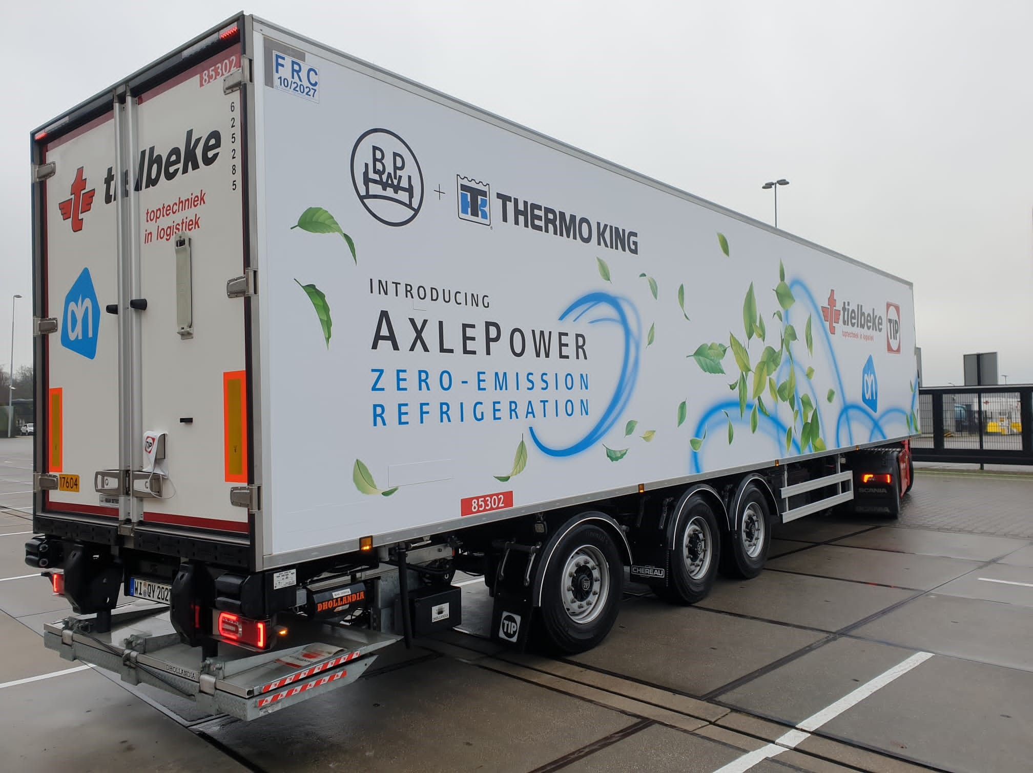
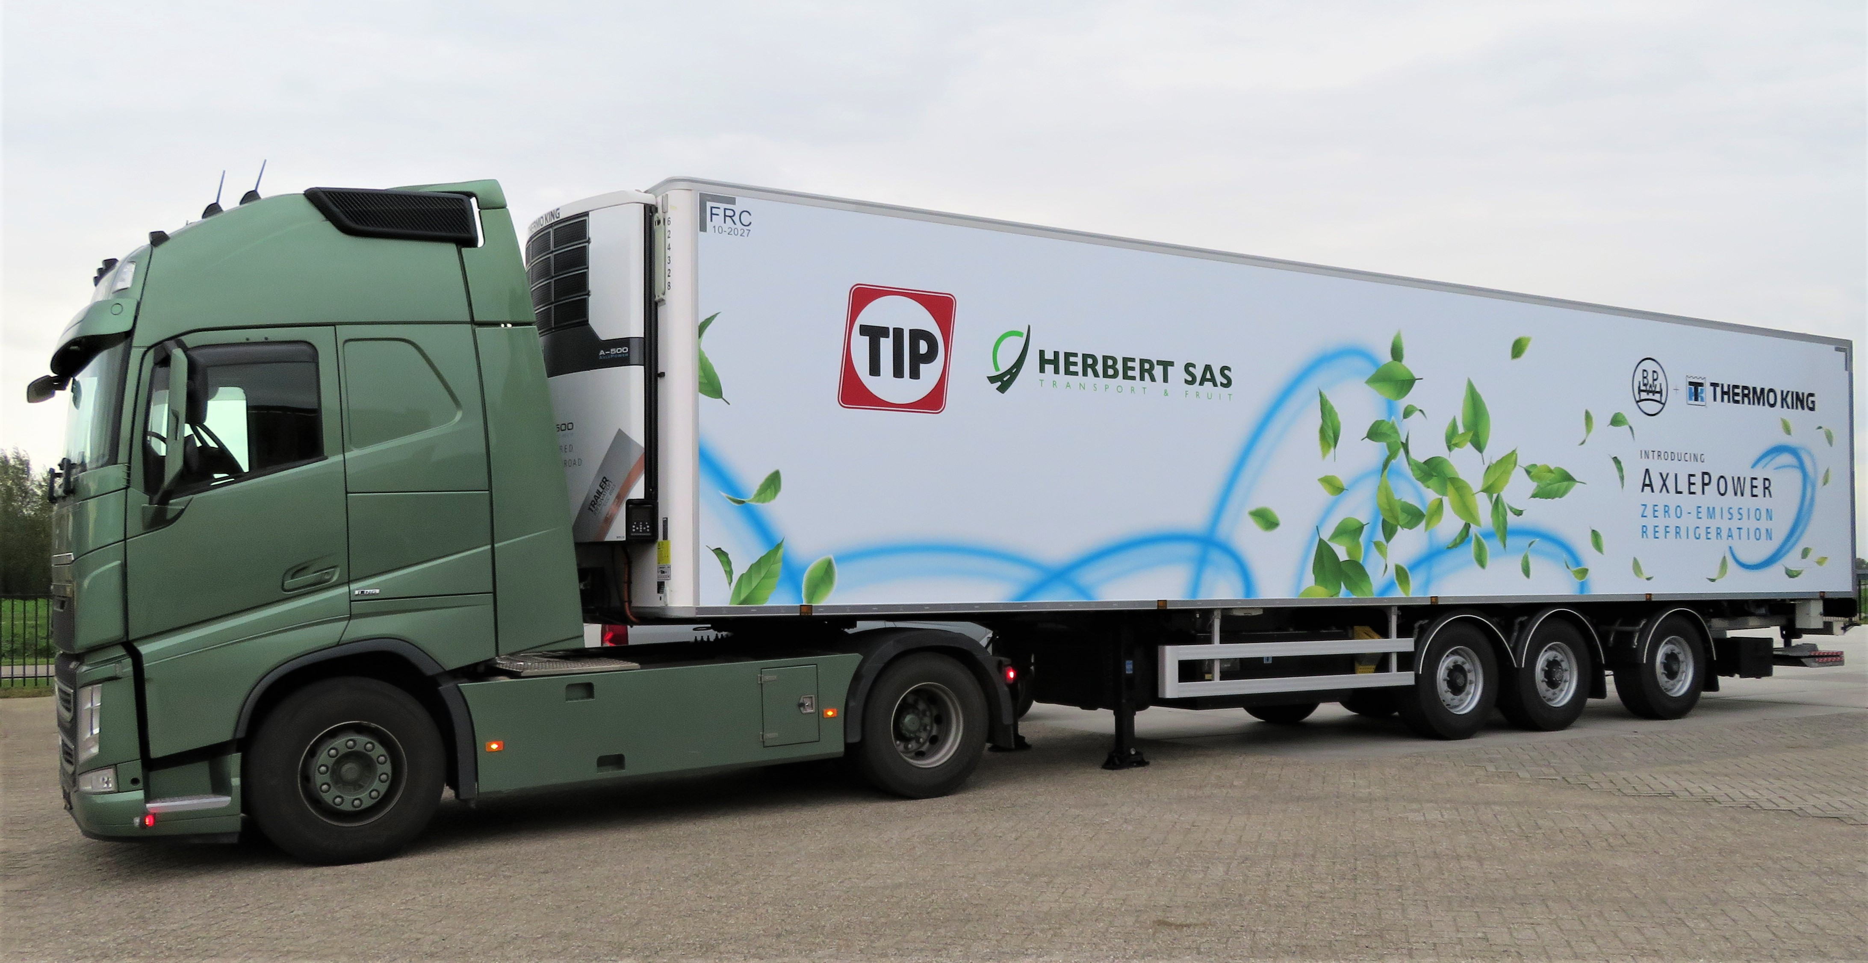
Trailer electrification – innovative solutions for the transport industry
A field test with different customers started in 2022.
Mileage of the 5 test vehicles to date approx. 250 tkm.
Individual trailers have driven >50.000km without charging.
100% independent, electrical operation
Customers praise the easy operation.
Customers have not noticed any noticeable increase in
fuel consumption on the trucks.
The field trial is currently being exten-
ded to other vehicles and countries.
A first system is on its way to
Australia to prove suitability.
Author:
Hans Werner Kopplow

Slide 16

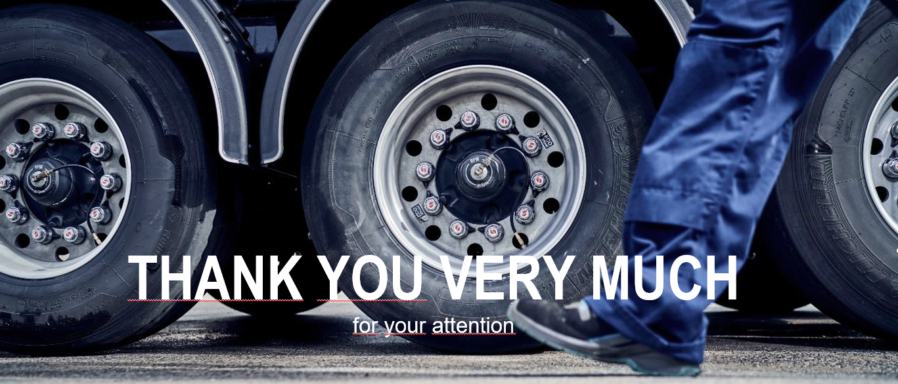
Axle design as a key factor for greening road freight transport
Author:
Hans Werner Kopplow

