Slide 1
A review of more than a decade of research and field tests on longer vehicle combinations in Sweden that supported road approval
Sogol Kharrazi, Leo Laine, Lena Larsson, Jesper Sandin,
Bengt Jacobson, Thomas Asp, Omar Bagdadi
VTI, Volvo, Chalmers, Swedish Transport Administration, Swedish Transport Agency

Slide 2
HCT progress in Sweden
For more than a decade, LVCs have been tested in Sweden on roads and test tracks and studied in simulations.
S. Kharrazi, L. Laine, L. Larsson, J. Sandin, B. Jacobson, T. Asp, O. Bagdadi

Slide 3
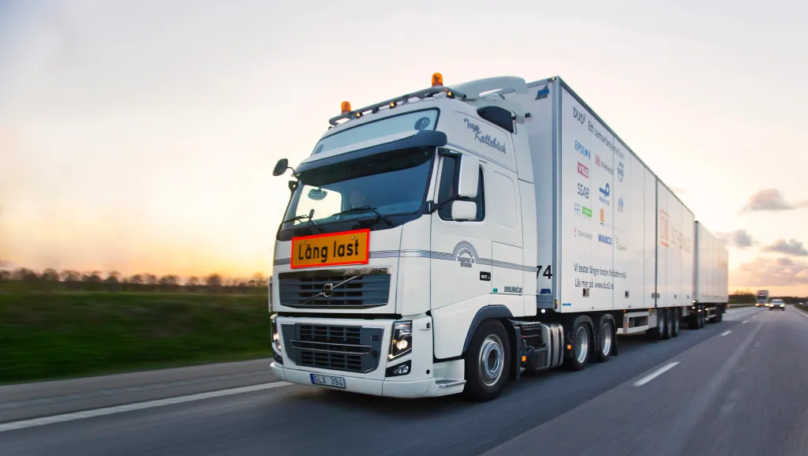
Trials in Sweden
Up till 2018, 80 different vehicle combinations were part of the trials and about half of them were LVCs with lengths up to 34 m (used in 15 trials).
The A-double combination, referred to as DOU-trailer, driven between Gothenburg and Malmö since 2010
The A-double within Scania Transportlab initiative, driven between Södertälje and Malmö
The A-double within the Volvo Autofreight projects, driven between Gothenburg and Borås since 2017
The A-double carrying containers for Jula company, tested between rail station in Falköping and Skara
S. Kharrazi, L. Laine, L. Larsson, J. Sandin, B. Jacobson, T. Asp, O. Bagdadi

Slide 4
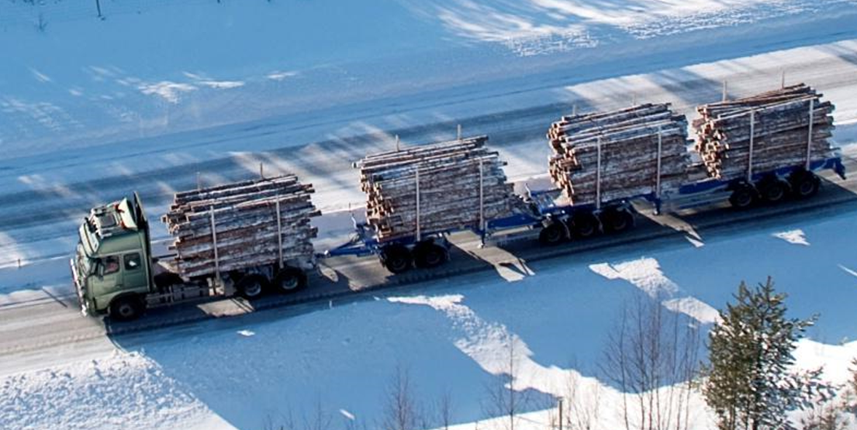
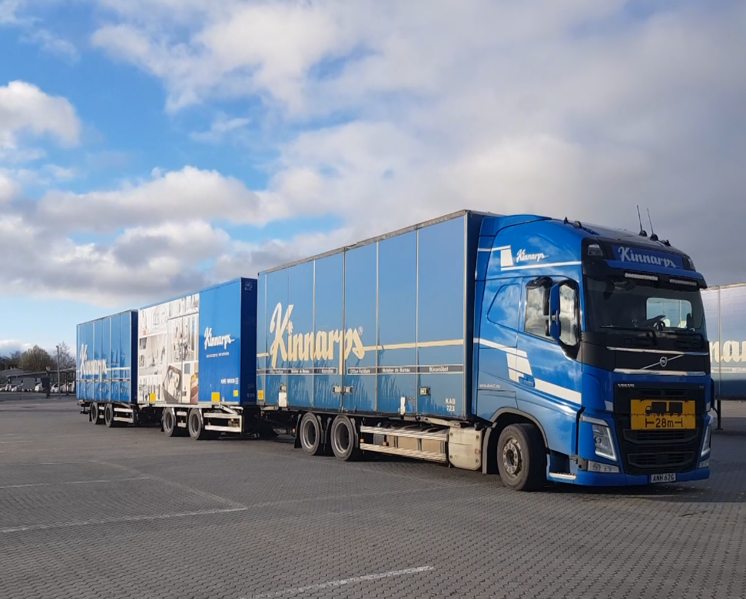
Trials in Sweden
Up till 2018, 80 different vehicle combinations were part of the trials and about half of them were LVCs with lengths up to 34 m (used in 15 trials).
Different versions of ETT vehicle, truck-dolly-link-semitrailer (AB-double), tested in forest industry since 2009
Truck with two center axle trailers (DUO-CAT), started to roll between Gothenburg and Helsingborg in 2015
The DUO-ETT combination (tractor-semitrailer-full trailer), transporting timber in northern Sweden since 2020
The B-double combination with a long link-trailer, carrying two 45-foot containers, tested in Gothenburg since 2021
S. Kharrazi, L. Laine, L. Larsson, J. Sandin, B. Jacobson, T. Asp, O. Bagdadi

Slide 5
Regulatory framework
Two national projects on PBS have been carried out since 2012
The aim of the first project was to propose a PBS scheme for Sweden
The second project was focused on development of standard tire models
Outcomes of PBS projects have been used to determine the “technical requirements” for HCT vehicles
“Truck-calculator” tool (Latbilskalkylator)
A web-based assessment tool for 74-ton vehicles, developed at Swedish Transport Agency
Needs to be further developed to cover LVCs and their potential performance measures
The OpenPBS tool developed during the PBS projects is a candidate for the next version of the tool
S. Kharrazi, L. Laine, L. Larsson, J. Sandin, B. Jacobson, T. Asp, O. Bagdadi

Slide 6
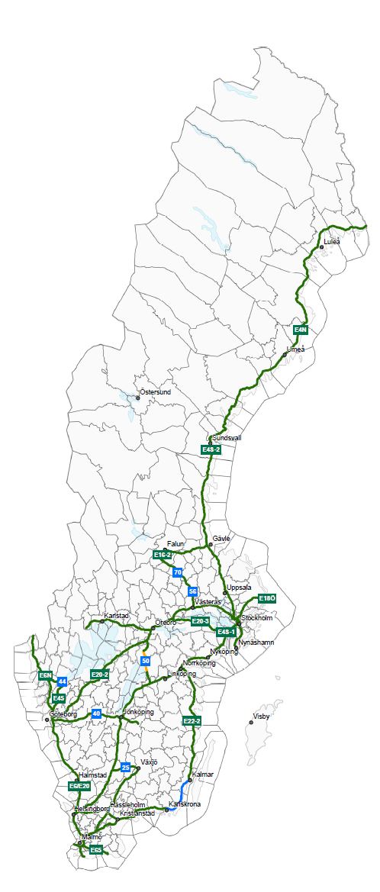
Regulatory framework
To speed up LVCs introduction, in the first phase a PBS based prescriptive approach will be used:
Dimension envelopes based on performance criteria, similar to the Canadian approach
Two vehicle combination types: A-double and AB-double
The designated road network (about 5900 km) will be opened on Dec 1st, 2023
S. Kharrazi, L. Laine, L. Larsson, J. Sandin, B. Jacobson, T. Asp, O. Bagdadi

Slide 7
Safety and maneuverability
Sample studies (in addition to the PBS projects):
A study on performance of A-doubles in real traffic on Swedish road
  Offtracking and rearward amplification in SLC, presented at IAVSD (Behera et al. 2023)
  Swept path in roundabouts, to be presented at HVTT17 (Behera et al. 2023)
A simulation study on swept path of LVCs in roundabout
  Presented at HVTT16, (Larsson et al. 2021)
  Most of the vehicles can turn in a roundabout with outer/inner radius of 12.5/2.0 m
  All vehicles can pass the roundabout test by using steerable and liftable axles
An extensive simulation study of HCT vehicles with respect to common performance measures
  A summary was presented at HVTT15 (Larsson et al. 2018)
S. Kharrazi, L. Laine, L. Larsson, J. Sandin, B. Jacobson, T. Asp, O. Bagdadi

Slide 8
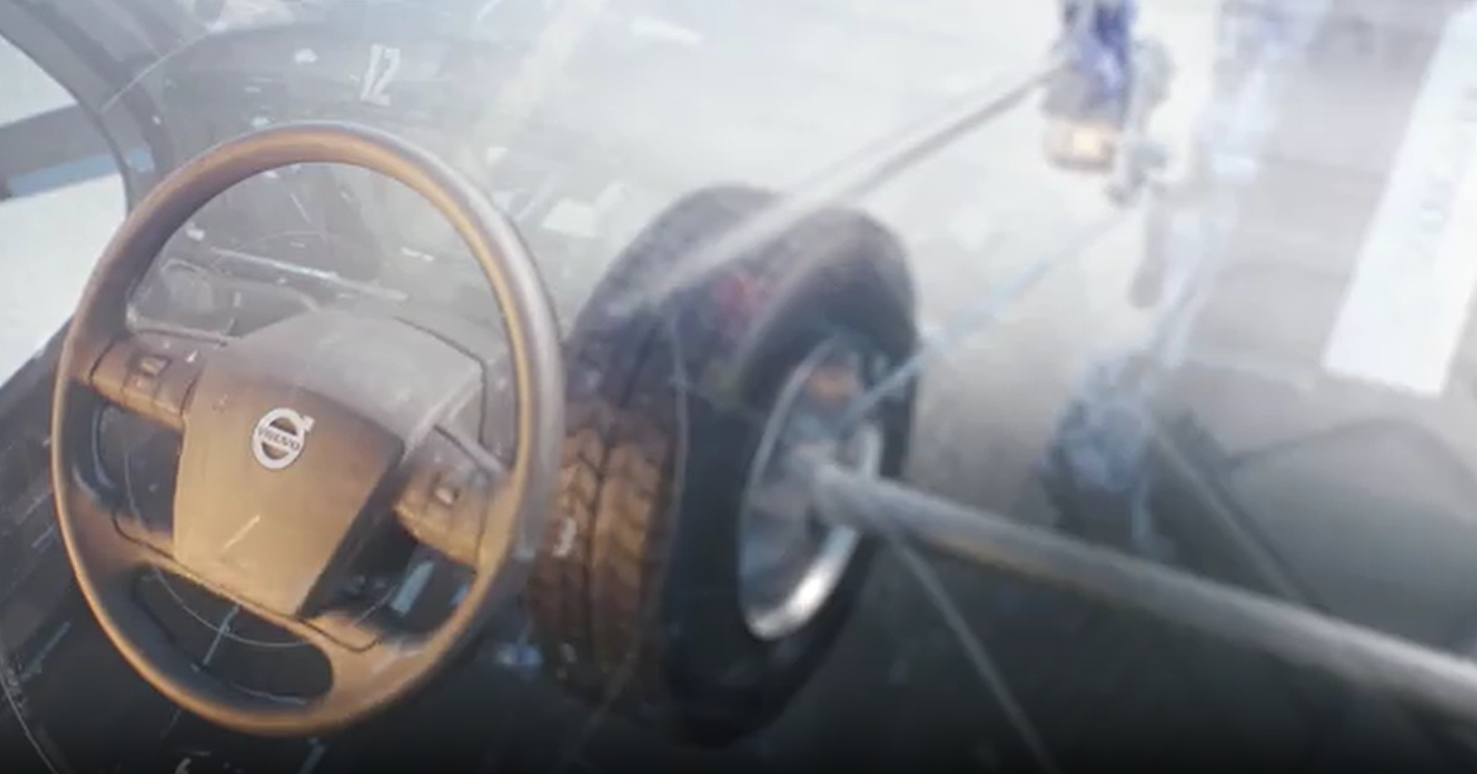
Safety and maneuverability
In addition to the passive safety of LVCs, the use of active safety for improved performance has been investigated in different projects in Sweden:
Active steering for reducing rearward amplification and offtracking in high-speed maneuvers has been studied in two PhD projects (Kharrazi 2012, Kati 2018).
Driving automation of LVCs for a given operational design domain has been investigated in another PhD project (Nilsson 2017).
S. Kharrazi, L. Laine, L. Larsson, J. Sandin, B. Jacobson, T. Asp, O. Bagdadi

Slide 9
Driver behavior and perception
Motion-based driving simulators is a useful tool for studying driving behavior and their perception of vehicle’s performance
Investigation of the required time to overtake an LVC (Andersson et al. 2012)
  The results did not show any drastic negative effects on traffic safety by introducing LVCs.
Comparison of two different automated driving systems for an A-double (Sandin & Nilsson 2014)
  Both systems were appreciated by the drivers, with a slight preference of the more advanced lateral control system.
S. Kharrazi, L. Laine, L. Larsson, J. Sandin, B. Jacobson, T. Asp, O. Bagdadi

Slide 10
Driver behavior and perception
Motion-based driving simulators is a useful tool for studying driving behavior and their perception of vehicle’s performance
Investigation of drivers’ actions prior a lane change in dense highway traffic (Nilsson et al. 2018)
  Driver decisions and actions are affected by the cooperation of surrounding traffic and urgency during mandatory lane changes.
Comparison of LVCs and conventional heavy vehicles in a study with 55 drivers (Kharrazi et al. 2019)
  PBS is a sound approach for assessing heavy vehicles safety and it correlates well with the drivers’ perception of the vehicle performance.
S. Kharrazi, L. Laine, L. Larsson, J. Sandin, B. Jacobson, T. Asp, O. Bagdadi

Slide 11
Accident analysis
Accident analysis of the existing “long” combinations (18.76-25.25 m) in Sweden in comparison with shorter combinations.
"long" combinations had lower rate of fatal or severe accidents per billion vehicle kilometers travelled compared to medium and short vehicles
Accident analysis of the HCT vehicles on trials in Sweden
Two accidents with LVCs during the Swedish trials between 2010 and 2016
The additional length was not the main cause of the accidents
S. Kharrazi, L. Laine, L. Larsson, J. Sandin, B. Jacobson, T. Asp, O. Bagdadi

Slide 12
Traction and electrification
Sample studies
Comparison of air and rolling resistances of LVCs and shorter combinations
  Presented at HVTT16 (Cider et al. 2021)
  Rolling resistance becomes larger than air resistance for LVCs around 80 km/h
  Highlighting importance of liftable axles for reducing rolling resistance
Startability and hill climbing
  Presented at HVTT15 (Cider et al. 2018)
  Successful hill start of an A-double is shown on an inclination of 11.7%
  An increased load of 5.5 t on the drive axle of an A-double by lifting semitrailer first axle and tractor last axle
  Highlighting importance of liftable axles for startability and hill climbing
S. Kharrazi, L. Laine, L. Larsson, J. Sandin, B. Jacobson, T. Asp, O. Bagdadi

Slide 13
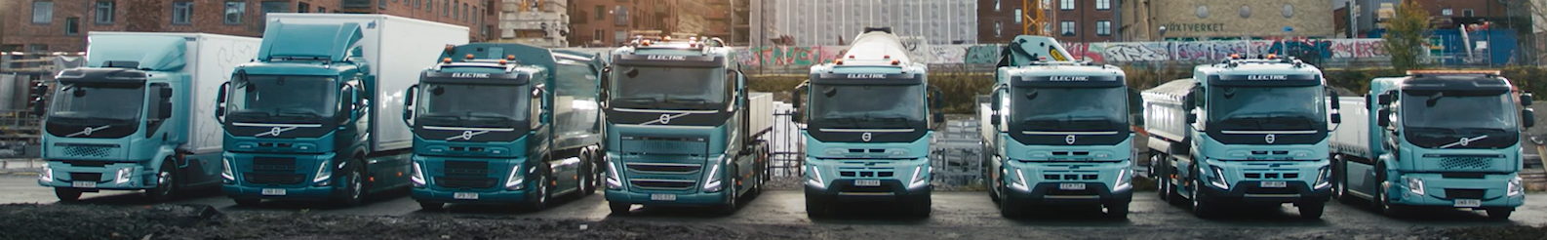
Traction and electrification
Sample studies
A study on smart dolly which can be propelled, steered, and braked
  Presented at HVTT13 (Kati et al. 2014)
  Improved startability and gradeability on wet and slippery roads
  A PhD project on distributed propulsion for safe and energy efficient driving (Ghandriz 2020)
  Optimization is used to select the best vehicle (size and propulsion system) for a given transport mission
  Battery electric and hybrid vehicle combinations exhibit the lowest total cost of ownership in certain scenarios
  Automation helps the adoption of battery electric heavy vehicles in freight transport
S. Kharrazi, L. Laine, L. Larsson, J. Sandin, B. Jacobson, T. Asp, O. Bagdadi

Slide 14
Socioeconomic aspects
Energy consumption
  Sweden HCT road map: HCT vehicles reduce the energy consumption per ton-km by about 10%.
  In another report by the Swedish Transport Administration this reduction is estimated to be about 13%.
  Larger savings, 15-20%, have also been reported, for instance in the ETT vehicle projects.
Noise emissions
  A comparative simulation study on noise emissions of LVCs and conventional vehicles was presented at HVTT15 (Sandberg et al. 2018).
  The noise emission from the considered LVC is higher than the conventional vehicle, per passage. But the number of vehicles for a certain transport mission is less, resulting noise exposure is very similar.
S. Kharrazi, L. Laine, L. Larsson, J. Sandin, B. Jacobson, T. Asp, O. Bagdadi

Slide 15
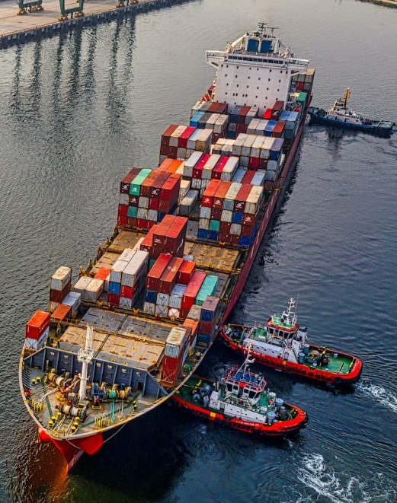
Socioeconomic aspects
Freight Transport work (driven kilometers)
  Freight transport on Swedish roads is expected to increase 140% by 2050
  Introduction of HCT vehicles can slow it down to 117-130%
Modal shift to road from rail/sea transport
  Modal shift will only slow the increase in transport volumes for rail and sea carriers since the total transport volumes will increase (Adell et al. 2016)
  Complementary policy measures can strengthen the competitiveness of rail/sea transport (Adell et al. 2016)
  Swedish Transport Administration: negative effects on emissions due to possible modal shift is limited in comparison with positive effects of HCT
S. Kharrazi, L. Laine, L. Larsson, J. Sandin, B. Jacobson, T. Asp, O. Bagdadi

Slide 16
Future outlook
In more than a decade, extensive research has been conducted on LVCs in Sweden. The first phase of introduction of LVCs on the roads is planned for Dec 1st, 2023.
Sweden’s efforts in this area will continue to ensure safe and efficient utilization of LVCs. Examples of recently started studies are:
  Driver assistance systems for reversing LVCs by rearward directed cameras
  Logistics solutions, electrification, and required steps towards automation of HCT vehicles
  Perceived safety/danger by a cyclist when overtaken by an LVC
S. Kharrazi, L. Laine, L. Larsson, J. Sandin, B. Jacobson, T. Asp, O. Bagdadi

Slide 17
Thank you!
sogol.kharrazi@vti.se
S. Kharrazi, L. Laine, L. Larsson, J. Sandin, B. Jacobson, T. Asp, O. Bagdadi

