Slide 1

High Productivity Freight Vehicles for the Physical Internet
Prof. Russell G. Thompson
The University of Melbourne
rgthom@unimelb.edu.au

Slide 2
Outline
Motivation
Network Performance
Physical Internet
A Shared Urban Freight System
Conclusions
Russell Thompson

Slide 3
Motivation
Ancillary transport within metropolitan areas often has low load factors (LTL cf. FTL)
A large proportion of trips are unladen (esp. return legs)
Congestion is becoming a major issue in Australian cities (esp. Sydney & Melbourne)
Concern that trucks cause congestion
How to design a network for a Shared Urban Freight Systems (SUFS)?
Can a SUFS be financially viable?
Russell Thompson

Slide 4


Network Performance
Improved vehicle loading or the tonnes moved by km driven (tonne-km / vehicle–km ratio) is a key driver of emissions decrease in the logistical field
This implies reducing the number of empty trips or km driven, increasing the use of available capacity in the vehicle (which involves optimising three measures of capacity: volume, weight and space floor) and reducing the overall km driven by vehicle while delivering the same amount of goods. (ITF 2018:26)
Russell Thompson

Slide 5
Network Performance Measures
Efficiency
Load Factors
Work
Laden
Number of arrivals & departures at receivers
Russell Thompson

Slide 6
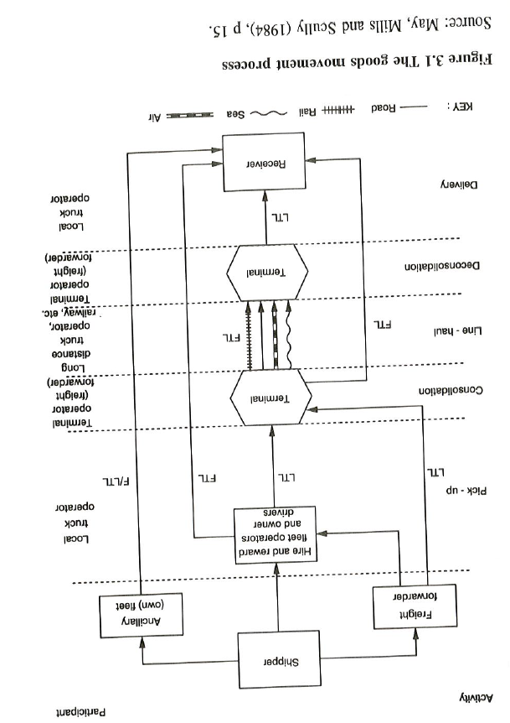
Russell Thompson

Slide 7
Physical Internet (PI)
Aims to transform the way physical objects are moved, stored, realized, supplied & used, pursuing global logistics efficiency & sustainability
Key Elements
Open & Shared Networks
Standardised & modular load carriers
Track & Trace protocols & certificates
New business models for sharing assets
Russell Thompson

Slide 8
PI Features
Compatible load units & coordinated transfers between modes
From: Right mode for the right load
To: Right modes & load factors for the right loads
Multiple modes: eg. HPFVs, trucks & vans
Network Design: vehicles, loads & transhipment facilities
Multi-modal routing & scheduling
Integration: vehicles at hubs loading bays/docks
Russell Thompson

Slide 9
A Shared Urban Freight System (SUFS)
Adapt Physical Internet (PI) concepts: Open & Shared Networks, Hyperconnected City Logistics (Crainic & Montreuil, 2016)
Utilising High Productivity Vehicles (HPVs) (Eg. B-Doubles)
Hub in each Key Freight Area (KFA)
Shuttle service between KFAs
Russell Thompson

Slide 10
SUFS Characteristics
Hubs in KFAs
  Transfer of pallets (in & out of KFAs)
  Transshipment of pallets (non-direct path between KFAs)
Minimum distance paths determine volume of pallets transshipped at hubs at specific KFAs when no direct transport between KFAs
B-Doubles: capacity 23 pallets
Russell Thompson

Slide 11
Freight Network between KFAs
Russell Thompson

Slide 12
Freight Network between KFAs with HPV Shuttles
Russell Thompson

Slide 13
Key Freight Areas in Melbourne
Russell Thompson

Slide 14
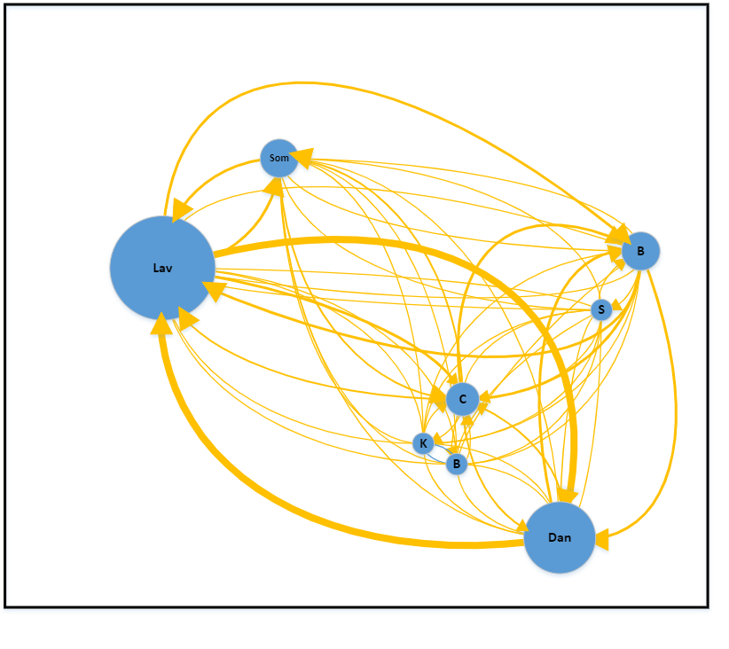
Complete Shared Network for Melbourne
 | VKT
Shuttle | 21,366
Local Routes | 6,172
Total | 27,539
Current
190,267
 | ($/day) | %
Shuttle | 108,000 | 55.3
Transfers & Transhipments | 55,836 | 28.6
Local Routes | 31,500 | 16.1
Total | 195,336 | 100.0
Average Cost = $0.41 per pallet/km
Current 2.5
Network Efficiency = 17.2 pallets/veh.
Russell Thompson

Slide 15
Conclusions
Shared shuttle services using HPFV
- reduce VKT substantially
- financially viable
- dramatically reduce congestion
- potential for achieving NZE
Requirements
- hubs
- digital platforms
Russell Thompson

