Slide 1



Comparative analysis of truck volumes from traffic counts and probe-based data:
A case study in the Winnipeg Metropolitan Region, Canada
Cassidy Zrobek
Giuseppe Grande Ph.D.
Jonathan D. Regehr Ph.D., P.Eng.
Babak Mehran Ph.D., P.Eng.
Notes:
The University of Manitoba campuses are located on original lands of Anishinaabeg, Cree, Oji-Cree, Dakota, and Dene peoples, and on the homeland of the Metis Nation.
We respect the Treaties that were made on these territories, we acknowledge the harms and mistakes of the past, and we dedicate ourselves to move forward in partnership with Indigenous communities in a spirit of reconciliation and collaboration.

Slide 2
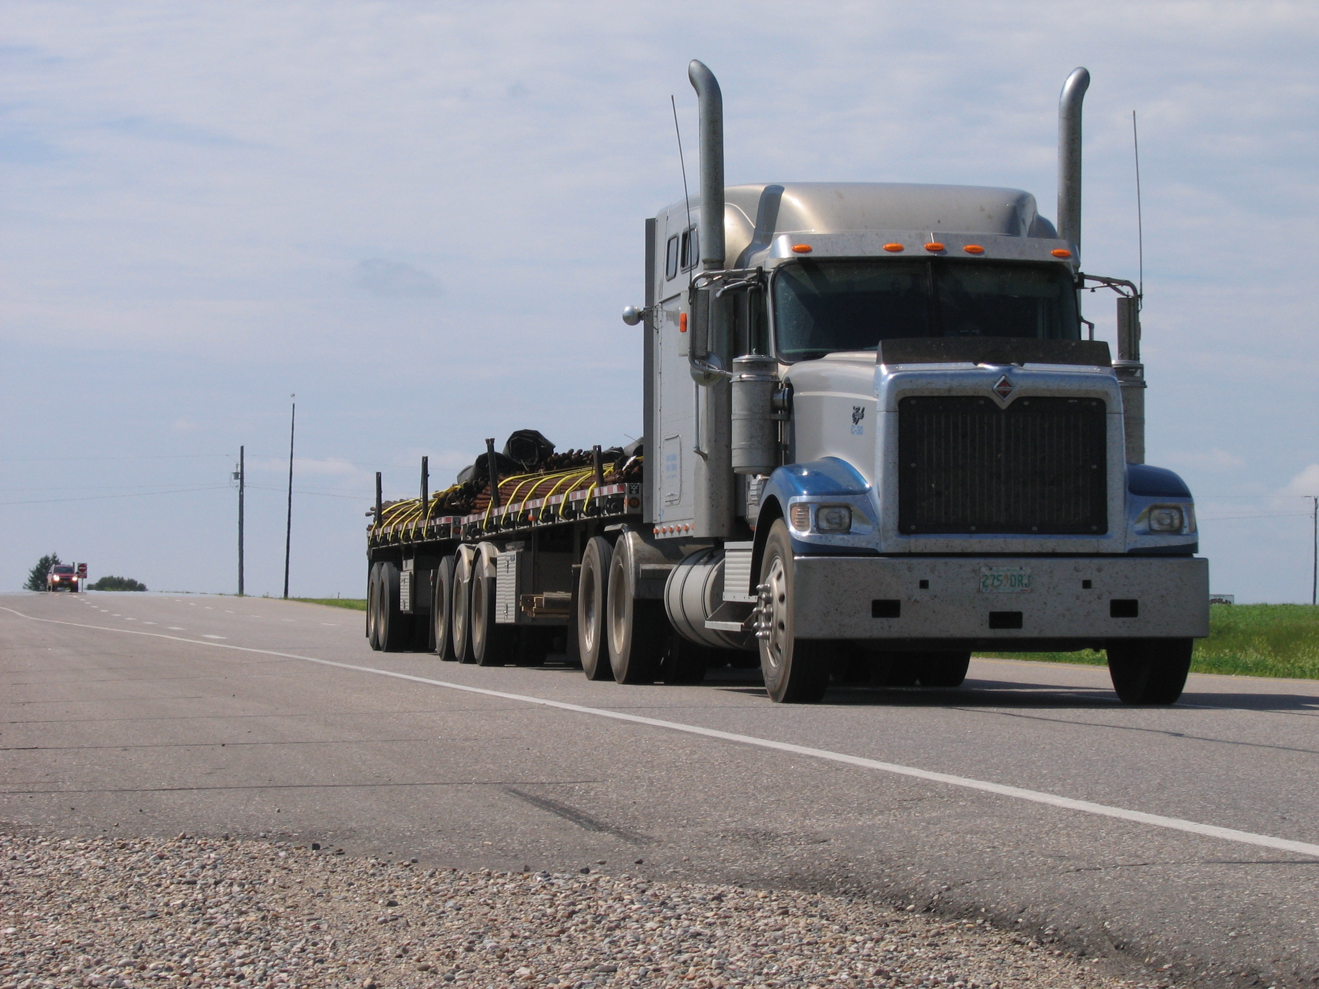
Contents
Introduction
  Background
  Research objectives
Methodology
  Manitoba count data
  StreetLight data
  Error metrics
Results
Conclusion
8-axle B-double (3-S3-S2)
(B-connected; 27.5 m; 63,500 kg GVM limit)
Author/s:
Zrobek, Grande, Regehr, Mehran

Slide 3
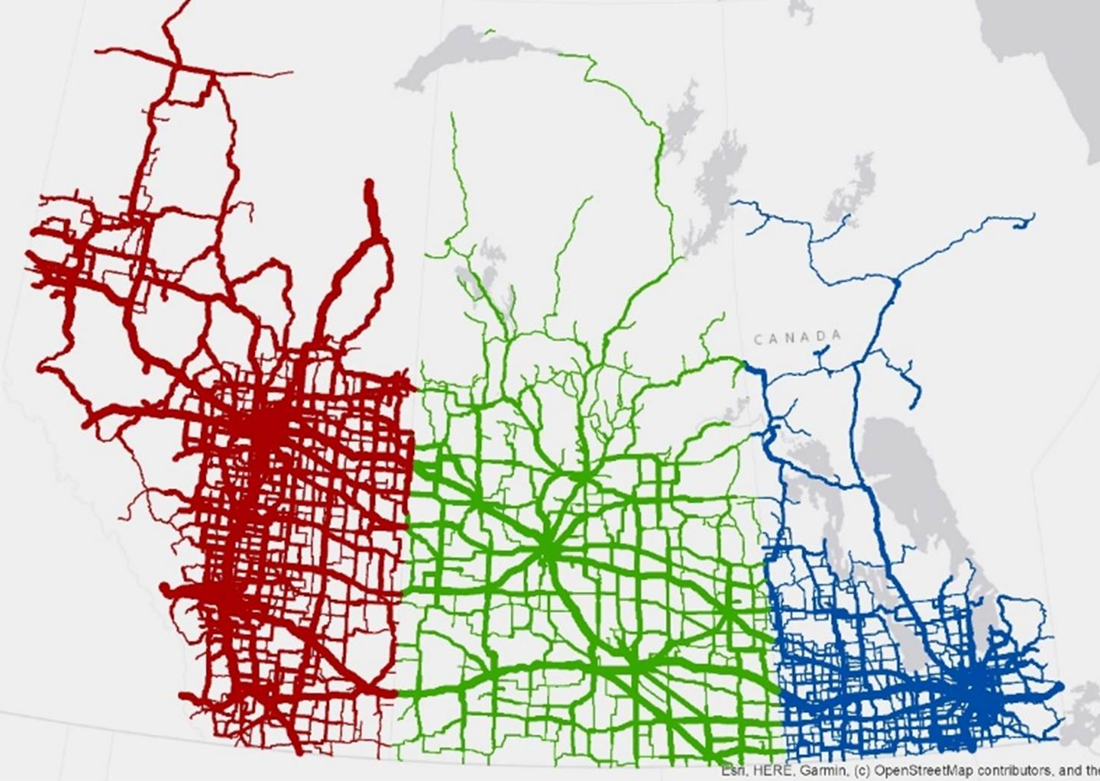

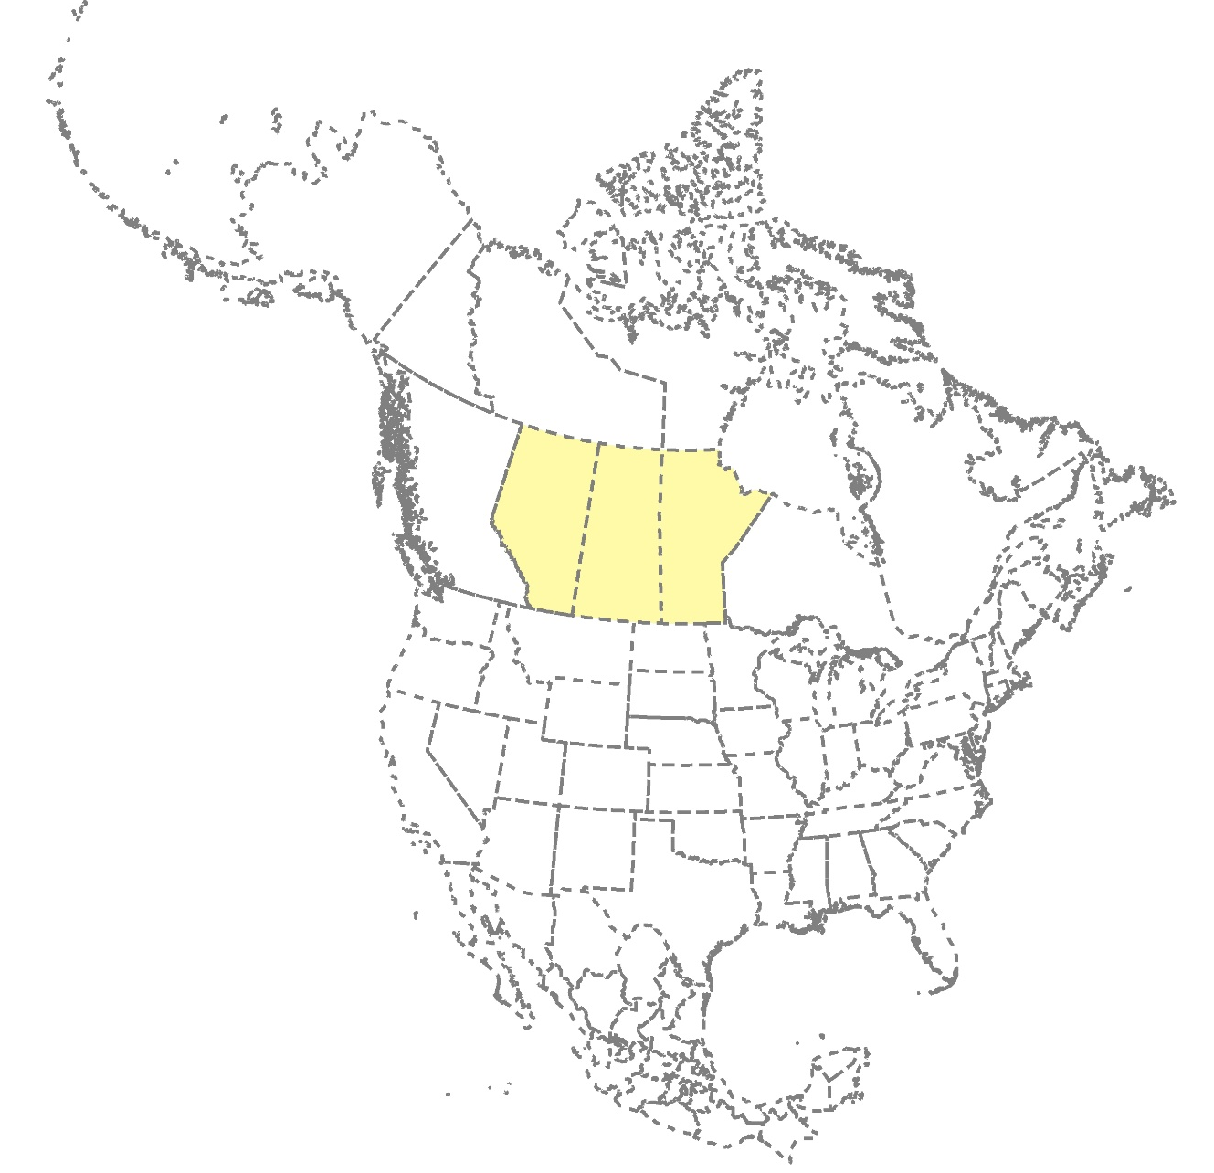
Introduction: Background
2019 Truck Volume Estimates for the Canadian Prairie Highway Network
Data sources?
Estimation methodology?
Temporal representativeness?
Spatial representativeness?
Consistency within a jurisdiction?
Consistency across jurisdictions?
Author/s:
Zrobek, Grande, Regehr, Mehran
(Grande et al., 2023)
Notes:
To enhance network-wide truck volume estimation, truck traffic monitoring research and practice has recently focused on: (1) improving the quality of data collected at count sites through improved sampling strategies and technologies; and (2) utilizing commercially available probe-based data products for traffic volume estimation. The purpose of this research was to investigate aspects of these two options for improving network-wide truck volume estimation.

Slide 4
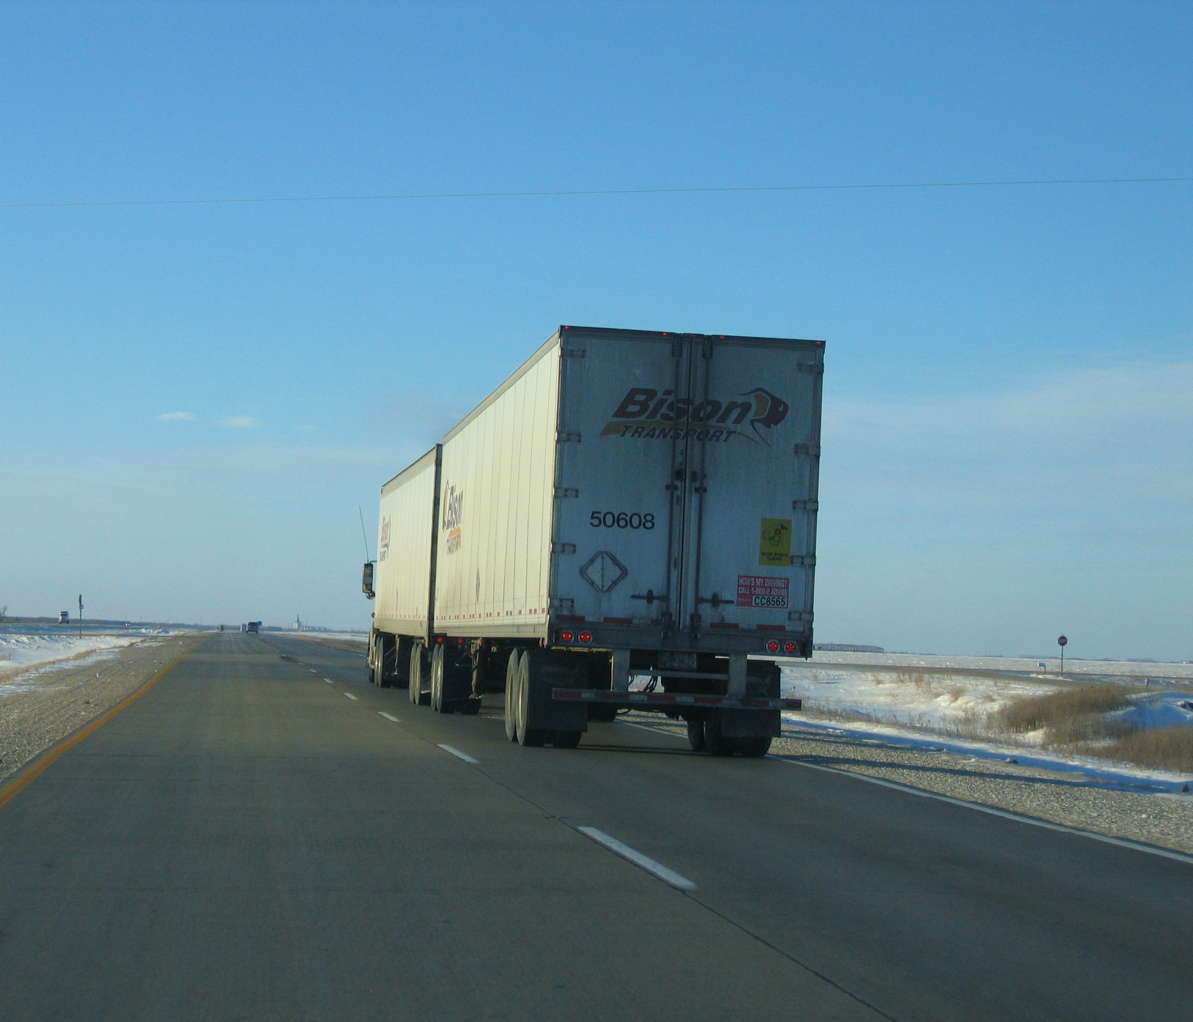
Introduction: Background
High-quality, detailed, and geographically representative vehicle classification data are an important input for many applications (Regehr et al., 2017)
AADTT estimated using continuous counts and short-duration classification counts (SDCCs)
Probe data from cell phones, connected vehicles, or GPS devices can be used as an alternative traffic data source (Klein et al., 2017; Zhang et al., 2019)
Availability of emerging, commercially-available data products compels agencies to evaluate their accuracy
9-axle Turnpike double (3-S2-4)
(A-dolly; 42 m; 63,500 kg GVM limit; operated under special permit)
Author/s:
Zrobek, Grande, Regehr, Mehran
Notes:
While SDCs are performed to the supplement the spatial coverage of costly and resource-intensive continuous counts, they do not sufficiently sample temporal traffic patterns, and there are still limitations on how many SDCs can be conducted within a year.
An emerging alternative to these traffic counts is using probe-based data. Unlike the traditional counts which measure all traffic at a single site, probe data is produced by monitoring the position of individual vehicles or devices which represent a sample of total traffic. Since these devices can be tracked all the time wherever they travel, this data source can provide broad spatial and temporal coverage. Further, there are now third-party data firms that buy, process, and integrate probe and contextual data to produce proprietary traffic data products that are available for purchase. However, their accuracy and utility are still being investigated, especially for truck traffic applications.

Slide 5
Introduction: Background
StreetLight Data (StL) has multiple analysis options available
StL uses commercial vehicle GPS data and location-based services (LBS) data
Two truck activity indices by weight
  Medium-duty: 14,001-26,000 lbs; GVWR class 4-6 (buses and trucks with ≤ 3 axles)
  Heavy-duty: 26,001+ lbs; GVWR class 7-8 (trucks with 4+ axles)
Several studies assessing StL AADTs in U.S. (Zrobek, 2023)
Medium-duty Trucks
Heavy-duty Trucks
Author/s:
Zrobek, Grande, Regehr, Mehran
(FHWA, 2022)
Notes:
So the probe based data used in this study was purchased from StL Data, which is a North American third-party data provider that uses machine learning algorithms to produce traffic volume estimates from probe data. In their online data platform, StL offers a variety of analysis types with different outputs and metrics, which include total traffic volume estimates, total traffic activity indices, and truck activity indices. StL’s data source for their truck indices is GPS data from commercial truck fleets, while the total traffic indices are based on Location based services data from cell phones. StL truck indices represent the relative volume of truck activity on a road and truck volumes from local continuous count data can be used to scale the indices into volume estimates. StL provides separate indices for trucks based on the gross vehicle weight ratings of medium and heavy duty. While StL provides the axle information for the weight classes in brackets here which can be associated with the FHWA classes, in reality the GVWRs don’t perfectly correspond to the FHWA axle-based classes.
The use of StL data for volume estimation has been the subject of several recent studies in the united states, including a pooled-fund study by the FHWA, but no Canadian studies on StL data have been published. Further, the studies primarily focused on AADT estimates, and none included StL medium and heavy duty truck indices.

Slide 6
Introduction: Research Objectives
How do AADT estimates produced by scaling StreetLight Data (StL) total traffic activity indices compare to ground truth AADT volumes from continuous count data?
How do AADTT estimates produced by scaling medium-duty and heavy-duty truck activity indices from StL compare to ground truth AADTT volumes from continuous count data?
How do the errors of the scaled StL AADTT estimates vary by truck volume?
Author/s:
Zrobek, Grande, Regehr, Mehran
Notes:
Based on the gaps in previous research, the objective of this study was to answer the following questions:
How do AADT estimates produced by scaling StL total traffic indices compare to ground truth volumes?
How do AADTT estimates produced by scaling medium-duty and heavy-duty truck indices from StL compare to ground truth volumes?
How do the errors of the scaled StL AADTT estimates vary by truck volume?
Can truck volumes estimates be improved by manually scaling StL activity indices?
HOW do the volume estimates produced by scaling StL indices compare to estimates obtained from SDCs?

Slide 7
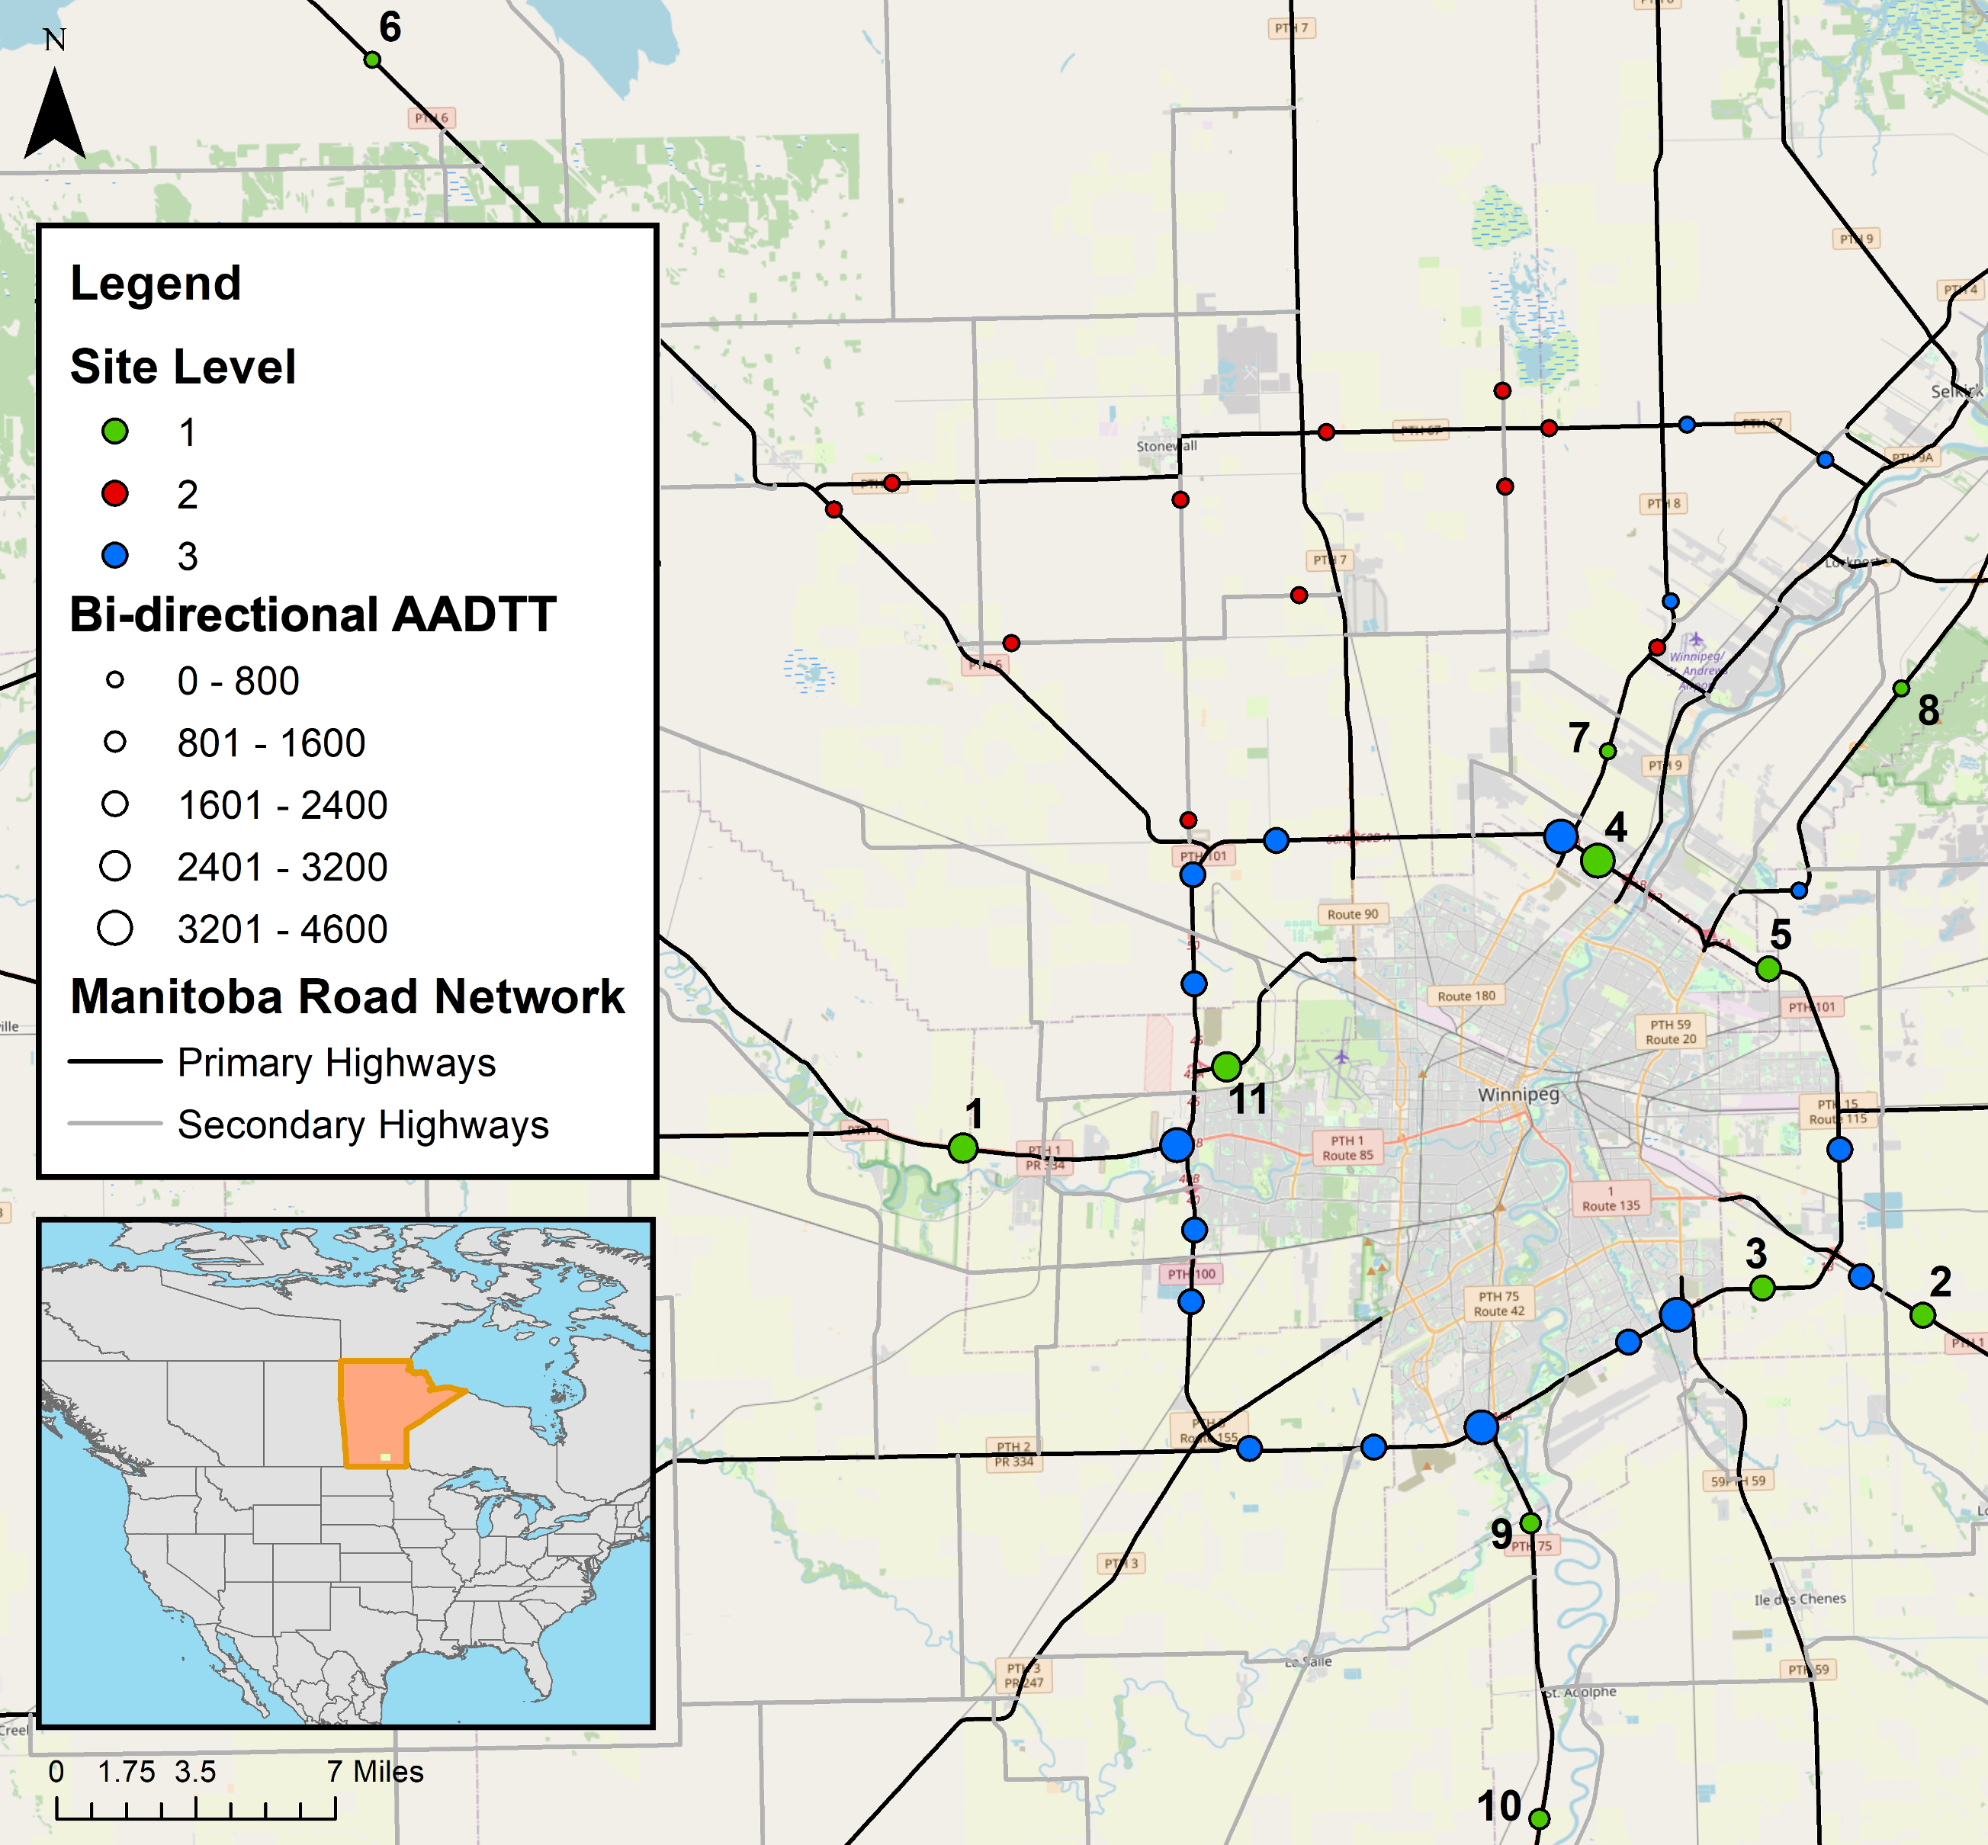
Methodology
Manitoba count data
  11 continuous count sites (Level 1)
  29 SDC sites
  18 SDCC (Level 2) and 11 SDC (Level 3)
  Used 2019, 2020, and 2021 data
  Calculated AADT, medium-duty AADTT (AADMT), heavy-duty AADTT (AADHT), and AADTT
Author/s:
Zrobek, Grande, Regehr, Mehran
Notes:
Moving on to the methodology, the study included the 11 continuous count sites shown in green on the map here which are classified as level 1 sites and 29 SDC sites. The SDC sites can be further divided into level 2 sites which have classification data and level 3 sites, which only have total traffic volume data.
This study included three analysis years which were 2019, 2020, and 2021.
The count data for each year was cleaned and the AADT, medium duty AADTT (or AADMT), heavy-duty AADTT or AADHT, and AADTT were calculated for all the site directions that had sufficient data in each year.

Slide 8
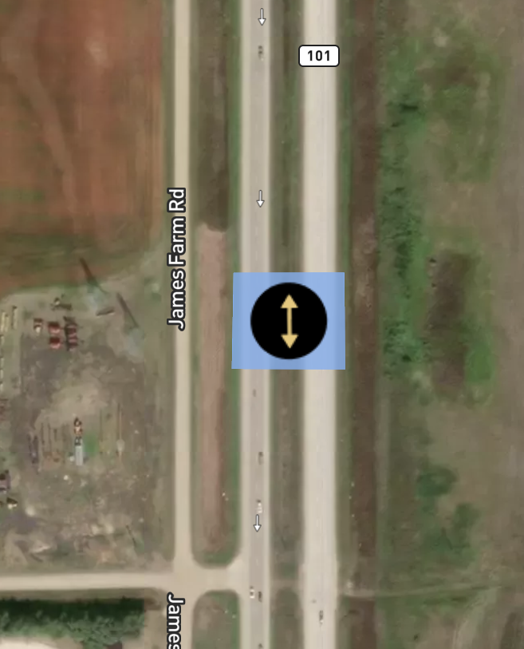
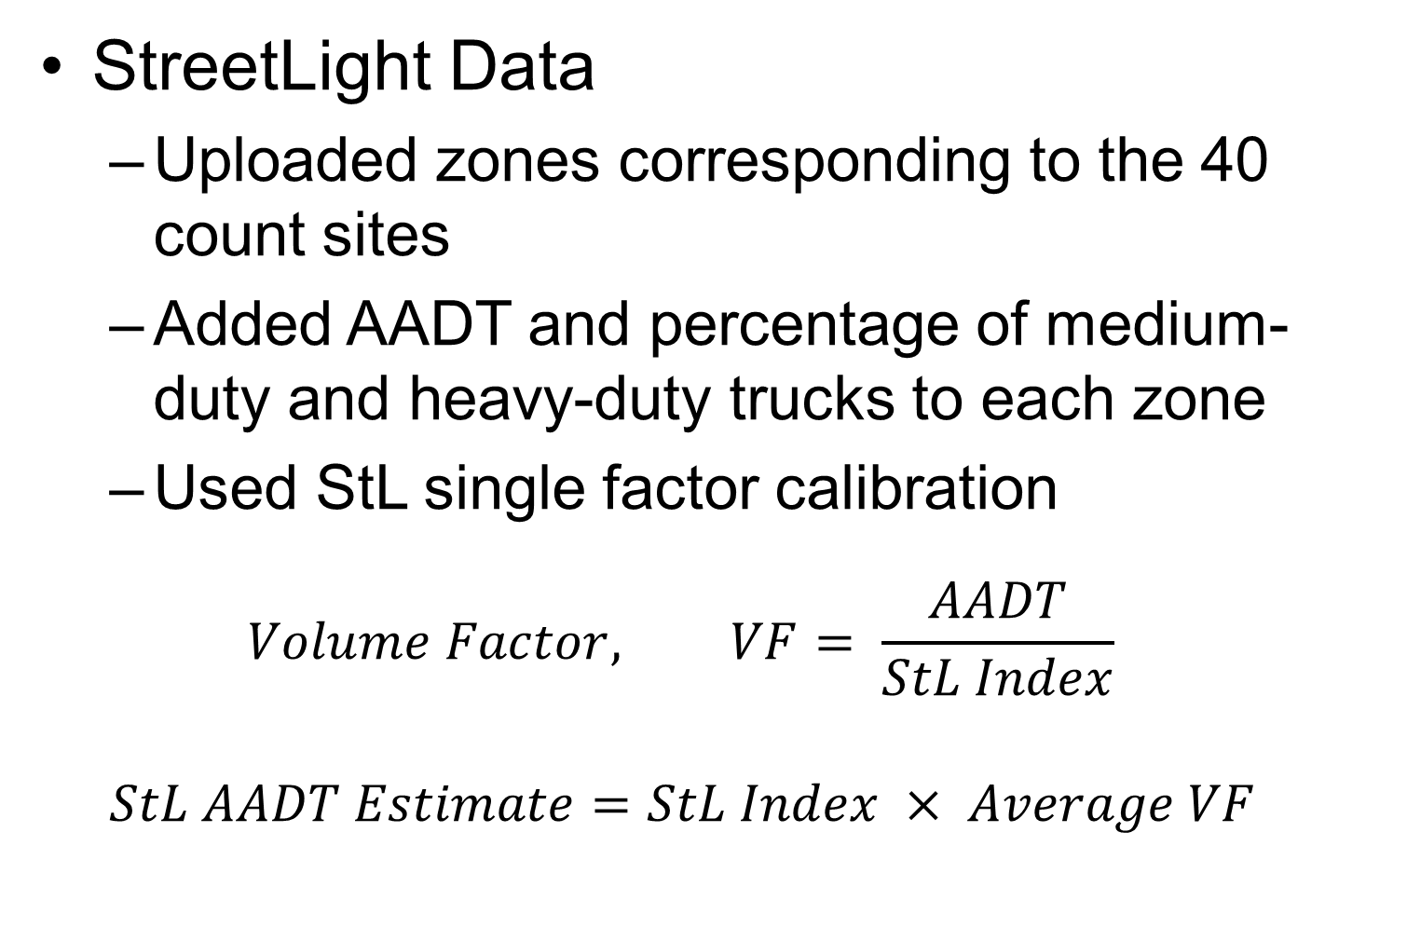
Methodology
StreetLight Data
  Uploaded zones corresponding to the 40 count sites
  Added AADT and percentage of medium-duty and heavy-duty trucks to each zone
  Used StL single factor calibration
  $$Volume Factor, VF= \frac{AADT}{StL Index}$$
  $$StL AADT Estimate=StL Index × Average VF$$
Example StL Zone
Author/s:
Zrobek, Grande, Regehr, Mehran
Notes:
Now to get data from StL, zones approximately rectangular in shape corresponding to each of the count sites were uploaded to their online data platform with an example zone shown here. The ground truth AADT and percentage of medium-duty and heavy-duty trucks obtained from the continuous counts were added to the level 1 zones in StL. StL provides a built-in function called single-factor calibration that uses the user entered ground truth data to scale the StL indices into volumes. Basically for single factor calibration, StL calculates a volume factor for each direction of travel at the level 1 calibration sites as the ground truth AADT divided by the stl index, they remove any outlier VFs, they take a simple average all the volume factors and multiply that average volume factor by the StL index at a site to get a volume estimate there.

Slide 9
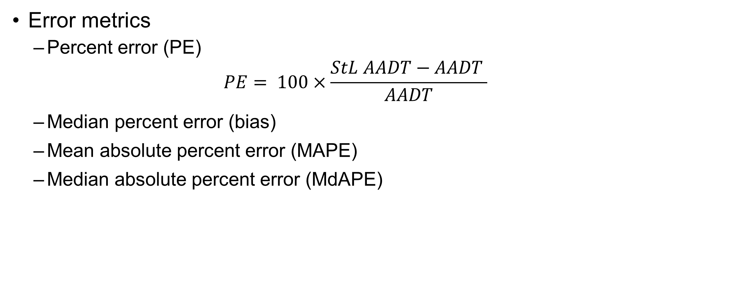
Methodology
Error metrics
  Percent error (PE)
    $$PE= 100×\frac{StL AADT−AADT }{AADT}$$
  Median percent error (bias)
  Mean absolute percent error (MAPE)
  Median absolute percent error (MdAPE)
Author/s:
Zrobek, Grande, Regehr, Mehran
Notes:
The error metrics used to compare the probe-based StL estimates to the ground truth traffic count volumes at the level 1 sites include percent error (PE), median percent error (bias), mean absolute percent error (MAPE), and median absolute percent error (MdAPE).
Though the same error metrics were used to compare the volume estimates at the Level 2 and 3 sites. the errors simply represent the differences between the estimates obtained from the SDCs and StL.

Slide 10
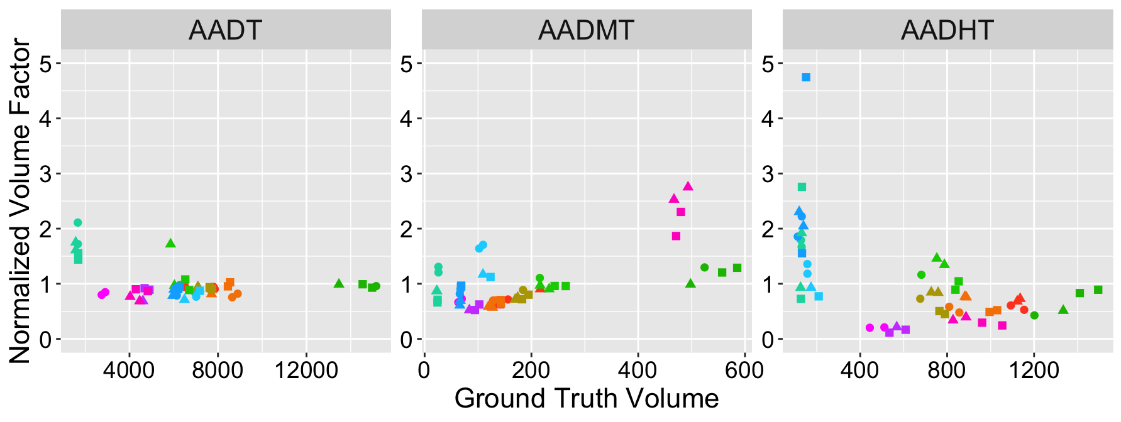
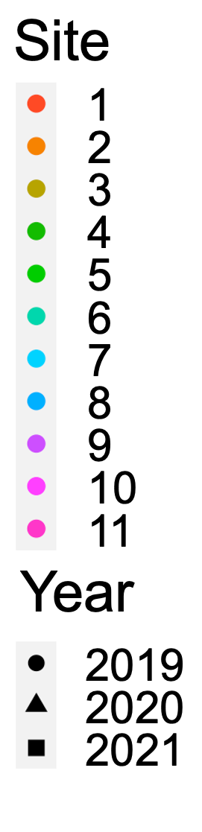
Results
Comparison of Normalized Volume Factors by Class Group – Level 1 Sites
Author/s:
Zrobek, Grande, Regehr, Mehran
Notes:
Moving on to the results, What we are looking at here are the Volume factors I mentioned earlier by year and class group, except they are normalized by the their mean VF to facilitate comparison across the indices. For StL to provide accurate estimates using single-factor calibration, the relationship b/w the ground truth volume & stl index which is represented by the VF, needs to be consistent across the calibration sites and estimation site, and this figure shows that they are most consistent for total traffic.
The quality of StL’s truck data sample is impacted by both the commercial vehicle GPS sample size and any bias in the sample towards certain truck fleets. (CLICK) For low volume Sites 6, 7, and 8 boxed in blue, the StL heavy-duty index has a weak relationship with AADHT. CLICK- Sites 9 and 10, which are boxed in red, are located on highway 75, which is the main link between Winnipeg and the U.S. They have the lowest volume factors and thus highest PRs for heavy duty trucks, which indicates that StL’s truck sample may be biased towards fleets that operate in both Canada and the U.S.

Slide 11
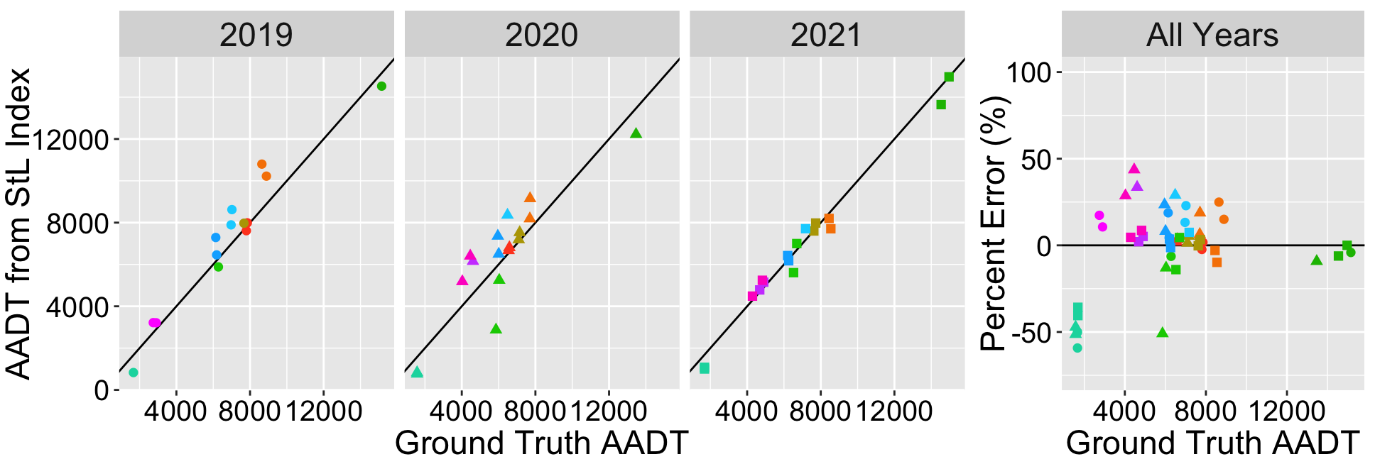
Results
Comparison of Ground Truth and StL AADT – Level 1 Sites
MAPE = 9% to 22%
Author/s:
Zrobek, Grande, Regehr, Mehran
Notes:
Now here is a comparison of ground truth and StL AADTs obtained using single-factor calibration, and the corresponding PEs with the line of perfect agreement shown in black.
Overall, we can see that there is reasonable agreement between the StL and ground truth AADTs with MAPEs ranging from 9% in 2021 to 22% in 2020. The lowest volume site (Site 6) had larger PEs in 2019 and 2021 than the other sites, which agrees with observations from previous research on StL AADTs

Slide 12
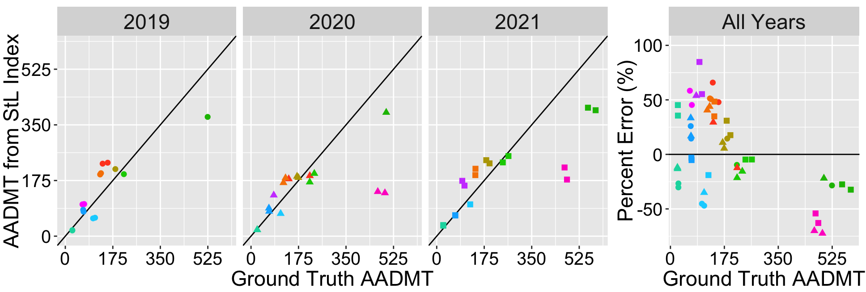
Results
Comparison of Ground Truth and StL AADMT – Level 1 Sites
MAPE = 30% to 38%
Author/s:
Zrobek, Grande, Regehr, Mehran
Notes:
Here we have the same comparisons but for medium-duty trucks.
The figure shows that there are more significant outliers with higher percent errors for medium-duty trucks than total traffic. Also, there is no clear relationship between the % error and medium-duty truck volume.

Slide 13
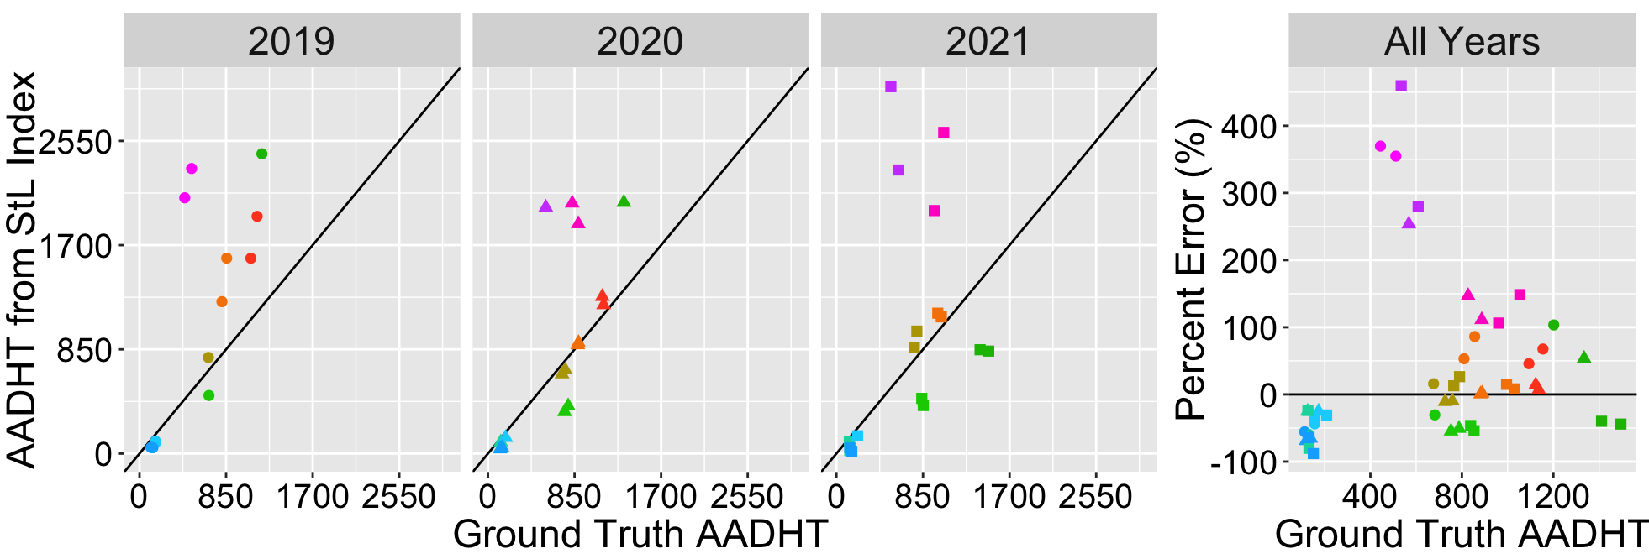
Results
Comparison of Ground Truth and StL AADHT – Level 1 Sites
StL sample trip count in 2020:
Medium-duty ~ 329,000; Heavy-duty ~ 10,000
MAPE = 57% to 96%
Author/s:
Zrobek, Grande, Regehr, Mehran
Notes:
Now here are the results for heavy-duty trucks. As I mentioned before, trucks at sites 9 and 10 on Highway 75 which are outlined in red appear to be overrepresented in StL’s sample, resulting in over-estimation at these sites. Compared to AADT and AADMT, the AADHT estimates have the largest percent errors at up to over 400%.
CLICK-Even though medium-duty trucks have lower volumes than heavy-duty trucks at all sites, StL had a substantially smaller sample size for heavy-duty trucks, resulting in large errors.

Slide 14
Results
Summary of Error Metrics and Sample Size
Metric | Year | Total Traffic | Medium-Duty | Heavy-Duty
Median PE (%) | 2019 | 4.4 | 14.5 | 15.9
 | 2020 | 5.4 | -12.0 | -9.9
 | 2021 | 0.0 | -3.0 | -23.7
MdAPE (%) | 2019 | 13.2 | 45.2 | 59.4
 | 2020 | 18.8 | 21.9 | 50.7
 | 2021 | 4.6 | 32.4 | 46.3
MAPE (%) | 2019 | 17.0 | 37.5 | 96.4
 | 2020 | 22.1 | 29.9 | 56.6
 | 2021 | 8.8 | 33.3 | 89.9
StL Approximate Sample Trip Count [PR (%)] | 2019 | 392,000 [0.91] | 329,000 [40] | 10,000 [0.29]
 | 2020 | 223,000 [0.51] | 224,000 [25] | 6,000 [0.13]
 | 2021 | 438,000 [1.05] | 29,000 [3] | 4,000 [0.11]
Author/s:
Zrobek, Grande, Regehr, Mehran

Slide 15
Conclusion
Assessed the accuracy of probe-based traffic volume estimates from StL
  Total traffic volume: MAPEs ranged from 8.8% to 22.1% over analysis years
  Medium-duty truck volume: MAPEs ranged from 29.9% to 37.5% over analysis years
  Heavy-duty truck volume: MAPEs ranged from 56.6% to 96.4% over analysis years
Implications
  Does not replace current sampling methods, but may still be useful for planning applications when no alternative exists
  Opportunities to reduce StL errors through manual scaling methods (e.g., use medium-duty truck index to estimate heavy-duty truck volume)
  Need to integrate StL data into truck traffic monitoring programs
Author/s:
Zrobek, Grande, Regehr, Mehran

Slide 16
Acknowledgements
Data provided by Manitoba Transportation and Infrastructure
Funding provided by National Research Council of Canada
Author/s:
Zrobek, Grande, Regehr, Mehran

Slide 17
Cited Works
Federal Highway Administration. (2022). Traffic monitoring guide. U.S. Department of Transportation.
Grande, G., Regehr, J. D., & Mehran, B. (2023). Applying a hierarchical approach to develop a regional truck traffic volume model. Proceedings of the Artificial Intelligence for Logistics Conference.
Klein, L., Stolz, L., & Regehr, J. D. (eds.) (2017). Advancing highway traffic monitoring through strategic research. Transportation Research Board e-Circular E-C227, Washington, D.C.
Regehr, J.D., Poapst, R., Rempel, G., Montufar, J., & Hallenbeck, M. (2017). Traffic monitoring practices guide for Canadian provinces and municipalities. Transportation Association of Canada.
Zhang, X., Van Dyke, C., Erhardt, G., and Chen, M. (2019). NCHRP synthesis 541: Practices on acquiring proprietary data for transportation applications. Transportation Research Board.
Zrobek, C. (2023). Options for enhancing network-wide annual average daily truck volume estimates. Master’s of Science thesis, University of Manitoba, Winnipeg, MB.
Author/s:
Zrobek, Grande, Regehr, Mehran

