Slide 1


TIRE WIDTH-BASED SCREENING AT A WIM PRECLEARANCE SITE
Douglas Pratt
Senior Project Engineer, International Road Dynamics
Tyler Haichert
Senior Mechanical Engineer, International Road Dynamics

Slide 2
Tire-Width Screening WIM Site
Why did this site need tire-width screening?
This site has a high frequency of unique vehicle configurations
  Carriers have chosen wide-base tires for steer axles to be efficient in their operations
Tire width is attached to vehicle compliance, so weight alone cannot determine compliance
  An automated screening technology is desirable as a high number of vehicles would otherwise require manual inspection by enforcement personnel
  Addresses the issue of maintaining fair screening and bypasses for all participants
Author/s:
D. Pratt, T. Haichert

Slide 3
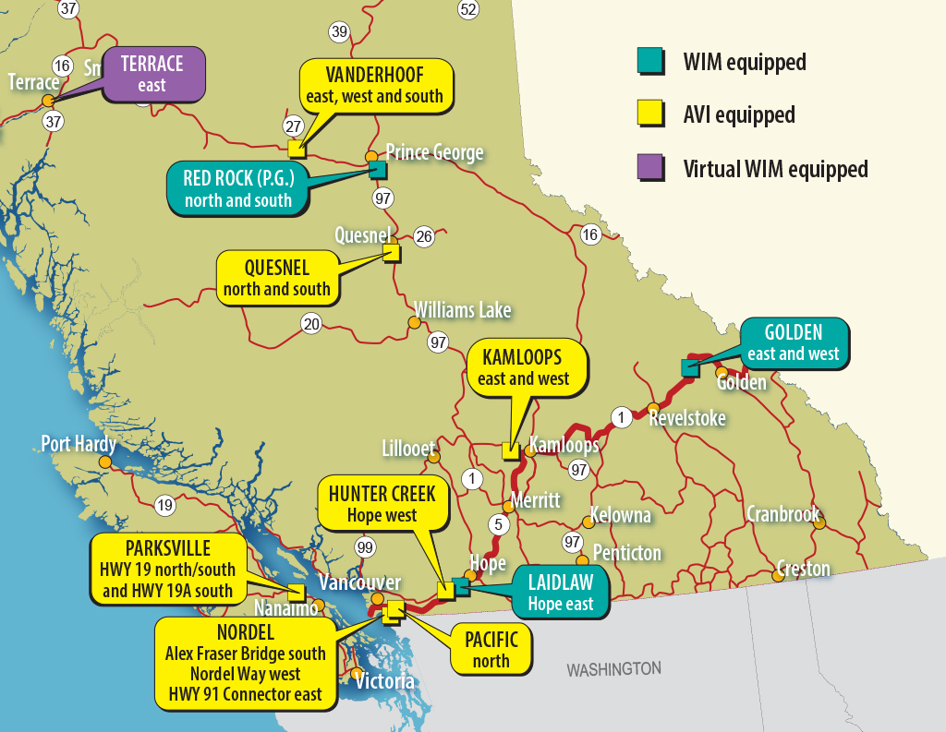
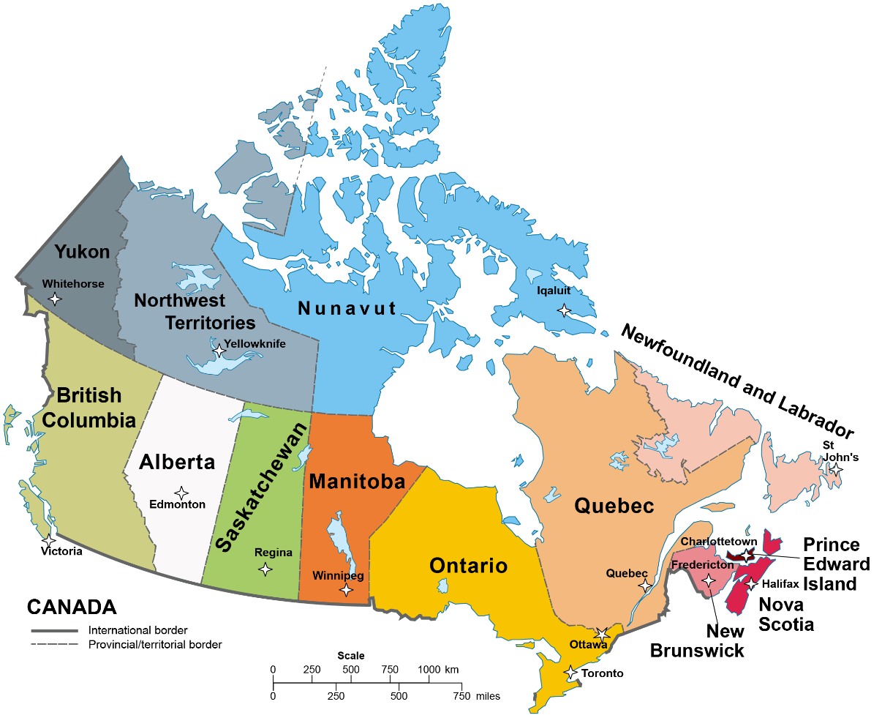
Weigh2GoBC WIM Preclearance Program in British Columbia, Canada
Author/s:
D. Pratt, T. Haichert
Notes:
Weigh2GoBC in British Columbia, Canada, was developed to improve safety by ensuring vehicles are properly licensed and insured and that drivers comply with weight restrictions.
The Terrace Virtual Weigh Station preclearance site with tire-width screening is indicated by the purple arrow/callout
The preclearance program objective is:
To conduct inspections as efficiently as possible.
Reduces the need to stop the same vehicles for inspection at multiple weigh stations across British Columbia’s trade corridor
The Ministry of Transportation has calculated that each commercial vehicle that reports to a station takes an average of 10 minutes to be processed
With six stops along the main corridor, a vehicle would lose 60 minutes per trip
There is also an environmental cost to excess inspections, with increased fuel consumption averaging 0.5715 liters per inspection [1]
(BC MoT, 2021)

Slide 4
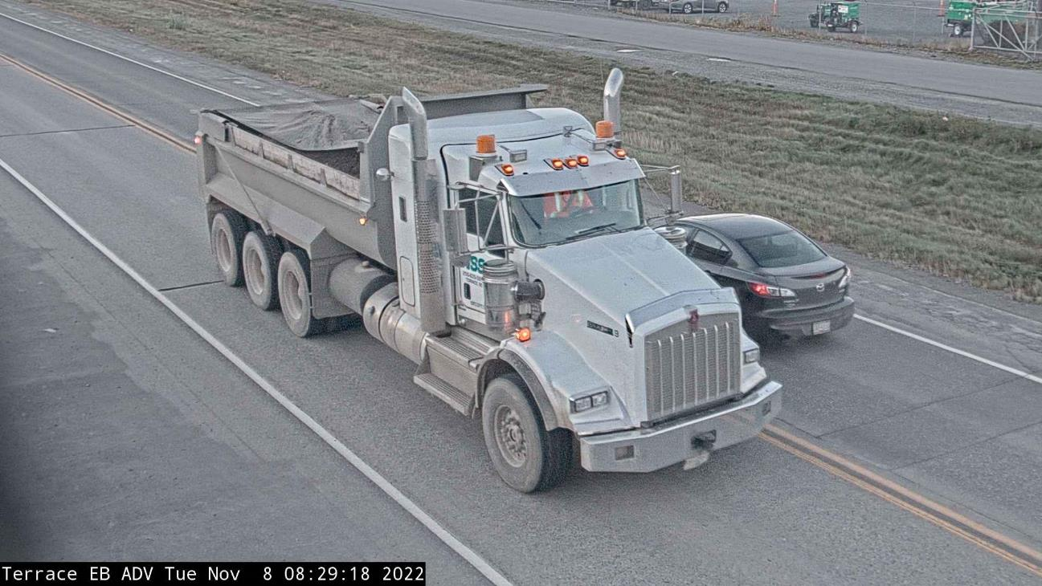
Terrace, BC Virtual Weigh Station
Logging, mining and construction trucks typically have different characteristics from standard Canadian heavy goods vehicles
  Complies with standards which allow larger tires to carry heavier weights
  Depending on axle configuration, tires may be allowed to carry as much as 8000 lbs (3600 kg) extra load on the steering axle
Truck image captured by the VWS system at Terrace, BC
Author/s:
D. Pratt, T. Haichert

Slide 5
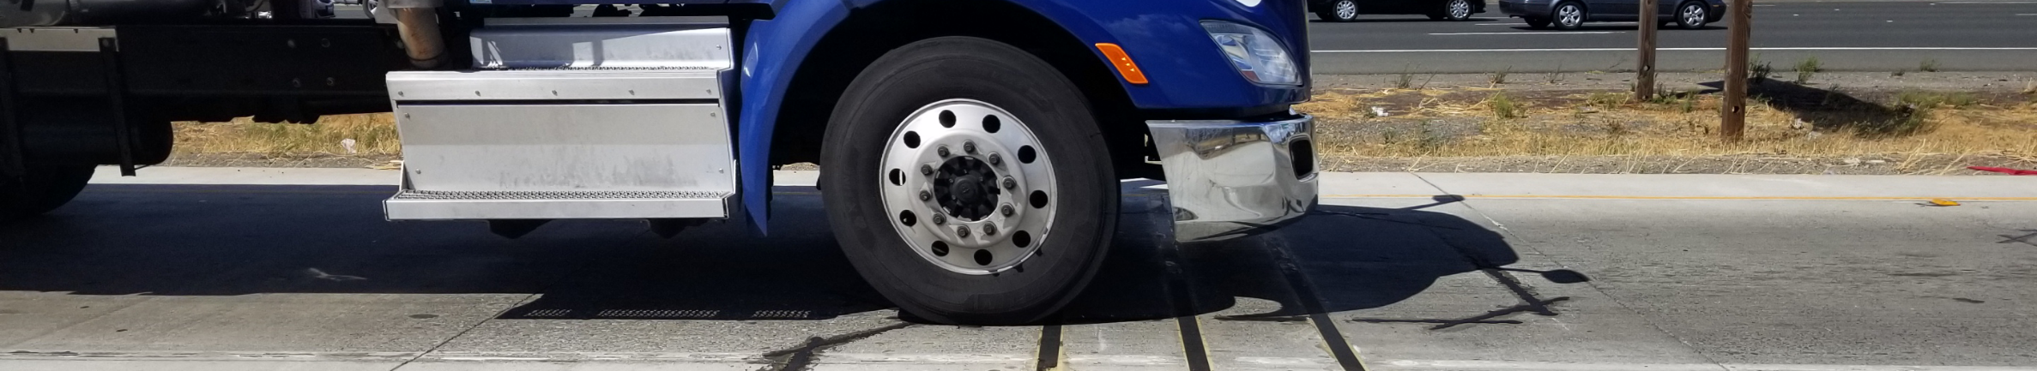
Tire Screening
Tire-width screening offers Weigh2GoBC several benefits
  Automated compliance screening that effectively assesses vehicles with wide-based tires
  Fewer vehicles are directed to report based on weight
  Bypass rate is improved
Author/s:
D. Pratt, T. Haichert

Slide 6
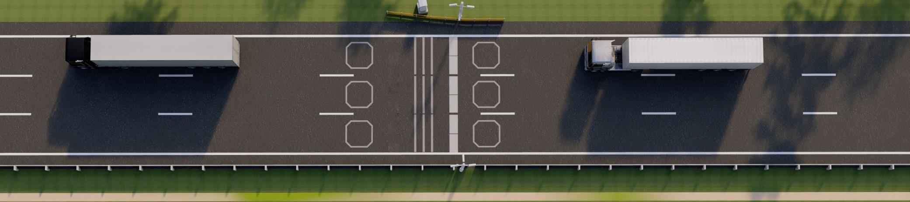
Weight Restrictions and Tires
The regulations set maximum available loads based on force per width of the vehicle tires
Integrating high-speed strain-in-motion sensors with the WIM system allows BCWeigh2Go to adjust maximum weights based on tire width
High-Speed Virtual Weigh Station Concept with Strain-In-Motion Tire Sensors
Author/s:
D. Pratt, T. Haichert
Notes:
Tire width expressed in mm – example 275, 385, 425, etc. The system sets a threshold for compliance.

Slide 7
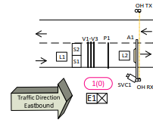
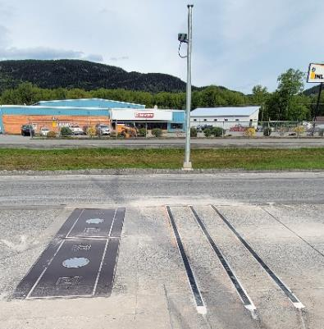
TACS Tire Anomaly and Classification System
TACS application provides tire anomaly detection and advanced vehicle classification with tire width
Steer axle classification is a new feature added for the first time at Terrace site
VectorSense tire footprint sensor technology can detect tire width with a high degree of accuracy
WIM Scales and VectorSense Sensors in Eastbound Lane of the Terrace VWS
Author/s:
D. Pratt, T. Haichert
Notes:
. TACS supports the real-time screening of commercial vehicles at highway speeds of up to 160 km/h

Slide 8

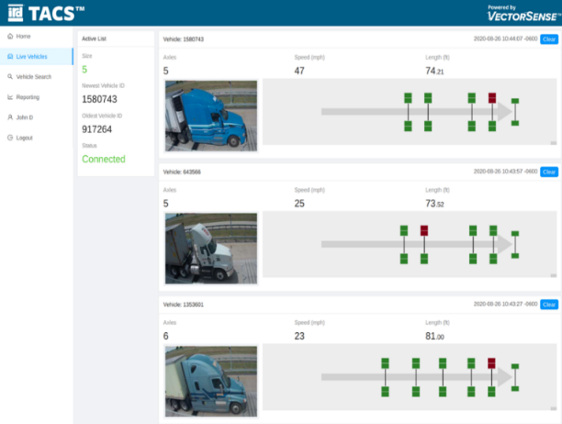
VectorSense Technology
Tire footprint sensor technology that can detect tire width with high accuracy
Thin slices of the tire contact are measured thousands of times per second
Measurements allow for the construction of contact pressure profile with the tire width and location for each tire on a vehicle
Direction of Travel
Single Tire Contact Patch
High Contact Stress Low Contract Stress
Author/s:
D. Pratt, T. Haichert

Slide 9
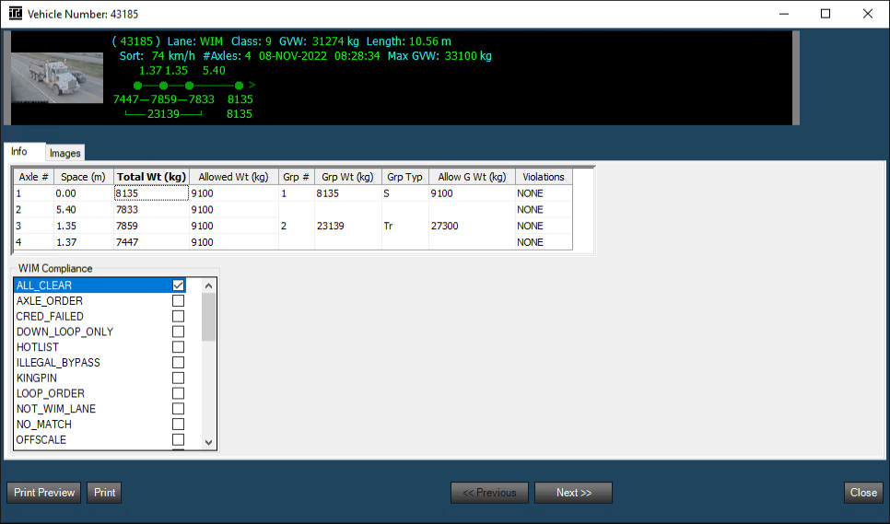
Vehicle Screening Software
BCWeigh2Go Custom Operator Software displays:
  Vehicle weights
  Violations (such as exceeding GVW)
Weight limits for the steer axle are automatically adjusted if the tire width measured by the VectorSense sensors indicates that the weight limit should be increased
Vehicle Record Displaying Weights and Screening Information
Author/s:
D. Pratt, T. Haichert
Notes:
Here the weight limit has been increased to an allowed weight of 9100 kgs because of the wider tires on the steer axle.

Slide 10
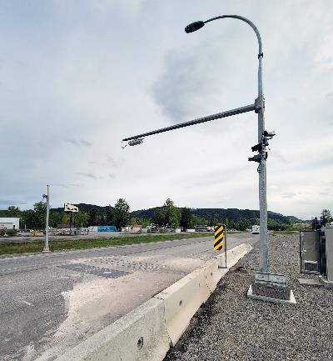
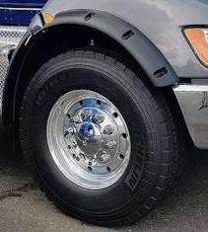
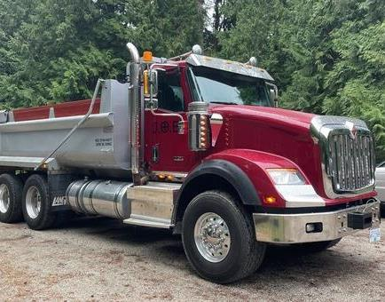
Weight Restrictions and Tires
Depending on the vehicle classification, the steer axle weight limits are increased by as much as 3600 kgs/axle for wide base tires, which have a tire width greater than the normal tire width of 275 mm
385/65R22.5 Tire on Steering Axle
425/65R22.5 front tires,
20000 lb front axle
Terrace, BC Virtual Weigh Station
Author/s:
D. Pratt, T. Haichert

Slide 11
Results
Over 3 months of operation, the system detected 27,323 commercial vehicles
TACS, using the Vectorsense sensors, has identified 3,544 commercial vehicles that had wide-base tires on the steer axle
Vehicle Screening Characteristic | Percentage
Commercial Vehicles with wide-base tires on steer axles | 13%
Trucks with wide-based tires on steer axles that have a weight above the weight limit for normal-width steer axle weight limit but under the wide tire limit. | 6%
Commercial Vehicles with identified Tire Anomalies | 0.8%
Author/s:
D. Pratt, T. Haichert
Notes:
1600 vehicles would have been incorrectly force to report to the weigh station
218 vehicles (0.8%) identified with unsafe tire conditions: flat, missing, mismatched, underinflated.

Slide 12
Conclusion
The ability to screen based on a combination of tire types and weights further improves safety, improves the efficiency of operations, and reduces congestion by more accurately screening for vehicles meeting overweight criteria
This system achieved better screening on 13% of the traffic by checking the width of the tires on the steering axles
The automated tire width screening program helps British Columbia’s Commercial Vehicle Safety and Enforcement (CVSE) agency meet the Weigh2GoBC preclearance program objectives:
  Accelerating the flow of goods through the Pacific trade corridor
  Saving carriers time, fuel, and money
  Reducing greenhouse gas emissions
Author/s:
D. Pratt, T. Haichert

Slide 13
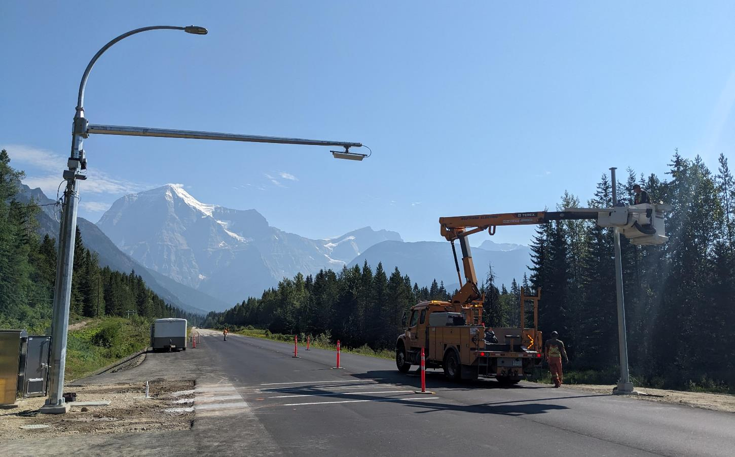
Next Steps
BC plans to implement a full weigh station and inspection facility at Terrace that adds westbound tire screening (2024)
Additional TACS sites with tire width screening have been implemented at Golden, BC and Mt. Robson, BC
Mt. Robson, BC Virtual Weigh Station
Author/s:
D. Pratt, T. Haichert

Slide 14
References
[1] BC MoT (British Columbia Ministry of Transportation and Infrastructure). (2021, August 31). WEIGH2GOBC. Province of British Columbia. Retrieved March 2, 2023, from https://www2.gov.bc.ca/gov/content/transportation/vehicle-safety-enforcement/services/weigh2gobc-join
Author/s:
D. Pratt, T. Haichert

