Slide 1
Smart On-Board mass in Australia - Learnings and Insights
John Gordon
Gavin Hill

Slide 2
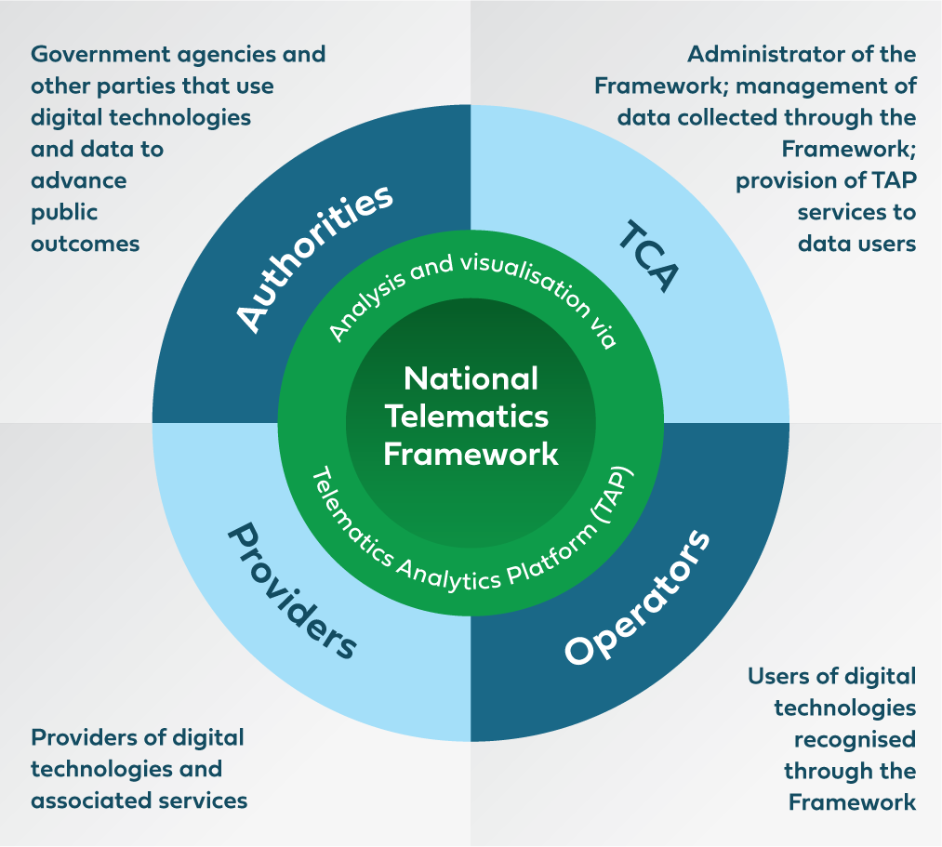
National Telematics Framework
National organisation responsible for providing assurance services related to use of telematics and intelligent access technologies — including smart on-board mass (OBM) systems.
Administrator of Intelligent Access and the National Telematics Framework (ISO 15638 – TARV)
Gordon and Hill, 2023

Slide 3
ISO 15638 (TARV)
= Consumer choice
= Consumer protections and assurance
Multiple providers
Multiple applications
Multiple schemes
enabled through:
Standards and specifications
Business rules
Legal agreements
Operational oversight
Privacy management
Cyber security
= Unlocks standardised data collection and reporting
Gordon and Hill, 2023

Slide 4
Smart On-Board Mass
OBM may be referred to as:
On-board scales
On-board weighing
Air pressure sensors
Electronic Braking System (EBS)
Gordon and Hill, 2023

Slide 5
Smart OBM – An enabler for reform
What’s sought (by industry)
What’s possible (by road managers)
Road & bridge access/ vehicle size, type & mass
What’s currently provided (by road managers)
Smart OBM taps into what’s possible
Gordon and Hill, 2023

Slide 6
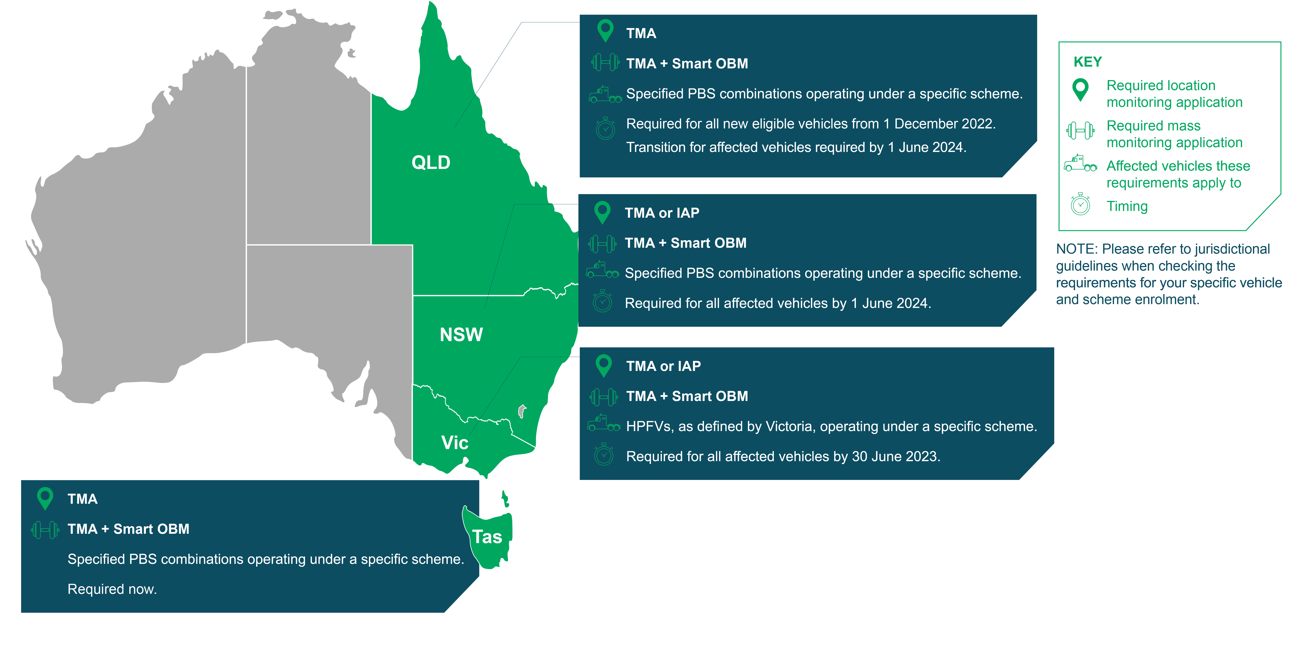
Smart OBM – An enabler for reform
Gordon and Hill, 2023

Slide 7
The road to Smart OBM
Interim OBM Program implemented
On-Board Mass System Functional and Technical Specification
Published
Updated Bridge Standard published
First road manager access scheme using Smart OBM approved
Currently 14 operational road access schemes using Smart OBM
Performance based assessment of OBM systems
OBM operational learnings
report
First OBM system type-approved
First Smart OBM system type-approved
Smart OBM systems commercially operational and data flowing
2009 2010 2011 2012 2013 2014 2015 2016 2017 2018 2019 2020 2021 2022 2023
Gordon and Hill, 2023

Slide 8
Adoption rates of Smart OBM
Adoption rates and expansion of Intelligent Access with Smart OBM
 | January 2022 | July 2022 | January 2023 | July 2023 | October 2023
Number of schemes associated with Smart OBM | 2 | 3 | 6 | 6 | 14
Number of vehicles transmitting Smart OBM data | 0 | 10 | 149 | 790 | 1301
Gordon and Hill, 2023

Slide 9
An marketplace of certified providers
Gordon and Hill, 2023

Slide 10
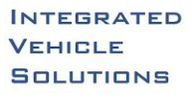
Paired with a marketplace of Smart OBM suppliers
Gordon and Hill, 2023

Slide 11
Key policy learnings
Allow sufficient time to adapt to policy changes
Provide early and solid market signals
Central coordination of the marketplace, and relationships between actors is necessary to manage interface issues between technology providers, service providers, the transport industry and policy makers.
Manage the market deployment and consider carefully any extension of timeframes
Robust monitoring, audit, and data validation to ensure the early identification of issues between actors
Gordon and Hill, 2023

Slide 12
Smart OBM analytics
Smart OBM data and analytics is supporting:
monitoring vulnerable bridges
monitoring newer low and zero emission heavy vehicles
monitoring vehicles with greater-than-regulated axle masses
reporting on productivity and economic utilisation of structures
supporting access and road management, investment and planning decisions
providing assurance to road managers
identifying potential non-compliances.
Gordon and Hill, 2023

Slide 13
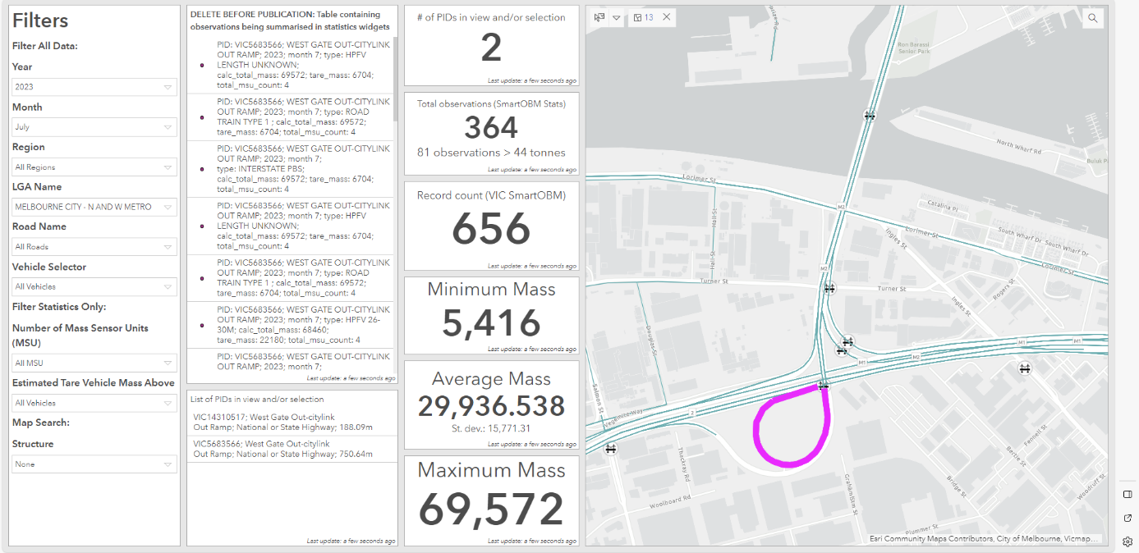
Smart OBM analytics
Gordon and Hill, 2023

Slide 14
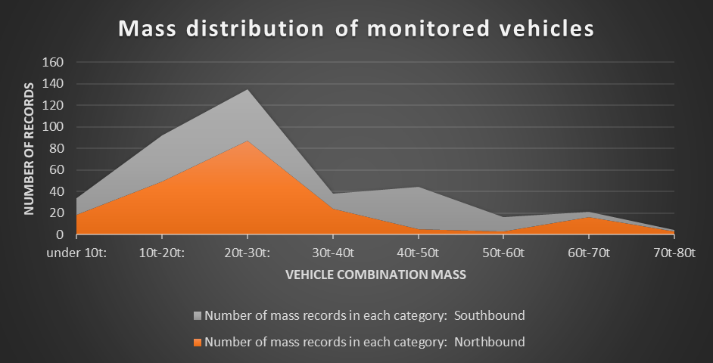
Smart OBM analytics
Gordon and Hill, 2023

Slide 15
Future developments
Smart OBM is anticipated to be increasingly used for:
monitor low and zero emission heavy vehicles with steer axle masses over 7 tonnes
informing investment decisions and target levels of service
integration of Smart OBM and telematics location data with automated vehicle access assessment systems
complementing dynamic mass and route access decisions.
Gordon and Hill, 2023

