Slide 1
DETERMINING THE TRAFFIC LOAD DISTRIBUTION ACROSS A LARGE PORTION OF THE ROAD NETWORK WITH SHORT-TERM B-WIM MEASUREMENTS: A CASE STUDY OF THE REPUBLIC OF SERBIA
Martin Hauptman
Rajko Branković

Slide 2
Introduction
Public Enterprise Roads of Serbia (PERS)
State enterprise: maintenance and management of first
and second category state roads
Manages more than 16.500 km of roads, 3.465 bridges,
109 tunnels
Cestel
Slovenian producer of bridge weigh-in-system
Experience in more than 30 countries on all continents
Author/s:
M. Hauptman, R. Branković
Notes:
Mr. Branković is a road safety expert from the Public enterprise roads of Serbia, Sector for Investments. Public enterprise roads of Serbia is a state enterprise …

Slide 3
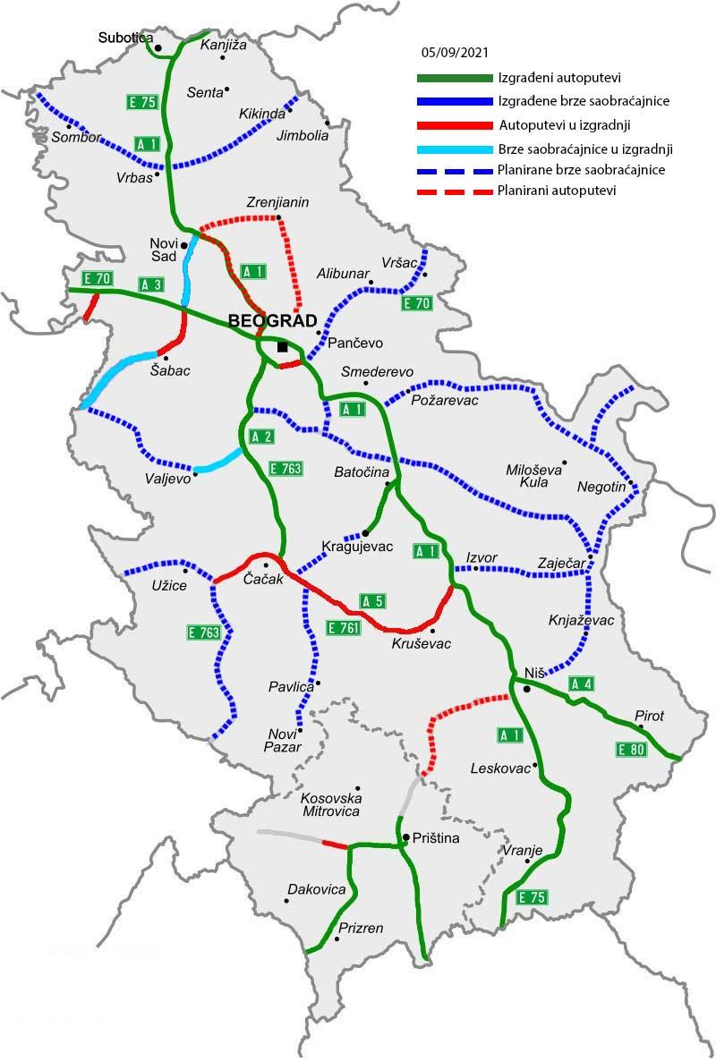
Background
Republic of Serbia, starting point:
IA roads (motorways): approx. 950 km
IB roads (state roads): approx 4.500 km
virtually no data on traffic loads
use of traffic counters
limited monitoring of HGVs
Author/s:
M. Hauptman, R. Branković

Slide 4
Project Serbia
Led by PERS
Road Rehabilitation and Safety Project, financed by the World Bank
Public tender: 17 two-week WIM measurement, procurement of a B-WIM system, training
Main goals:
determine hotspots of overloaded vehicles
get an overview of the network-wide statistics on overloaded vehicles
gather data on real traffic loads for road design
setup future enforcement strategy
Author/s:
M. Hauptman, R. Branković

Slide 5
Project Serbia: phases of the implementation
bridge survey
installations of the systems
calibrations
deinstallations
moving the systems to new locations
data analysis
Author/s:
M. Hauptman, R. Branković

Slide 6
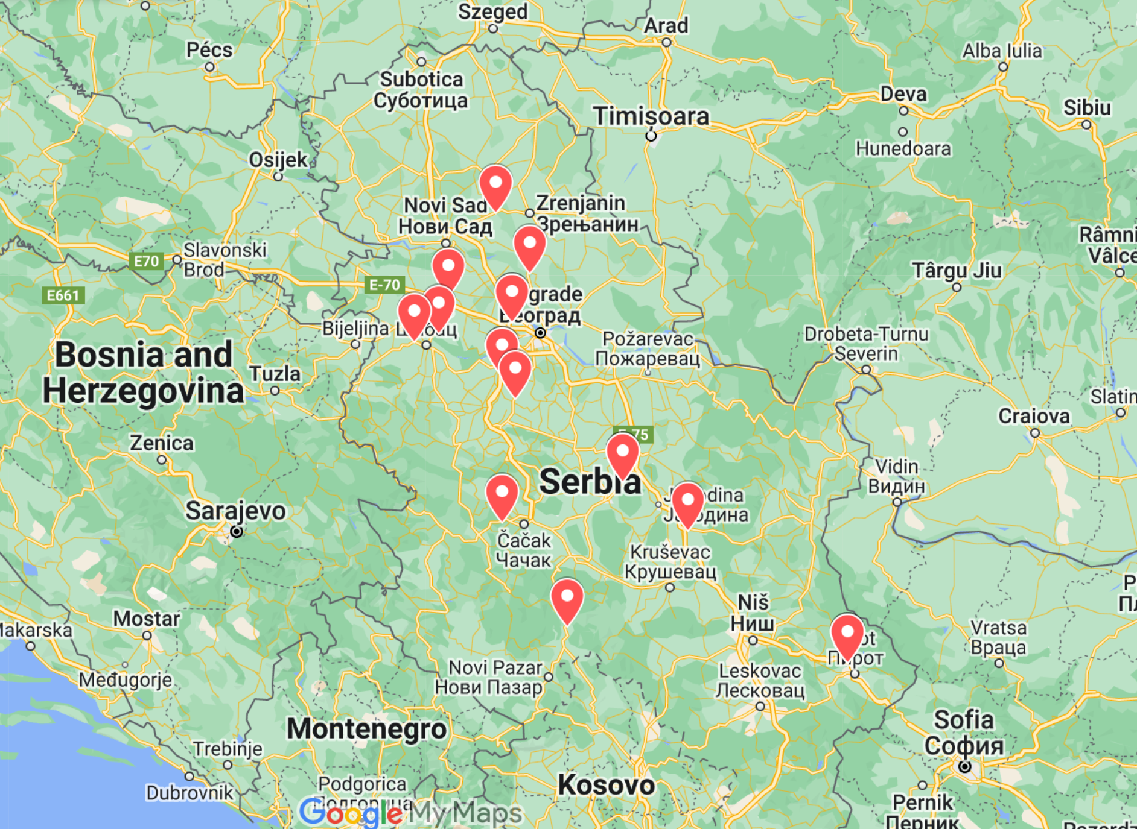
Project Serbia: bridge survey
Author/s:
M. Hauptman, R. Branković
Notes:
Locations proposed by PERS, upon bridge survey, all of the location were approved by Cestel.

Slide 7
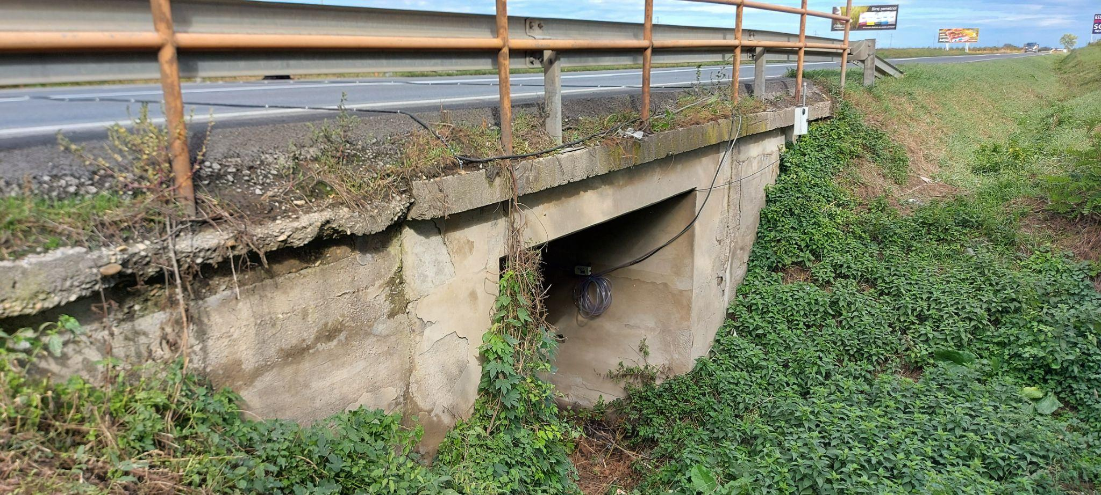
Project Serbia: bridges
Author/s:
M. Hauptman, R. Branković
Notes:
A large variety of bridges, from small ones …

Slide 8
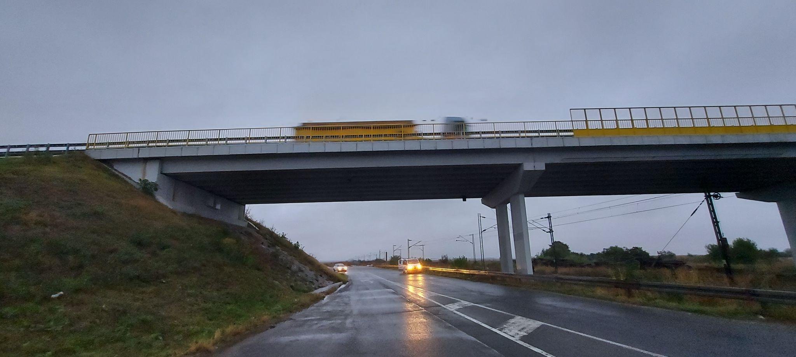
Project Serbia: bridges
Author/s:
M. Hauptman, R. Branković
Notes:
to quite large structures.

Slide 9
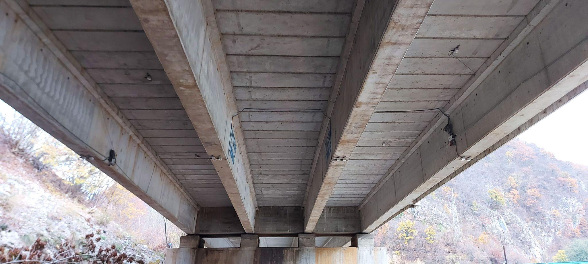
Project Serbia: bridge types
Author/s:
M. Hauptman, R. Branković
Notes:
Various bridge types

Slide 10
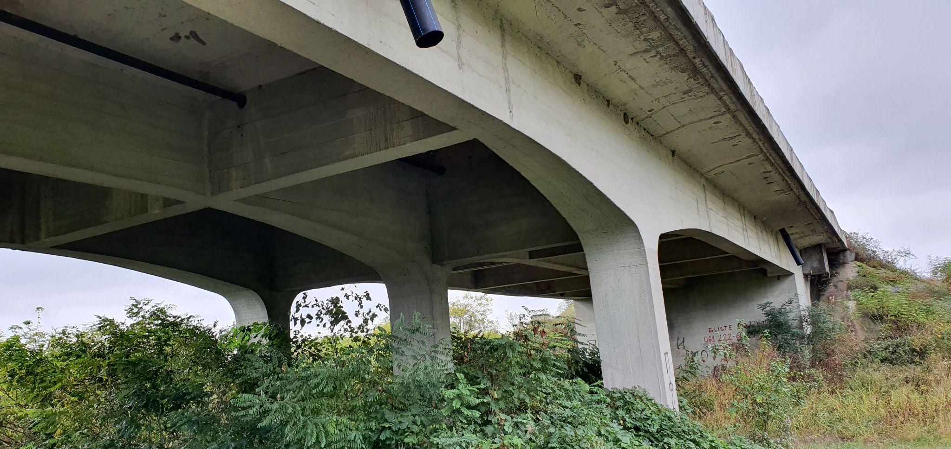
Project Serbia: bridge types
Author/s:
M. Hauptman, R. Branković

Slide 11
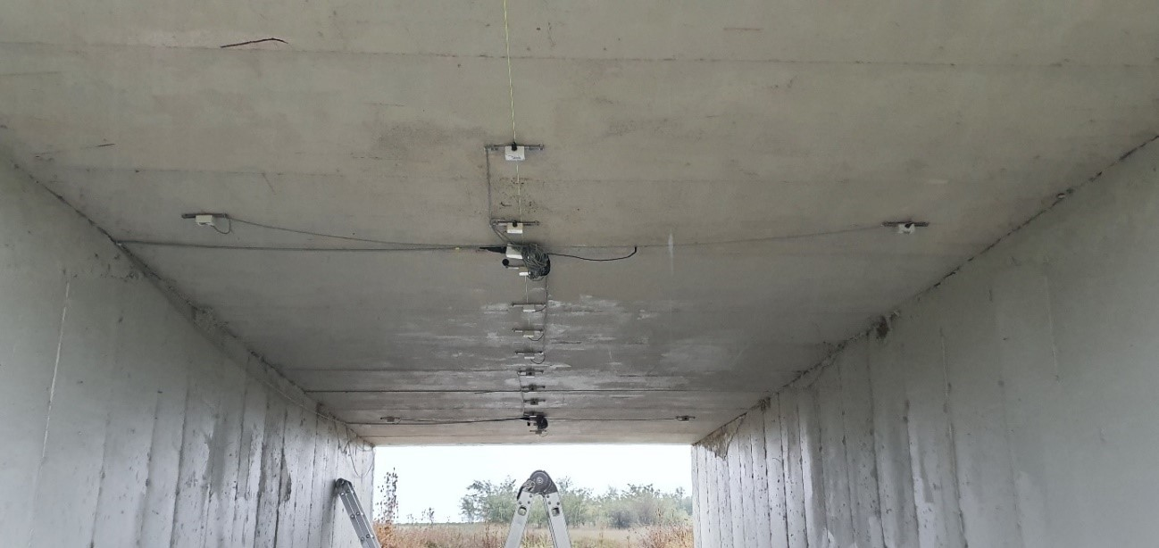
Project Serbia: bridge types
Author/s:
M. Hauptman, R. Branković

Slide 12
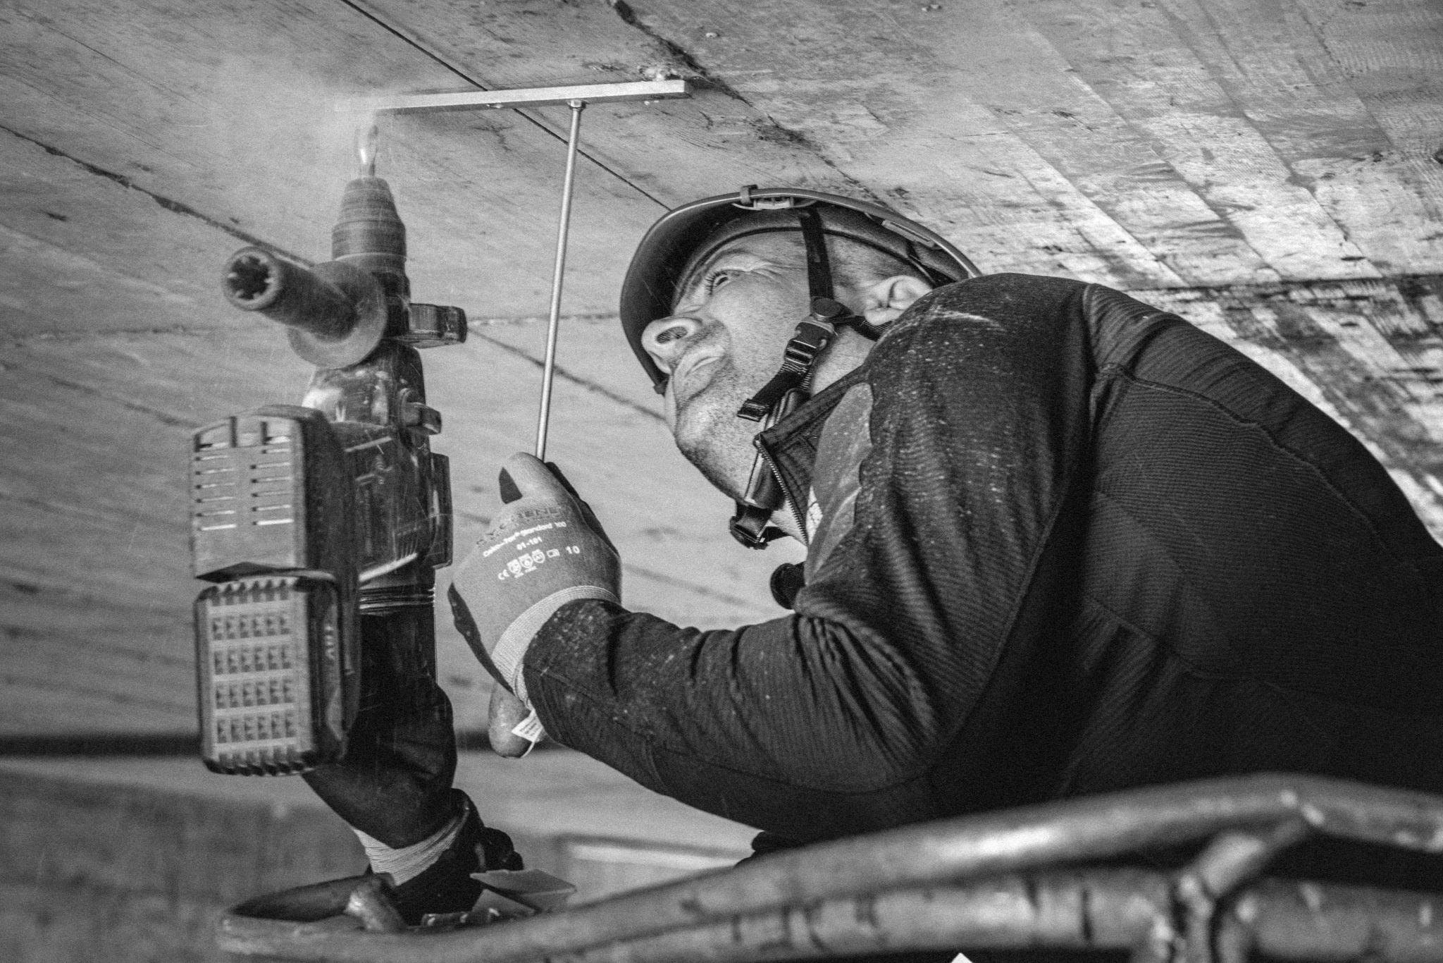
Project Serbia: installations
Multiple simultaneous bridge WIM measurements
2-week measurements
7 portable bridge WIM system
2 team, 2 technicians in each team
Author/s:
M. Hauptman, R. Branković
Notes:
Installation done in about 8 hours

Slide 13
Project Serbia: calibration
 | Required accuracy
Single axle load | ±15%
Load per axle group | ±12%
Gross vehicle weight | ±10%
Author/s:
M. Hauptman, R. Branković
Notes:
NMi WIM calibration protocol
A fully loaded heavy vehicle, which was of the same configuration as the most common HGVs on the road section, was used for calibration.
15 calibration runs were performed over the bridge WIM systems at each of the following speeds: 70 km/h, 80/km/h and 90 km/h.

Slide 14
Project Serbia: deinstallation
Author/s:
M. Hauptman, R. Branković
Notes:
Holes filled with cement paste
Deinstallation done in about 3 hours
After deinstallation, system moved to a new location

Slide 15
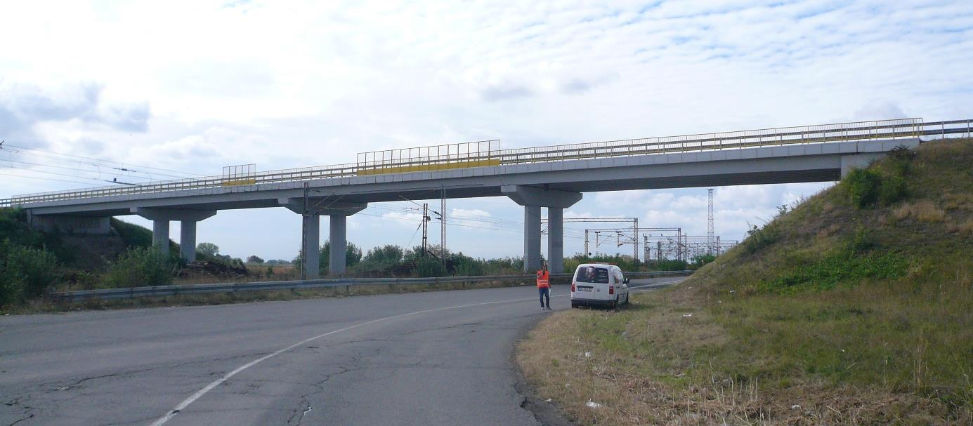
Project Serbia: data analysis
Sample report: Ruma-Šabac
between 14 and 27 October 2020
Author/s:
M. Hauptman, R. Branković
Notes:
Prepared for each measurement

Slide 16
Project Serbia: Ruma-Šabac report
Daily traffic average
Direction | Busses | Medium trucks | Heavy trucks | Semi/trailers | Other | Sum
Ruma-Šabac | 37 | 106 | 17 | 456 | 1 | 617
Šabac-Ruma | 37 | 106 | 17 | 495 | 0 | 655
Both directions | 74 | 212 | 34 | 951 | 1 | 1272
Author/s:
M. Hauptman, R. Branković

Slide 17
Project Serbia: Ruma-Šabac report
Average daily traffic loading
Direction | Busses | Medium trucks | Heavy trucks | Semi/trailers | Other | Sum
Ruma-Šabac | 14,68 ESAL | 0,64 ESAL | 23,99 ESAL | 274,69 ESAL | 0,09 ESAL | 314,1 ESAL
Šabac-Ruma | 20,00 ESAL | 0,51 ESAL | 41,04 ESAL | 765,33 ESAL | 0,15 ESAL | 827,0 ESAL
Overall | 34,68 ESAL | 1,15 ESAL | 65,03 ESAL | 1040,02 ESAL | 0,24 ESAL | 1141,1 ESAL
Author/s:
M. Hauptman, R. Branković
Notes:
Significantly uneven traffic loading when looking at the direction due to garbage dump located on the road section.
72,5 % of average daily traffic loading was detected in the direction Šabac-Ruma
Reason: 4 and 5-axle dumpster trucks, full in one direction, empty in the opposite direction

Slide 18
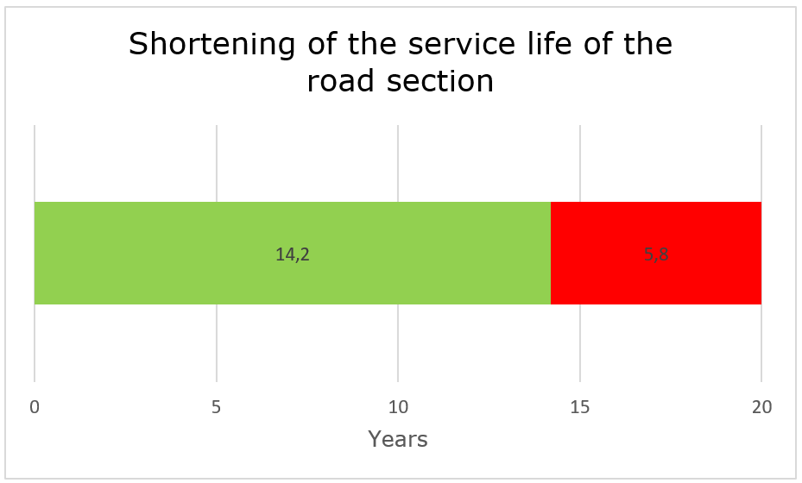
Project Serbia: Ruma-Šabac report
Service life of the road section
Author/s:
M. Hauptman, R. Branković

Slide 19
Conclusion
Duration of the project: 3 months
On average, 16,8 % of HGVs were overloaded across 17 locations.
Average daily overloading: 124 ESAL
16,8 years - the average remaining service life of road sections
Future
road WIM stations, additional bridge WIM measurements, preselection etc.
B-WIM data used for bridge analysis (prof. Rade Hajdin: Evaluation of bridge traffic load model using B-WIM measurements in Serbia, October 2023)
Author/s:
M. Hauptman, R. Branković
Notes:
From the end of the tender process to the end of the project, approximately 3 months
On one location, 26 % of HGVs were overloaded!
Maximum daily overloading 290 ESAL.
At the location we saw before, the remaining service life is just 14,2 years.

Slide 20
THANK YOU FOR YOUR ATTENTION!
Author/s:
M. Hauptman, R. Branković
Notes:
From the end of the tender process to the end of the project, approximately 3 months
On one location, 26 % of HGVs were overloaded!
Maximum daily overloading 290 ESAL.
At the location we saw before, the remaining service life is just 14,2 years.

