Slide 1
PERFORMANCE ANALYSIS OF AN A-DOUBLE IN ROUNDABOUTS USING NATURALISTIC DRIVING DATA
Abhijeet Behera
Sogol Kharrazi
Erik Frisk

Slide 2
Introduction
PERFORMANCE ANALYSIS OF AN A-DOUBLE IN ROUNDABOUTS USING NATURALISTIC DRIVING DATA
Data collected unobtrusively in real-traffic (uncontrolled environment)
Performance-based standards (PBS)
Tracking
Low-Speed Swept Path
Tail Swing
32 m
Abhijeet Behera, Sogol Kharrazi, Erik Frisk

Slide 3
Motivation and Research Questions
2.7x
How much space (Tracking) do A-doubles occupy in the roundabouts?
How do drivers respond to roundabouts?
Test by Volvo Trucks [1]
Abhijeet Behera, Sogol Kharrazi, Erik Frisk
[1] https://www.youtube.com/watch?v=gYVnp9x6UCk

Slide 4
Research Objectives
Estimate the influence of the roundabout’s radius on the Low-Speed Swept Path (LSSP) and Tail Swing (TS).
Analyze the steering and speed patterns of drivers of A-doubles in the roundabouts.
Evaluate the cognitive workload of the drivers of A-doubles in the roundabouts using Steering Reversal Rate (SRR).
Abhijeet Behera, Sogol Kharrazi, Erik Frisk

Slide 5
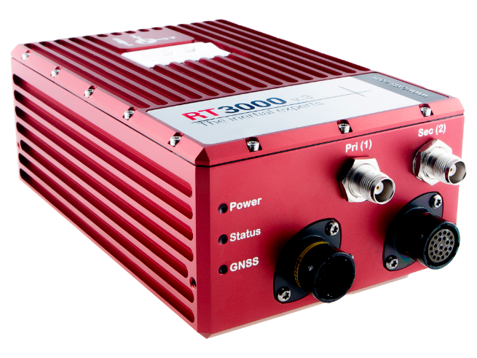
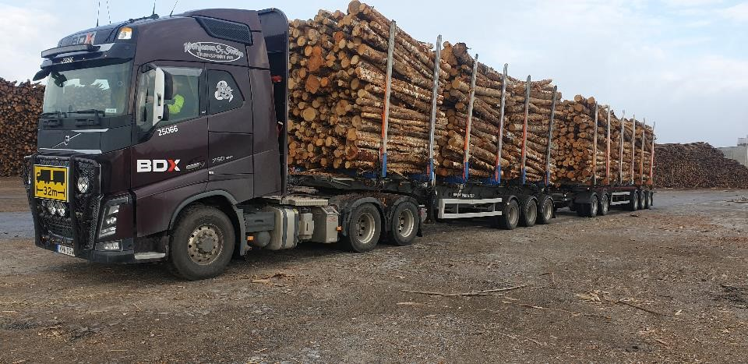
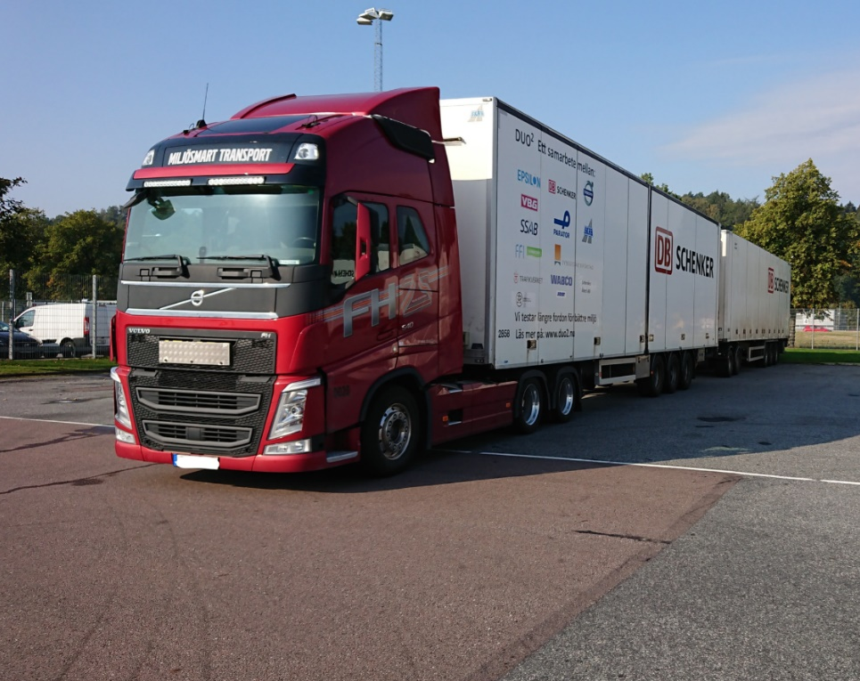
Data Collection
Piteå
40 km, 35 trips
OxTS RT3000
Differential GPS and IMU
Accuracy of 1 cm under clear sky
Positions, translational and angular velocities, and corresponding accelerations
Fixed in first and last units
Gothenburg
540 km, 6 trips
Malmö
Abhijeet Behera, Sogol Kharrazi, Erik Frisk

Slide 6
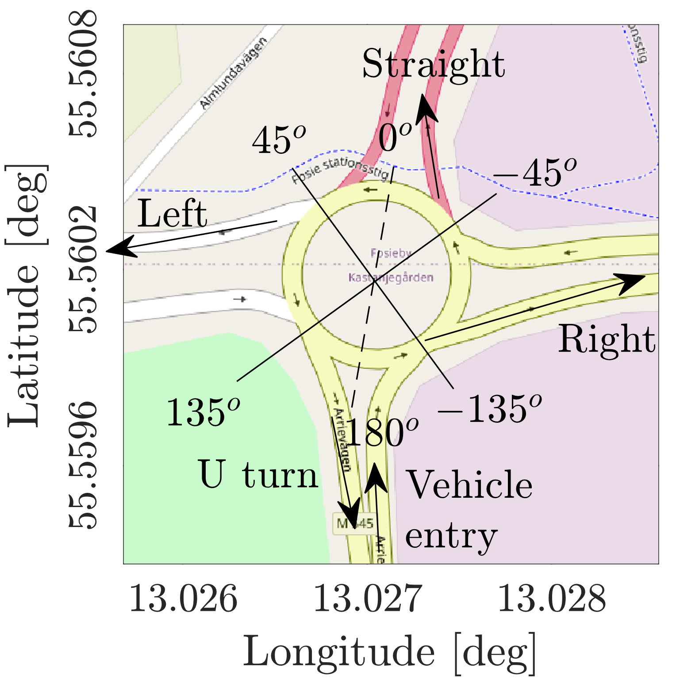
Roundabout Categorization
Direction of travel | No. of cases
Straight | 130
Left | 11
Right | 11
Radius of roundabouts | No. of cases
R11 | 22
R15 | 17
R24 | 21
R30 | 92
9 Roundabouts: 152 Crossings
Abhijeet Behera, Sogol Kharrazi, Erik Frisk

Slide 7
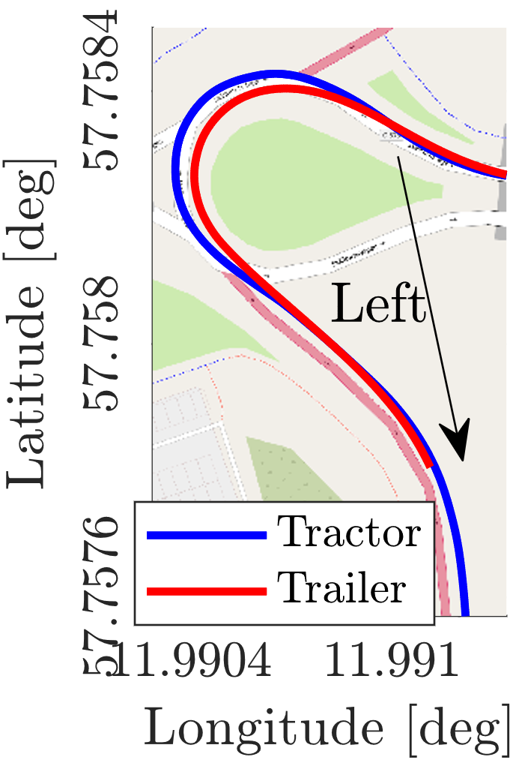
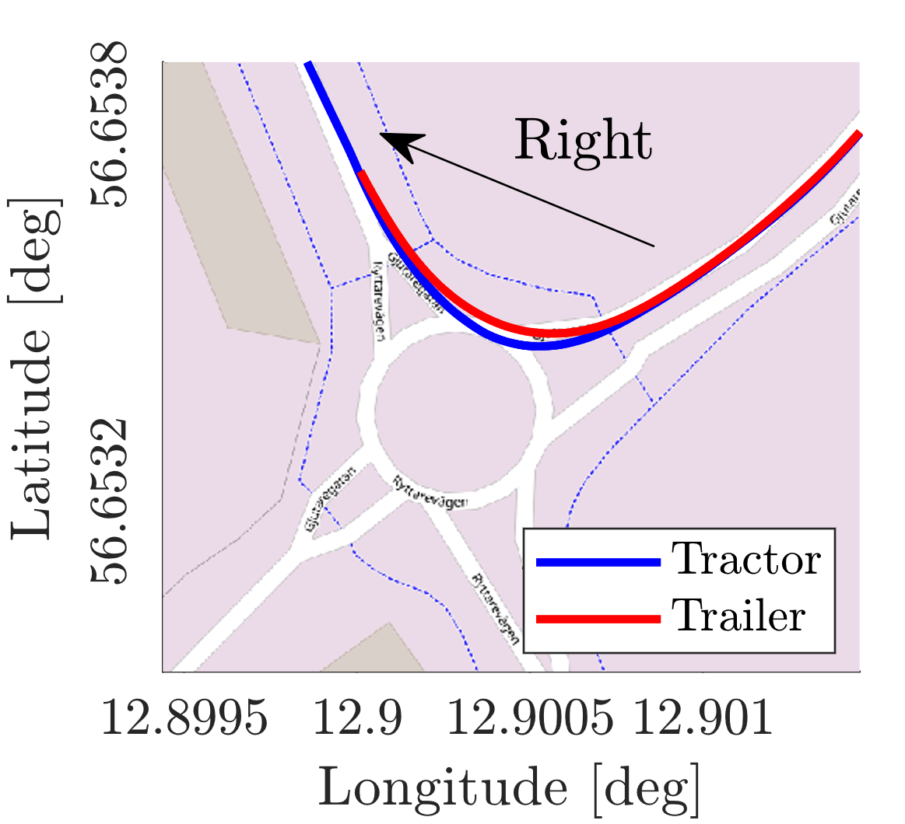
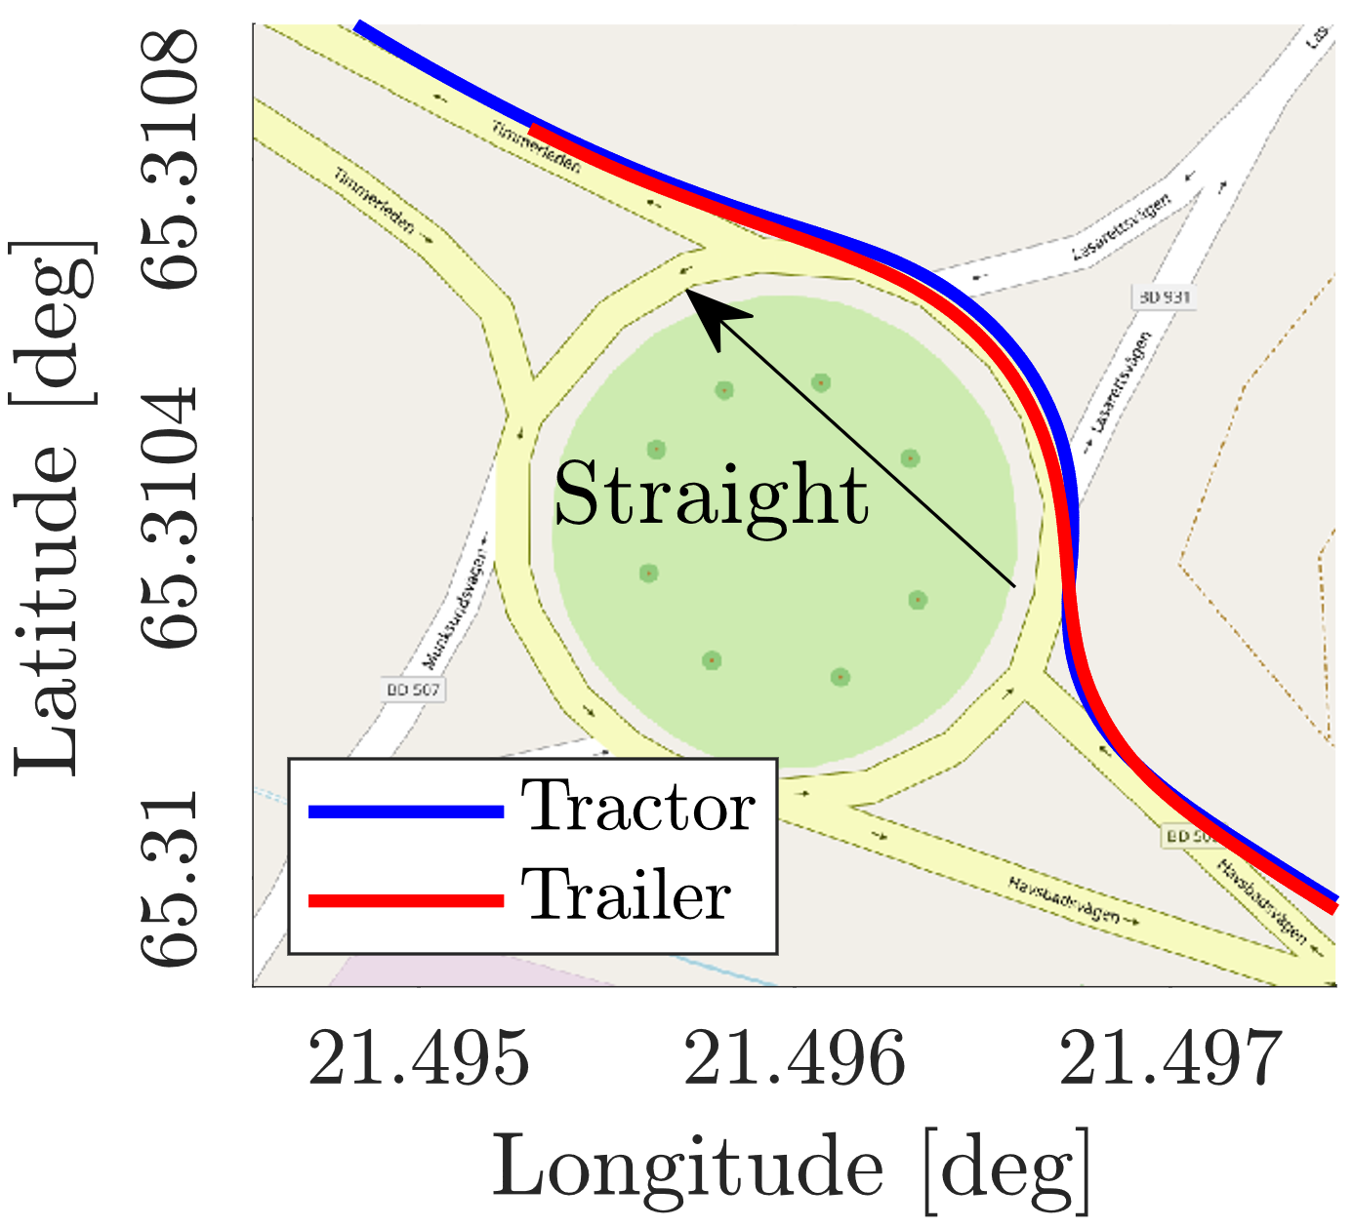
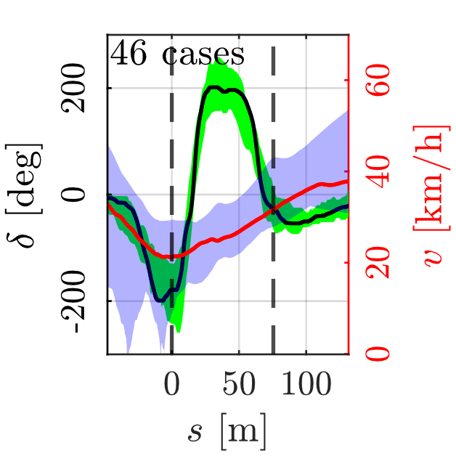
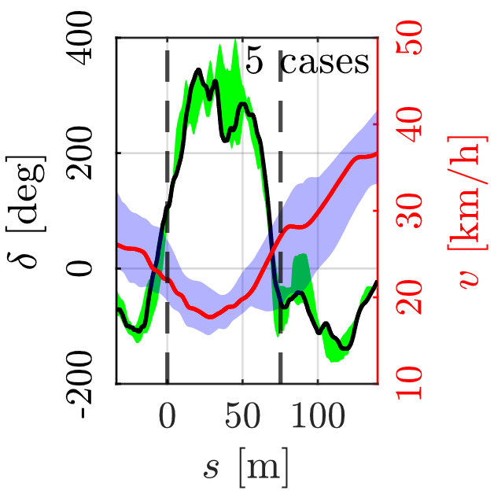
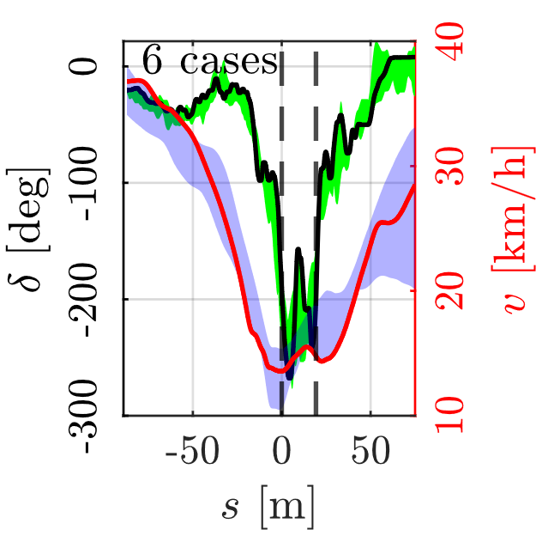
Steering Angle and Speed (1)
Ring
Ring
Ring
Abhijeet Behera, Sogol Kharrazi, Erik Frisk

Slide 8
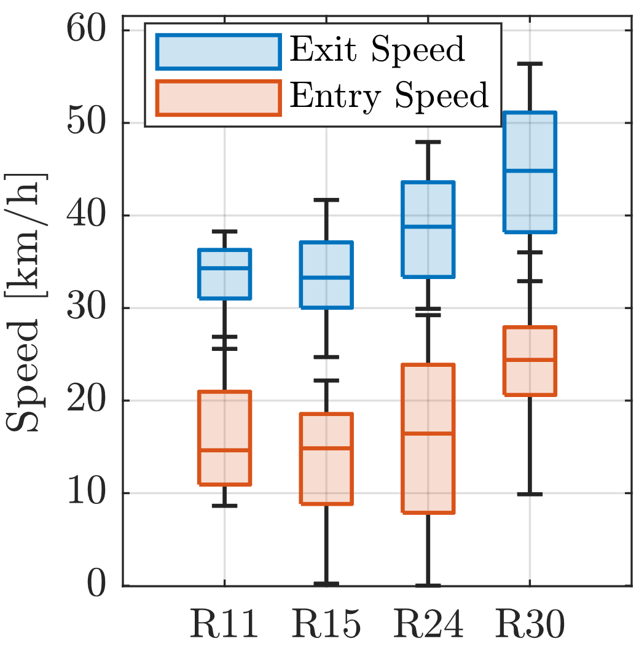
Steering Angle and Speed (2)
Exit speed is around 2 times the entry speed.
Entry and exit speeds increase with the radius of the roundabout.
Abhijeet Behera, Sogol Kharrazi, Erik Frisk

Slide 9
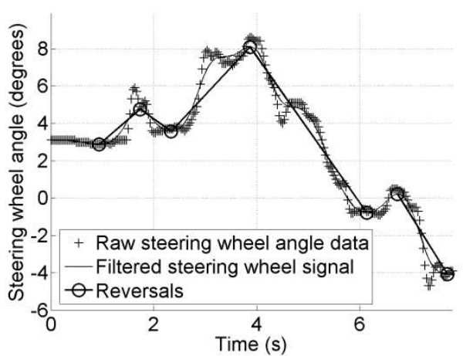
Workload: Steering Reversal Rate
Steering Reversal Rate (SRR) is the number, per minute, of steering wheel reversals larger than a certain minimum angular value [2].
SRR$= \frac{4}{\frac{6}{60}}=40 \min^{−1}$
Abhijeet Behera, Sogol Kharrazi, Erik Frisk
[2] Markkula G, Engström J. A steering wheel reversal rate metric for assessing effects of visual and cognitive secondary task load. In Proceedings of the 13th ITS World Congress 2006. Leeds.

Slide 10
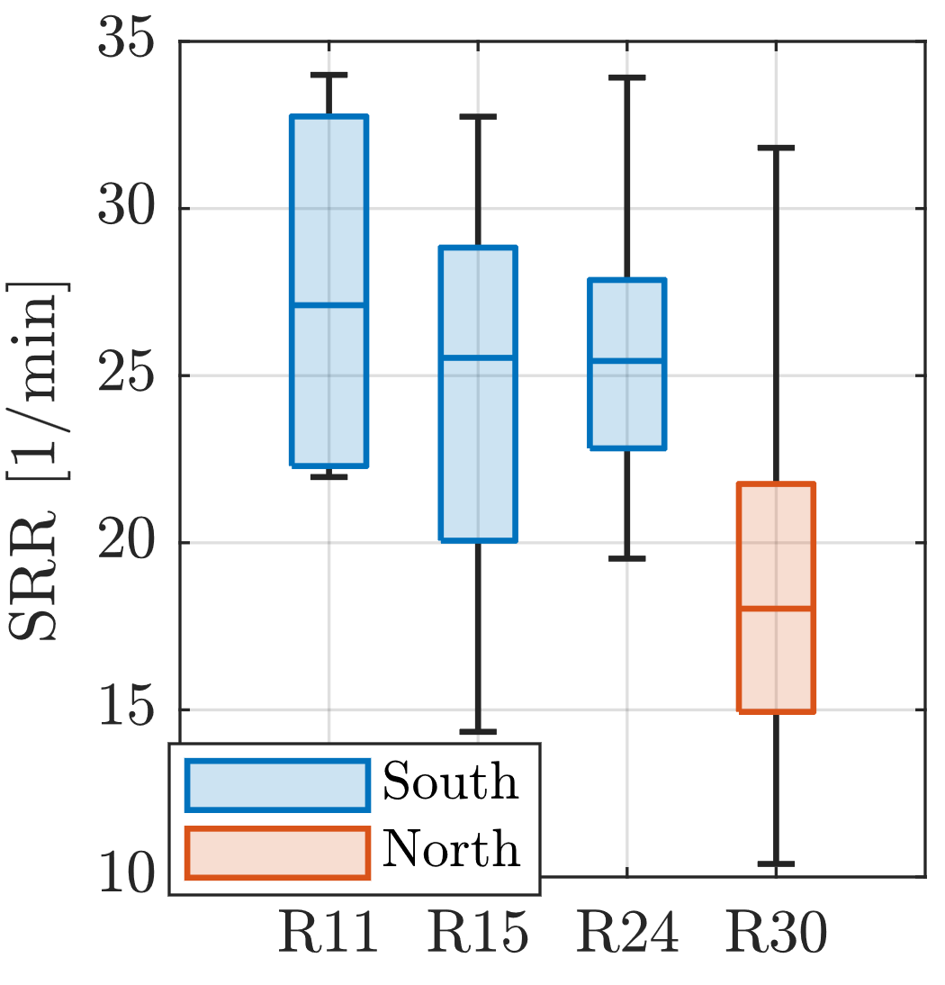
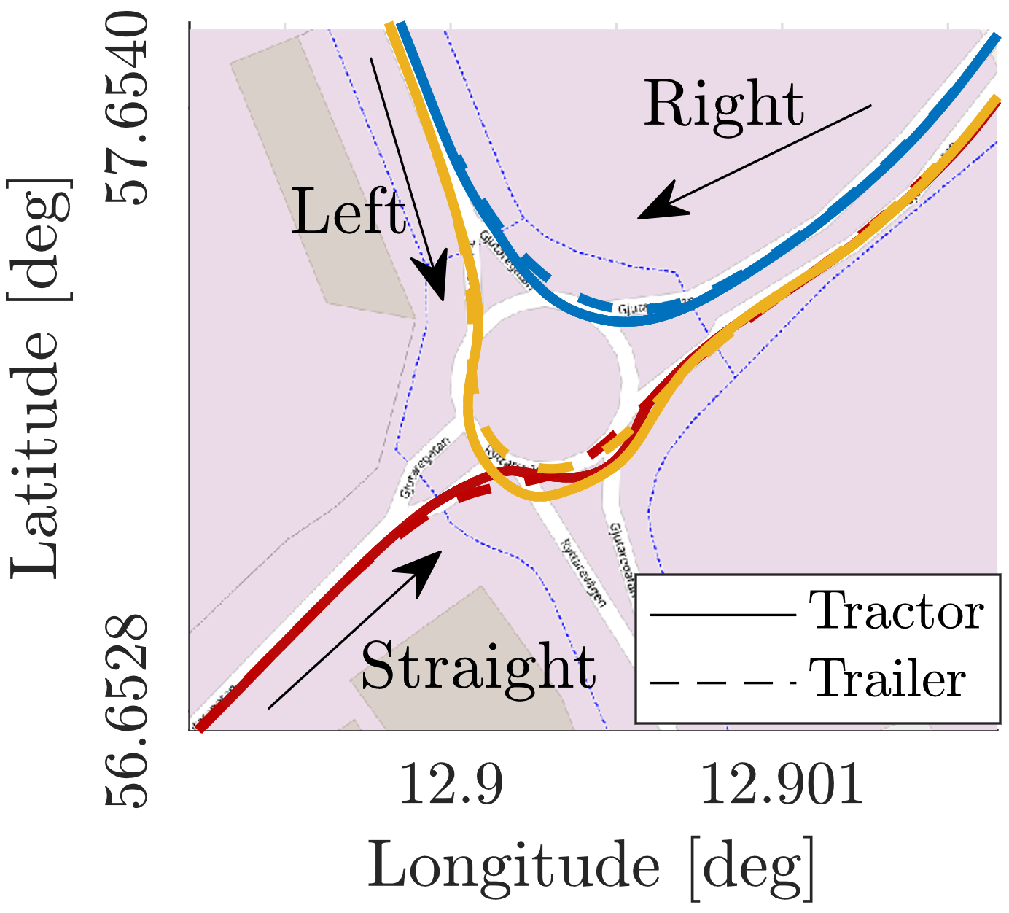
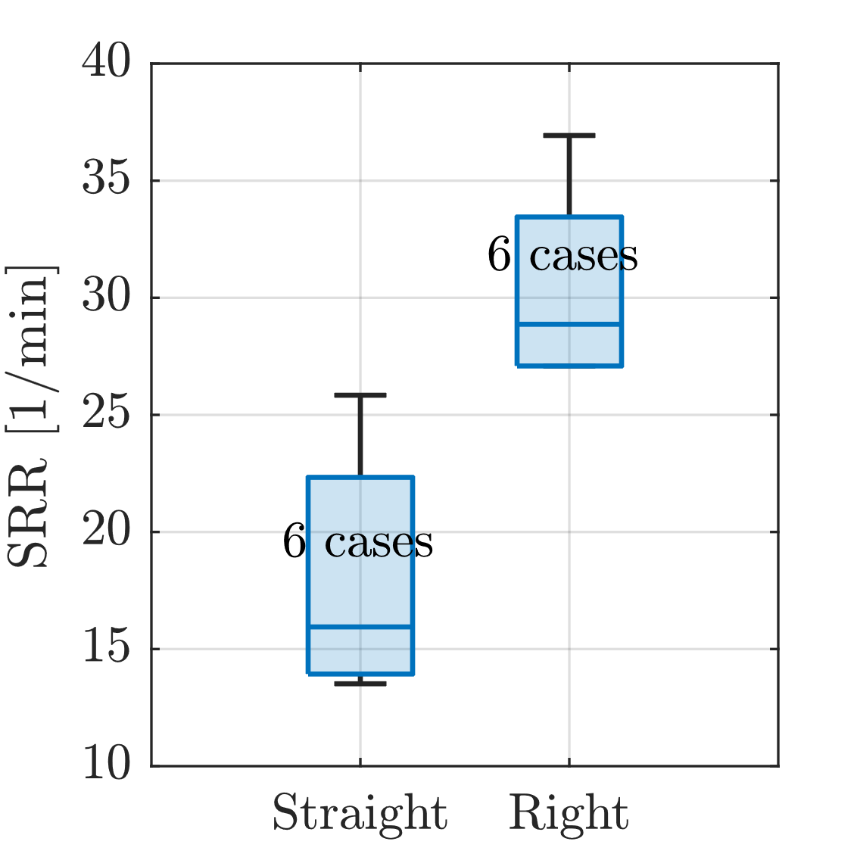
Workload: Steering Reversal Rate
Cognitive workload decreases with the radius.
The right turns are more workload-intensive than straight crossings.
Abhijeet Behera, Sogol Kharrazi, Erik Frisk

Slide 11
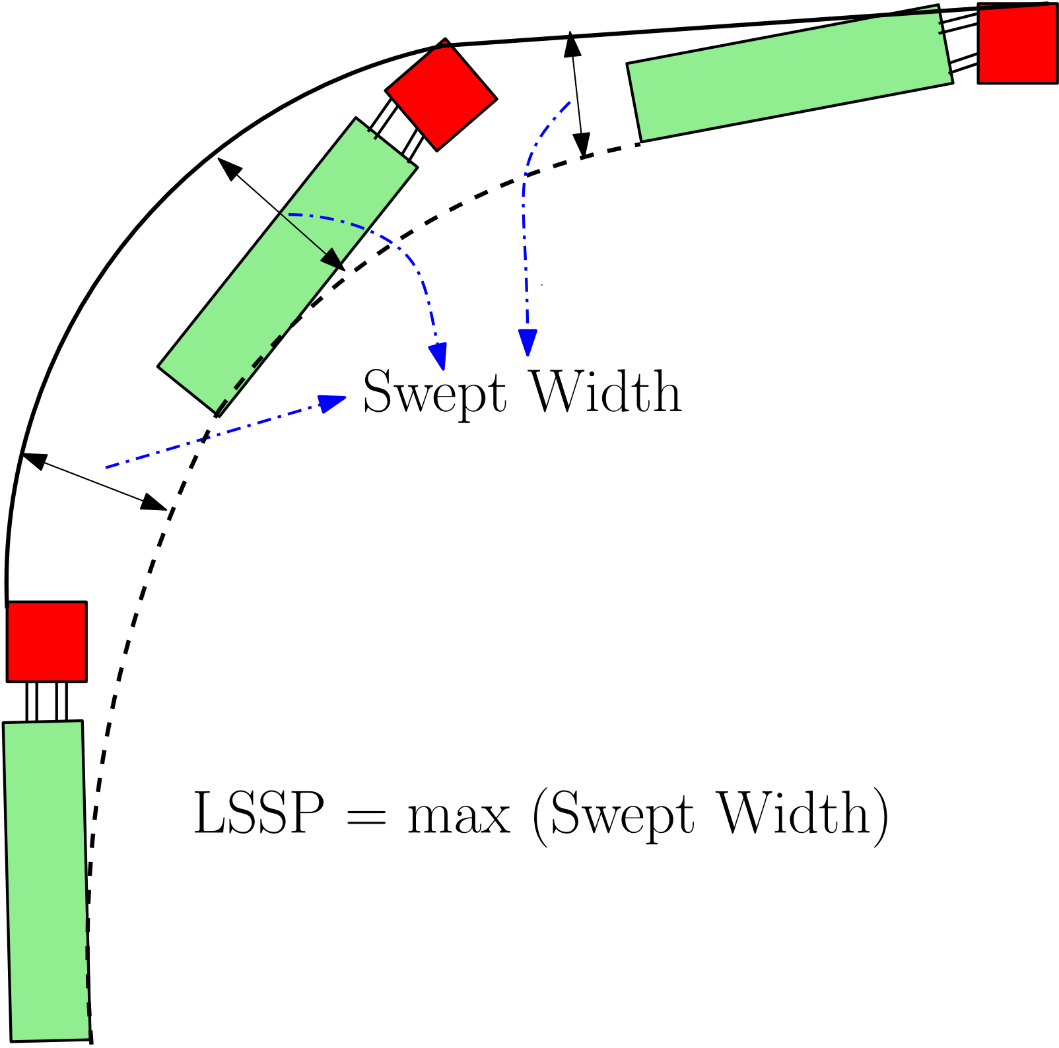
Swept Path
Low-Speed Swept Path (LSSP) is the maximum width of the swept path, i.e., the maximum road width swept out by the extremities of the vehicle as it moves along the path.
Abhijeet Behera, Sogol Kharrazi, Erik Frisk

Slide 12
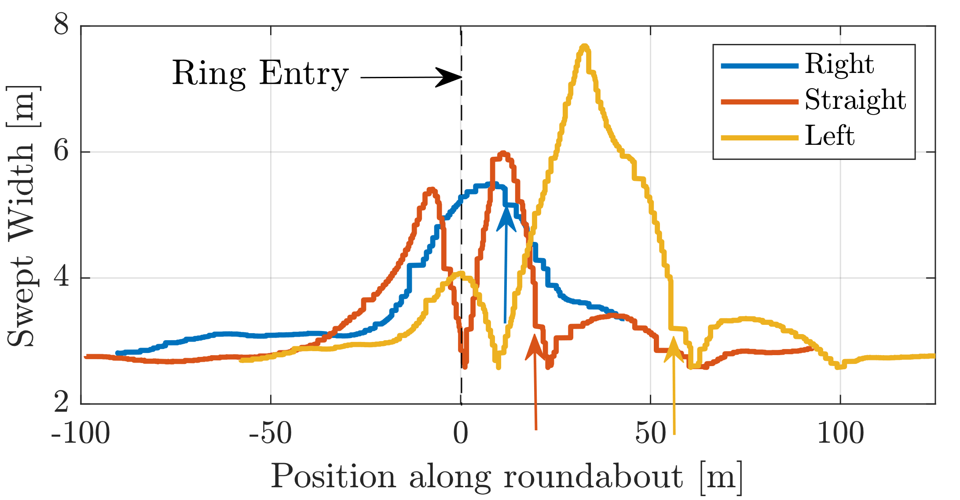
Swept Width Variation
Three peaks for straight and left turns in the roundabout compared to one peak in right turn.
The magnitude of the peak is mostly the highest in the ring. (It may not be always true!)
Abhijeet Behera, Sogol Kharrazi, Erik Frisk

Slide 13
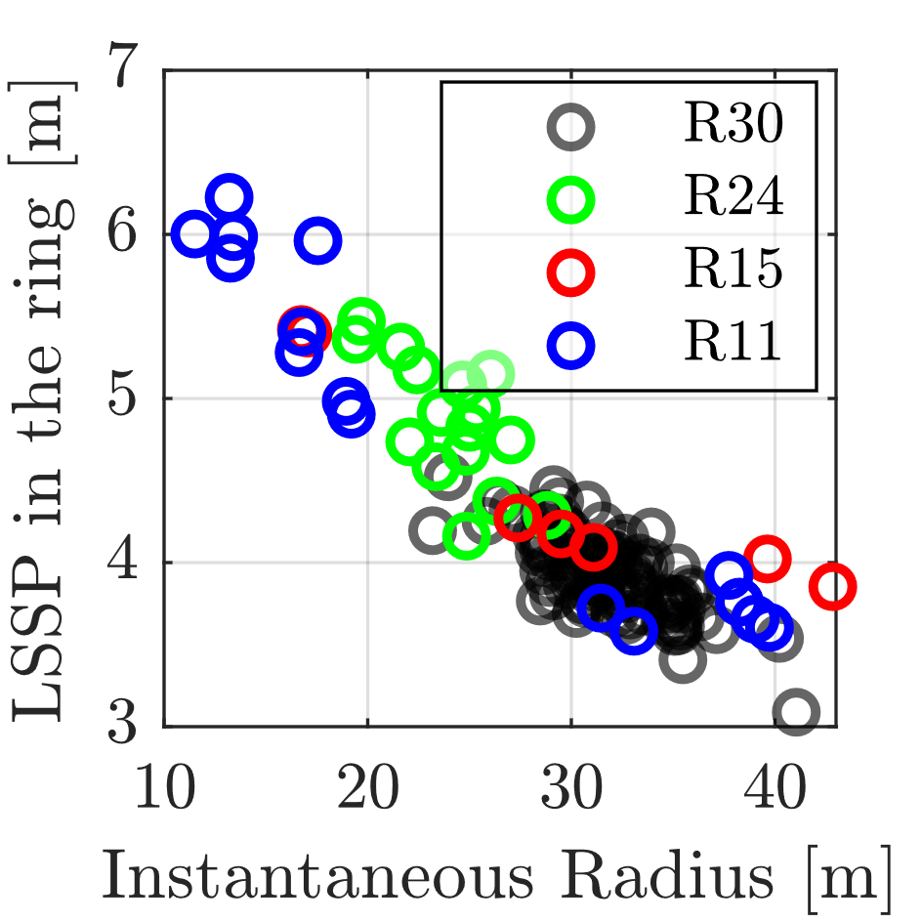
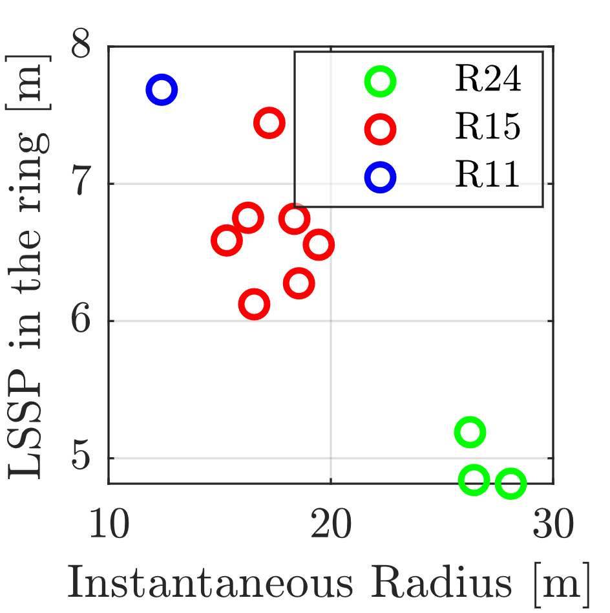
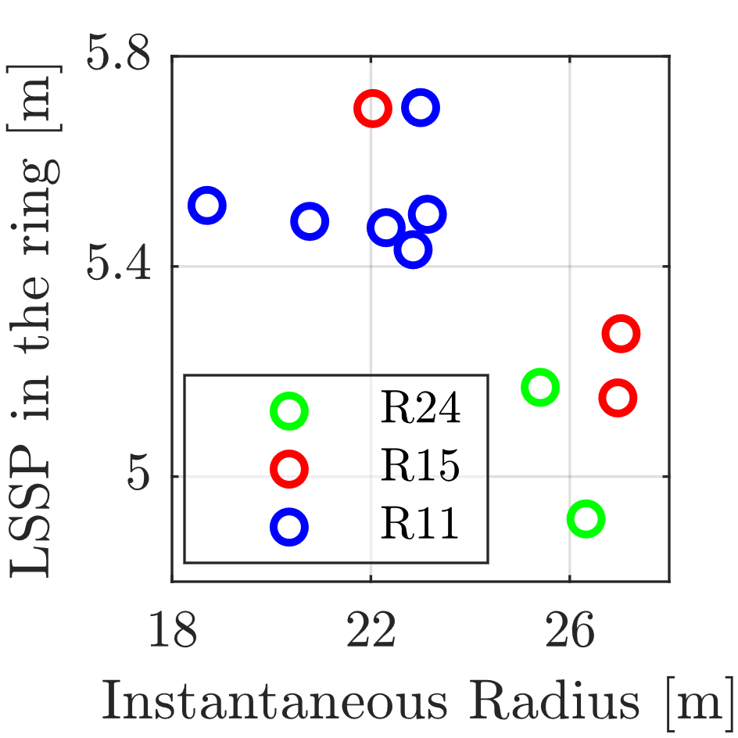
Low-Speed Swept Path (LSSP)
Straight
Left
Right
LSSP decreases with instantaneous radius irrespective of the roundabout’s radius for straight and left.
Large variance in instantaneous radius (also LSSP) for smaller radii compared to higher radii for straight.
Small variance in instantaneous radius (also LSSP) for left cases.
Abhijeet Behera, Sogol Kharrazi, Erik Frisk

Slide 14
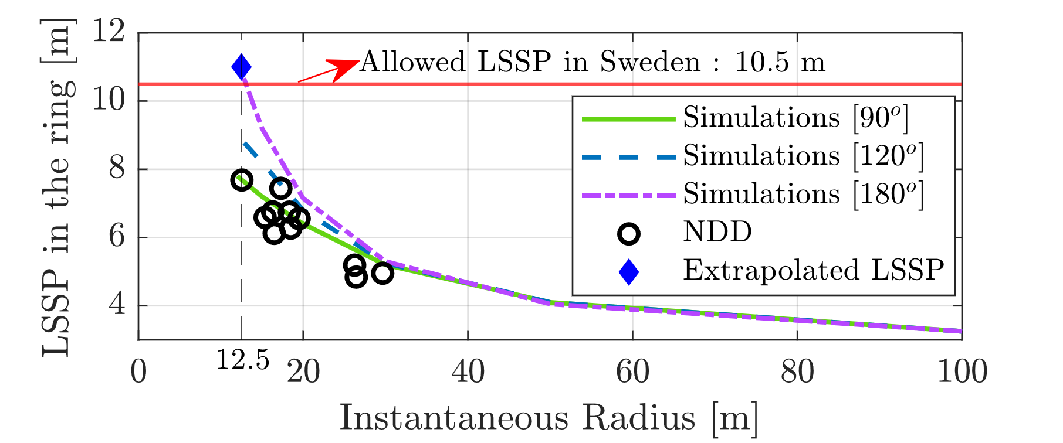
Conclusions
A-doubles are driven safely in all the studied roundabout crossings.
The A-double needs steerable axles to satisfy the existing LSSP requirement for 25.25 m combinations in Sweden (12.5/2.0 m of outer/inner radius).
Abhijeet Behera, Sogol Kharrazi, Erik Frisk

Slide 15
Acknowledgement
Funding Agency
Data Collection
Abhijeet Behera, Sogol Kharrazi, Erik Frisk

Slide 16
Thank you for listening! ☺
Abhijeet Behera, Sogol Kharrazi, Erik Frisk

