Slide 1

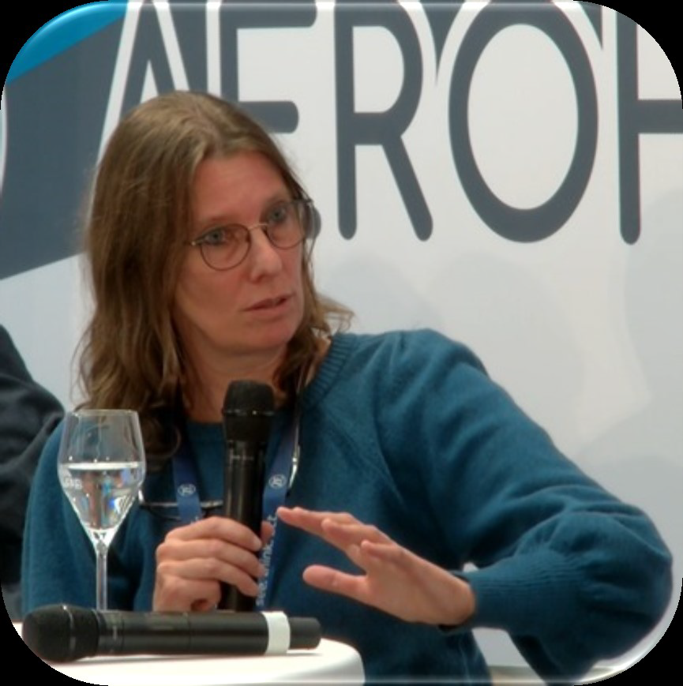
Results from CEDR-work done around Intelligent Access
Thomas Asp
Loes Aarts

Slide 2
CEDR WG Road Freight Transport
ASECAP (3)
Austria (1)
Denmark (1)
Estonia (1)
Finland (2)
Hungary (1)
Italy (1)
Netherlands (2)
Norway (2)
OECD ITF (1)
Portugal (1)
Slovenia (1)
Spain (1)
Sweden (1)
12 countries
2 international organizations
19 members
2 co-leaders (Loes Aarts and Thomas Asp)
Authors:
Thomas Asp, Loes Aarts
Notes:
CEDR is the organization of the European road authorities

Slide 3
Background and scope
CEDR’s WG Road Freight Transport started 2021 a task group on Intelligent Access (IA)
IA is a regulatory framework using vehicle technology to ensure the right vehicle with the right cargo/freight, operates on the right road at the right time
Main purpose with IA is to have a better use of existing infrastructure
Scope of the work was
  To collect best practices about IA incl. benefits, obstacles and recommendations for implementation within NRAs.
Authors:
Thomas Asp, Loes Aarts

Slide 4
Why Intelligent Access (IA)
Better use of existing infrastructure with traffic management based on time and place
Less degradation of road infrastructure
Realizing climate objectives by reducing congestion and prioritizing climate-friendly vehicles
Increasing road safety through, for example, less overloading or insight into safety events in relation to location
Create a level playing field between carriers
Improved control of the transport of abnormal loads and dangerous goods
Controlled introduction of High Capacity Vehicles
Faster and more controlled processing of transport documents
Authors:
Thomas Asp, Loes Aarts
Notes:
Better use of existing infrastructure with traffic management based on time and place
Less degradation of road infrastructure through improved management of weight, speed and routing of heavy vehicles
Realizing climate objectives by reducing congestion and prioritizing climate-friendly vehicles for example in management of low emission zones
Increasing road safety through, for example, less overloading or insight into safety events in relation to location
Create a level playing field between carriers, harder to cheat
Improved control of the transport of abnormal loads and dangerous goods
Controlled introduction of High Capacity Vehicles
Faster and more controlled processing of transport documents maybe most important in cross-border transport

Slide 5
Following activities have been undertaken
A survey was conducted among CEDR members with a response from 12 NRA:s
Based on the results of the survey, in-depth interviews were held with 5 countries
In collaboration with PIARC
  Have we in January 2022, organized a webinar around IA with participation of stakeholders from Australia, South and North America and Europe
  Have we in October 2022 organized a workshop with focus on GDPR with European experts
A CEDR-Call around IA has just been released
Authors:
Thomas Asp, Loes Aarts

Slide 6
Results from questionnaire
Five of twelve answering countries has implemented IA or plan to do it but all countries can see possibilities in IA.
Data to collect was position, weight (total and on axle), volume of heavy traffic and vehicle type.
First step is to use IA for preselection of vehicles for control and for statistical use. Next step direct enforcement.
Most important stakeholders are road and vehicle authorities but all stakeholder (OEMs, Logistic service providers, drivers, shippers, policy makers) needs to be involved in IA.
Obstacles vary from personal integrity like GDPR to lack of political willingness.
Authors:
Thomas Asp, Loes Aarts
Notes:
Five of twelve answering countries has implemented IA or plan to do it but all countries can see possibilities in IA.
Data to collect was position, weight (total and on axle), volume of heavy traffic and vehicle type.
What sort of data you want to collect depend a lot on the purpose of collecting and/or planned use of data.
First step is use for preselection of vehicles for control and for statistical use. Next step direct enforcement.
Most important stakeholders are road and vehicle authorities but all stakeholder (OEMs, Logistic service providers, drivers, shippers, policy makers) needs to be involved in IA.
Obstacles are from personal integrity like GDPR to lack of political willingness. There are EU-regulations like eFTI and eCMR that can help introduction.

Slide 7
Results from interviews
Estonia
  Has since 2010 been developing and using IA that includes VELUB-system there you can apply for permits and ongoing tests with cloud based systems that use eCMR
Italy
  Have systems up and running for abnormal loads (TeWeb) and dangerous goods (Ulisse)
  Both systems are time and cost saving
Netherlands
  Marcel Otto will present their pilots in another presentation
Sweden
  Developed 2018 a system including how and how often you need to collect data
  Have ongoing pilot there IA are used for allowing higher weights wintertime
  Plan to introduce a system for abnormal loads
Authors:
Thomas Asp, Loes Aarts

Slide 8
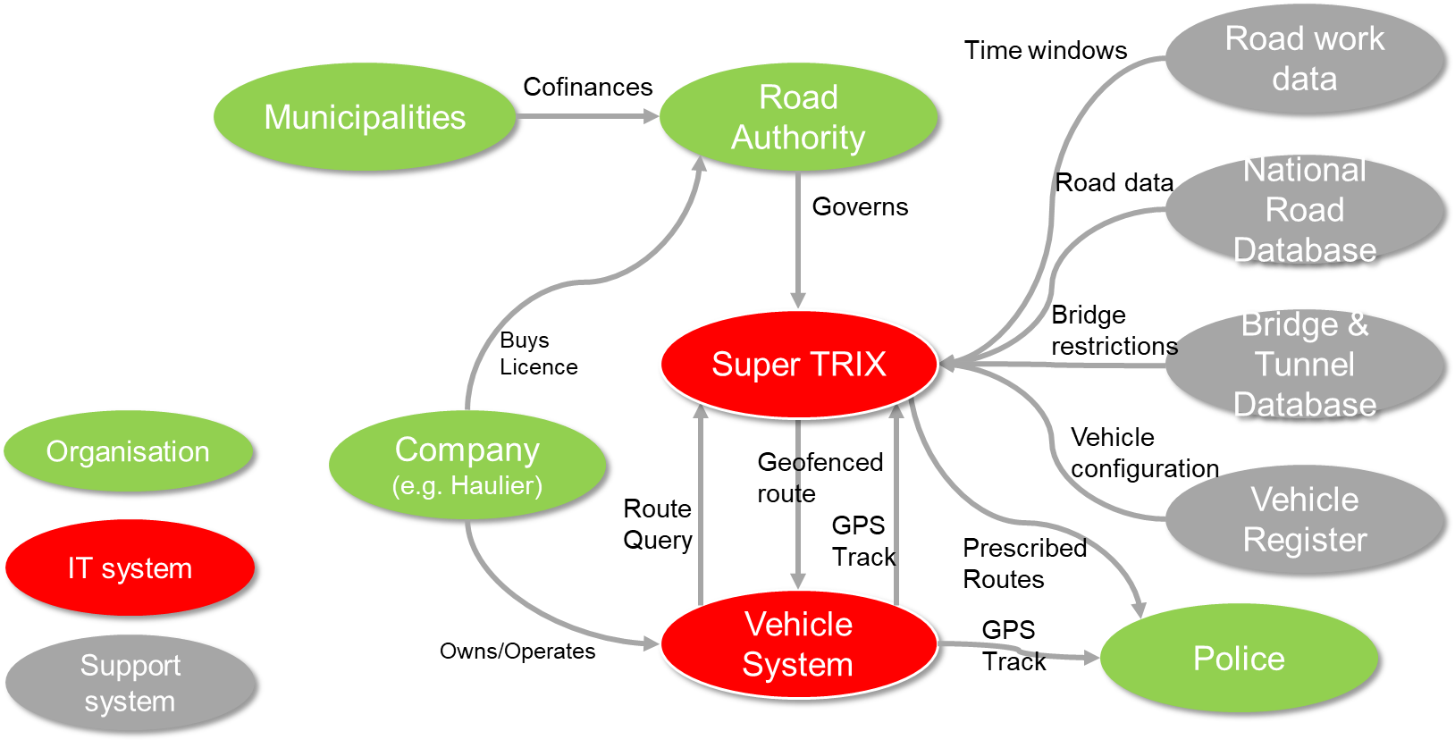
IA - example from Sweden
(abnormal loads)
Authors:
Thomas Asp, Loes Aarts

Slide 9
Results from CEDR-PIARC webinar
Taking advantage of opportunities
  We need to understand the importance of creating incentives for parties in the logistics chain to share data.
The promises of Intelligent Access
  IA technology can bring useful information for drivers and vehicle.
  IA can lead to harmonization in regulations but it is not obvious.
Are we ready for IA?
  Various domains play a role in technology and we need to understand that better.
  Authorities also have to analyze more what their needs are and what they want to achieve.
  We need collaboration between stakeholders who are normally more likely to oppose each other
Authors:
Thomas Asp, Loes Aarts
Notes:
Taking advantage of opportunities
We need to understand the importance of creating incentives that make it interesting for parties in the logistics chain to share data.
The promises of Intelligent Access
IA technology can bring useful information for drivers and vehicle. This will help traffic management and therefore road authorities. There are various expectations and statements regarding the relationship between IA and harmonization. Stakehold-ers who are currently dealing with a patchwork of regulations in different countries hope that IA will lead to harmonization in regulations but that is not obvious. This is an important incentive for certain stakeholders to participate in IA and it is im-portant to further explore this relationship.
Are we ready for IA? Various domains play a role in technology and we need to understand that better. Authorities could/should play a role in promoting technologi-cal readiness. This can range from making telematics devices in the vehicle manda-tory to promoting the eCMR. Authorities also have to analyse more what their needs are and what they want to achieve. We need collaboration between stakeholders who are normally more likely to oppose each other

Slide 10
Results from GDPR Workshop
GDPR is not just a barrier there are also possibilities that could be used.
There is a distinction between the rules and the interpretation of those rules
The underlying principle should by default be to share as little data as possible.
There is a distinction between data and information
Authors:
Thomas Asp, Loes Aarts
Notes:
- Legislation about GDPR is not just a barrier there are also possibilities that could be used.
- There is a distinction between the rules and the interpretation of those rules
- The underlying principle should by default be to share as little data as possible. The question should therefore not be how could we circumvent the GDPR, the question should be. “Why do I need which data and are there perhaps alternatives that require fewer personal data.”
- There is a distinction between data and information and usually you don´t need all the data you only need the information you can get from all the data

Slide 11
Topics for further exploration
IA as catalyst for harmonization of regulations.
  How can IA promote harmonization of regulations? If it does not promote harmonization, what other incentives are there for the transport sector to participate in an IA system on a voluntary basis?
Rewarding desirable behavior instead of punishing undesirable behavior.
  Can we by rewarding desirable behavior get all stakeholders on board?
Transformation of the relationship between transport sector and government.
  What change is needed in the attitude of the transport sector on the one side and the government on the other side?
The organization of trust.
  Third party or authority vs block chain? How to secure the reliability of self-declaration system? How do we create information with minimum data processing? Need to show the benefits of transparency for all stakeholders involved.
Authors:
Thomas Asp, Loes Aarts
Notes:
Rewarding desirable behavior instead of punishing undesirable behavior.
How can we get all stakeholders on board? How do we build in efficient incentives? Show the benefits of transparency for all stakeholders involved.
IA as catalyst for harmonization of regulations.
How can IA promote harmonization of regulations? If it does not promote harmonization, what other incentives are there for the transport sector to participate in an IA system on a voluntary basis?
Transformation of the relationship between transport sector and government.
What change is needed in the attitude of the transport sector on the one side and the government on the other side?
The organization of trust.
Third party or authority vs block chain? How to secure the reliability of self-declaration system? How do we create information with minimum data processing?

Slide 12
Thanks for listening
thomas.asp@trafikverket.se
Authors:
Thomas Asp, Loes Aarts

