Slide 1
ROAD FREIGHT ELECTRIFICATION AROUND THE WORLD USING ELECTRIC ROAD SYSTEMS
Parth Deshpande
Christopher de Saxe
Daniel Ainalis
John Miles
David Cebon
Centre for Sustainable Road Freight
Department of Engineering, University of Cambridge

Slide 2
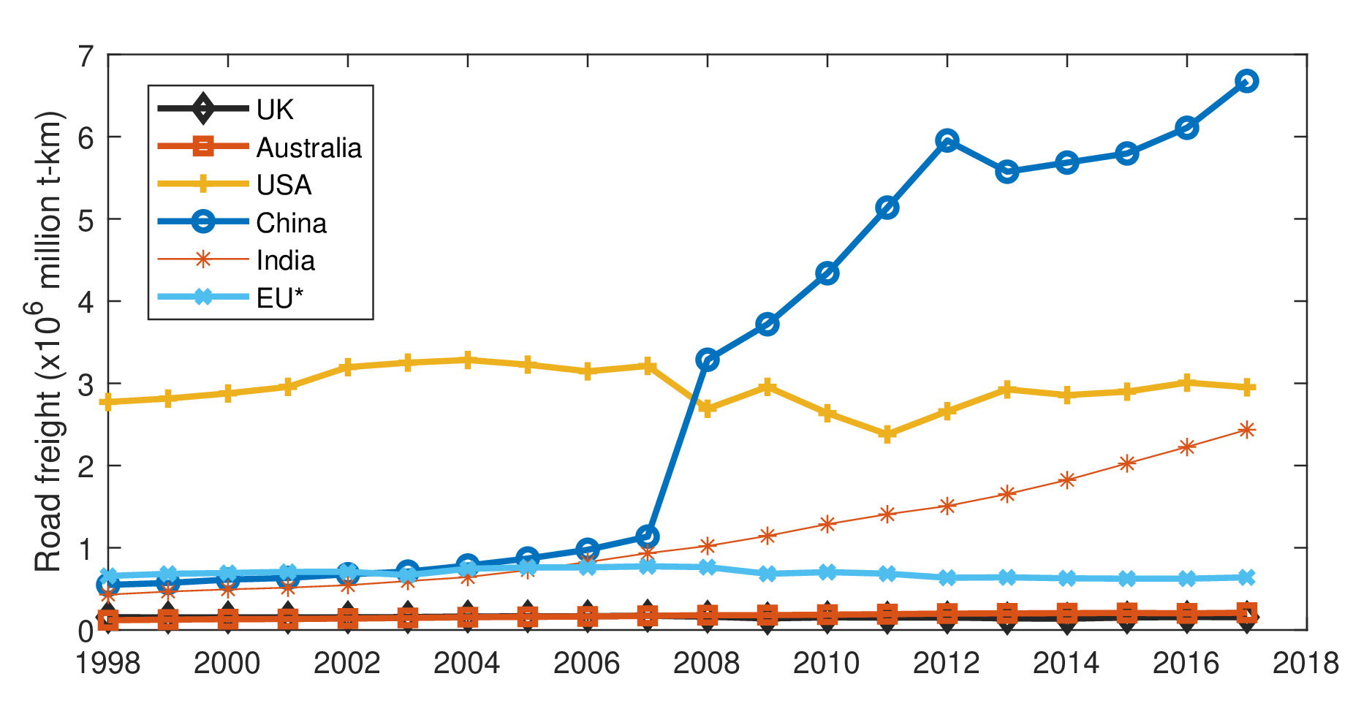
Road Freight Statistics
* EU data from major countries, i.e., France, Germany, Italy and Netherlands
Source: OECD https://data.oecd.org/transport/freight-transport.htm
Authors:
P. Deshpande, C. de Saxe, D. Ainalis, J. Miles, D. Cebon
2

Slide 3
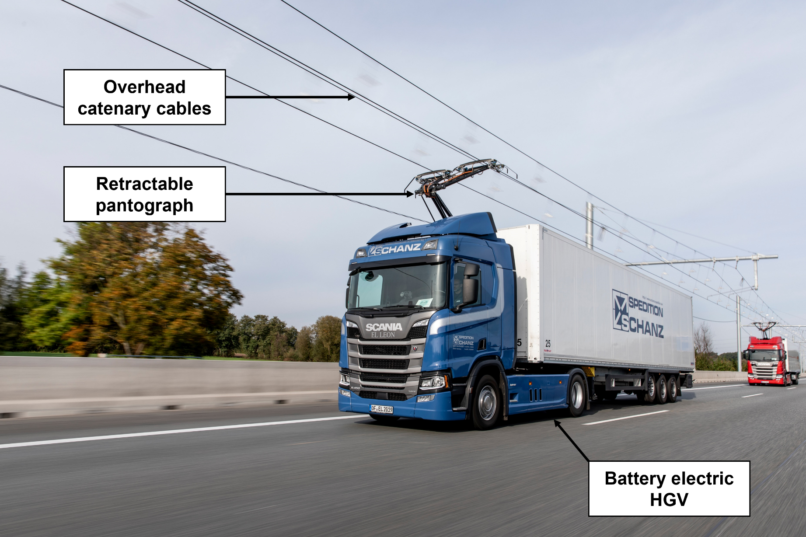
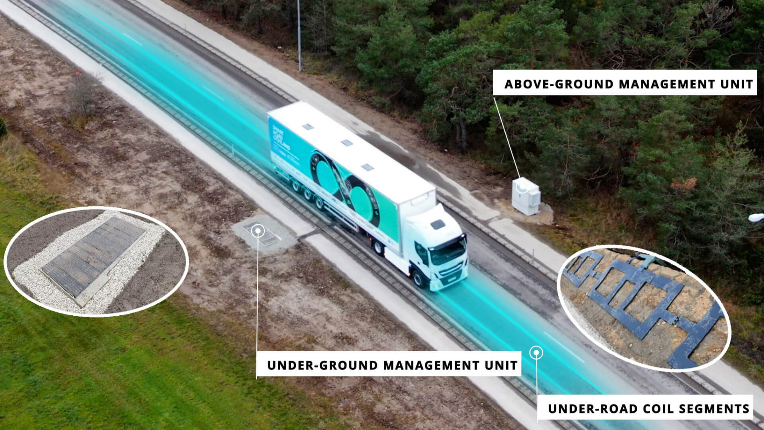
Electric Road Systems (ERS)
In-road (on-ground) power transfer
Wireless (inductive) power transfer
Overhead catenary cables
Image Credit: BusinessWire
Image Credit: Siemens Mobility GmbH
Image Credit: Dezeen.com
Authors:
P. Deshpande, C. de Saxe, D. Ainalis, J. Miles, D. Cebon
3

Slide 4
Emissions Comparison
Well-to-wheel efficiencies: 23% for FCEV, 70% for BEV, 77% for ERS EV
Diesel well-to-wheel efficiency: 38%; Emissions factor: 0.3 kg-CO₂/kWh
Source: 2020 Grid Electricity Emissions Factors v1.4 www.carbonfootprint.com | Emissions subject to change
Authors:
P. Deshpande, C. de Saxe, D. Ainalis, J. Miles, D. Cebon
4

Slide 5
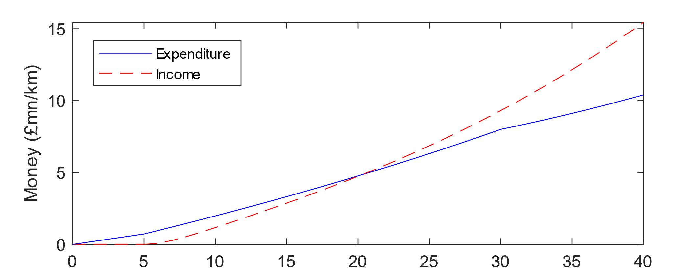
ERS Cost Breakeven Model
Money in/out for maximum number of trucks ($n_{T}$) = 3000/day
Time (years)
Loan duration ($n_{i}$)
Breakeven point (at $n_{y}$ years)
Construction time ($n_{c}$)
98% usage ramp-up time ($n_{r}$)
Authors:
P. Deshpande, C. de Saxe, D. Ainalis, J. Miles, D. Cebon
Ref: Parth Deshpande et al. (2023), “A breakeven cost analysis framework for electric road systems”, Transportation Research Part D: Transport and Environment, ﻿103870.
5

Slide 6
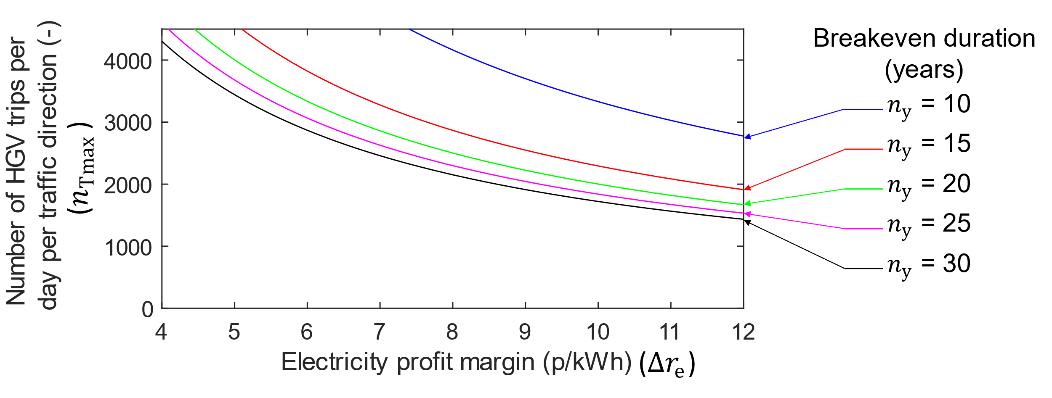
ERS Cost Breakeven Model
Authors:
P. Deshpande, C. de Saxe, D. Ainalis, J. Miles, D. Cebon
6

Slide 7
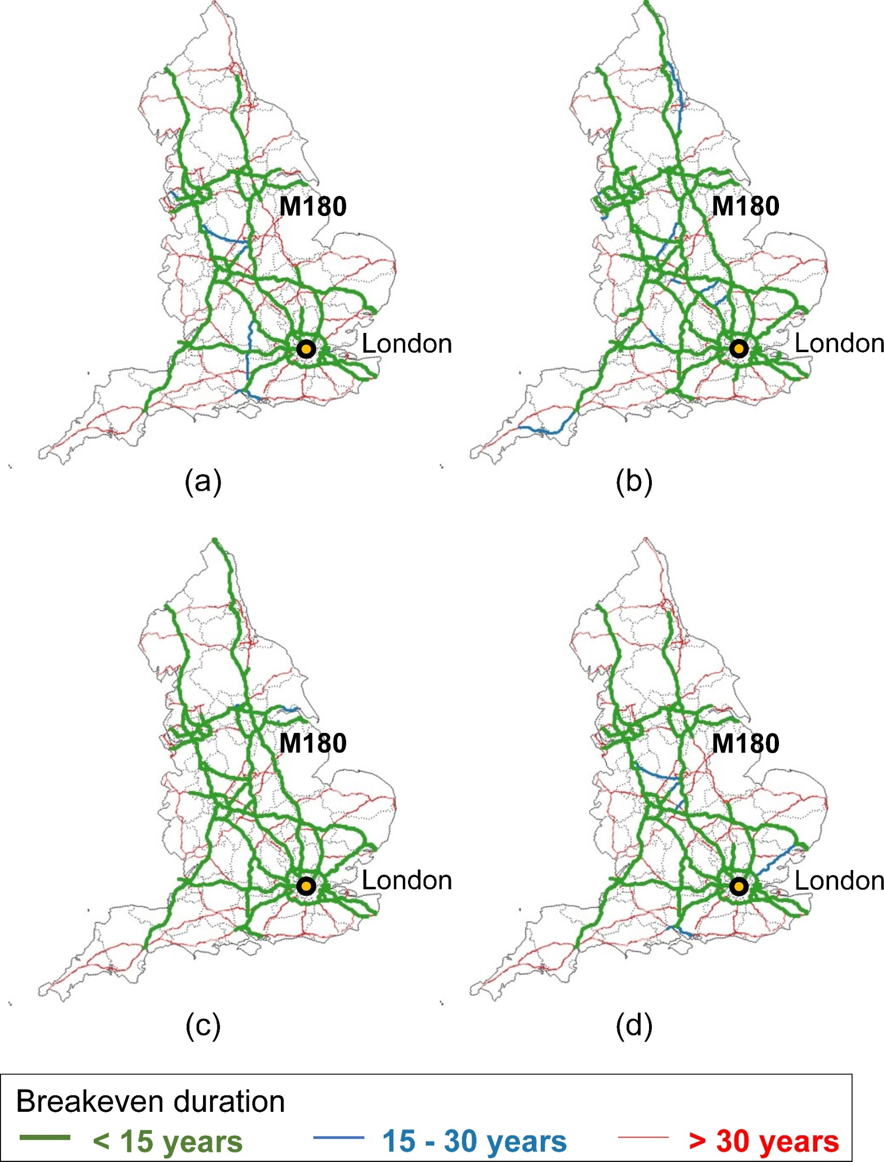
ERS Cost Breakeven Results
Scenario | Description
(a) | Base case
(b) | Increased profit margin
(c) | Lower infrastructure costs
(d) | Longer loan duration
7

Slide 8
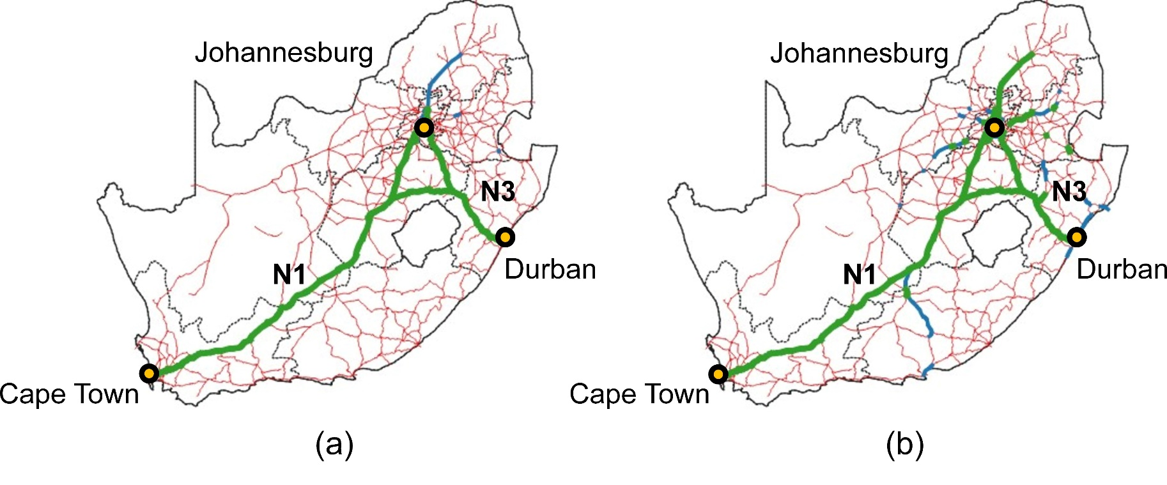
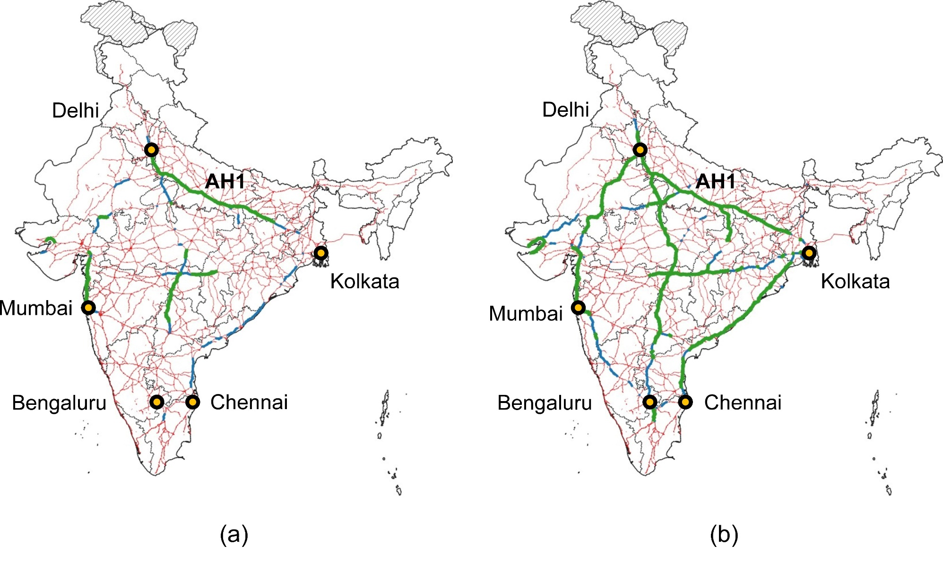
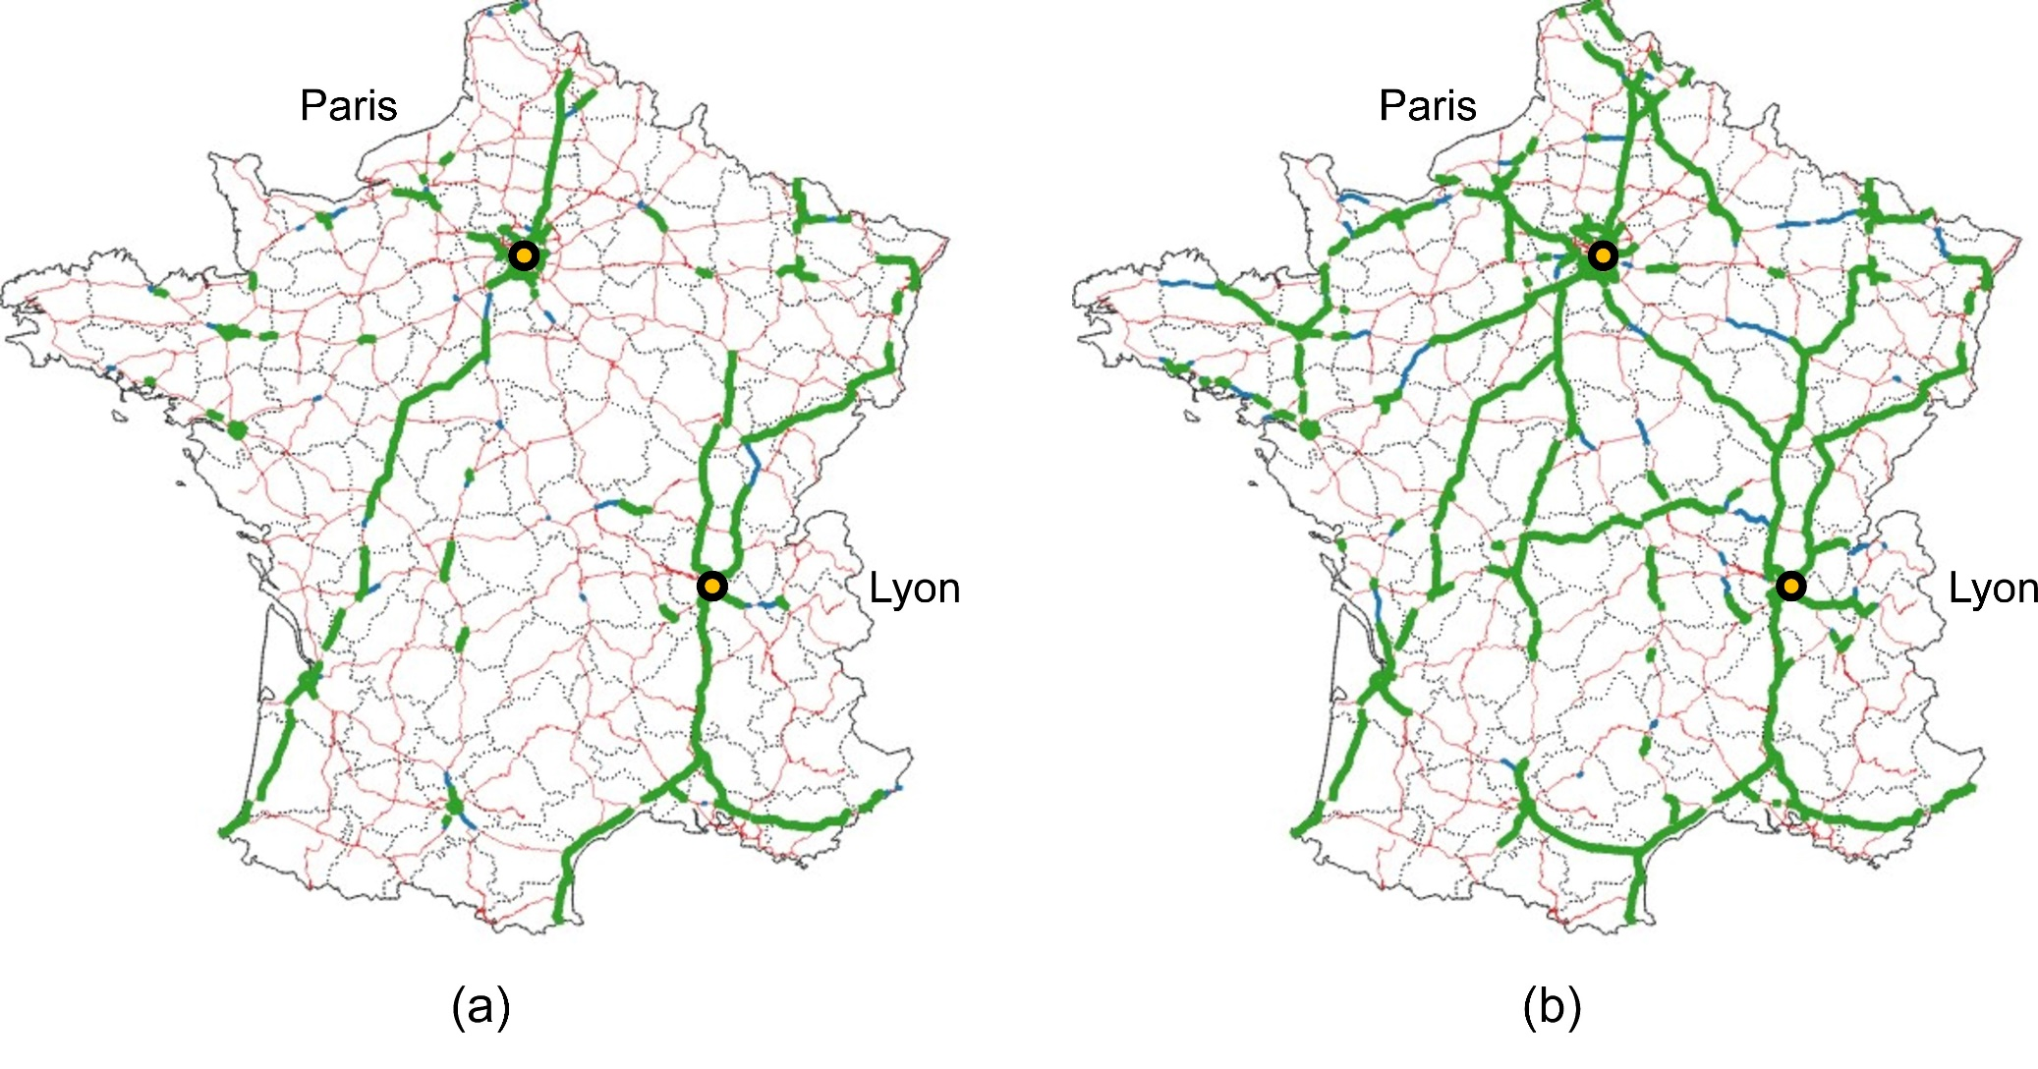
ERS Cost Breakeven Results
South Africa – ERS Cost: £1.8m / km
France – ERS Cost: £2m / km
India – ERS Cost: £1.8m / km
Authors:
P. Deshpande, C. de Saxe, D. Ainalis, J. Miles, D. Cebon
8

Slide 9
Journey Analysis Methodology
Origin and destination
Rest stop locations and durations
ERS locations
SRF Drive Cycle Synthesiser
Routing using
HERE Maps API
Adding stop locations as via points
Generating static charging signal
Generating ERS on/off signal
Driver and Vehicle Model
Driver behaviour
Vehicle systems:
Motor, inverter, transmission
Battery charging model
Energy consumption calculation
Drive cycle
Battery dip
Energy consumption
Authors:
P. Deshpande, C. de Saxe, D. Ainalis, J. Miles, D. Cebon
Ref: Christopher de Saxe et al. (2023), “An electric road system or big batteries: Implications for UK road freight”, Transportation Engineering, 100210.
9

Slide 10
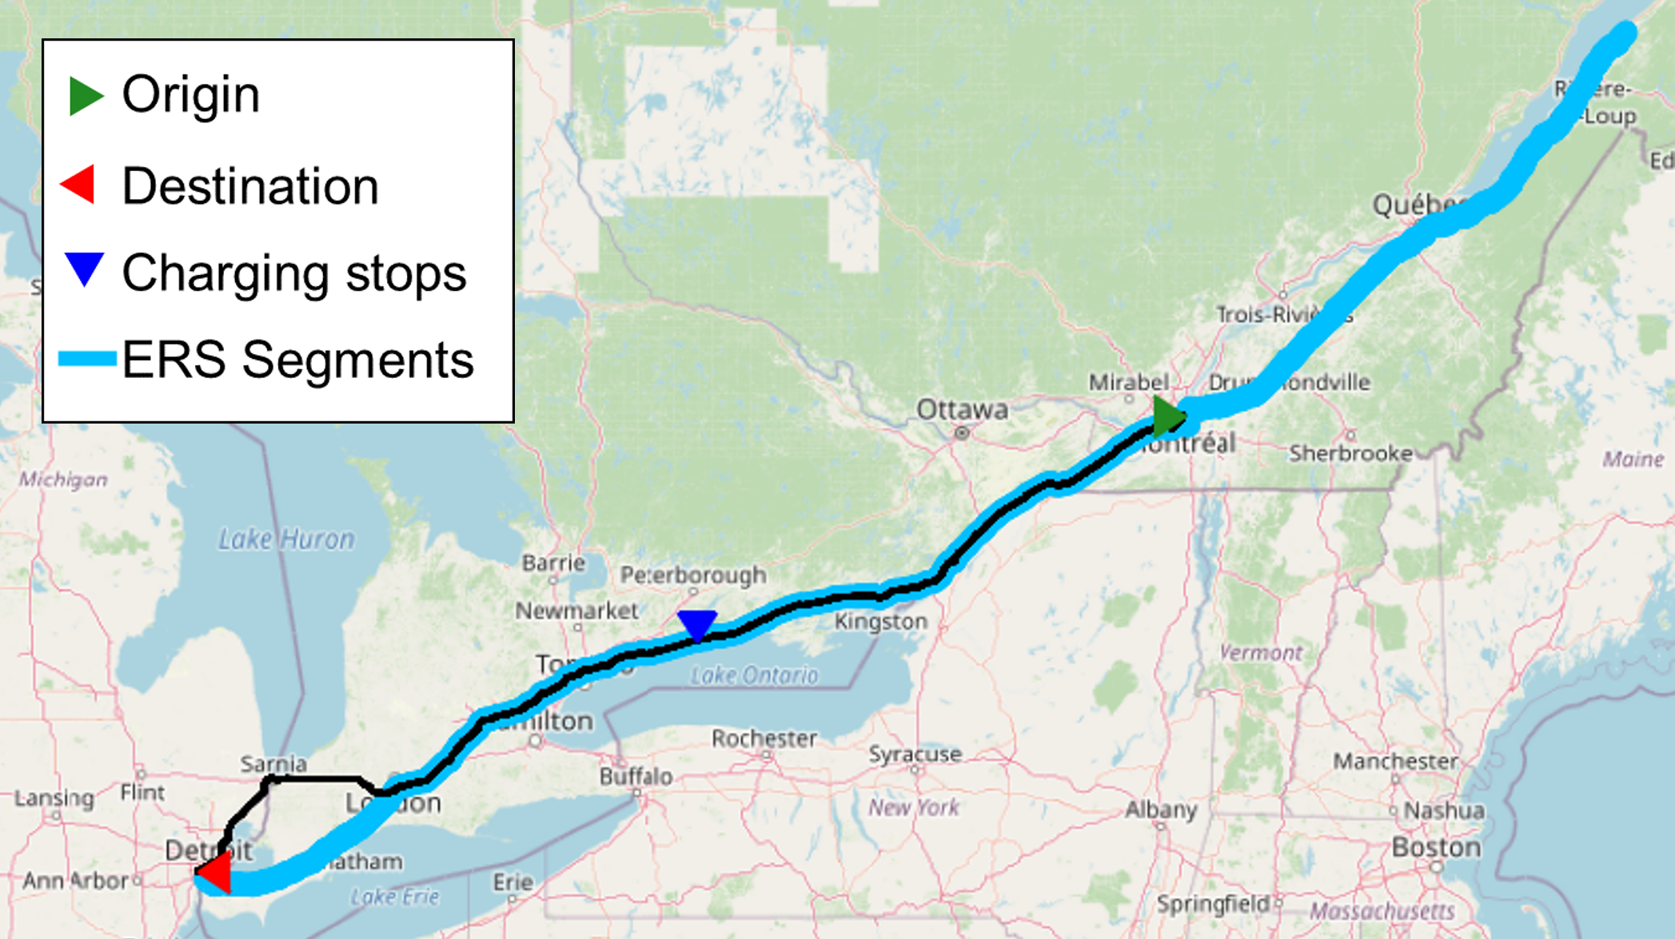
Case Study – Single Corridor (Canada)
Authors:
P. Deshpande, C. de Saxe, D. Ainalis, J. Miles, D. Cebon
10

Slide 11
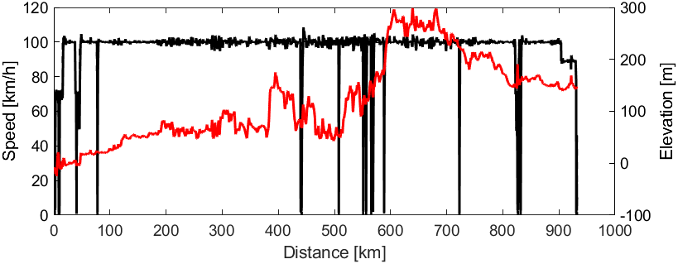
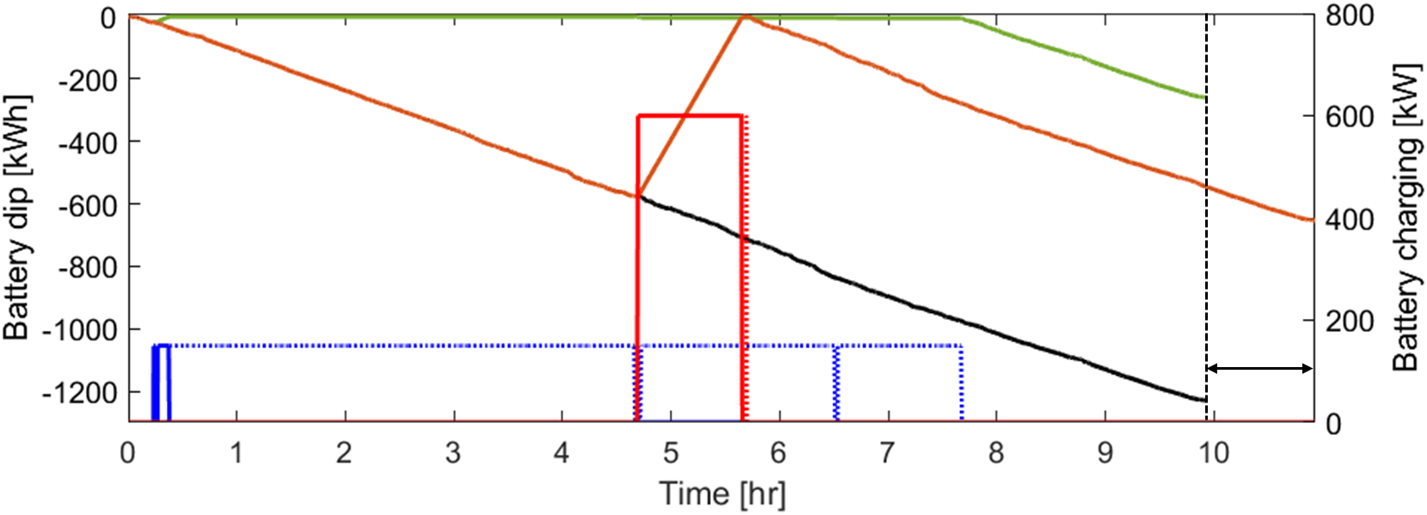
Case Study – Single Corridor (Canada)
Speed
Elevation
Drive Cycle
Battery dip
(static charging)
Battery dip
(ERS charging)
Battery Dip
Battery dip
(no charging)
ERS charging
(150 kW)
Static charging
(600 kW)
Extra journey time due to charging stop
11

Slide 12
Case Study – Single Corridor (Canada)
Battery dip
(static charging)
Battery dip
(ERS charging)
Battery Dip
Battery dip
(no charging)
ERS charging
(150 kW)
Static charging
(600 kW)
Extra journey time due to charging stop
Assumptions:
Tesla Semi – 36 tonnes gross, 12 tonnes tare (tractor), 4 tonnes (empty trailer)
Coefficient of drag: 0.36 (lower than most trucks)
Battery energy density: 0.186 kWh/kg
Battery size required = Lowest battery dip / 0.8
Authors:
P. Deshpande, C. de Saxe, D. Ainalis, J. Miles, D. Cebon
12

Slide 13
Case Study – Single Corridor (Canada)
Battery dip
(static charging)
Battery dip
(ERS charging)
Battery Dip
Battery dip
(no charging)
ERS charging
(150 kW)
Static charging
(600 kW)
Extra journey time due to charging stop
Charging Scenario | Required Battery Size (kWh) | Battery Weight (tonnes) | Max Payload (tonnes) | Journey Time (min)
No charging | 1538 | 8.2 | 16.3 | 596#
Static charging | 818 | 4.5* | 20* | 656
ERS charging | 325 | 1.4 | 22.8 | 596#
Authors:
P. Deshpande, C. de Saxe, D. Ainalis, J. Miles, D. Cebon
#similar to diesel HGV assuming no other stops.
*assuming an 850 kWh battery with the current charging strategy.
13

Slide 14
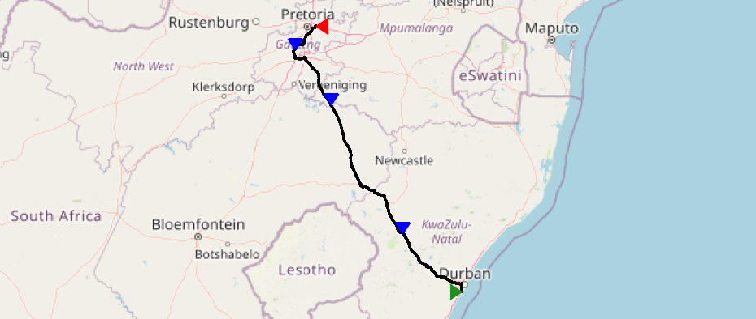
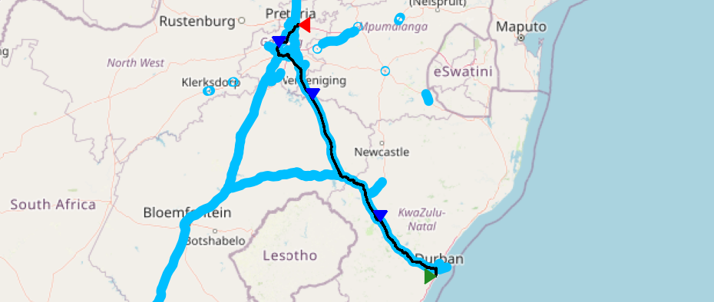
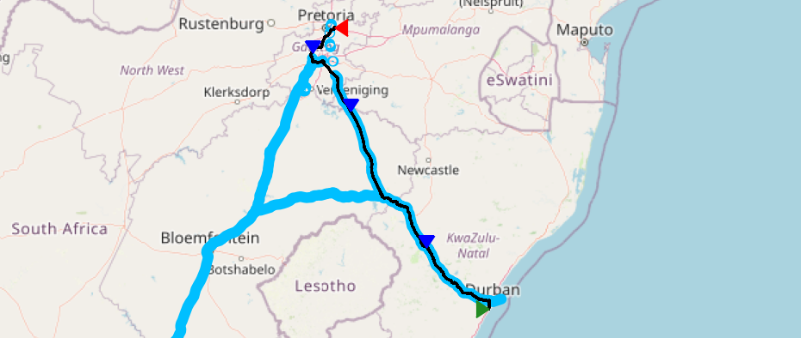
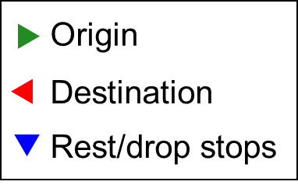
Case Study – South Africa Long-Haul
Logistics company based in South Africa
Route: Durban to Pretoria via Johannesburg
Total distance: 675 km in 1 day
44 tonne HGV
Journey / Battery size (kWh) | No charging | ERS (a) | ERS (b) | SC | ERS (a) + SC | ERS (b) + SC | DC | ERS (a) + DC | ERS (b) + DC
Durban - Johannesburg - Pretoria | 1708 | 193 | 95 | 1138 | 193 | 95 | 1534 | 147 | 95
SC: static charging at rest stops, DC: static charging at drop locations.
Authors:
P. Deshpande, C. de Saxe, D. Ainalis, J. Miles, D. Cebon
14

Slide 15
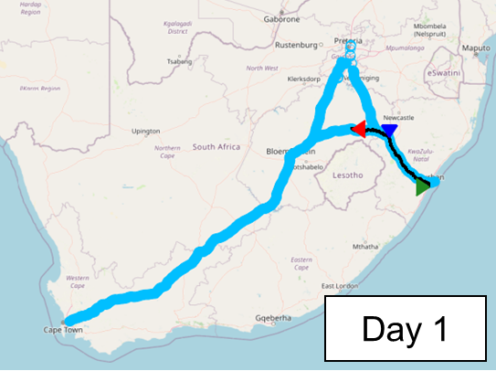
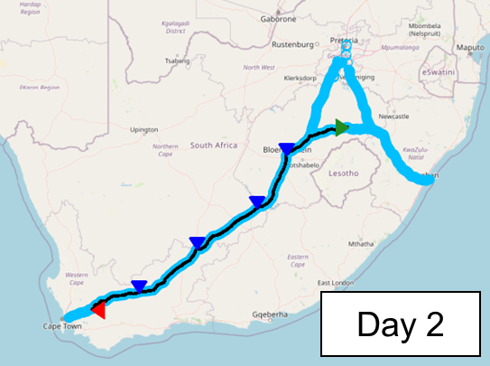
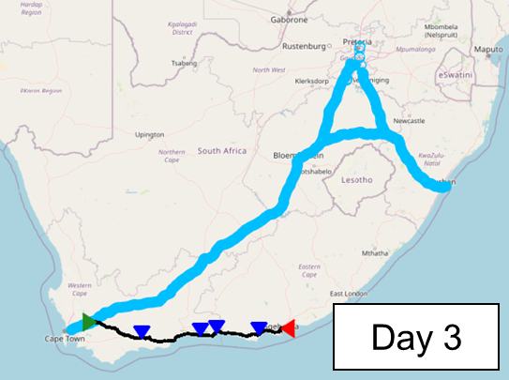
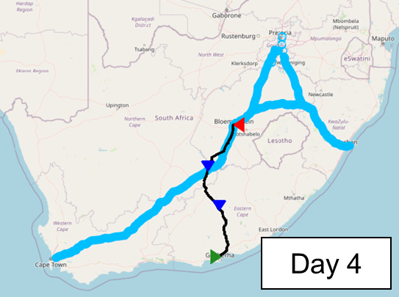
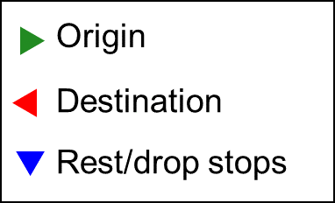
Case Study – South Africa Multi-Day
More off-ERS journeys: need large batteries, more charging stops or range extenders.
Journey / Battery size (kWh) | No charging | ERS (a) | SC | ERS (a) + SC | ERS (b) | ERS (b) + SC
Day 1: Durban - Bethlehem | 1139 | 50 | 949 | 50 | 50 | 50
Day 2: Bethlehem - Worcester | 2116 | 20 | 1355 | 20 | 20 | 20
Day 3: Worcester - Port Elizabeth | 1476 | 1476 | 726 | 726 | 1476 | 726
Day 4: Port Elizabeth - Bloemfontein | 1589 | 1320 | 1209 | 942 | 1177 | 799
Max | 2116 | 1476 | 1355 | 942 | 1476 | 799
SC: static charging at rest stops.
Authors:
P. Deshpande, C. de Saxe, D. Ainalis, J. Miles, D. Cebon
15

Slide 16
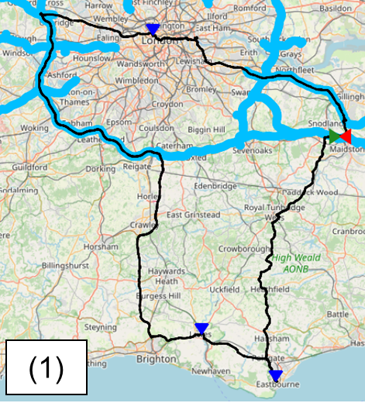
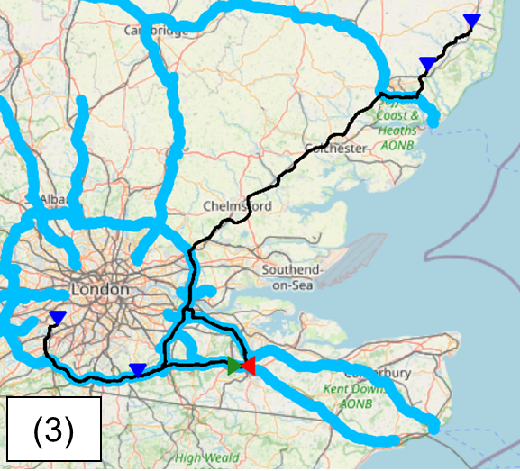
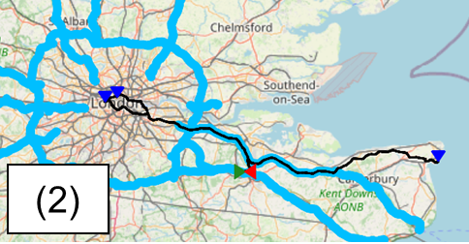
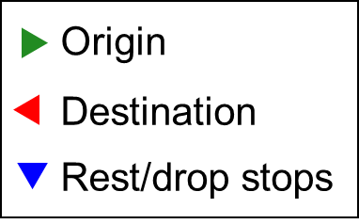
Case Study – UK Multi-Drop Journeys
Journey | No charging | DC | ERS (a) | ERS (a) + DC | ERS (b) | ERS (b) + DC
(1) Aylesford - Eastbourne - Lewes - Marylebone - Aylesford | 818 | 336 | 456 | 223 | 413 | 223
(2) Aylesford - Bloomsbury - Kensington Gardens - Ramsgate - Aylesford | 700 | 310 | 230 | 99 | 230 | 99
(3) Aylesford - Saxmundham - Woodbridge - Dover - Aylesford | 1152 | 466 | 475 | 226 | 172 | 79
Max | 1152 | 466 | 475 | 226 | 413 | 223
SC: static charging at rest stops
DC: static charging at drop locations.
Authors:
P. Deshpande, C. de Saxe, D. Ainalis, J. Miles, D. Cebon
16

Slide 17
Conclusions
ERS can electrify major freight routes in these countries with economic feasibility
Differences in countries in terms of geographic distribution of road freight and economics
Potential decarbonisation solutions: a mix of what is presented here
This analysis acts as a base for governments to promote Electric Road Systems
Future Work
Evaluating battery swapping, pony express and range extenders
Modelling multiple journeys for determining optimal charging strategies
Authors:
P. Deshpande, C. de Saxe, D. Ainalis, J. Miles, D. Cebon
17

Slide 18
Thank You!
Parth Deshpande
prd41@cam.ac.uk | www.eng.cam.ac.uk/profiles/prd41
Centre for Sustainable Road Freight
Department of Engineering, University of Cambridge
www.csrf.ac.uk
18

Slide 19
Appendix: ERS Cost Breakeven Model
Aim: To determine number of trucks required for cost breakeven
For 1 km of ERS:
Expenditure:
Infrastructure (£2m) on loan
Maintenance (5%)
Profit:
Electricity selling (7p/kWh) - Depends on number of trucks
Number of years for breakeven
Annual loan instalment fraction
Number of years for ERS construction
Sum of inflation terms over $\left(n_{y}−n_{c}\right)$years
Capital cost of ERS (£/km)
Annual maintenance cost fraction
$$n_{T}=\frac{C_{ERS} \left[n_{y}\frac{r_{i}{\left(1+r_{i}\right)}^{n_{i}}}{{\left(1+r_{i}\right)}^{n_{i}}−1}+f\left(\frac{{\left(1+r_{z}\right)}^{(n_{y}−n_{c})}−1}{r_{z}}\right)\right]}{\frac{∆r_{e}}{100} e_{tr} n_{d}\left(1−e^{\frac{−4(n_{y}−n_{c})}{n_{r}}}\right) \left(\frac{{\left(1+r_{z}\right)}^{{(n}_{y}−n_{c})}−1}{r_{z}}\right)}$$
Maximum number of trucks
Max. number of trucks (1/day)
Number of years for 98% ERS usage
Energy transferred per vehicle (kWh/km)
Number of days of ERS usage (days/year)
Number of days of ERS use per year
$$Q_{T}=\frac{e_{tr} n_{T} n_{d}}{E_{T}}$$
Electricity profit margin (pence/kWh)
Energy transferred per vehicle (kWh/km)
(= Max. power / average speed)
Ramp-up curve for number of trucks using the ERS
Energy efficiency of freight (kWh/t-km)
Annual freight flow (t/year)
^ In terms of freight flow
Authors:
P. Deshpande, C. de Saxe, D. Ainalis, J. Miles, D. Cebon
Ref: Parth Deshpande et al. (2023), “A breakeven cost analysis framework for electric road systems”, Transportation Research Part D: Transport and Environment, ﻿103870.
19

