Slide 1
Truck tire and real-life fuel consumption
Frédéric Domprobst
Jean François Beaupère

Slide 2
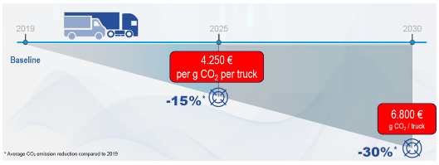
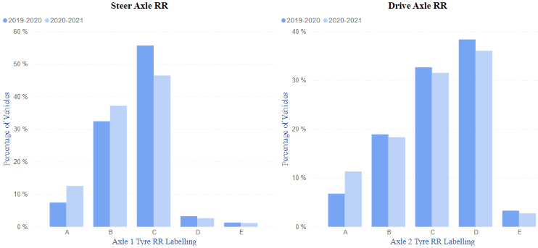
Context and stakes (1)
Follow up of our work on RRC FC in real life, presented at HVTT16
The European regulation 2019/1242 forces truck makers to decrease CO2 emissions by 15% in 2025 and 30% in 2030
Shift from 30% to 40% Label A or B tires from 2020 to 2021 at Original Equipment : low transition speed!!
Truck original equipment tire energy label distribution (all OEMs, all tire makers).
Sources: European Commission and Michelin.

Slide 3
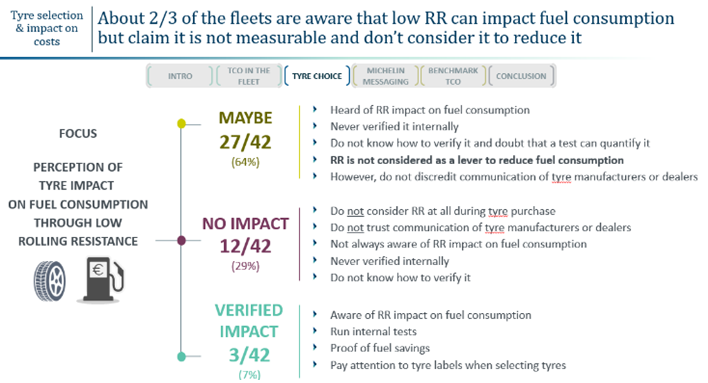
Context and stakes (2)
Need to convince Fleets to adopt Low RR Tires not only at OE but in Aftersales as well

Slide 4
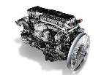
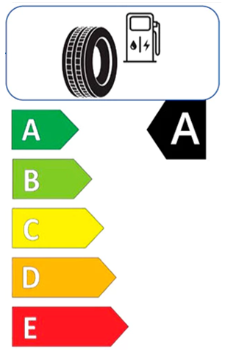
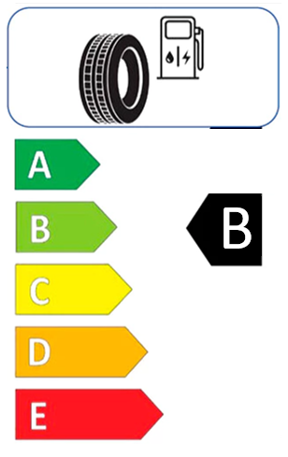
Several components of fuel consumption
Aerodynamic resistance
Auxiliaries
Inertia
Internal losses
Gravity
Rolling resistance
α
P_{consumed}
=
P_{engine losses}
+
P_{required}
Fuel : 300kW
100%
Engine losses : 200kW
65%
Truck : 100kW
35%
P_{required}
=
P_{roll resist}
₊
P_{aerodynamic}
₊
P_{inertia}
₊
P_{gravity}
₊
P_{internal losses}
₊
P_{auxiliaries}
-0,8 L/100 Km
3% Fuel Consumption (30L/100km base)
-1,0 kg/t RRC

Slide 5
RR impact on Fuel is complex to test on field
Rolling resistance is a big contributor, but don’t forget :
Absolute RR contribution to fuel consumption depends on truck loading
Relative contribution depends on total fuel consumption, then usage severity
➔RR impact on fuel consumption is usage dependent!
P_{required}
=
P_{roll resist}
₊
P_{aerodynamic}
₊
P_{inertia}
₊
P_{gravity}
₊
P_{internal losses}
₊
P_{auxiliaries}
Loading
Speed
Acceleration
Hilliness
X
X
X
X
X
X

Slide 6
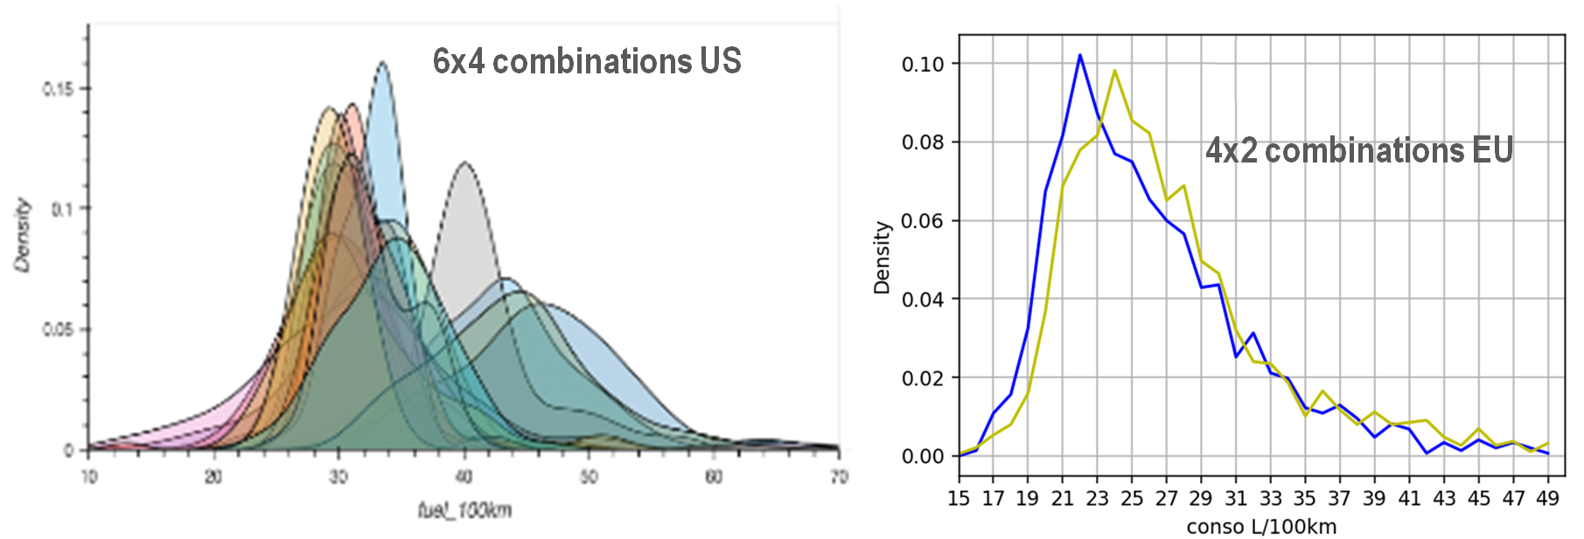
RR impact on Fuel is complex to test on field
When combining all usage statistical distributions, real life Fuel Consumption is highly dispersed !
Remove usage bias in FC dispersion to enable a fair comparison between tire RRC

Slide 7
Approaches to prove FC gains with low RRC
Approach 1
- 2 sites of same fleet equipped with 2 tires sets
- Comparison of average FC of each site
➔ result impacted by usage differences
Approach 2
- FC monitoring with CAN bus data
- On single road with different tire sets per truck
- Machine learning to remove remaining usage bias
➔ restricted validity domain on that usage.
Approach 3
- CAN Bus data aggregated on board (weekly) digital twin calculation to remove usage bias
- Tire effect comparison when change of tire
➔ Usage bias lowered with weekly averaging
Approach 4
- High frequency CAN Bus time signals
- Modeled torque fitting and decomposition
- Instantaneous FC decomposition.
➔ Pure tire RRC contribution to FC expected, whatever the usage conditions

Slide 8
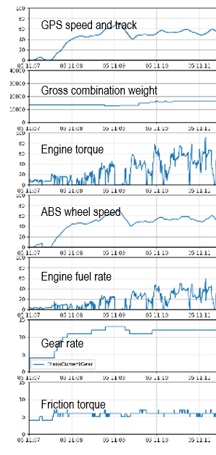
Usage statistics analysis is not enough
High frequency time signals allow us to engineer relevant features (ex sqrt(<v²>))
Precise local slope needed !!!

Slide 9
Our goal
delta aero
delta RRC-
FC
delta accel
delta elevation

Slide 10
Recipe for a fair RR – FC comparison
Estimate vehicle model parameters to adjust engine torque model to actual engine torque from CAN
Choose relevant usage time spans for an accurate vehicle model parameter estimation
Decompose actual engine fuel rate
Sum the instantaneous engine fuel rate contributions over the trip
P_{required}
=
P_{inertia}
₊
P_{aerodynamic}
₊
P_{roll resist}
₊
P_{gravity}
₊
P_{internal losses}
₊
P_{auxiliaries}

Slide 11
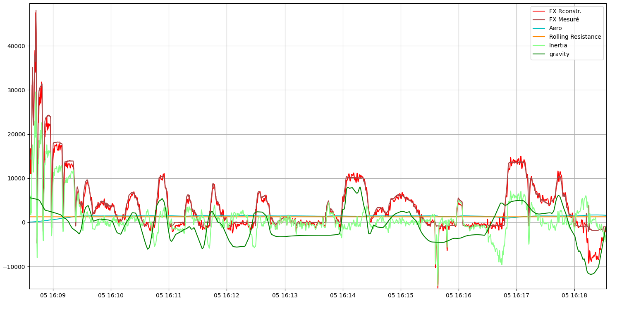
FC decomposition with a vehicle model
gravity
Aero+RR
Balanced by gravity
Inertia
Brake event

Slide 12
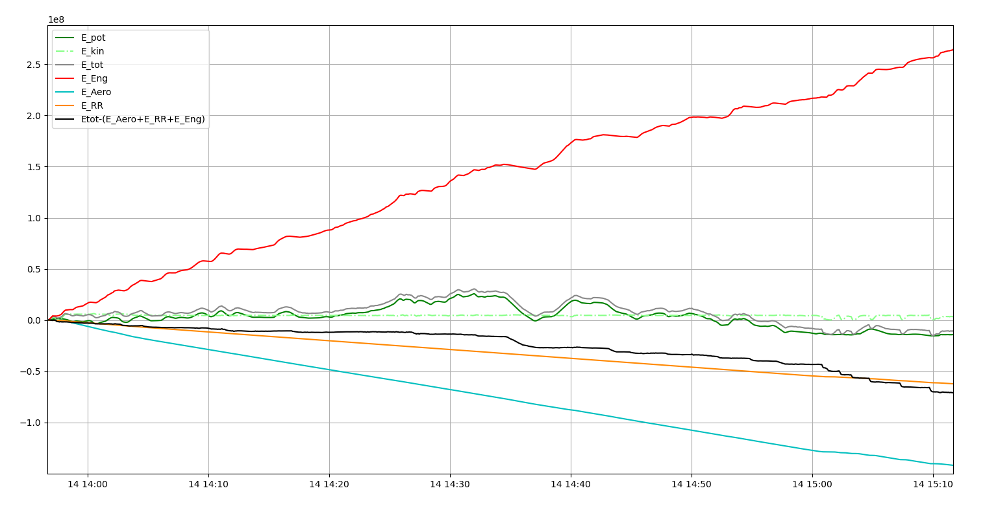
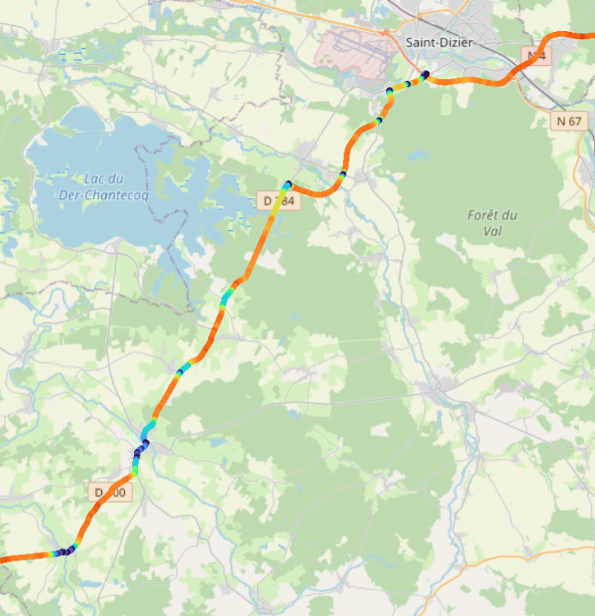
Energy balance
Brake events

Slide 13
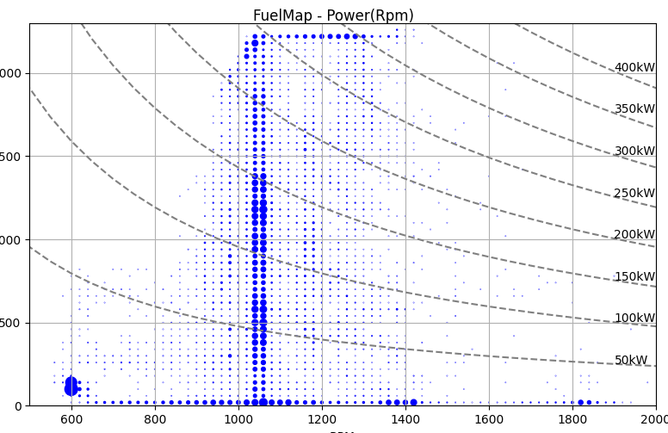
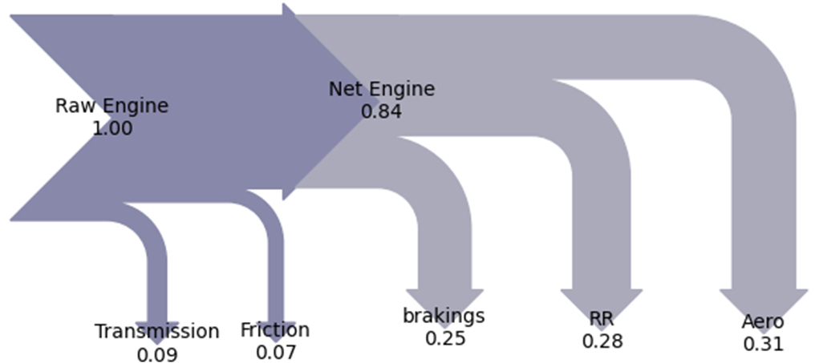
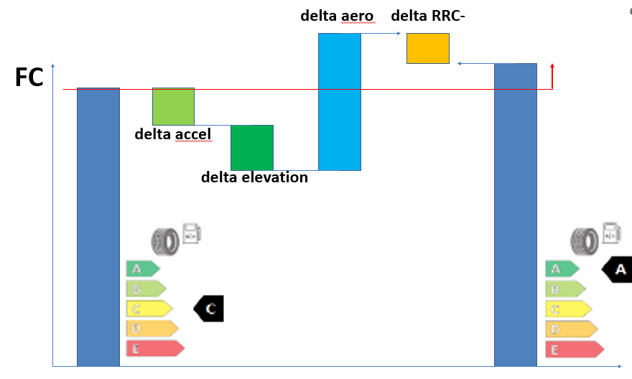
Energy balance
Cranckshaft energy decomposition
Fuelmap fitting

Slide 14
Conclusion
An accurate slope value along the trip is mandatory to perform a precise energy decomposition
Samples covering the widest range of {weight , speed, slope} are needed for an accurate estimation of aero, RR, loading.
Set up of more several field test comparisons on fuel consumption - RRC
This approach enable high fuel consumption events understanding.
Work still in progress to extend the approach from a few trips analysis on a wider scale of several hundreds of trips.

Slide 15
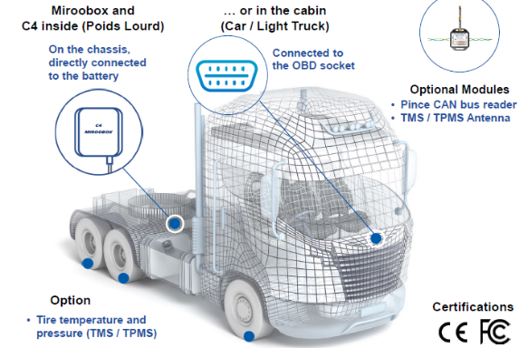
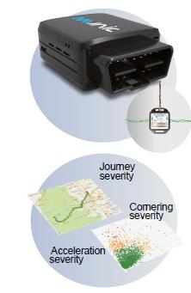
Michelin open to partnership with OEM
To prove tire impact on FC, Michelin already deployed telematics by fleets
➔ Michelin - OEM Partnership would be leaner

