Slide 1
Perspectives on the use of
Weigh-in-Motion (WIM) for Road Safety Applications in North America
Leonardo GUERSON
Intercomp Company
USA
Tyler HAICHERT
International Road Dynamics
Canada

Slide 2
Overview
Objective:
  Provide insight to road owners, public agencies, and road safety specialists about how to effectively deploy WIM systems in conjunction with other ITS devices to promote safer roadways.
Technical approach:
  Review how Weigh-in-Motion (WIM) systems have been used for road safety in North America.
  Describe a specific case study of Nevada Department of Transportation, where WIM has been integrated with Tire Inspection Technologies.
Authors:
Leonardo GUERSON, Tyler HAICHERT

Slide 3
Introduction
Overloaded vehicles significantly increase the risk of accidents.
Road enforcement organizations in North America inspect vehicle overloading and safety attributes at the same locations.
Weight information is becoming a direct means for enforcing safety standards, especially regarding tire loading.
Advanced enforcement systems with Weigh-In-Motion (WIM) and tire inspection technologies currently help keep the public safe from accidents caused by vehicles that are poorly maintained and overloaded.
Authors:
Leonardo GUERSON, Tyler HAICHERT

Slide 4
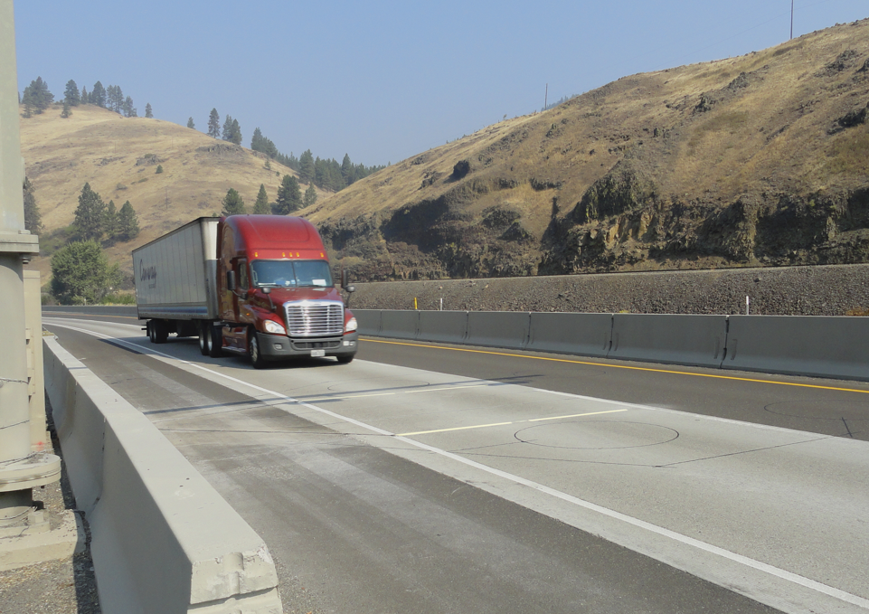
Virtual Weigh Stations (VWS)
Inspection site
Purpose
Functions
Vehicle overload control
Enforcement planning
Overload pre-selection
Traffic load data collection
Pavement design and management
Safety screening
Inspection Selection System (ISS)
CVSA Decal
Tire inspection
Authors:
Leonardo GUERSON, Tyler HAICHERT

Slide 5
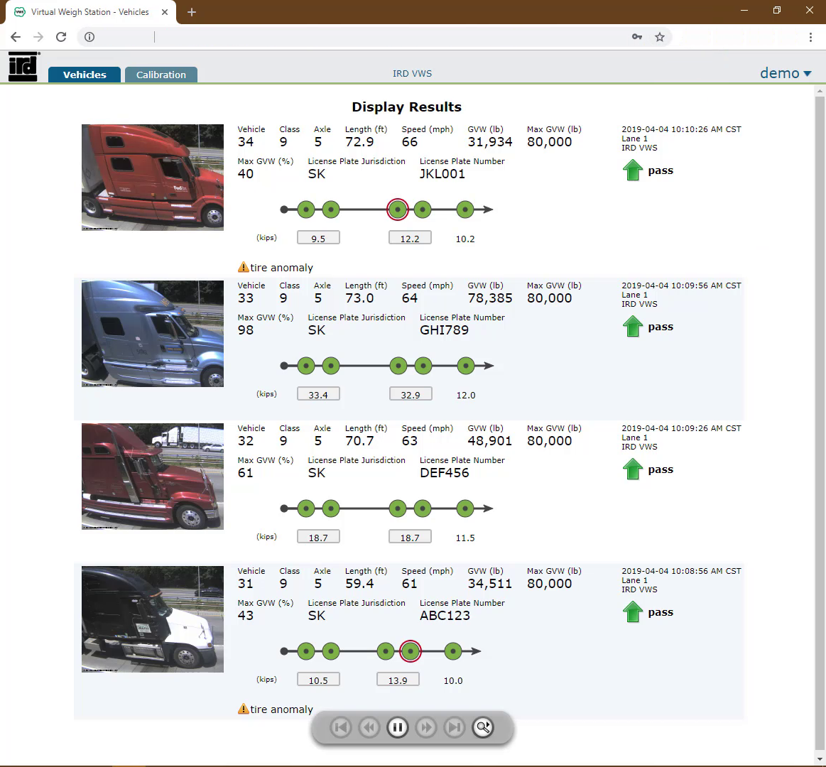
Virtual Weigh Stations (VWS)
Typical data output:
Gross Vehicle Weight (GVW) and Axle/Axle Group Weights.
Vehicle class.
Speed.
Vehicle Identification:
  Automatic License Place Reading (ALPR).
  Automatic Department of Transportation (DOT) number reading.
Authors:
Leonardo GUERSON, Tyler HAICHERT

Slide 6
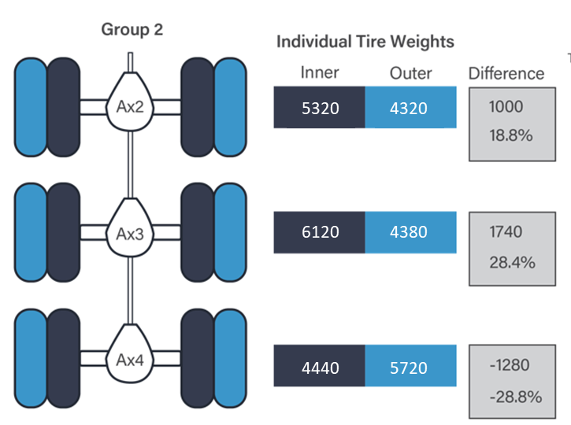
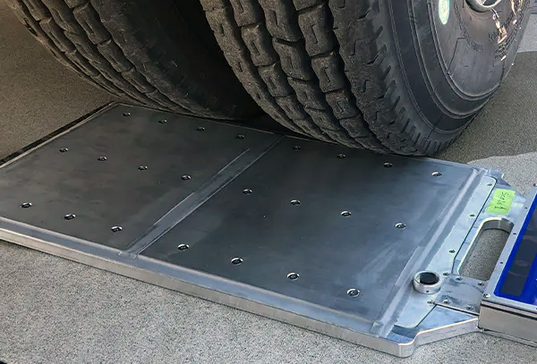
Tire Loading Technologies
Dual wheel weighing
Authors:
Leonardo GUERSON, Tyler HAICHERT

Slide 7
Case Study - Nevada DOT
Combining WIM and Tire Inspection Technologies
  Remote operation.
  Strain Gauge Strip Sensors.
  Tire Anomaly and Classification System.
Osino, NV Virtual Weigh Station
Authors:
Leonardo GUERSON, Tyler HAICHERT

Slide 8
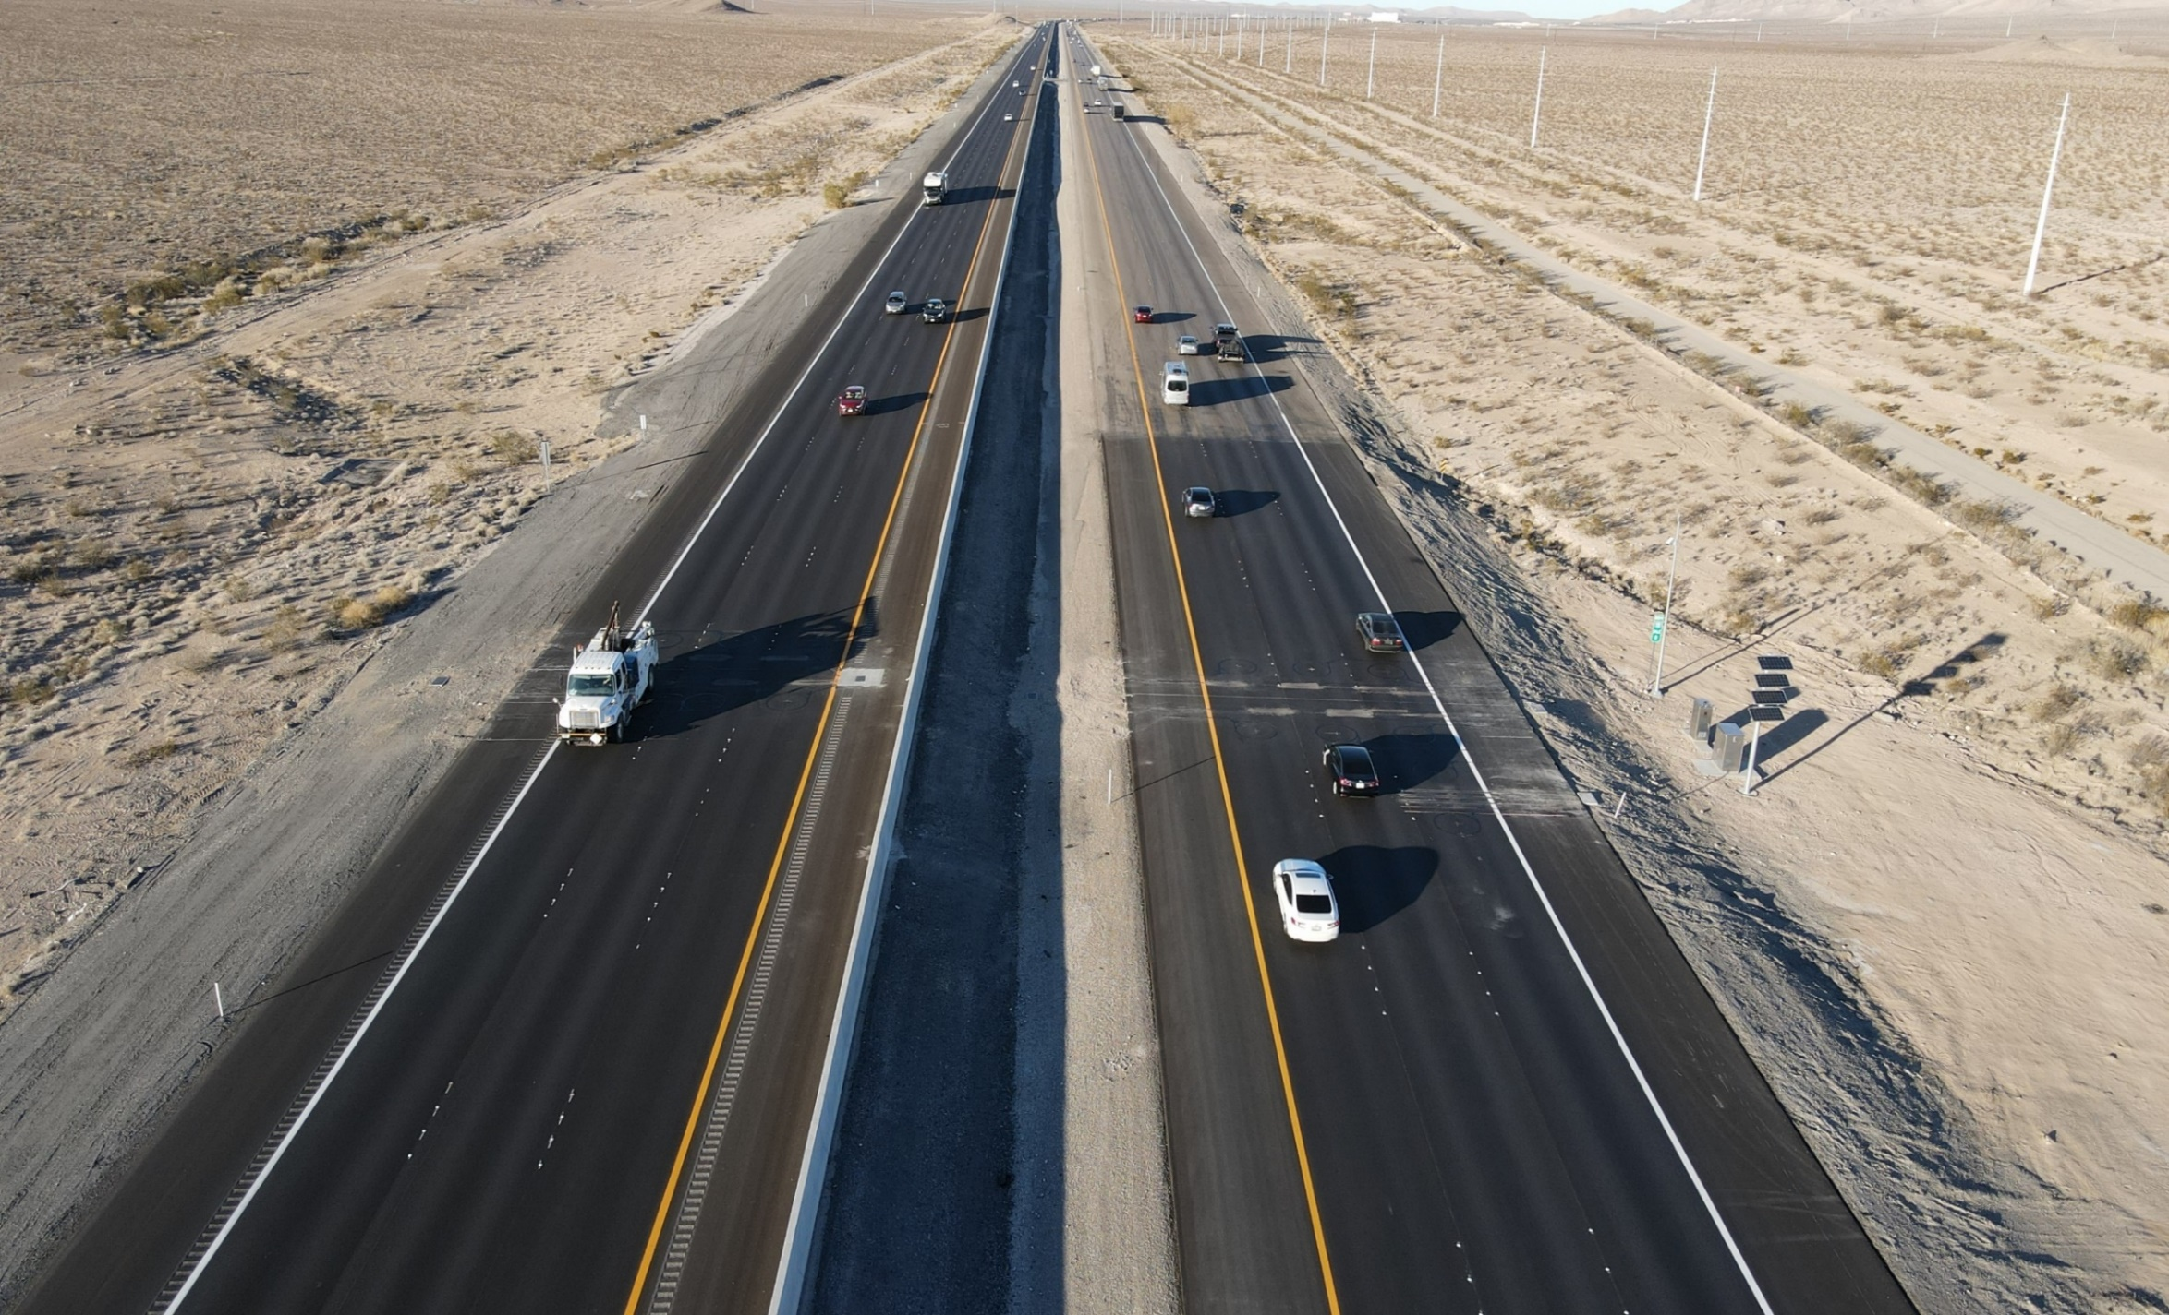
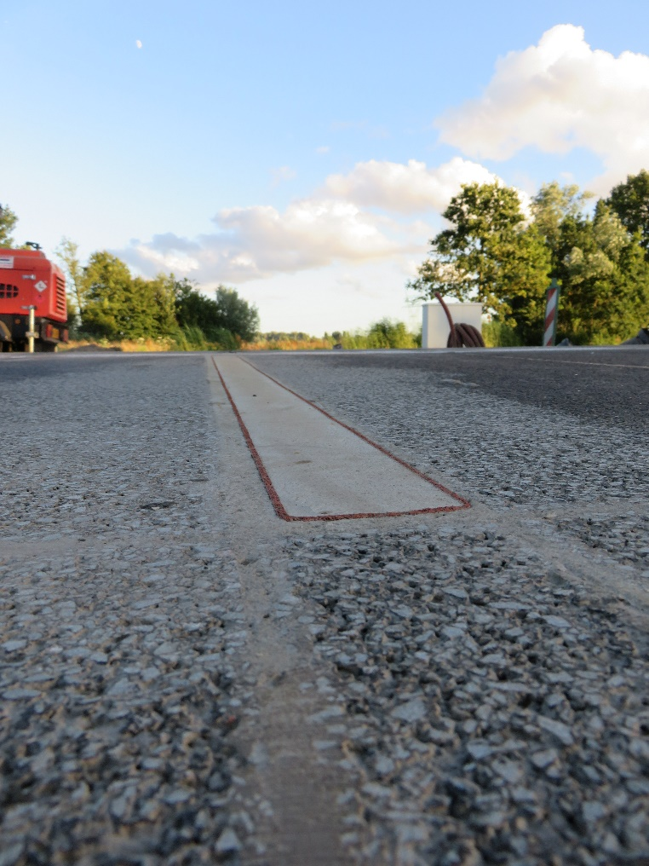
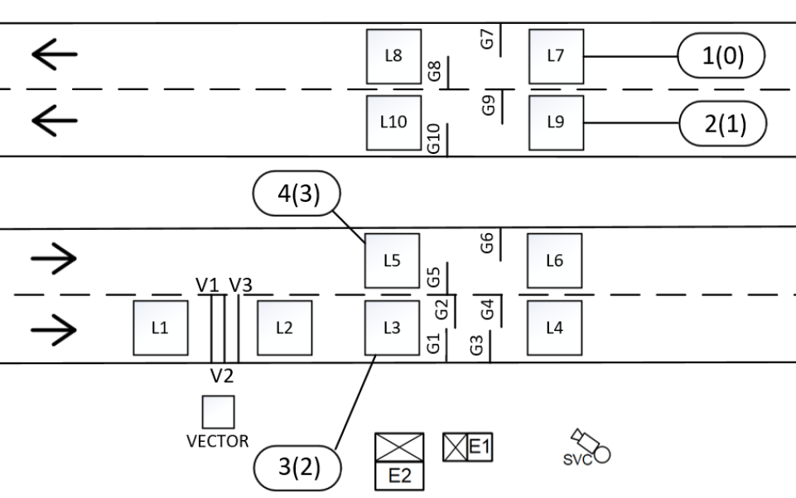
Case Study - Nevada DOT
Sensor Layouts
Clark County, NV Virtual Weigh Station
Osino, NV Virtual Weigh Station
Authors:
Leonardo GUERSON, Tyler HAICHERT
Notes:
Double threshold in the driving lane.

Slide 9

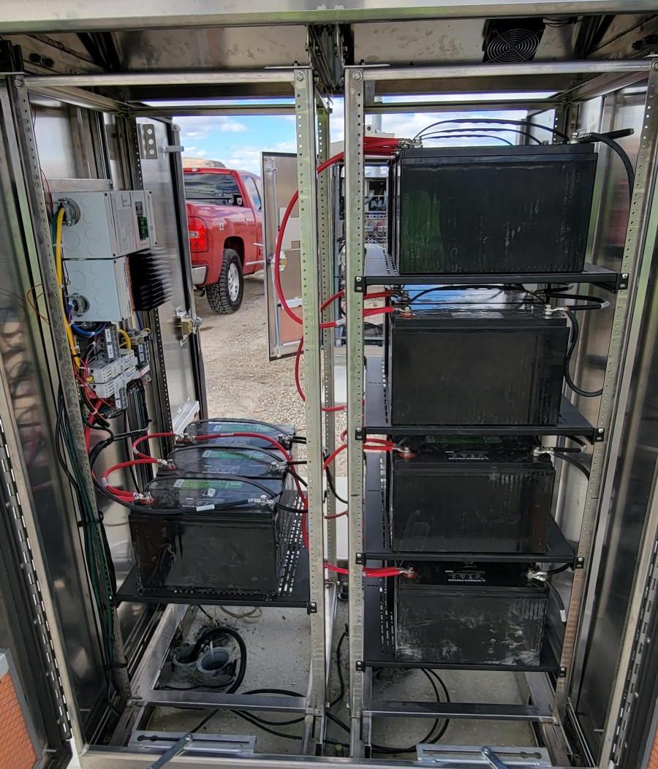
Nevada DOT - WIM Controller
The WIM Controller connects with:
  WIM sensors.
  Loop sensors.
  Cameras and AVI systems.
  Communications systems.
  Custom equipment/subsystems.
Outputs data for sorting systems, Virtual Weigh Stations, data reporting, real-time raw data.
The modular hardware and software technology results in configurable, scalable, and reliable systems.
iSINC WIM Controller
Solar Battery Array
Authors:
Leonardo GUERSON, Tyler HAICHERT

Slide 10
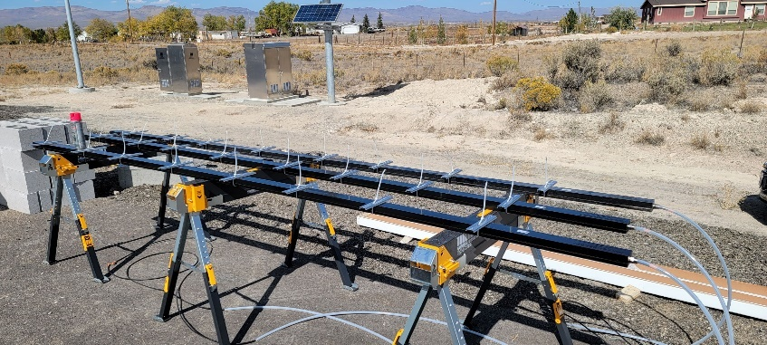
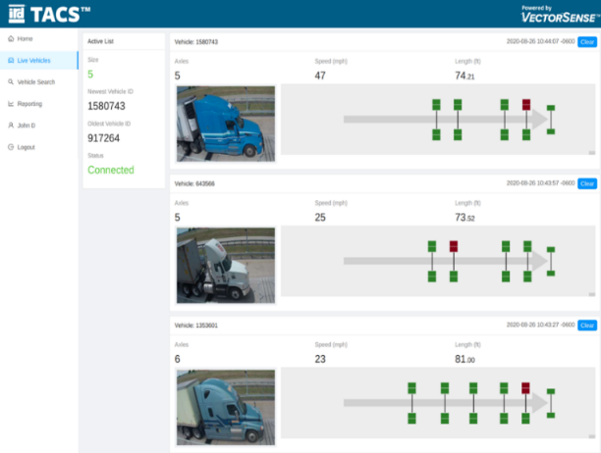
Tire Inspection Technologies
Tire Anomaly and Classification System (TACS)
  Automated tire inspections using VectorSense technology
  Flat, missing, mismatched, underinflated tires
TACS – VectorSense Tire Footprint Sensors
TACS Standalone Interface: Vehicle Records
Authors:
Leonardo GUERSON, Tyler HAICHERT
Notes:
TACS can be standalone with its own interface, or it can be integrated with weigh station operator’s software or Virtual Weigh Station software for remote monitoring.

Slide 11
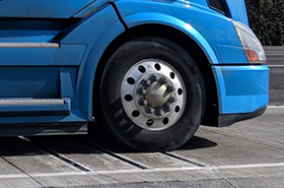

Nevada DOT – Tire Inspection
VectorSense technology that measures tire contact pressure and size.
Thin slices of the tire contact are measured thousands of times per second.
Measurements allow for the construction of detailed contact pressure profile for each tire on a vehicle, also indicating the location of the tire on the vehicle and its position in the lane.
Direction of Travel
Single Tire Contact Patch
High Contact Stress Low Contract Stress
Author/s:
Leonardo GUERSON, Tyler HAICHERT

Slide 12
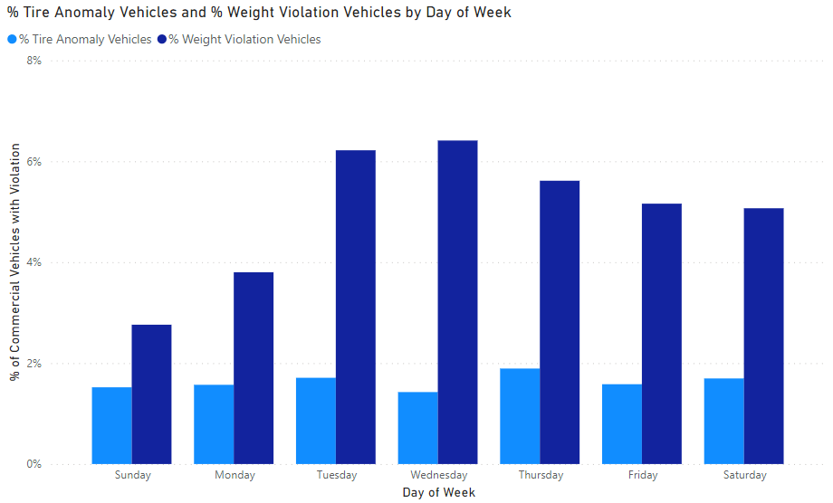
Nevada DOT – Data Analysis
Percentage of violations among heavy vehicles
  Relative trends in weight violations by day of week.
  Tire anomaly violations remain stable, suggesting they are of a more random nature.
Osino, NV Virtual Weigh Station
Authors:
Leonardo GUERSON, Tyler HAICHERT

Slide 13
WIM for Road Safety
Perspectives in North America:
  HS-WIM systems globally established for pre-selection, constantly evolving with new integrated technologies.
  Remote use of WIM for safety and road protection, far from fixed weigh stations.
  Integration of tire anomaly detection and tire inspection into enforcement strategies.
  Improved data analytics for road safety analysis, aiding informed decision-making by road agencies.
  Development of future applications where WIM data is used directly to support the identification of vehicles with a particular high risk of accidents.
Authors:
Leonardo GUERSON, Tyler HAICHERT

