Slide 1
Dynamic Excursions of Mass:
A Newtonian Approach
Roger Philip Sack

Slide 2
The basics – Dynamic Excursions of Mass.
In the first law, an object will not change its motion unless a force acts on it = an impulsive input
In the second law, the force on an object is equal to its mass times its acceleration = rapid weight changes = D.E.M.s
And, in the third law, when two objects interact, they apply forces to each other of equal magnitude and opposite direction = suspension impacts with subsequent asset wear at varying rates.
These Forces are “seen” as D.E.M.s in the air suspension and as Dynamic Impacts on the infrastructure.
Author/s:
Roger P. SACK.

Slide 3
Dynamic Excursions of Mass and their importance.
Rapid weight changes are generated in Road-Friendly suspensions by road/asset irregularities.
They are contemporaneously captured and analyzed as to the When, Where, How, Why and What data they contain.
Histograms provide wear and degradation rates of road assets and the suspensions which travel over them.
Tramanco has been doing this since 2003 over tens of thousands of kilometers predominately in the East Coast states of Australia.
The data is available from up to 16 suit multi-axle groups in combination as per the O.S.O.M. trails detailed on the following slides. The data also can be “shared” via the internet with WIM installations and government agencies.
Author/s:
Roger P. SACK.

Slide 4
D.E.M.s from bridges & abutments.
Text in “Arial” size 36
Smaller text can be used
Larger text can also be used
Author/s:
Roger P. SACK.

Slide 5
Typical A-double A.P.T. installation.
Text in “Arial” size 36
Smaller text can be used
Larger text can also be used
Author/s:
Roger P. SACK.

Slide 6
Typical D.E.M.s from a culvert.
Text in “Arial” size 36
Smaller text can be used
Larger text can also be used
Author/s:
Roger P. SACK.

Slide 7
(O.S.O.M.) Over Size – Over Mass 4x4 Low Loader.
Text in “Arial” size 36
Smaller text can be used
Larger text can also be used
Author/s:
Roger P. SACK.

Slide 8
O.S.O.M. Low Loader with typical combined H.P.T. & A.P.T. installation. “Arial”(size 60)
Text in “Arial” size 36
Smaller text can be used
Larger text can also be used
Author/s:
Roger P. SACK.

Slide 9
O.S.O.M. Google shots with D.E.M.s.
Text in “Arial” size 36
Smaller text can be used
Larger text can also be used
Author/s:
Roger P. SACK.

Slide 10
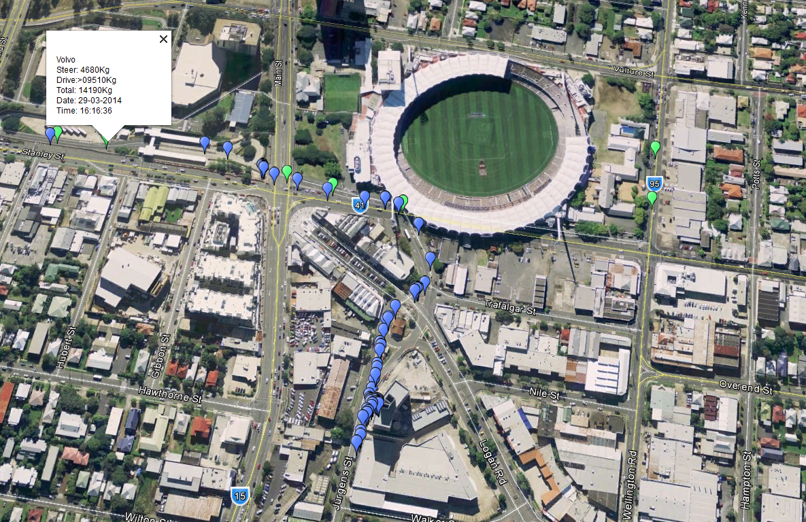
B.C.C. Bus Trials. 29.03.2014.
Text in “Arial” size 36
Smaller text can be used
Larger text can also be used
Author/s:
Roger P. SACK.

Slide 11
OTHER USES for DEMs = Asset evaluations in real-time.
Text in “Arial” size 36
Smaller text can be used
Larger text can also be used
Author/s:
Roger P. SACK.

Slide 12
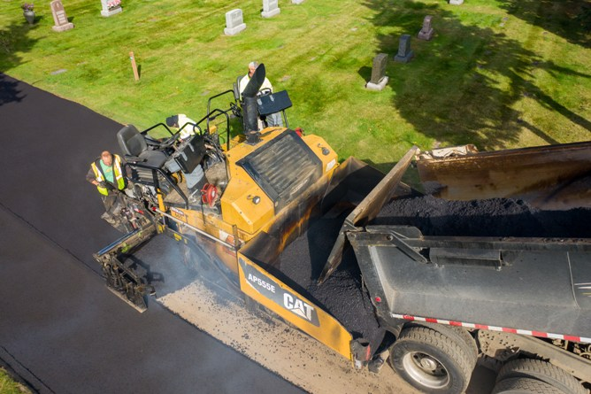
Road building in Australia & USA
Text in “Arial” size 36
Smaller text can be used
Larger text can also be used same methosd
Author/s:
Roger P. SACK.

Slide 13
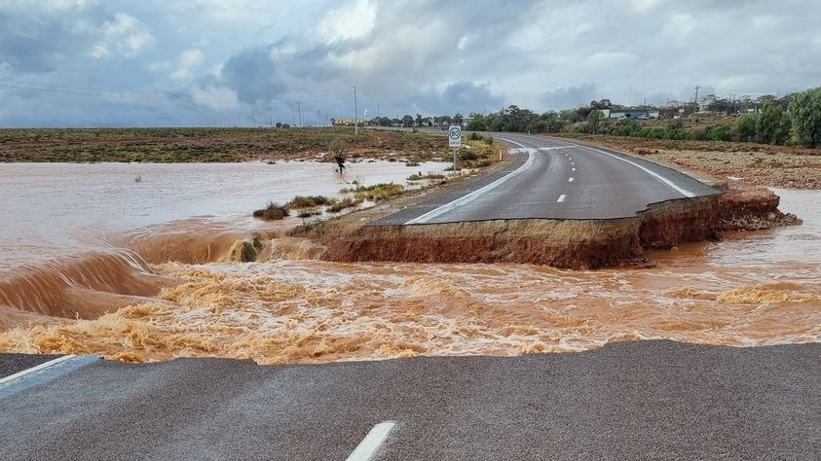
Olympic DAM road washout 2022.
Text in “Arial” size 36
Smaller text can be used
Larger text can also be used
Author/s:
Roger P. SACK.

Slide 14
The OPTIONS.
#1 - Do nothing and IGNORE D.E.M.s caused by road and suspension wear?
#2 - Do not compare OBM and WIM data to prove the veracity of the D.E.M. data from both in real-time, OR
#3 - Spray and Pray and hope it does not rain too heavily again this year, OR
#4 - Take the Hagar the Horrible approach and invest in joint infrastructure monitoring – in real-time.
Author/s:
Roger P. SACK.

Slide 15
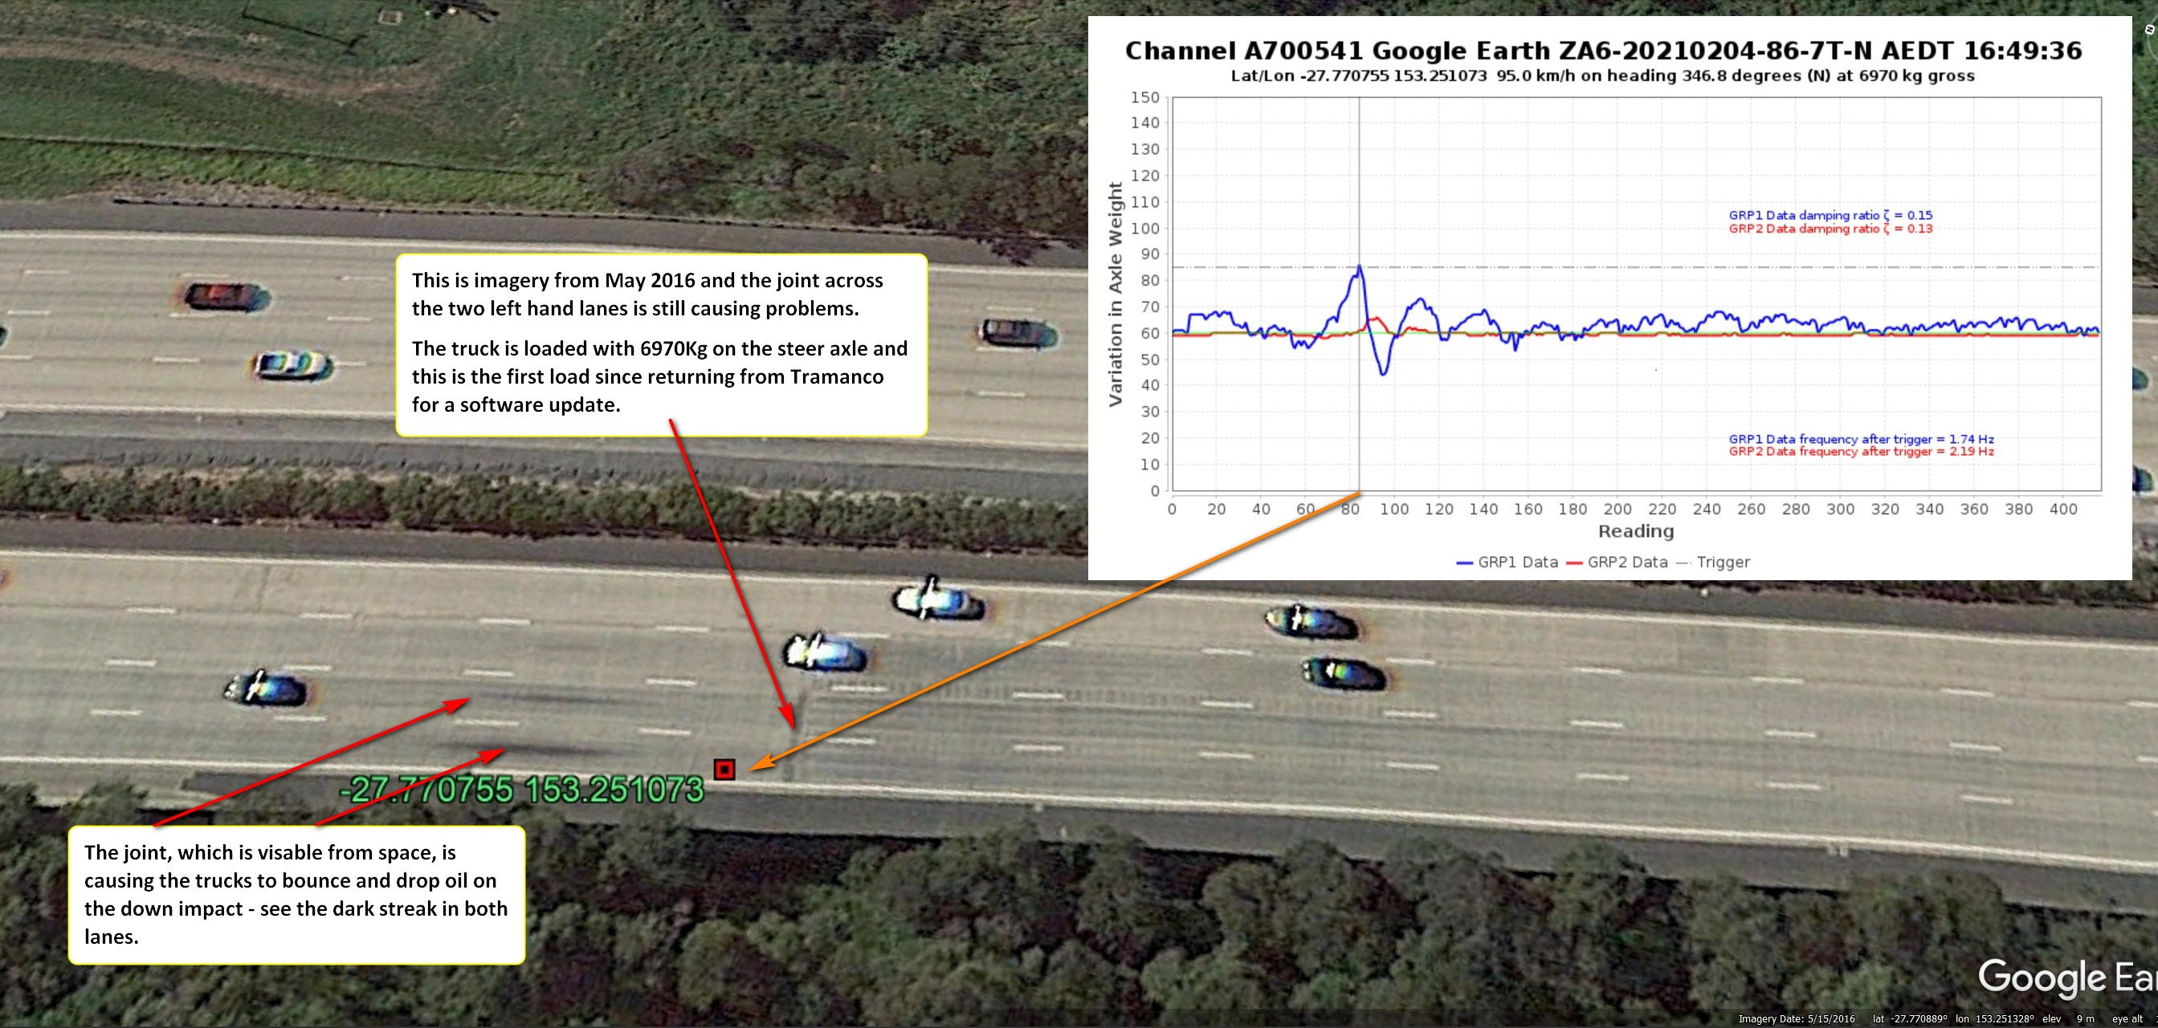
ROAD JOINT in 2021 – GOOGLE shot 2016 – still not fixed in October 2023
Author/s:
Roger P. SACK

Slide 16
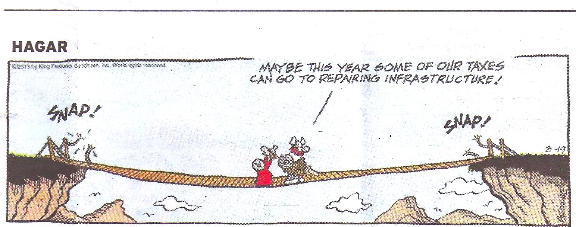
Thank-you for your time and remember HAGAR’s Advice:
T
Author/s:
Roger P. SACK.

