Slide 1
Intelligent Access Pilot for Special Road Transport
G. Van Stekelenburg, MSc., Research Engineer at V-tron
N. Kneppers, BSc., Project leader at V-tron
R. Kusumakar., MSc, Chief Technology at V-tron

Slide 2
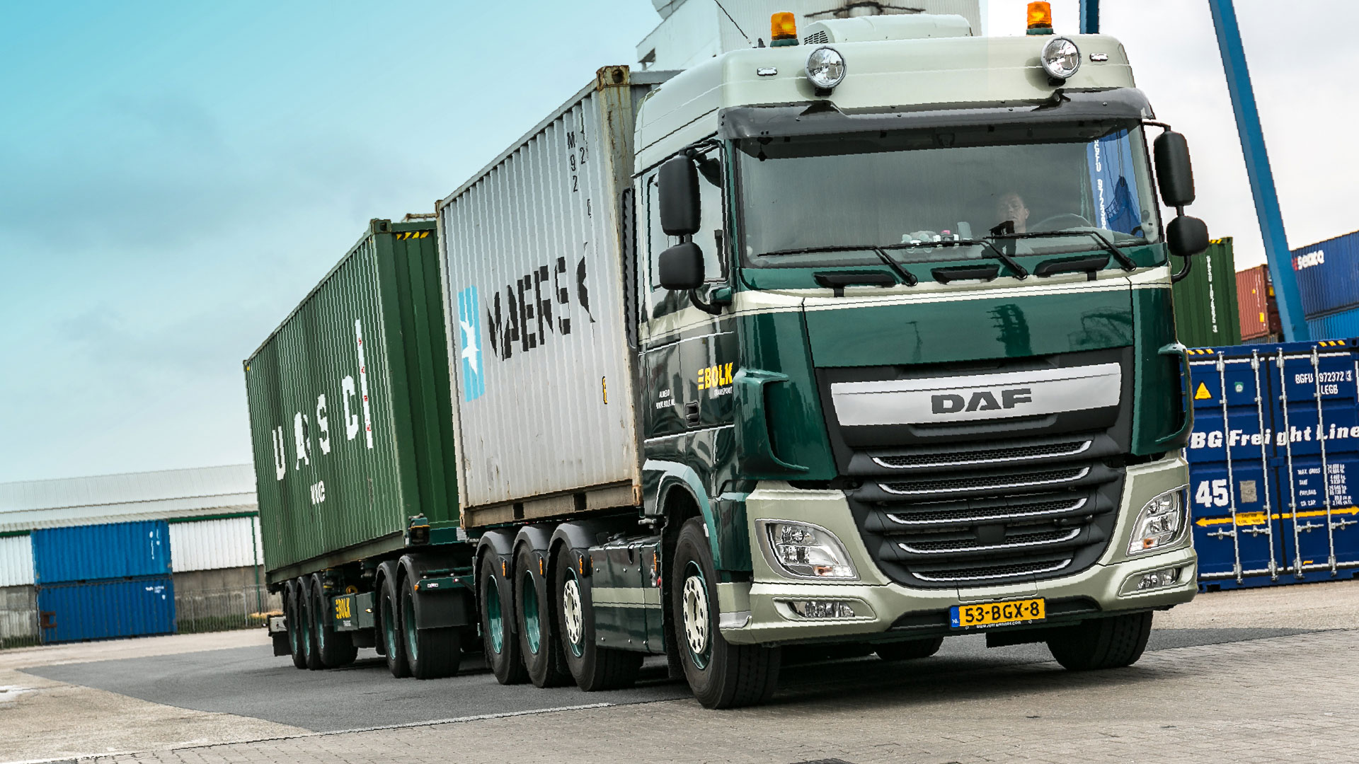
Agenda
Goal of the study
Consortium
Pilot approach
Pilot conclusion
Lessons-learned & recommendations
Processing raw data into performance indicators
Author/s:
XXX, XXX, XXX

Slide 3
Goal of the study
To address the growing road traffic and infrastructure replacement needs in a more sustainable manner.
To assess the impact of road transport, especially with regard to varying weights and axle loads, and implement measures to minimize impact and safety risks.
To explore the feasibility and scalability of a continuous monitoring system for the compliance with transportation regulations and to identify associated risks and effects.
To support the objectives of the Goods Transport Agenda and further digitalization efforts in the transportation sector.
To identify technical challenges and opportunities for improvement in various transportation scenarios, including hazardous materials, long and heavy freight vehicles, and others.
To promote the use of data and information for better management of road transportation and risk mitigation.
To establish a legal and policy framework for the legitimacy and legality of intelligent access to the transportation network.
To contribute to the harmonization of policies for intelligent access to special road transport, in line with European Union guidelines.
To emphasize the importance of knowledge expansion, technical problem-solving, and collaboration among stakeholders to enable the scaling of intelligent access initiatives.
To define roles and responsibilities within the data and information management chain, focusing on data quality, security, and the reduction of administrative burdens.
To consider various enforcement options, such as automated notifications and additional camera surveillance, for transporters who do not comply with regulations.

Slide 4





Consortium
V-tron
  Expertise in ‘Connected Car’ and ‘Driver Safety’ systems
  Data collection from participating EMS1s using T&T and ADAS systems
MAPtm
  Expertise in formulating KPIs, data analysis, and creating dashboards
  Preparation of monthly reports
Hogeschool Arnhem Nijmegen – Automotive Research
  Support in the field of intelligent infrastructure, road transport, and real-time data extraction
Bolk Transport
  Contribution of 2 EMS1s
  Setting up an API for data exchange
  Data extration from vehicle to cloud to service provider
Rijkswaterstaat, the executive agency of the Ministry of Infrastructure and Water Management
  Client of the pilot

Slide 5

Pilot Approach
Determining requirements and elaborating the request specifications for creating KPIs for monthly reporting
Inventory of existing sensors and methods for data extraction
  Installation missing sensors (TPMS)
  Installating our video recording equipment
  Installing track-and-trace equipment
  Installing ADAS-camera
Setting up automatic data exchange through API & V-tron
  Trip data
  Vehicle sensor data
Processing (aggregating) the data for reporting
Establishing a system for ‘urgent notifications’
  In case of deviation from allowed location, overloading, and tire blowouts
  Set up through API to Police and RWS, still to be activated
Reporting the received data in the monthly report
  Iterative process during the pilot’s duration

Slide 6
Conclusion Pilot Intelligent Access
Conclusion: According to the consortium, there is potential for scaling up when:
Further refinement occurs in data requirements. What information is truly essential, and what are the KPIs?
  The consortium can provide better guidance when there is a specific request from RWS. Many steps have been taken during the pilot, but improvement is still possible. Dialogue about available data and requirementswill lead to clear KPIs.
Futher development of digital maps in necessary for generic scaling
  Sharing M2M data, implementing it into existing systems, enabling automation.
Standardization of processes, names, and goods classifications.
Refinement of sensor data and interoperability of systems and sensors.
  Starting with a minimal basic set of data from vehicles. Facilitates scaling without significant investments for carriers.
  Key data: Location, axle loads (and the ability to share as a single vehicle), and updating the ‘update moment’ sensor data.
Establishment of a trusted domain for reliable and useful data, in conjunction with correct and reliable sensor data

Slide 7
Lessons-learned and recommandations
Selection of 3 most important lessons-learned and recommandations:
Lack of harmonization in sensor data extraction
Detection of route deviations and improvement of DWO (Digital World Orientation) maps required for scaling
Analysis of vehicle usage through safety events from vehicles

Slide 8



Lack of harmonization in sensor data access
Despite the FMS standard, it appears that not all truck manufacturers provide the same ‘basic data’.
In theory, axle loads values for all vehicle units can be accessed. In practice, not all hardware communicates with each other. Further research is needed to determine the costs/possibilities of implementing this on the existing fleet.
Currently, the update frequency of the sensors and systems is not in order. It is expected that this can be a ‘quick fix’ in collaboration with the carrier and FMS provider.
The sum of transmitted axle loads forms the total weight of the combination in this pilot. Due to differences in update times, it is difficult to determine the exact weight of the EMS1 at a specific moment.
Pre-trip monitoring is possible when all sensor data in sent as one package.

Slide 9
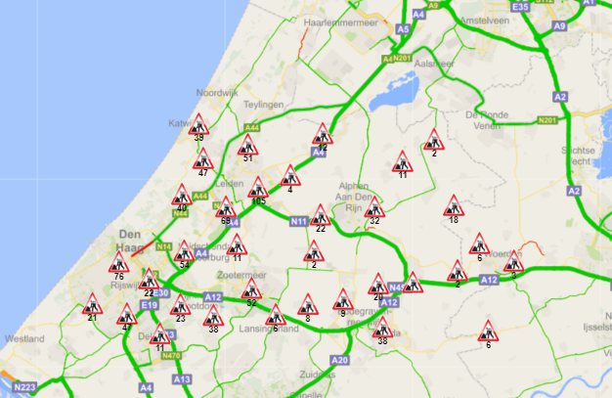
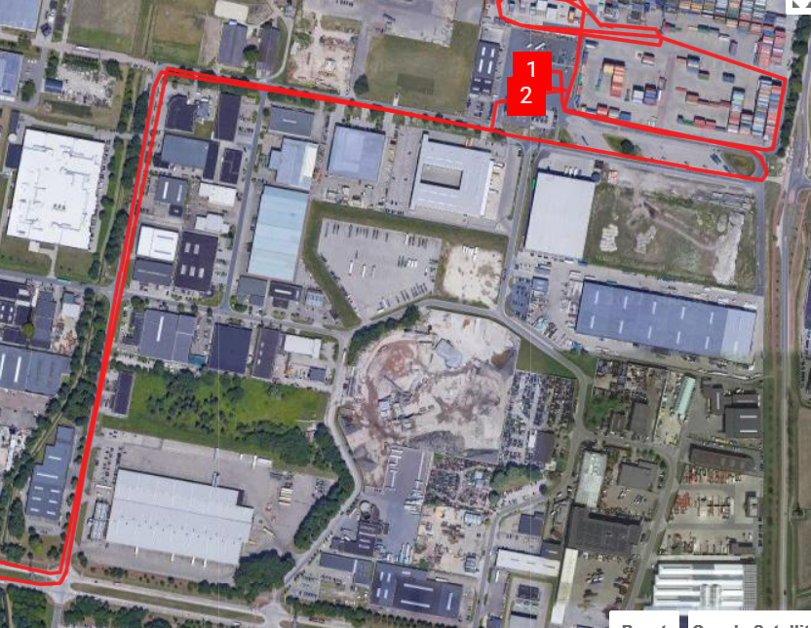
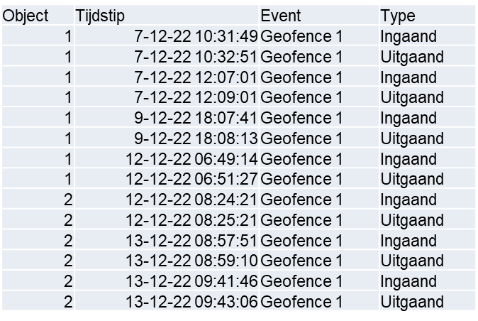
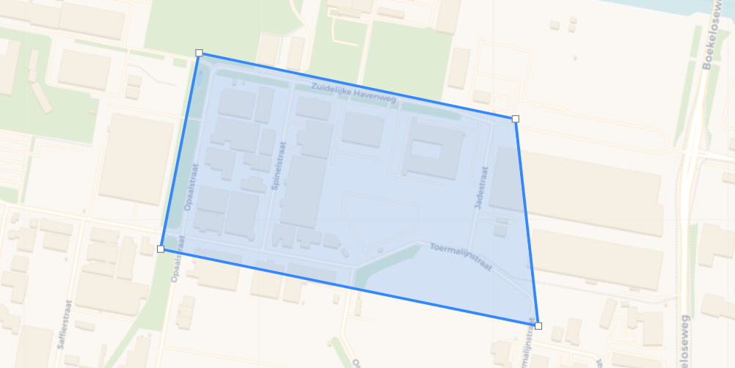
Improvement of the DWO map is required for scaling up
DWO map necessary for ‘driving on prohibited roads’ control.
  In the pilot, manually drawn geofences were used to register deviations from authorized routes.
  Routes are currently check by the carrier themselves, and the driver adjusts the route accordingly.
  A digitally workable DWO map enables implementation in TMS (Tranport Management System) systems.
  A digitally workable DWO map allows for automation of compliance checks.
  An improvement to the DWO map is necessary for scaling up to more carriers or integration into existing systems.

Slide 10
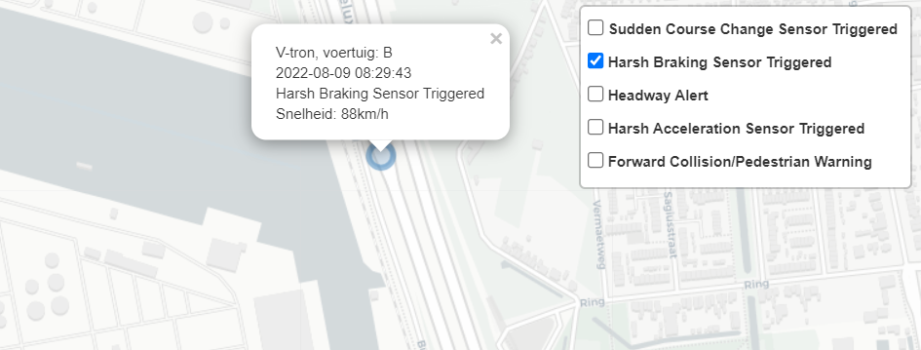
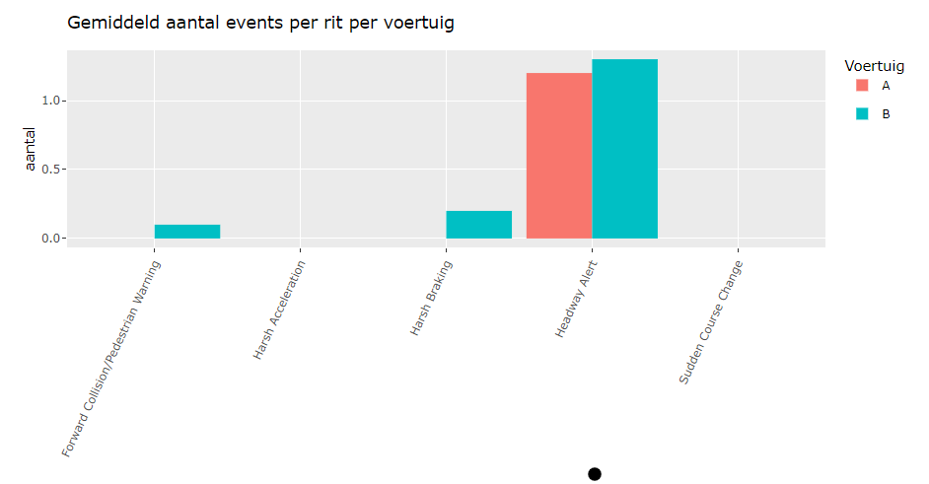
Analysis of vehicle usage through safety events from vehicles
In the pilot, aftermarket ADAS (camera) was used for recording safety events:
  Variours events from ADAS
  Insight in hotspots
  Context can be provided based on, for example, historical traffic information.
  Focus can be placed on specific POIs
  Connection with video recording equipment and images was not possible during the pilot. Linking with events likely in the future.
  Research is needed to access data from factory-installed safety systems
  Research on monitoring the
  distribution of axle loads over vehicle parts

Slide 11

Processing large amounts of raw data into performance indicators
Example of ‘from raw data to performance indicators’
  Request specification: Total weight and axle loads per unit.
Available data per vehicle unit:
Location
Upload timestamp
Sensornr.
Value
Sensor timestamp

Slide 12
Barriers
Biggest barriers to make the pilot happening in the Netherlands
  Lack of uniformity technical requirements
  Integration with FMS parties and transport companies
  Unclear KPIs: there is a lot of data, clear KPIs can be indicated wih less data
Everybody has a different approach, e.g:
  Via eCMR
  Different stakeholders have different interest, makes it hard to set clear KPIs

Slide 13
Processing large amounts of raw data into performance indicators
Urgent notification in case of exceeding the maximum axle load
Sum of axle loads of vehicle units uquals total weight
The following KPIs have been established:

Slide 14
Processing large amounts of raw data into performance indicators
Average tare weight of the container per type of goods
  Instead of the weight of the (empty) container, the dimensions of the container could also be included here
Average weight per type of goods
  Provides insights into which types of goods pose the highest risk of overloading

Slide 15
Processing large amounts of raw data into performance indicators
Sum of axle loads makes total weight
Determined through geofencing which structures were crossed (e.g., Botlek bridgde)
Number of trips over the bridgde categorized by weight class
Sum of all trips over the Botlek bridge constitutes the total load per day (from 2 participating EMS1s)

Slide 16
Processing large amounts of raw data into performance indicators
Aggregated data: number / percentage of trips that exceeded the maximum allowed axle loads

Slide 17
Processing large amounts of raw data into performance indicators
How can this be improved?
  Combination of different data sources?
  Which structures are being selected?
  How do you calculate ‘total load’ when not all vehicles are ‘intelligent’, or share data?
  How do you efficiently determine the load on the road?
  What makes a good performance indicator?

Slide 18
Lessons learned & Action points
Lessons Learned: General
Focus of the pilot on EMS1s due to data availability and clear regulations.
Challenges in scaling up to other transport types due to diversity in nationalities of carriers.
Need for collaboration between road authorities and logistics companies to address concerns.
Importance of making advantages of the monitoring system clear for logistics companies.
Shifting workload towards a more equal balance between logistics companies and road authorities.
The role of an independent intermediary for data accuracy and trustworthiness.
Need for digitization and a workable digital map for the exemption map.
Lessons Learned: The Process
Not all transportation companies use integrated route navigation systems.
Difficulty in verifying weight declarations with actual axle loads.
Challenges in tracking CO2 emissions and the need for standardized measurements.
Difficulty in classifying goods and understanding what is being transported.
The need for standardizing names or abbreviations for origin-destination terminals.

Slide 19
Conclusions
Insights from the pilot regarding the effectiveness of the monitoring system.
Potential for improved transparency in goods transport.
Challenges to be addressed when scaling up.

Slide 20
Recommendations
Establish a robust data assurance mechanism through an independent intermediary party.
Clearly communicate advantages to logistic companies and align KPIs with their goals.
Investigate the influence of average fuel use on total vehicle load.
Further investigate challenges related to axle load monitoring, emission assessment, tire pressure measurement, and the EMS1 exemption map.

