Slide 1
Performance-based heavy vehicle driver fatigue management trial
Dom Kalasih
Rachel Lehen
Boyd Peacock

Slide 2
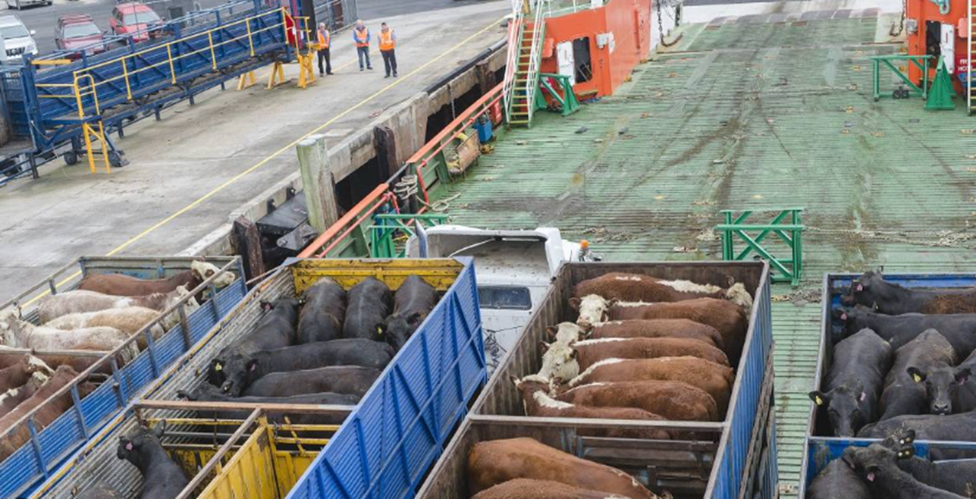
Concessions
Vary the 30 minutes break requirement
Require 60 minutes in a work day with no more than 4 hours between each rest period
Extend the work day
Allow up to 15 hours of worktime to manage
unexpected circumstances
Authors:
D. Kalasih, R. Lehen, B. Peacock

Slide 3
Aims of trial
Test the effectiveness and ease of use of the digital systems
Show the system enables more informed decision making on flexible hours
Better understand the issues that make compliance with current legislation problematic
Authors:
D. Kalasih, R. Lehen, B. Peacock

Slide 4
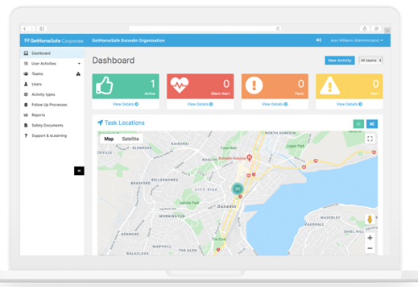
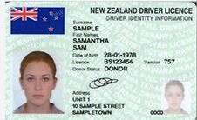
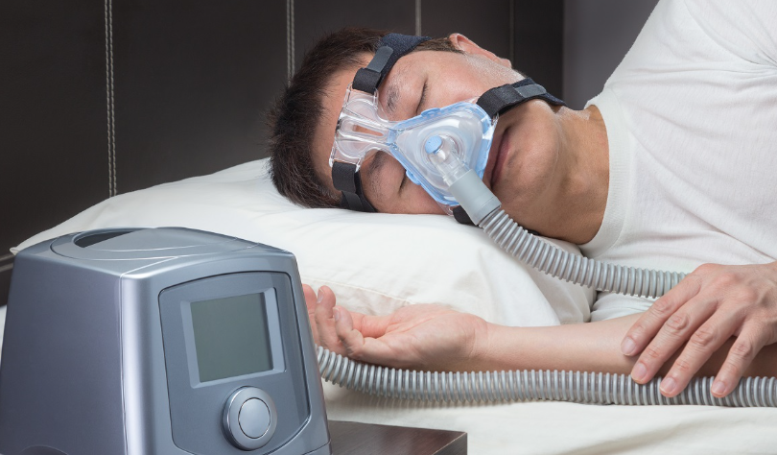
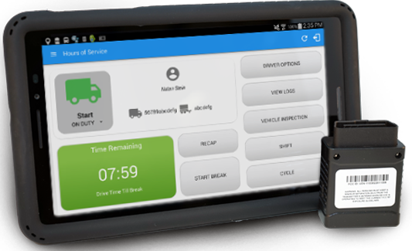
A systemic approach
Approve or decline
Driver and operator
selection screening
Fatigue risk awareness & training
Sleep
studies
Real time welfare monitoring
(GetHomeSafe)
Use of biomathematical algorithms in driver rostering
(PRISM)
Request for work time extension
Telemetry
GPS vehicle location data
&
e-logbooks
Cognitive performance assessment
(AlertMeter)
Authors:
D. Kalasih, R. Lehen, B. Peacock

Slide 5
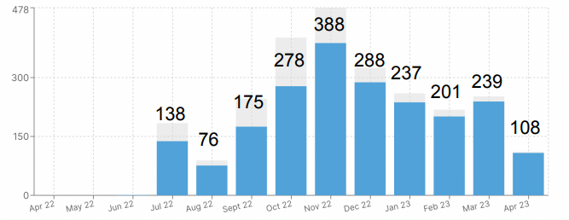
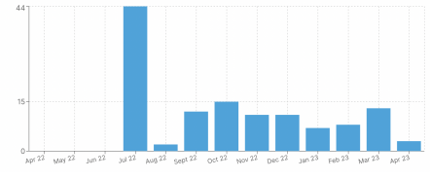
Findings
Varied rest breaks
(from 26,200 hours)
Cases of extended hours
Authors:
D. Kalasih, R. Lehen, B. Peacock

Slide 6
Learnings
Operational challenges create a demand for greater flexibility with working hours, and better responsiveness benefits wellbeing of animals and drivers
Operators would benefit from support with behavioural change management capability
The comprehensiveness and invasiveness of the trial system is a barrier
The trial is extended using a simplified control system
Authors:
D. Kalasih, R. Lehen, B. Peacock

Slide 7
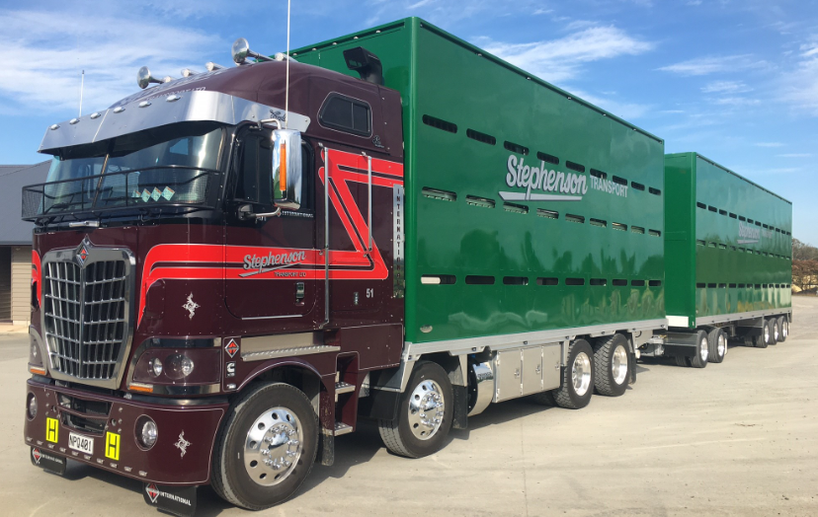
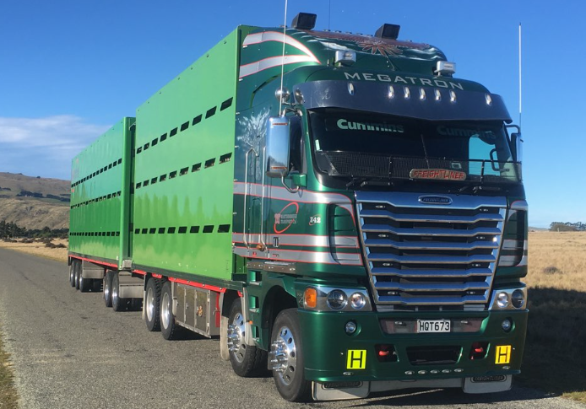
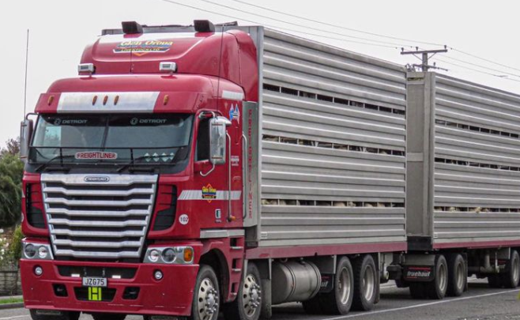
Authors:
D. Kalasih, R. Lehen, B. Peacock

