Slide 1
WIM placement on road networks: optimization model and a proposed deployment process
Lucas Franceschi
Camila Quevedo Sobrosa
Gustavo Garcia Otto
Hans Van Loo (presenter)
Wellington Longuini Repette
Amir Mattar Valente

Slide 2
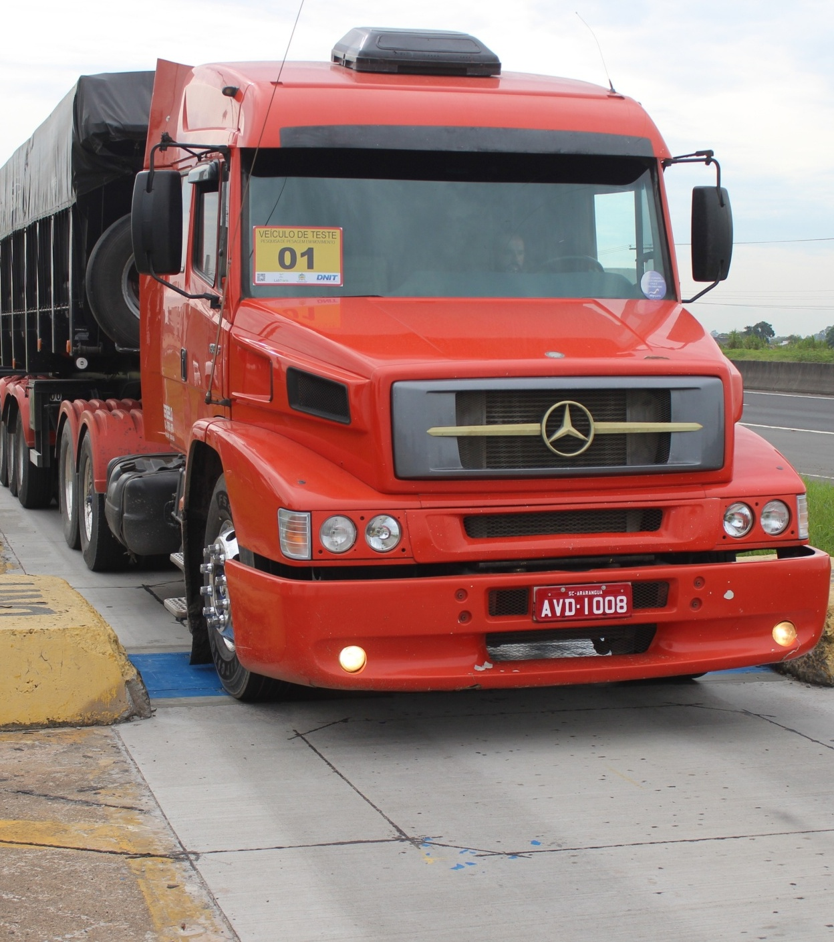
Weight Enforcement
A critical issue for any organization that maintains and operates road networks.
Overweight trucks are a threat to
Infrastructure (pavements and bridges)
Traffic Safety
Fair competition between freight carriers
Systemic cost of overloading >>> Investment in weight enforcement
Author/s:
L. Franceschi, C. Q. Sobrosa, G. G. Otto, H. Van Loo, W. L. Repette, A. M. Valente

Slide 3
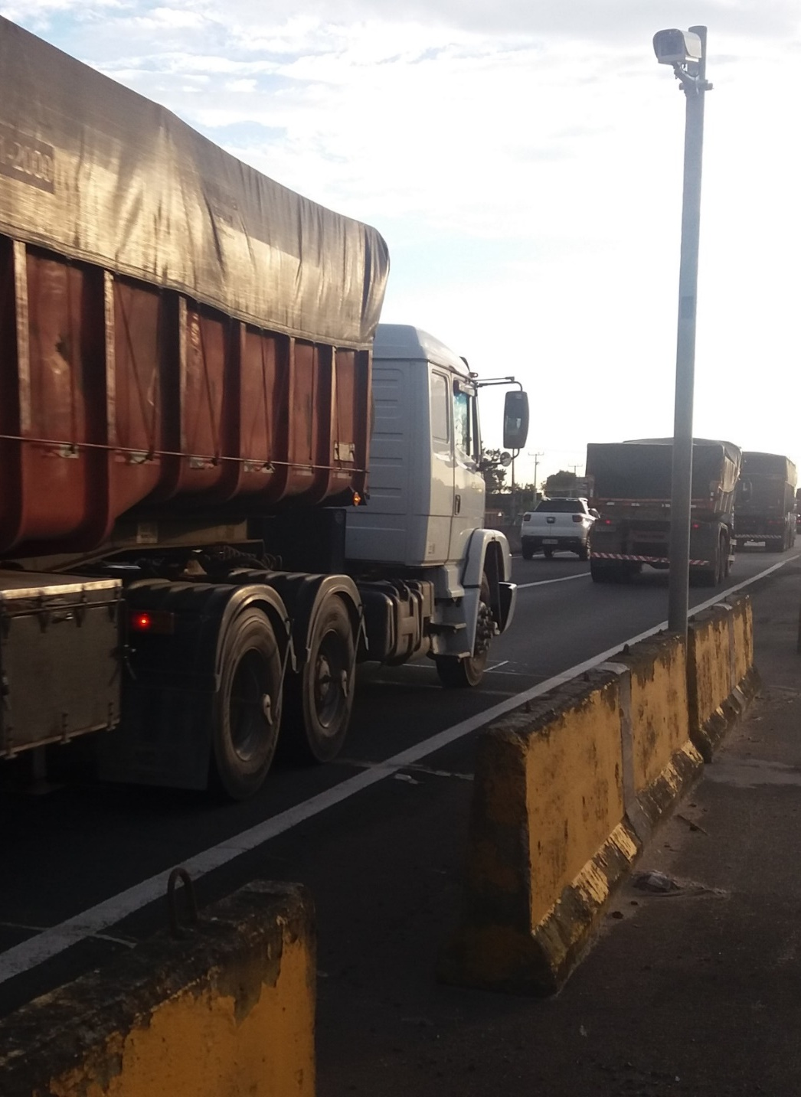
Weigh-In-Motion (WIM)
Applications of WIM for enforcement:
Planning and evaluation of overload controls
Pre-selection for road side controls
Generation of company profiles
Direct, automatic weight enforcement
Advantages of high-speed weighing:
No disturbance of overall traffic flow
No need to stop legally loaded trucks
No need for land expropriation for fixed weigh stations
Overall, a tenth of the cost of a full weigh station
Author/s:
L. Franceschi, C. Q. Sobrosa, G. G. Otto, H. Van Loo, W. L. Repette, A. M. Valente

Slide 4
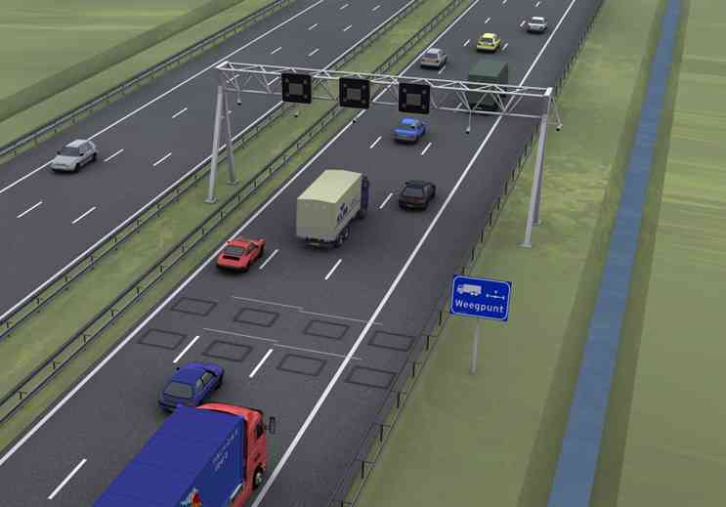
WIM placement
Without the need of a parking area for weight enforcement, WIM placement becomes more flexible.
Even though WIM systems have become cheaper, the number that can be build is always limited .
So the question is: Where to place the WIM stations most efficiently?
Especially for large or finely branched road networks.
Author/s:
L. Franceschi, C. Q. Sobrosa, G. G. Otto, H. Van Loo, W. L. Repette, A. M. Valente

Slide 5
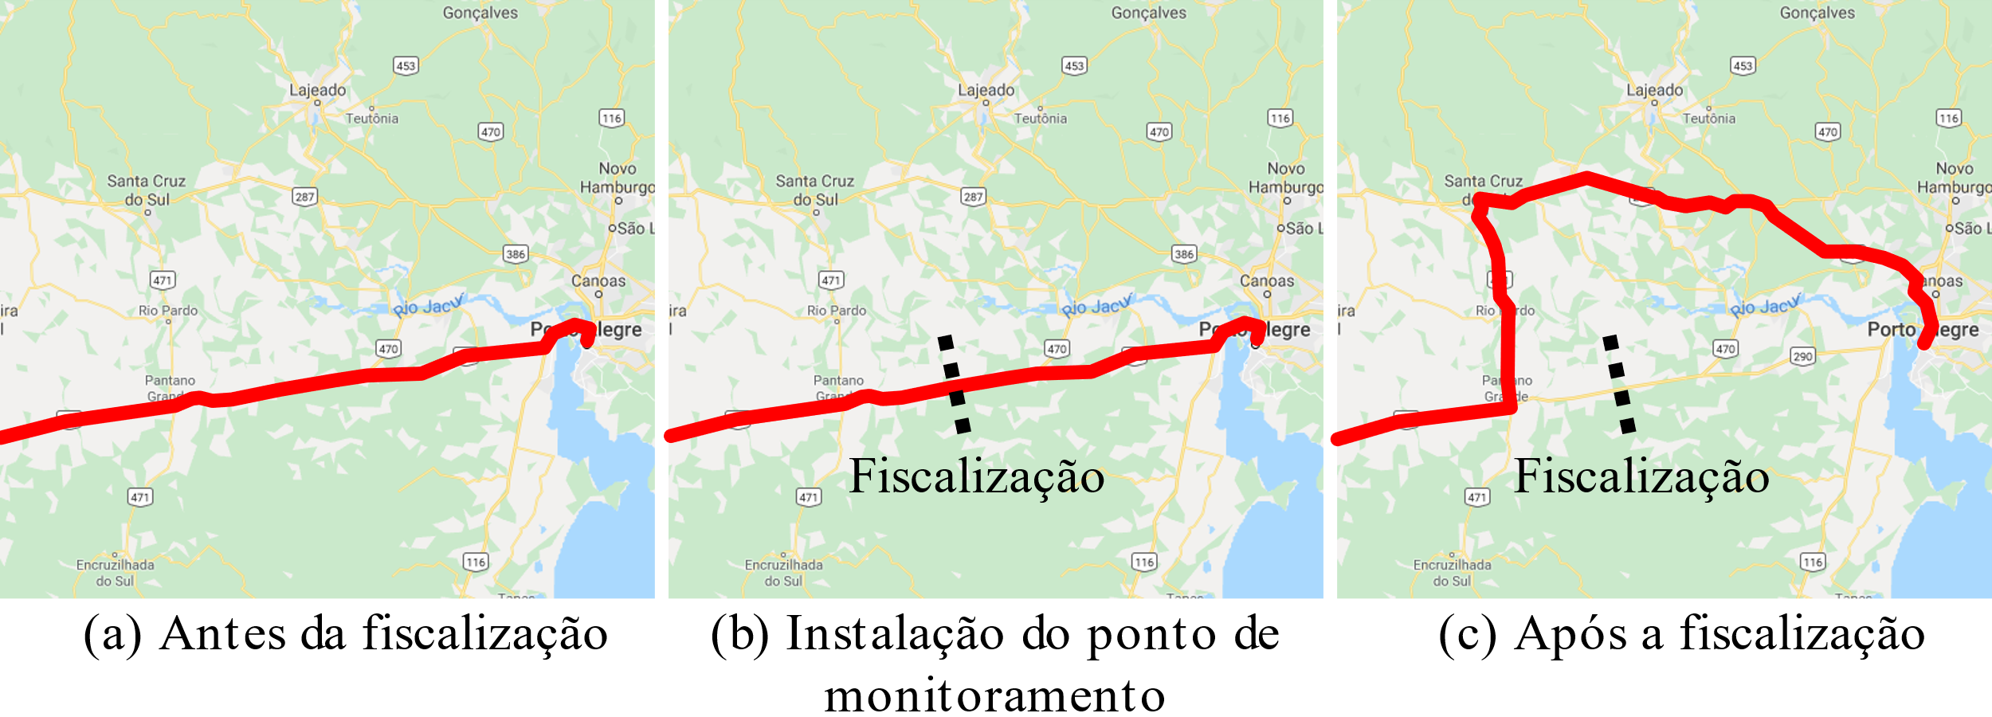
WIM placement
There are several factors
Road network topology
Logistic corridors
Traffic volumes
Regional / national access
Historic overloading tendencies
Evasion routes
Enforcement evasion is not trivial to consider.
It is known that freight carriers will try to avoid weight stations,
This undermines the effectiveness of the enforcement operation.
a)
b)
WIM
c)
Evasion
Author/s:
L. Franceschi, C. Q. Sobrosa, G. G. Otto, H. Van Loo, W. L. Repette, A. M. Valente

Slide 6
WIM placement
Mathematical model was developed; using formulations to solve the evasive flow capture problem.
MODEL
INPUT
OUTPUT
Road network topology (graph)
# of WIM
Optimized WIM placement
Multiple O-D pairs
Traffic volumes
Max. extra distance to evade WIM
% of controlled trucks
Author/s:
L. Franceschi, C. Q. Sobrosa, G. G. Otto, H. Van Loo, W. L. Repette, A. M. Valente

Slide 7
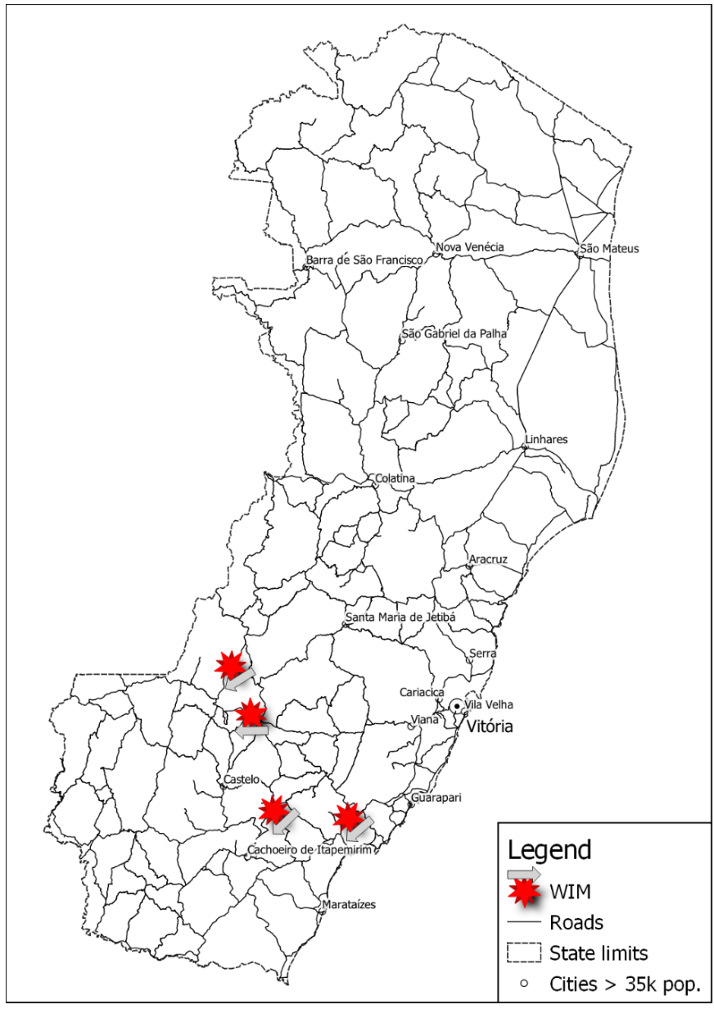
Case application
Practical application in state of Espírito Santo, Brazil
Practical conditions
4 x WIM stations
% of enforced vehicles
Max. of detour +20% longer distance
INPUT OUTPUT
Author/s:
L. Franceschi, C. Q. Sobrosa, G. G. Otto, H. Van Loo, W. L. Repette, A. M. Valente

Slide 8
Case application
Conditions & Input
Main traffic flow West-East from/to the port of Vitória
All overloaded trucks use evasion route when exists
4 WIM systems
Max. 20% deviation
Case study results:
All WIM systems covering main traffic flow
89% of all truck traffic in state is controlled
Port
Large volumes
Author/s:
L. Franceschi, C. Q. Sobrosa, G. G. Otto, H. Van Loo, W. L. Repette, A. M. Valente

Slide 9
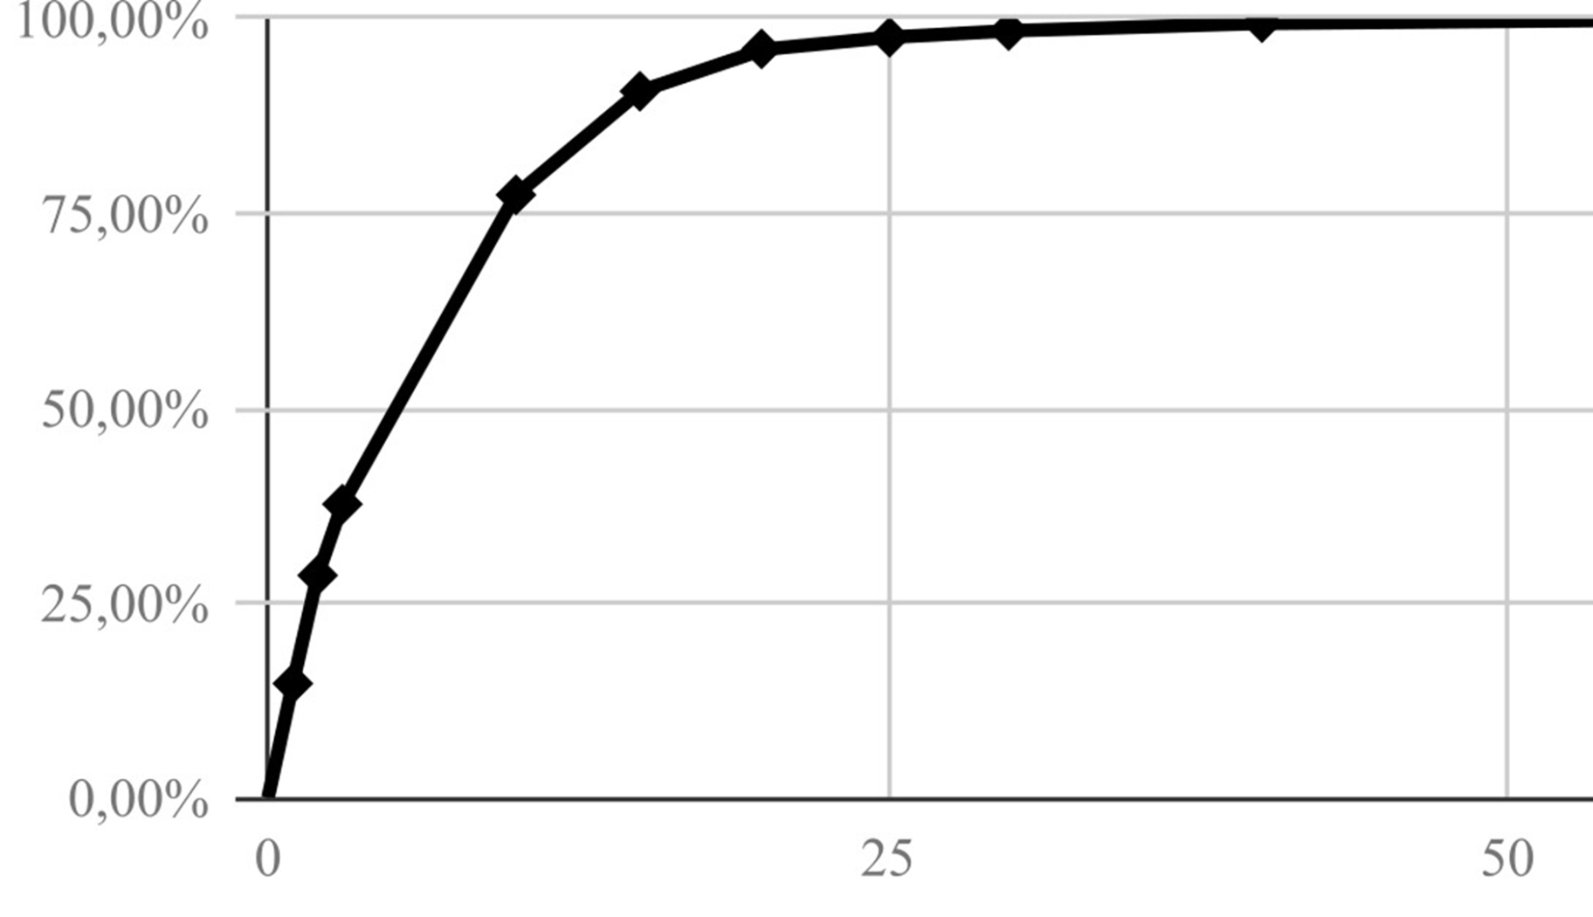
Case application
Optimizing the number of systems:
Versus the percentage of controlled traffic
2 WIM => 54%, 4 WIM => 89%, 6 WIM => 96%
Case study conclusions:
4 WIM systems controlling 89% of all truck traffic
Effective tool to optimize the number and placement of WIM systems in a road network
Create a WIM network that will counter possible evasion (needed for effective weight enforcement)
0 2 4 6 8 10 12
Author/s:
L. Franceschi, C. Q. Sobrosa, G. G. Otto, H. Van Loo, W. L. Repette, A. M. Valente

Slide 10
WIM deployment strategy
A planning process must be carried out:
Including models for WIM placement to counter evasion are just a part of the process,
While evasion is critical, it is not the only factor for decision making.
Also other decision support methods.
Theoretical models are as good as their input. The actual situation on site may be different.
Proposition: Use it as part of an overall WIM deployment strategy.
Author/s:
L. Franceschi, C. Q. Sobrosa, G. G. Otto, H. Van Loo, W. L. Repette, A. M. Valente

Slide 11
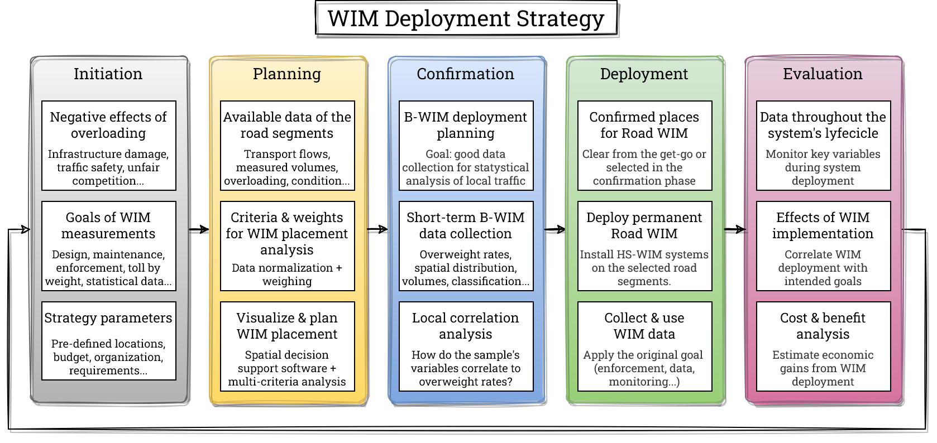
WIM deployment strategy
Step1 Initiation:
Make estimate of effects of overloading
Describe goals of WIM implementation
Application of WIM data
Objectives of weight enforcement
Define conditions for implementation

Slide 12
WIM deployment strategy
Step 2 Planning:
Collect data on road network and traffic flow
Set criteria for WIM locations
Develop model for WIM placement
Calculate optimized WIM locations (theoretical)

Slide 13
WIM deployment strategy
Step 3 Confirmation:
Determine locations for short term measurements using Bridge-WIM
Do short term measurements
Compare results of model and measurements
If needed; adjust locations for permanent WIM systems

Slide 14
WIM deployment strategy
Step 4 Deployment:
Installation and operation of permanent WIM systems
Collection and use of WIM data
Step 5 Evaluation:
Evaluate the effects of WIM implementation
Make Cost & Benefit analysis
If needed adjust step 1

Slide 15
Conclusions
Creating efficient WIM networks is necessary to control overloading.
Choice of WIM placement is critical for the network’s efficiency.
A theoretical analytical method was developed to optimize WIM placement by not leaving evasion routes open.
However, in practice many other factors may be involved.
To address these challenges, a WIM deployment strategy was proposed.
Including a confirmation by short term Bridge-WIM measurements.
Author/s:
L. Franceschi, C. Q. Sobrosa, G. G. Otto, H. Van Loo, W. L. Repette, A. M. Valente

Slide 16
Thank you!
Lucas Franceschi
Camila Quevedo Sobrosa
Gustavo Garcia Otto
Hans Van Loo (presenter)
Wellington Longuini Repette
Amir Mattar Valente

