Slide 1
A comparison of axle weight masses from a low-speed weigh-in-motion scale and a static weighbridge scale for the purpose of broadening law enforcement efforts
Phindile Lydia Binda
6 - 10 November 2023
Brisbane, Australia

Slide 2
Introduction/Background
WIM scale vs Static Weighbridge
Weigh-In-Motion uses in South Africa
Why Weigh-In-Motion is not used for law enforcement.
Why this study
Author
Phindile Binda
Notes:
According to (Slavik, 2007), a WIM scale is "a technique for the measurement of axle loads without stopping vehicles" and "a scale that measures dynamic forces applied to the road surface by passing wheels."
Then vice versa, a static weighbridge scale is a scale that assesses

Slide 3
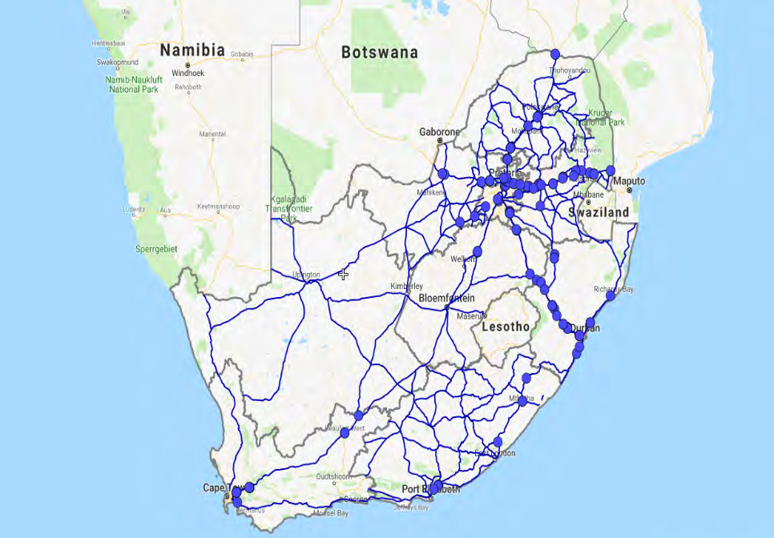
Introduction
Weigh-In-Motion History in South Africa (Slavik, 2007)
Permanent WIM Stations across South Africa(Kannemeyer, 2018)
Author
Phindile Binda
Notes:
Most of the WIM in SA are found along the Port Roads

Slide 4
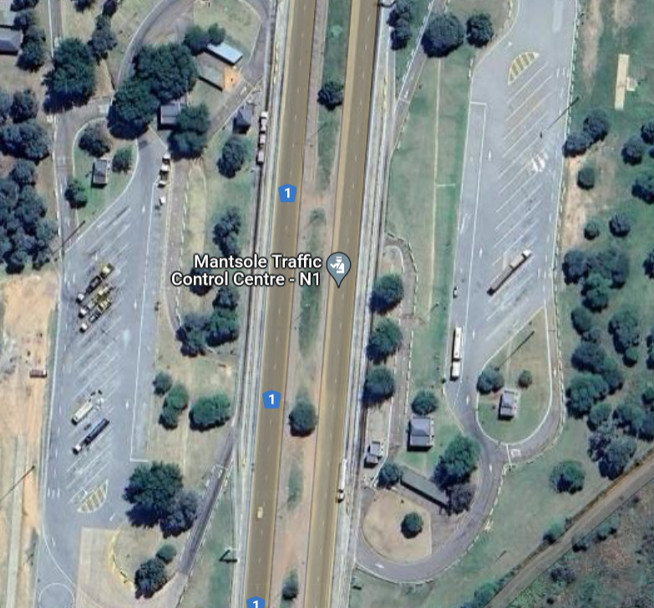
Methodology
Data used comes from two 24 hours operating static weighbridge scales and 2 automated weigh-in-motion scales.
Author
Phindile Binda

Slide 5
Methodology
Data used was from November 2022 to January 2023
Date, Time and Vehicle Registration numbers
Static weigh bridge data >> Weigh-In-Motion data
Data cleaning
Author
Phindile Binda

Slide 6
Methodology
31 717 heavy Vehicles >> 26 vehicle configurations
3 744 >> 2 axle units, 9 585 >> 3 axle units, and 18 388 >> 4 axle units
2 axle units >> 3 Vehicle configurations
3 axle units >> 8 Vehicle configurations
4 axle units >> 15 Vehicle configurations
Author
Phindile Binda

Slide 7
Data Analysis & Results
All Vehicles Loading Status
Total Number of Vehicles | Static Legal HV, s | Static Overload | Static Warning H
WIM Legal | 17 851(81%) | 230 (24%) | 3 966 (46%)
WIM Overload | 932 (4%) | 435 (46%) | 1 352 (16%)
WIM Warning | 3 269 (15%) | 280 (30%) | 3 402 (39%)
Total | 22 052 (100%) | 945 (100%) | 8 720 (100%)
Author
Phindile Binda

Slide 8
Data Analysis & Results
Axles which have an accuracy rate of 100% and +-15%.
𝐴𝑐𝑐(𝐴𝑐𝑐𝑢𝑟𝑎𝑐𝑦)=𝑊𝐼𝑀 𝑊𝑒𝑖𝑔ℎ𝑡𝑠/𝑆𝑡𝑎𝑡𝑖𝑐 𝑊𝑒𝑖𝑔ℎ𝑡𝑠∗100
Axle. No | 85% <= Acc < 100% | Acc=100% | 100% < Acc <= 115% | Total Percentage
Axle1 | 42% | 8% | 46% | 96%
Axle2 | 21% | 7% | 63% | 91%
Axle3 | 36% | 8% | 36% | 80%
Axle4 | 21% | 5% | 26% | 52%
Author
Phindile Binda
Notes:
ASTM E 1318 (2002) ‘Standard Specification for Highway Weigh-In-Motion (WIM) Systems with User Requirements and Test Methods

Slide 9
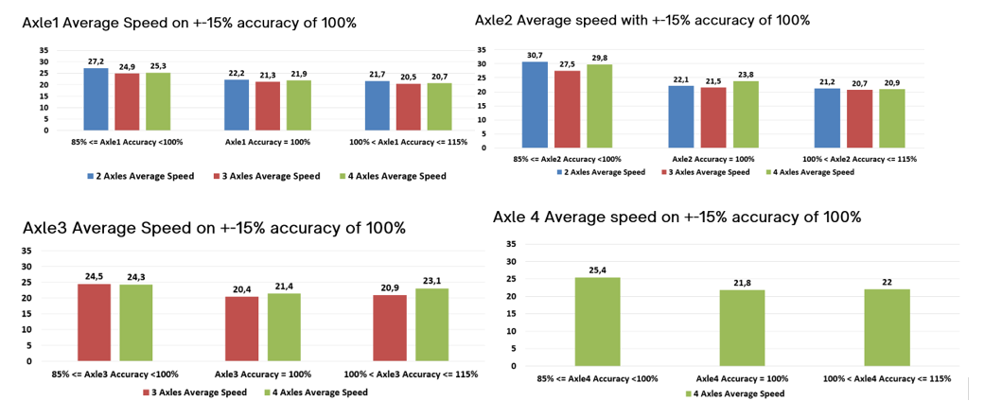
Data Analysis & Results
Author
Phindile Binda

Slide 10
Data Analysis & Results
Axle Accuracy Rate of Legal Vehicles
Axle No. | 85% <= Acc < 100% | Acc=100% | 100% < Acc <= 115% | Total Percentage
Axle1 | 41% | 8% | 45% | 94%
Axle2 | 21% | 7% | 65% | 93%
Axle3 | 35% | 8% | 36% | 79%
Axle4 | 24% | 6% | 29% | 59%
Author
Phindile Binda

Slide 11
Data Analysis & Results
Axle Accuracy Rate of Warning Vehicles
Axle No. | 85% <= Acc < 100% | Acc=100% | 100% < Acc <= 115% | Total Percentage
Axle1 | 43% | 10% | 45% | 98%
Axle2 | 25% | 13% | 59% | 97%
Axle3 | 39% | 13% | 37% | 89%
Axle4 | 11% | 4% | 21% | 36%
Author
Phindile Binda

Slide 12
Data Analysis & Results
Axle Accuracy Rate of Overload Vehicles
Axle No. | 85% <= Acc < 100% | Acc=100% | 100% < Acc <= 115% | Total Percentage
Axle1 | 43% | 7% | 48% | 98%
Axle2 | 31% | 9% | 56% | 96%
Axle3 | 25% | 6% | 21% | 52%
Axle4 | 4% | 1% | 11% | 16%
Author
Phindile Binda

Slide 13
Discussion/Conclusion
Majority of the accuracy rates were among the +- 15%
Very few weights were 100% accurate.
WIM will always be a WIM
Future Work.
Author
Phindile Binda

