Slide 1
Coronavirus and Road Freight Supply Chains in Australia – Impact and Implications
Dr Sarah Jones
Jennifer Rivera Gonzalez

Slide 2
About this research
Supported by the National Road Safety Partnership Program
describing and assessing how the government responded to the challenge of provisioning the country via road
exploring the impact government policy had on truck drivers and operators and what lessons we can apply to future crisis
interrogating how and why road user behaviour and road safety changed during the pandemic with particular reference to truck drivers (incorporating and expanding on a previous paper Impact of the coronavirus on road safety in Australia: lessons from the national lockdown)
interrogating the truck driver experience during the pandemic
exploring how the pandemic changed purchasing behaviours and how road freight operators adapted to meet the changing behaviour
situating the road freight experience within the broader supply chain challenges generated by the pandemic, and
proposing the key lessons for supply chain resilience and whether the behaviours adopted during the pandemic will require a re-think of government policy and industry strategy into the future.
Acknowledgement of co-author Jennifer Rivera-Gonzalez
Jones and Rivera-Gonzalez

Slide 3
Australian roads in context
Roads are vital to the Australian economy and way of life
Australia has the world’s ninth largest road network
877,651km in length (2018)
Highway 1 is the world’s longest national highway
Around 26,000 tonne-kilometres of freight moved annually for every Australian
Road network carries the bulk of Australian passengers
Road transport activity generated around $137b in economic output
Complex and multi-tiered regulatory environment
Jones and Rivera-Gonzalez
Notes:
I doubt anyone in this meeting needs to be convinced of the central importance of roads to the Australian way of life and economy.
Sources:
Austroads’ Submission House of Representatives Standing Committee on Regional Development, Infrastructure and Transport Inquiry into the Implications of Severe Weather Events on the National Regional, Rural, and Remote Road Network, 2023
https://www.aph.gov.au/DocumentStore.ashx?id=e8551e17-6331-4d7c-b5e9-06f5b9c236ba&subId=734148
https://www.roadtraffic-technology.com/features/featurethe-worlds-biggest-road-networks-4159235/
Department of Infrastructure, Transport, Regional Development, Communications and the Arts, Australian Infrastructure and Transport Statistics Yearbook 2022, December 2022, Bureau of Infrastructure and Transport Research Economics Statistical Report, p. 85 (Graph at left)
Australian Logistics Council, The Economic Significance of the Australian Logistics Industry, 2014
BIS Oxford Economics, 2021 Update: the Value of Australia’s Roads, August 2021
Australian Bureau of Statistics, Australian Transport Economic Account: An Experimental Transport Satellite Account
https://www.abs.gov.au/statistics/economy/national-accounts/australian-transport-economic-account-experimental-transport-satellite-account/latest-release#contribution-of-total-transport-activity-to-gross-domestic-product
Department of Infrastructure, Regional Development, Transport and Communications, Heavy Vehicle Road Reform Consultation Paper, Proposed changes to the way heavy vehicle charges are set and invested, June 2020
There are about 50,000 trucking businesses in Australia

Slide 4
Australia in context
Jones and Rivera Gonzalez

Slide 5
The Psychology of Scarcity
Australia is usually a highly food secure nation
Fear of scarcity --> panic buying March 2020
Purchase of perishable goods ↑ 10.5%, non-perishable goods ↑ 6.9%
Product limits introduced in supermarkets
Unprecedented experience for most Australians
Exacerbated by 2022 flooding that cut off the East-West corridor for 24 days
Arguable that food supply chain disruptions were more problematic than the pandemic itself
Government policy documents are explicit on the connection between functional supply chains and orderly civil society
Jones and Rivera-Gonzalez
Notes:
Repetition of words like ‘cohesion’ and ‘stability’ in govt policy documents
“ The movement of domestic freight is critical to the cohesion of our society and economy” - Freight Movement Code for the Domestic Border Controls, July 2020

Slide 6
The Government Policy Response: movement
Oscillated between ‘movement’ and ‘containment’
Various concessions and initiatives to promote movement
Essential worker designation
National consistency – “streamlined, standardised and recognised across jurisdictions”
Relaxed curfews
Exemptions for roadhouses and service stations
NHVR administrative concessions
Testing at nil cost to the freight worker
Stuart Highway land-bridge
Rhetoric lauding freight movement
Jones and Rivera-Gonzalez

Slide 7
The Government Policy Response: containment
The example of the Spanish flu of 1918
Containment characterised by
Borders as a site of stress and anxiety
Cross border administrative uniformity was never achieved
Drivers had minimal contact with communities
Density quotients and limited access to amenities
High volume invasive testing
No mutual recognition of testing
Contradictory and constantly changing instructions/directives
Jones and Rivera-Gonzalez

Slide 8
The industry response
“It is just chaos here at the borders – it’s a debacle.” – Cam Dumesney, CEO Western Roads Federation, (Graham, November 2021)
Preconditions for compliance
Issues with directions/orders
Time of publication
Hurried drafting → incoherence & error
Super-imposed on existing framework
The importance of a single arbiter
Jones and Rivera-Gonzalez

Slide 9
Road safety and the truck driver experience
Jones and Rivera-Gonzalez

Slide 10
Road safety and the truck driver experience
Jones and Rivera-Gonzalez

Slide 11
What accounts for this?
exposure to important but invasive covid tests
restricted access to suitable areas of rest and even bathrooms
the introduction of new contactless technologies
pressures at port infrastructure as container space became increasingly limited
unfamiliar and potentially unsafe on-road conditions
shift from CBD to residential deliveries
influx of inexperienced delivery drivers
spike in cyclists and motorbike riders (vulnerable road users)
proportionately more risk takers on the road
Jones and Rivera-Gonzalez

Slide 12
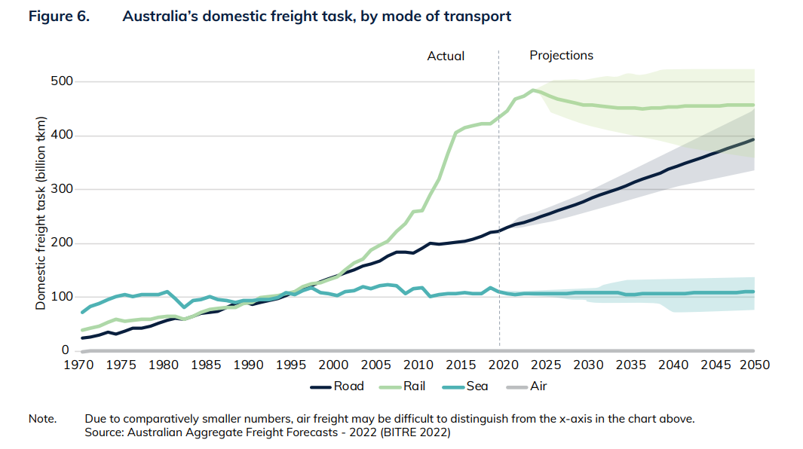
We must learn the lessons
13 key lessons for future crisis
Notes:
Source: BITRE

